Slide 1
Satellites

Slide 2
Information
Constructing Explanations and Designing Solutions
6. Structure and Function

Slide 3
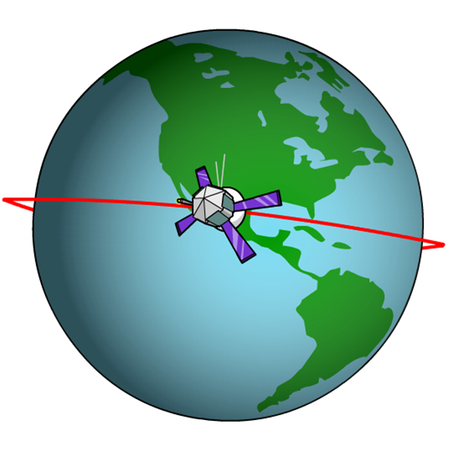
Natural and artificial satellites
A satellite is an object that orbits a larger object. For example, the Moon orbits the Earth.
The Moon is a natural satellite of the Earth and is kept in orbit by the attraction of the Earth’s gravity and by its motion.
An artificial satellite is an object made by, and put into orbit by, humans.

Slide 4
Types of orbit

Slide 5
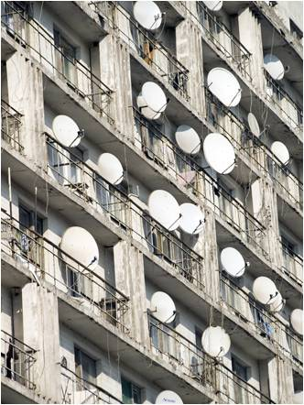
Uses for geostationary satellites
Geostationary satellites are particularly useful because they stay fixed above a single point on Earth.
This makes them useful for communications and satellite TV broadcasting, because the satellite never goes out of range.
Satellite dishes can be fixed to face in the correct direction, without the need to track the movement of the satellite.
Geostationary satellites are also used for weather forecasting.
Notes:
This slide covers the Science and Engineering Practice:
Constructing Explanations and Designing Solutions: Design, evaluate, and/or refine a solution to a complex real-world problem, based on scientific knowledge, student-generated sources of evidence, prioritized criteria, and trade-off considerations.
Photo credit: © Fedoroy Oleksiy, Shutterstock.com 2018

Slide 6
Problems with geostationary satellites
There are some disadvantages to geostationary satellites.
All geostationary satellites must orbit over the equator at a specific altitude of 36,000 km. There are limited slots in this orbit, which can lead to disputes when different countries want a certain slot.
A geostationary satellite can only “see” a certain area of the Earth’s surface – the rest is hidden from view.
All geostationary satellites are a long way from the Earth, which causes delays in signals. This can be a disadvantage for commercial or military communications.
Notes:
This slide covers the Science and Engineering Practice:
Constructing Explanations and Designing Solutions: Design, evaluate, and/or refine a solution to a complex real-world problem, based on scientific knowledge, student-generated sources of evidence, prioritized criteria, and trade-off considerations.

Slide 7
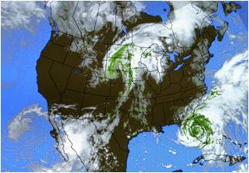
Uses for polar orbit satellites
Polar satellites are particularly useful because they orbit at a low altitude and high speed.
This makes them useful for mapping, as they can image the Earth’s surface in higher resolution than more distant satellites.
It also makes them useful for observation purposes, such as military surveillance, or weather monitoring, as they can view all of the Earth’s surface in one day.
However, polar satellites must be tracked from the ground, and will be out of range for much of the time, causing delays in data retrieval.
Notes:
This slide covers the Science and Engineering Practice:
Constructing Explanations and Designing Solutions: Design, evaluate, and/or refine a solution to a complex real-world problem, based on scientific knowledge, student-generated sources of evidence, prioritized criteria, and trade-off considerations.
Photo credit: © Carolina K Smith, MD, Shutterstock.com 2018

Slide 8
Which type of satellite?

