Slide 1
Seismic Waves

Slide 2
Information
Developing and Using Models
Using Mathematics and Computational Thinking
5. Energy and Matter

Slide 3
Earthquakes
Notes:
This slide covers the Science and Engineering Practice:
Developing and Using Models: Use a model to provide mechanistic accounts of phenomena.

Slide 4
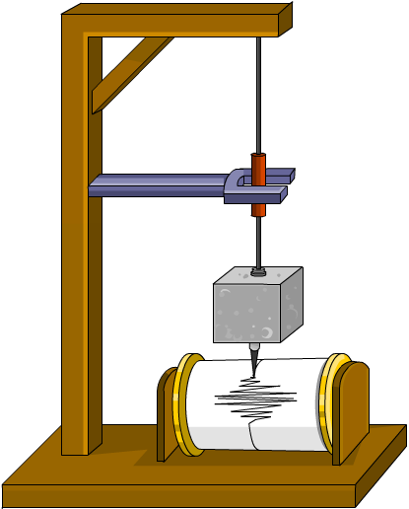
Measuring earthquakes
The Richter scale can be used to measure the magnitude of an earthquake using an instrument called a seismometer.
The Richter scale classifies earthquakes by magnitude from 1–10. It is a logarithmic scale, which means that a size “6” earthquake on the Richter scale is 10 times larger than a size “5,” and 100 times larger than a size “4.”
Notes:
Teacher notes
The Richter scale highlights the following effects at these magnitudes:
1–3: normally only detected by instruments
4: faint tremor causing little damage
5: noticeable shaking and rattling, some structural damage to poorly-constructed buildings
6: poorly constructed buildings can collapse
7: can cause damage over an area of at least 100 miles
8: large buildings collapse, can cause serious damage over several hundred miles
9 or greater: ground seen to shake, can cause devastation over an area of at least 1,000 miles

Slide 5
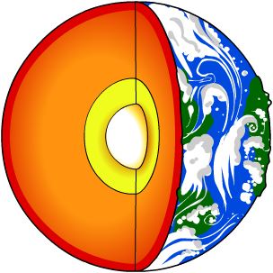
Seismographs
A seismograph is an image taken from a seismometer, which shows the amplitude of the Earth’s motion at various times.
We cannot drill through the Earth’s crust. However, scientists have been able to use seismographs to discover things about the structure of the Earth, including:
it has a thin crust
crust
it has a semi-fluid mantle where density increases with depth
mantle
outer core
its core has a liquid outer part and a solid inner part.
inner core

Slide 6
Seismic waves

Slide 7
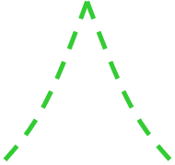
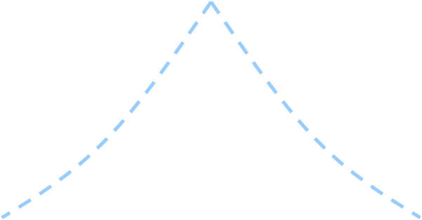
Seismic waves in the Earth
S waves can only travel through solids, so they cannot travel through the Earth’s liquid outer core. They travel at 3.5–7.5 km/s.
P waves can travel through solids and liquids, so they pass through all of the Earth’s layers. They travel at 6–13 km/s.
The changing density of the Earth’s layers causes the waves to change direction as they travel.
Notes:
This slide covers the Science and Engineering Practice:
Developing and Using Models: Develop, revise, and/or use a model based on evidence to illustrate and/or predict the relationships between systems or between components of a system.

Slide 8
P waves and S waves
Notes:
Image credit: © oriontrail, shutterstock.com 2018

Slide 9
Calculating distances I
The data from seismometers in different locations can be used to find the epicenter of an earthquake.
On average, P waves travel at around 5 km/s (v_{p}) while S waves travel at around 3 km/s (v_{s}). The distance they travel from the epicenter to a given seismometer is the same.
If the S waves from an earthquake’s focus arrive at seismometer A 90 seconds after the P waves, what is the travel time (t_{p}) for the P waves?
v_{p} × t_{p} = v_{s} × (t_{p} + 90 s)
5 km
3 km
t_{p} =
t_{p} + 270 km
s
s
2 km
s
t_{p} = 270 km
t_{p} = 135 s
Notes:
Teacher notes
This content is extension material and may be suitable for higher level students only.
This slide covers the Science and Engineering Practice:
Using Mathematics and Computational Thinking: Apply techniques of algebra and functions to represent and solve scientific and engineering problems.

Slide 10
Calculating distances II
We can use the total travel time of the P waves to find the distance the waves have traveled, using the formula:
distance = speed × time
For example, using the solution from the previous calculation:
distance = 5 km/s × 135 s
distance = 675 km
By performing these calculations based on the data from several seismometers in different locations, it is possible to plot the distances from each seismometer to the epicenter of the earthquake on a map.
Notes:
This slide covers the Science and Engineering Practice:
Using Mathematics and Computational Thinking: Apply techniques of algebra and functions to represent and solve scientific and engineering problems.

Slide 11
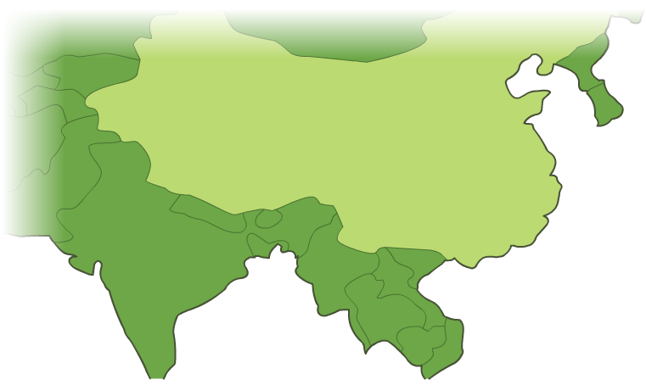
Calculating distances III
6.75 cm
A
8.1 cm
1 cm:100 km
B
4.8 cm
C
A
B
C
The point at which the circles intersect is the epicenter of the earthquake.
travel time of P waves
135 s
162 s
96 s
distance traveled
675 km
810 km
480 km
Notes:
This slide covers the Science and Engineering Practice:
Using Mathematics and Computational Thinking: Apply techniques of algebra and functions to represent and solve scientific and engineering problems.

