Slide 1
Solar Energy

Slide 2
Information
Asking Questions and Defining Problems
Developing and Using Models
Planning and Carrying Out Investigations
Analyzing and Interpreting Data
Using Mathematics and Computational Thinking
Constructing Explanations and Designing Solutions
Engaging in Argument from Evidence
Obtaining, Evaluating and Communicating Information
1. Patterns
2. Cause and Effect
3. Scale, Proportion, and Quantity
4. Systems and System Models
5. Energy and Matter
6. Structure and Function
7. Stability and Change

Slide 3
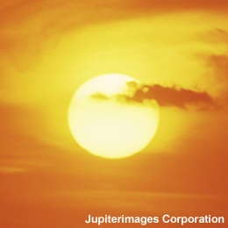
How much energy comes from the Sun?
The Sun is a huge sphere of very hot gas and has been producing energy for millions of years.
Even though it is about 150 million kilometers away, the Sun is our closest star and sustains all life.
Solar energy is the radiation from the Sun that reaches Earth. The amount of solar energy that strikes the Earth each day is 10,000 to 15,000 times greater than our daily energy needs.
In fact, the Sun is so powerful, that every minute, enough solar energy reaches Earth to meet our needs for one year!
Notes:
Photo credit: © Jupiterimages Corporation 2018

Slide 4
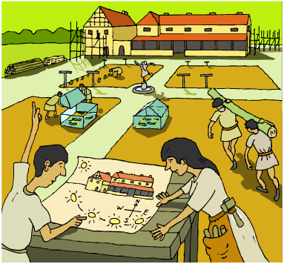
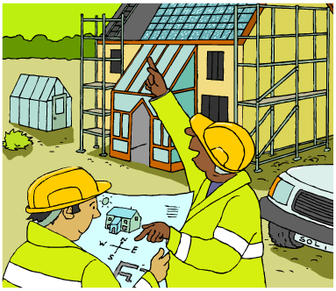
How do we use solar energy?
The Greeks and the Romans designed and built houses to maximize use of the Sun.
The Romans also made glass and knew that it could trap solar energy. Sunlight was so important that the Roman legal system actually included the right to have access to the Sun!
In modern times, there are three main ways of using solar energy:
passive solar heating
solar power stations
solar cells.

Slide 5
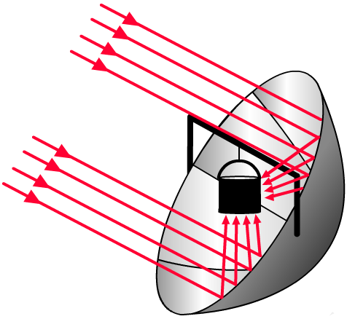
What is passive solar heating?
Passive solar heating involves any system that can capture the Sun’s energy directly. This can be done using a simple solar collector or by the design of a building.
For example, the heat of the Sun can be focused on one spot
using a curved mirror.
Solar cookers work on this principle and so require no fuel. Other examples of passive solar heating include a greenhouse or a south-facing window.
What do you think are the advantages and disadvantages of passive solar heating?

Slide 6
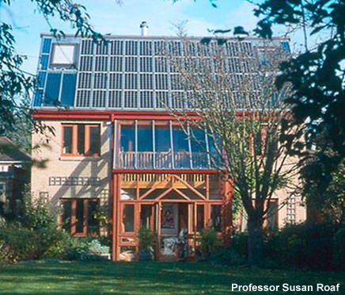
How can the Sun heat buildings?
Buildings can be designed to allow in as much light as possible by incorporating glass walls instead of solid walls. The building is then heated by utilizing the greenhouse effect, which reduces additional energy needs and costs.
This low energy house has a photovoltaic roof and has been designed so that it requires only a minimum amount of energy for heating and lighting.
Notes:
Photo credit: Professsor Susan Roaf, The Oxford Ecohouse.

Slide 7
How does a greenhouse work?

Slide 8
Greenhouse effect – ordering activity
Notes:
Teacher notes
This ordering activity could be used as a review of the greenhouse effect, or at the start of class to gauge students’ existing knowledge of this subject matter. Mini-whiteboards could be used to make this a whole class exercise.

Slide 9
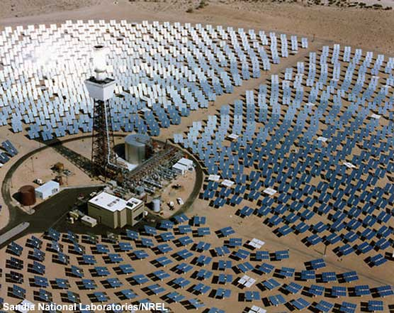
What is a solar power station?
Solar power stations use the Sun’s energy to heat water and make steam, which then drives a turbine to produce electricity.
Some solar power stations use a series of mirrors, called heliostats, to reflect light onto a boiler.
This solar power station in California consists of about 1,800 heliostats, with an electrical output of 10 megawatts.
© Sandia National Laboratory/NREL
Notes:
Photo credit: Sandia National Laboratories/NREL.
The Solar One power station in California, which operated from 1982 to 1988, was the world’s largest power tower plant. It used the Sun's heat to make steam, and drive a generator to make 10 megawatts of electricity.
The mirrors are arranged in semicircles around the "power tower." This heliostat field consists of approximately 1,800 heliostats. As the Sun moves across the sky, the mirrors turn to keep the rays focused on the tower, where oil is heated to 3,000 degrees Celsius. The heat from the oil is used to generate steam, which then drives a turbine, which in turn drives a generator.

Slide 10
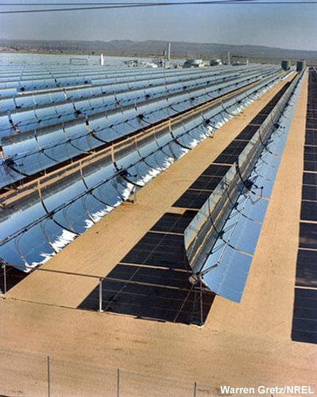
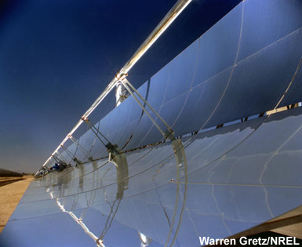
More solar power stations
Some solar power stations
use curved mirrors, which
focus solar energy onto pipes containing water. This heats the water and forms the steam needed to drive a turbine.
Notes:
Photo credit (bottom left): Warren Gretz/NREL
This line-concentrator power plant, with parabolic troughs, is located at Kramer Junction, California, and has been operating since 1980. It is one of nine plants with a combined output of 354 megawatts - the largest being 80 megawatts. Parabolic trough systems reflect and concentrate sunlight onto a receiver pipe located along the focal line of a curved, trough-shaped reflector. The heat generates steam to drive a turbine.
Photo credit (right): Warren Gretz/NREL
This line-concentrator solar power plant is located in the Mojave Desert in Kramer Junction, California. During operation, oil in the receiver tubes collects the concentrated solar energy as heat and is pumped to a power block located at the power plant for generating electricity.

Slide 11
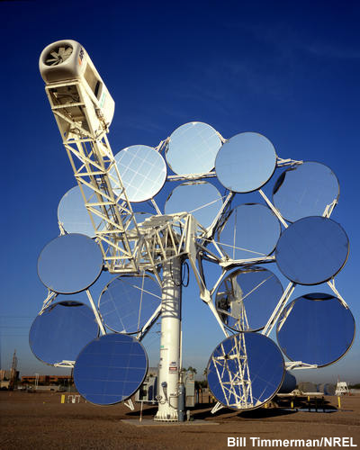
Making solar power stations effective
Solar power stations are most effectively located in areas with high light intensity.
This test design is located in Arizona where the sunlight is intense and the air temperature is high.
The mirrors must track the Sun as it moves across the sky to be as efficient as possible.
Notes:
Photo credit: Bill Timmerman/NREL
Dish Stirling Solar power system at the Solar Test and Research (STAR) Center belonging to Arizona Public Service, Arizona's largest electric utility company. This new technology, capable of producing 25 kW of electricity, uses mirrors to focus sunlight onto a thermal receiver. The heat is used to run a Stirling heat engine, which drives an electric generator. This highly efficient solar energy production system also can use alternative fuels instead of the Sun's heat, so power can be made anytime, day or night.

