Slide 1
Sustainable Use of Resources

Slide 2
Information
Analyzing and Interpreting Data
Engaging in Argument from Evidence
7. Stability and Change

Slide 3
The Earth’s resources
Humans use the Earth’s resources for many purposes, from creating materials such as clothing and buildings, to generating energy such as using gasoline to fuel cars.
Some resources are considered non-renewable, meaning that when we use them up no more can be produced.
Others are called renewable, meaning more can be grown or generated.
Natural resources can be supplemented by agriculture. Humans can also make synthetic versions of some resources to help reduce the amount of natural resources used.

Slide 4
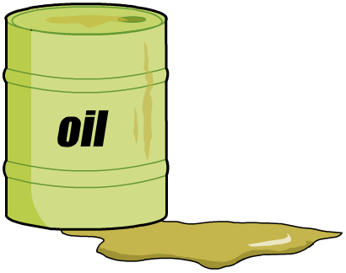
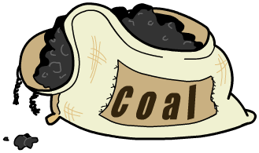
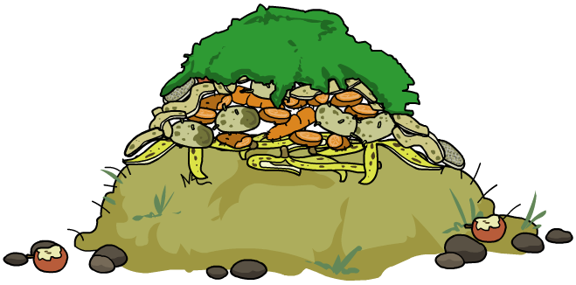
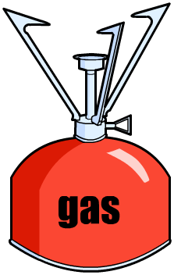
Energy resources from the Sun
The Sun is the original source of most energy resources.
Plants store the Sun’s energy through photosynthesis and that energy is transferred up the food chain.
The energy in these resources came from the Sun. Which of these resources is renewable and which is non-renewable?
coal
biomass
oil
food
natural gas

Slide 5
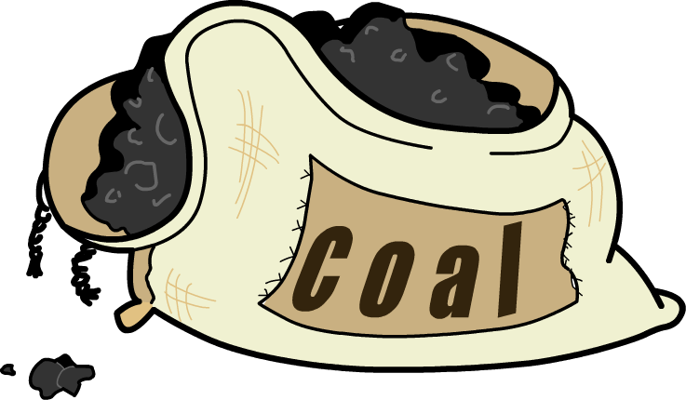
Non-renewable energy resources
Oil, coal and natural gas are examples of fossil fuels. They were formed from biological deposits over the course of millions of years.
coal
gas
oil
The amount of fossil fuel on Earth is limited. Fossil fuels are non-renewable because they cannot be replaced and will eventually run out.

Slide 6
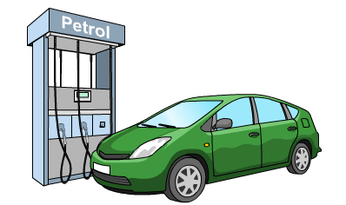
Uses of fossil fuels
Fossil fuels are very important and have many uses.
Can you name some ways in which humans use fossil fuels?
They are used to generate heat and electricity to power our businesses and homes.
They are used as fuels for our cars and airplanes.
They can be used to make plastics, medicines, packaging, fabrics and televisions.
We use fossil fuels for just about everything.

Slide 7
Atmospheric carbon dioxide levels
Notes:
Teacher notes
This animated graph could be used to illustrate the current increase in atmospheric carbon dioxide levels. Data from the Mauna Loa observatory, Hawaii, courtesy of NOAA.
The key points about the data are:
Carbon dioxide levels have risen annually.
Within each year there are seasonal changes in the level of carbon dioxide in the atmosphere. Dips in carbon dioxide levels correspond to spring and summer months, when plants are growing and photosynthesizing more rapidly.
Students should be aware that CO₂ levels are increasing. Within this increase there is a yearly variation in CO₂ levels.
More information about atmospheric gases is available at www.esrl.noaa.gov/gmd
This weblink was working correctly at the time of publication. Boardworks takes no responsibility for the content of external sites.
This slide covers the Science and Engineering Practice:
Analyzing and Interpreting Data: Analyze data using tools, technologies, and/or models (e.g., computational, mathematical) in order to make valid and reliable scientific claims or determine an optimal design solution.

Slide 8
Sustainability
All of the Earth’s natural resources are limited. Sustainability is the ability to provide for our needs without damaging the Earth. Humans will always need resources. Our use of resources can be sustainable or unsustainable.
Unsustainable use of resources can damage the environment and lead to pollution.
Using resources sustainably means using them in a way that prevents them from running out, and avoids causing damage to the environment. It can also mean reducing how much we use and reusing and recycling used materials.

Slide 9
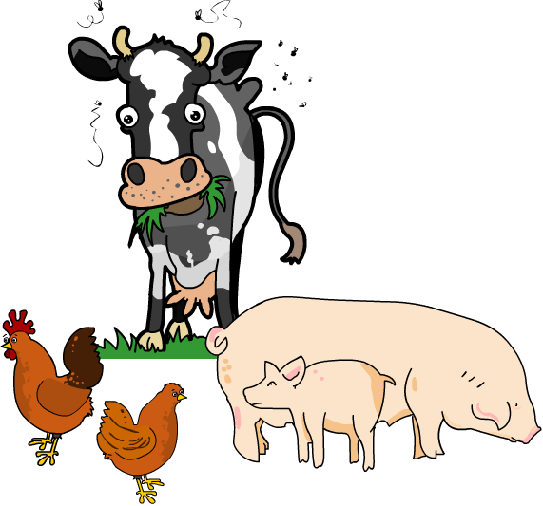
Natural resources and agriculture
Every year, when crops are harvested, they remove some of the nutrients from the soil.
Over time, this will affect the soil quality if the nutrients are not replenished.
To replenish the nutrients in the soil, farms can use manufactured fertilizers, which require fossil fuels in their manufacture, or manure, which is naturally occurring and renewable.
What are the advantages and disadvantages of using manufactured fertilizers vs. manure? Which is more sustainable and which is more effective?
Notes:
Teacher notes
This is a good point to stop for a discussion. Encourage students to do their own research about the sustainability and effectiveness of fertilizers and manure. You could split the class into two groups, one to argue in favour of fertilizers and the other to argue in favour of manure, and stage a short debate.
This slide covers the Science and Engineering Practice:
Engaging in Argument from Evidence: Evaluate competing design solutions to a real-world problem based on scientific ideas and principles, empirical evidence, and logical arguments regarding relevant factors (e.g. economic, societal, environmental, ethical considerations).

Slide 10
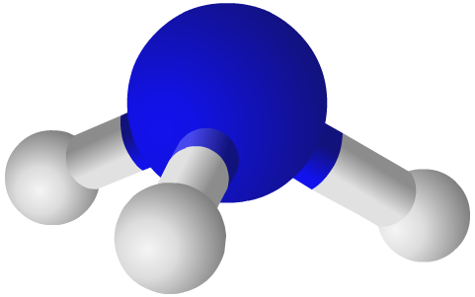
Improving agriculture using chemistry
How can chemistry improve agricultural processes?
Using knowledge of chemistry in agriculture can make agricultural processes more efficient, which can reduce the use of non-renewable resources.
Fertilizers are made using ammonia, which is created through a series of chemical processes called the Haber Process.
By studying how various conditions affect chemical reactions, scientists can reduce the energy needed for the process and improve the yield. This means creating more desired product using less energy!
Notes:
Teacher notes
Information has been gained from https://www.acs.org/content/acs/en/careers/college-to-career/chemistry-careers/agricultural-and-food-chemistry.html .
This weblink was working correctly at the time of publication. Boardworks takes no responsibility for the content of external sites.

Slide 11
Food scientists and chemistry
Food scientists have a wide range of responsibilities, from making branded ice cream taste more luxurious than supermarket own brands, to making sure we have clean water to drink.
Food scientists use their knowledge of the chemistry of food for a wide range of purposes:
to develop new chemicals to increase crop production and yield, defend against pests and protect the environment
to create new and improved flavors
to process, package, preserve, store and distribute foods and drinks to make them safe, economical, and sustainable.
Notes:
Teacher notes
For more information about food scientists, please refer to this website - https://www.acs.org/content/acs/en/careers/college-to-career/chemistry-careers/agricultural-and-food-chemistry.html .
This website was working correctly at the time of publication. Boardworks takes no responsibility for the content of external sites.

Slide 12
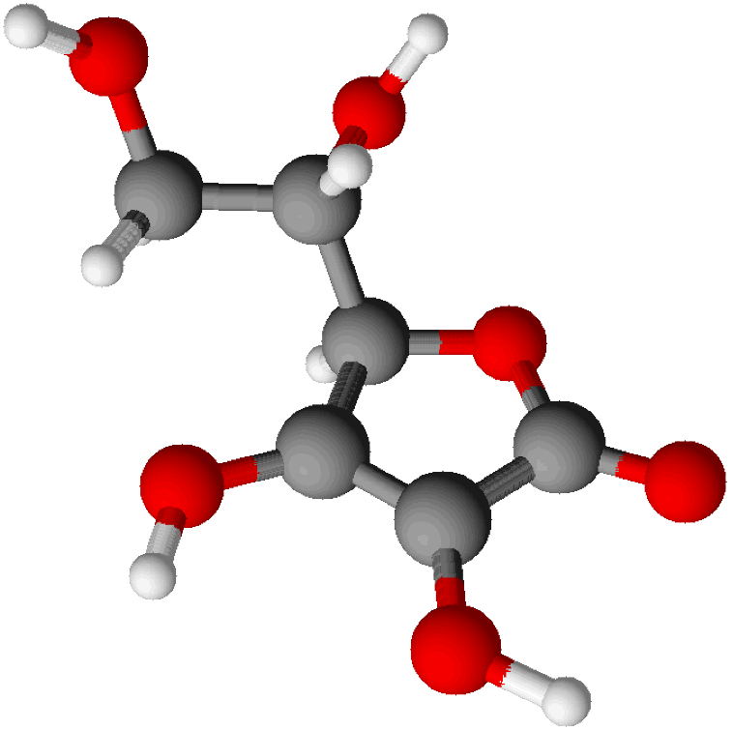
Supplementing natural products 1
Natural substances exist in nature, in the Earth, rocks, plants and animals. Synthetic versions of many substances can be made in a laboratory.
For example, vitamin C is naturally found in oranges. Scientists can make synthetic vitamin C from glucose.
Alcohol is naturally made by fermenting fruit. Scientists have developed a way to make alcohol from ethane using steam, in a process called hydration.

Slide 13
Supplementing natural products 2
Humans get vitamin B from the food they eat. Synthetic vitamin B is found in vitamin tablets and can be made from coal.
Why are synthetic substances made when natural ones exist?
Natural ingredients can be scarce or expensive. It may be easier and cheaper to produce a synthetic version in the lab.
Sometimes, more of a substance is needed than is supplied naturally. For example, folic acid is used in the body to make and repair DNA. Synthetic folic acid is given to pregnant women to make sure they have enough for their growing baby.
Notes:
This slide covers the Science and Engineering Practice:
Engaging in Argument from Evidence: Evaluate competing design solutions to a real-world problem based on scientific ideas and principles, empirical evidence, and logical arguments regarding relevant factors (e.g. economic, societal, environmental, ethical considerations).

Slide 14
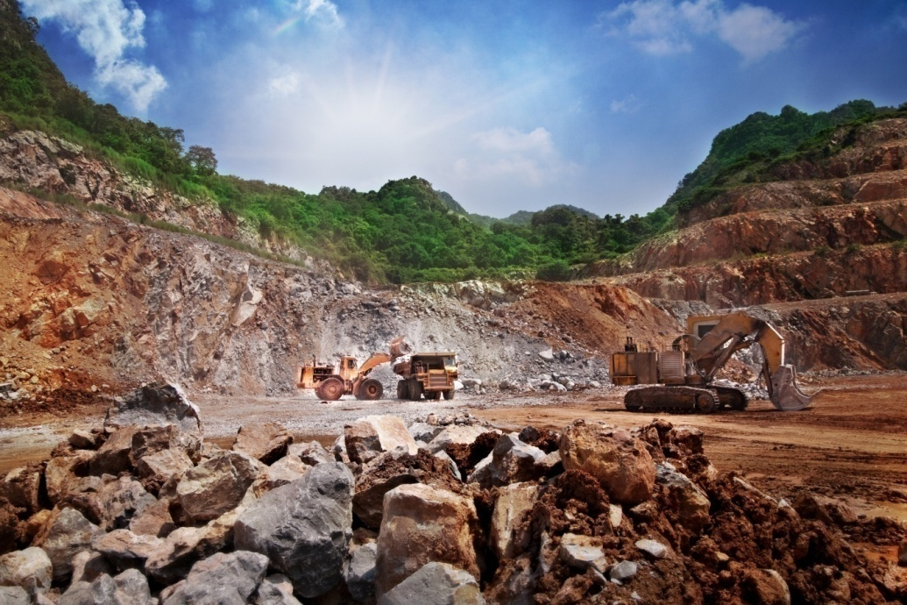
Obtaining raw materials
Obtaining raw materials from the Earth by quarrying and mining causes environmental impacts.
For example, explosives are used to extract limestone from rock in a process called blasting. The noise scares wildlife. Blasting also leaves large craters in the rock face which ruins the landscape.
Much of the limestone is then transported to cement factories near the quarries and the craters can be filled with rubbish and used as landfill sites.
Notes:
Photo credit: © Duron123, Shutterstock.com 2018

Slide 15
Ways of reducing the use of resources
Metal, glass, ceramics and most plastics are produced from limited raw materials. For example, plastics are made from crude oil, which is a fossil fuel.
Much of the energy used in the processes to form these products also comes from limited resources. For example, coal is used in the extraction of iron in the blast furnace.
Raw materials can be conserved by reducing the amount of resources we use, reusing resources wherever possible or recycling.

Slide 16
Recycling
Recycling is a good way to reduce the amount of resources we use. Recycling turns waste into usable material again. This means that fewer raw materials are used and less energy is used to process the raw materials.
For example, glass bottles can be recycled. The glass is sorted by color then crushed into small pieces. Any bits of other materials are removed from the glass and then it is melted. It can then be made into new glass bottles.
What other resources can be recycled?
paper
some plastic
aluminum
batteries.
What are other benefits of recycling?
Notes:
Teacher notes
Recycling also prevents potentially useful materials from ending up in landfills. Recycling can help the environment by limiting the amount of space needed for landfills as well as reducing the amount of raw material that needs to be gathered from the environment.
Encourage students to consider how useful recycling is. Will recycling alone help prevent us from running out of natural resources? What other steps can we take?

Slide 17
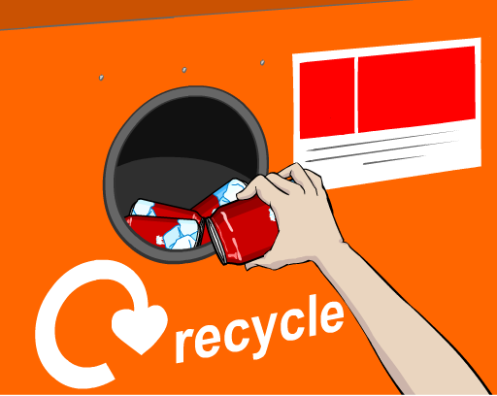
Recycling metals
Almost all metals can be recycled into something new. Metal recycling helps to protect the environment as fewer raw materials are needed.
For example, aluminum extraction happens at about 900 °C. This requires a lot of energy and this comes from burning fossil fuels.
Scrap aluminum can be melted down at around 660 °C. This means less energy is needed, and therefore we can save some raw materials as well as reducing the amount of carbon dioxide we are releasing.

Slide 18
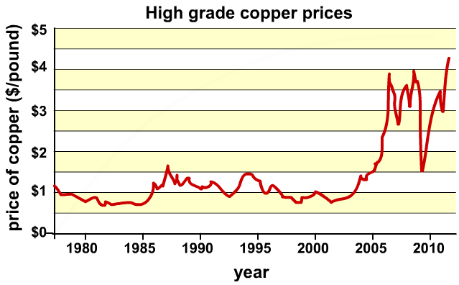
Price of copper
What does the graph tell us about the price of copper and how it has changed?
Why do you think this has happened?
What will happen to the price in the future, if we continue the way we are?
Notes:
This slide covers the Science and Engineering Practice:
Analyzing and Interpreting Data: Analyze data using tools, technologies, and/or models (e.g., computational, mathematical) in order to make valid and reliable scientific claims or determine an optimal design solution.

Slide 19
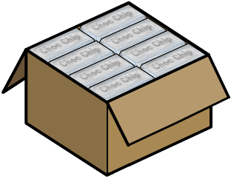
Reduce and reuse
The most sustainable change we can make is to reduce our use of materials. Some products are wrapped in much more packaging than is necessary.
If the packaging cannot be reduced, the next best thing is to reuse it. Some packaging materials can be used several times.
For example, you could reduce your use of plastic bottles by reusing and refilling them.
What other things can be reused?
Notes:
Teacher notes
Student should understand that reducing and reusing come before recycling. An item should only be recycled after it has been reused as much as possible.
Even larger items like furniture can be reused. Selling second hand items to a new home or repurposing them are both ways of reusing something.

