Slide 1
Telescopes

Slide 2
Information
Developing and Using Models
Constructing Explanations and Designing Solutions
3. Scale, Proportion, and Quantity
6. Structure and Function

Slide 3
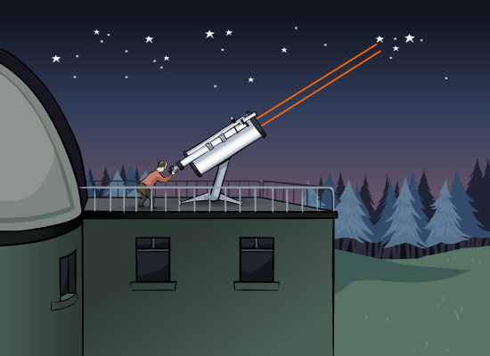
Light from stars
Stars emit light in all directions. Only a tiny fraction will travel through space towards Earth. The more distant the star, the smaller the fraction of light that reaches us.
Any light that reaches Earth from distant stars is effectively composed of parallel rays.
These are very weak, so large telescopes are needed to gather enough rays to observe their source.

Slide 4
The refracting telescope
Notes:
Teacher notes
Allow the students to predict the outcome in each stage, playing the animation to test their ideas. Highlight the difference between the two lenses in the telescope, and the different jobs they do. The key points from the animation are tested in a summary activity on the next slide.
This slide covers the Science and Engineering Practices:
Developing and Using Models: Use a model to provide mechanistic accounts of phenomena.
Constructing Explanations and Designing Solutions: Apply scientific ideas, principles, and/or evidence to provide an explanation of phenomena and solve design problems, taking into account possible unanticipated effects.

Slide 5
How does a telescope work?

Slide 6
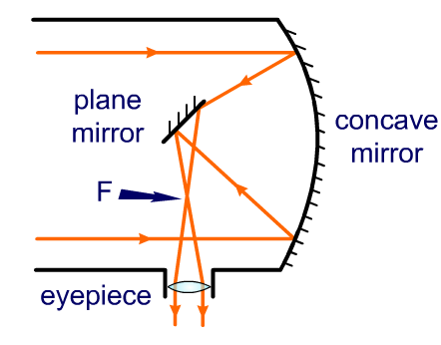
Reflecting telescopes
Light arriving from distant objects may be very weak.
In order to collect as much light as possible, the objective lens needs a large diameter.
Large lenses are very difficult to make and so are very expensive.
Reflecting telescopes overcome this by using relatively cheap mirrors as their objective. These can be made extremely large.
Notes:
Teacher notes
There is an urban legend that glass is able to flow. This is supposed to cause glass lenses to lose their shape over time. This is not true. The cost of large lenses, and the degradation of the image caused by dispersion, are the reasons why mirrors are preferred to lenses for astronomy.
This slide covers the Science and Engineering Practices:
Developing and Using Models: Use a model to provide mechanistic accounts of phenomena.
Constructing Explanations and Designing Solutions: Apply scientific ideas, principles, and/or evidence to provide an explanation of phenomena and solve design problems, taking into account possible unanticipated effects.

