Slide 1
The Earth and Moon

Slide 2
Information
Developing and Using Models
Constructing Explanations and Designing Solutions
1. Patterns

Slide 3
The rotation of the Earth

Slide 4
What time is it?
It is 4 am in New York.
Casablanca
Philippines
What is the time in the rest of the world?
place
EDT
time
Casablanca
+5 hr
9 am
Pretoria
+7 hr
11 am
Antananarivo
+8 hr
12 pm
Philippines
+13 hr
5 pm
Pretoria
Antananarivo

Slide 5
The path of the Sun in the sky

Slide 6
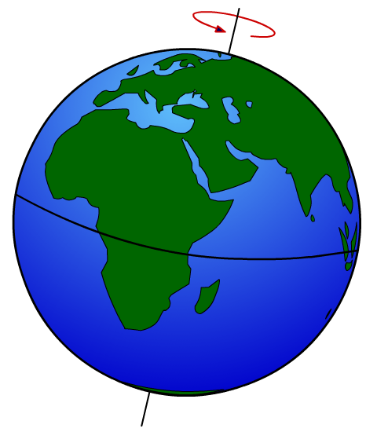
What are hemispheres?
The Earth is divided into two hemispheres, separated by the equator.
northern
hemisphere
equator
southern
hemisphere
Why do the hemispheres have different seasons at different times of the year?

Slide 7
The seasons
Notes:
This slide covers the Science and Engineering Practices:
Developing and Using Models: Use a model to provide mechanistic accounts of phenomena.
Constructing Explanations and Designing Solutions: Apply scientific ideas, principles, and/or evidence to provide an explanation of phenomena and solve design problems, taking into account possible unanticipated effects.

Slide 8
What is the season?

Slide 9
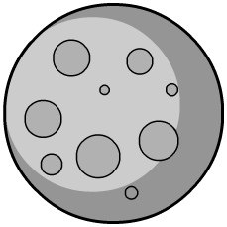
The Moon
The Sun and the Moon look about the same size from Earth, but they are not.
The Sun is about 400 times wider than the Moon but is 400 times further away!
The Moon takes just over 27 days to orbit the Earth.

Slide 10
The phases of the Moon
Notes:
This slide covers the Science and Engineering Practice:
Developing and Using Models: Use a model to provide mechanistic accounts of phenomena.

Slide 11
Phases of the Moon activity

Slide 12
Questions about the Moon

Slide 13
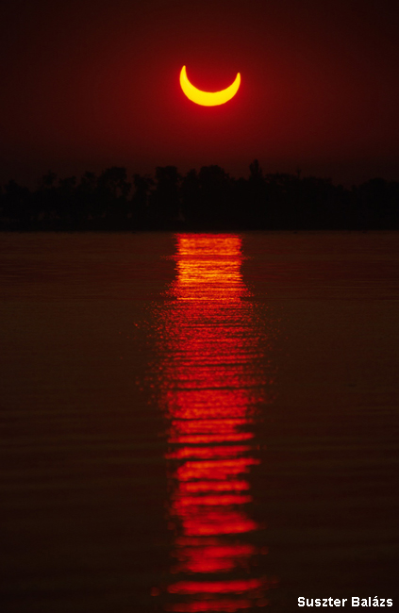
Eclipses
A solar eclipse happens when the Moon passes between the Sun and the Earth, casting a shadow over the Earth.
The last total solar eclipse visible from the US was in 2017. The next is not until 2024!
A lunar eclipse happens when the Earth passes between the Sun and the Moon, casting a shadow over the Moon.
Lunar eclipses happen in most years.
Notes:
Photo credit: Suszter Balázs

Slide 14
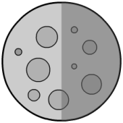
What happens during a solar eclipse?
Where must the Moon be for a solar eclipse to take place?
During a solar eclipse, the Moon moves directly between the Sun and the Earth, blocking the Sun’s rays from reaching part of the Earth.
Notes:
Teacher notes
If viewing a solar eclipse, always use eclipse viewers. Never look directly at the Sun.
This slide covers the Science and Engineering Practice:
Developing and Using Models: Use a model to provide mechanistic accounts of phenomena.

Slide 15
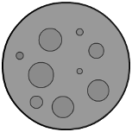
What happens during a lunar eclipse?
Where must the Moon be for a lunar eclipse to take place?
During a lunar eclipse, the Moon is on the opposite side of the Earth from the Sun, blocking the Sun’s light from reaching the Moon.
Notes:
This slide covers the Science and Engineering Practice:
Developing and Using Models: Use a model to provide mechanistic accounts of phenomena.

Slide 16
Questions about eclipses

