Slide 1
The Greenhouse Effect

Slide 2
Information
Developing and Using Models
2. Cause and Effect
7. Stability and Change

Slide 3
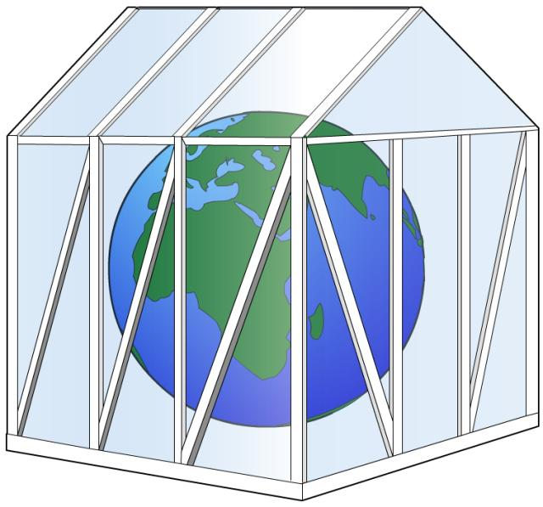
Warming Earth’s atmosphere
Climate is affected by the conditions and components of the atmosphere.
The Earth’s atmosphere acts like the glass in a greenhouse. It is needed to keep the planet warm enough for life to exist.
The Sun releases radiation in the form of light waves. This radiation enters Earth’s atmosphere and warms the planet.
The Earth also releases radiation in the form of heat. This radiation contributes to warming the planet.
Notes:
Teacher notes
Some of the radiation from the Sun is reflected by Earth, and so released back to the atmosphere.

Slide 4
What is the greenhouse effect?
The infrared radiation released by the Earth can pass through the atmosphere and into space.
However, some of the radiation can be trapped in the atmosphere by gases. These gases are called greenhouse gases.
The trapping of radiation by these gases warms the planet. This is called the greenhouse effect.
Having some greenhouse gases is a good thing. If it wasn’t for these gases, Earth would be too cold to live on!

Slide 5
What is the greenhouse effect? (2)
Notes:
Teacher notes
This animation can be used to illustrate the principles of the greenhouse effect. Students could be asked to consider the impact of rising greenhouse gases on the natural phenomenon of the greenhouse effect.
This slide covers the Science and Engineering Practice:
Developing and Using Models: Use a model to provide mechanistic accounts of phenomena.

Slide 6
What are the greenhouse gases?
Notes:
Teacher notes
This activity can be used to investigate which atmospheric gases are greenhouse gases. Traffic light colored voting cards could be used to engage the whole class in discussing which gases absorb infrared radiation before showing the animations for each gas.

Slide 7
The greenhouse effect: summary
Notes:
Teacher notes
This ordering activity can be used as an introductory or summary activity.

Slide 8
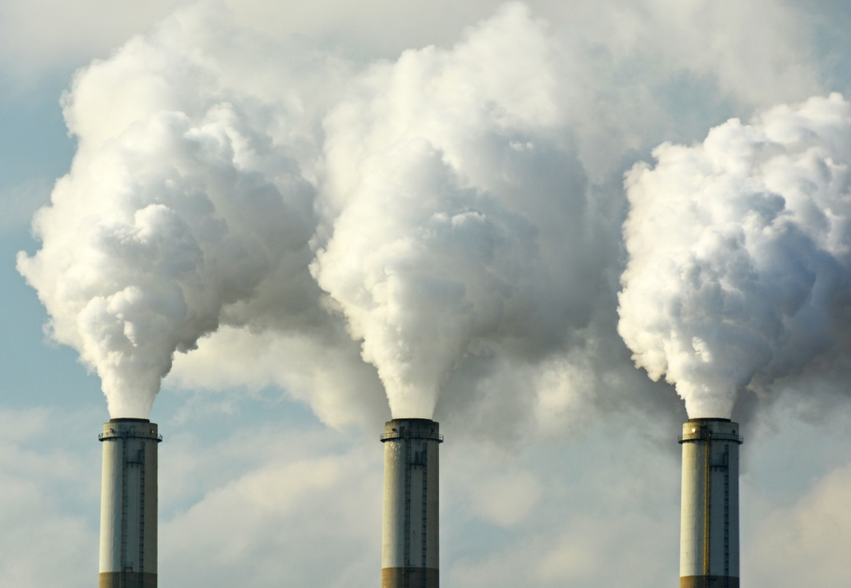
Increasing carbon dioxide
Human activity is increasing the amount of greenhouse gases released into the environment.
For example, carbon dioxide is a greenhouse gas released during the combustion of fossil fuels.
The use of fossil fuels has increased since the Industrial Revolution. This coincides with an increase in atmospheric carbon dioxide levels.
Notes:
Teacher notes
Students should be aware that carbon dioxide is also released from natural sources.
The Industrial Revolution took place between the 18th and 19th century.
For more information about increasing carbon dioxide levels, please refer to the Climate Change presentation.
Photo credit: © Jeff Zehnder, Shutterstock.com 2018

Slide 9
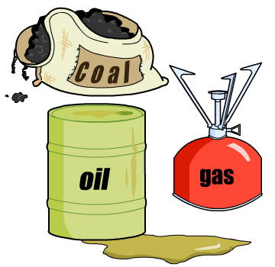
Fossil fuels
Fossil fuels are carbon-based materials. They formed over millions of years from the remains of ancient plants and animals.
Coal, petrol and natural gas are common fossil fuels used today.
The use of fossil fuels is the major cause of increasing atmospheric carbon dioxide levels.
Increasing human population increases the demand for fossil fuels.
Notes:
Teacher notes
For more information about the formation of fossil fuels, please refer to the Earth’s Atmosphere presentation.

Slide 10
Burning fossil fuels
Fossil fuels are burned to generate energy in a combustion reaction:
fossil fuels + oxygen → carbon dioxide + water
This releases large amounts of carbon dioxide into the atmosphere each year.
How would limiting the use of fossil fuels affect our lifestyles?
Notes:
Teacher notes
Fossil fuels are a major source of energy. Some uses of fossil fuels include:
transport e.g. cars and airplanes
generating electricity
making plastics
production of some medicines
production of material, e.g. clothing.

Slide 11
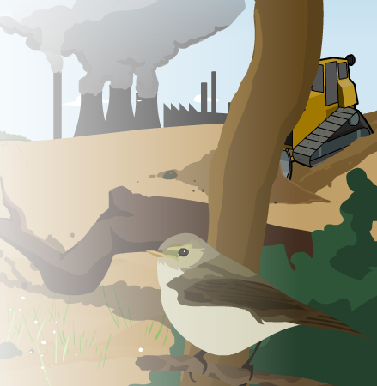
Deforestation and carbon dioxide
Deforestation is the removal of forests to make alternative use of the land. This is often to make way for human activities, such as farming.
Deforestation requires the combustion of fossil fuels for energy. This releases carbon dioxide into the atmosphere.
The removal of trees and plants by deforestation reduces the amount of photosynthesis taking place. This causes an increase in carbon dioxide levels.
Notes:
Teacher notes
Carbon dioxide is stored in trees and other plants. When these are burned, the carbon dioxide is released into the atmosphere.

Slide 12
Increasing methane
Methane is a stronger greenhouse gas than carbon dioxide; however, it is currently in the atmosphere at much lower levels.
Methane is found in natural gas, a type of fossil fuel used for electricity, heating and cooking.
The increasing human population has caused an increase in methane. This is due to:
increased waste disposal – the decomposition of organic matter at landfill sites leads to the production of methane.
increased farming – rice and cattle farming produce methane.
Notes:
Teacher notes
While an increase in methane release has been observed, the release of methane from natural sources has remained constant. This confirms that the methane released is from human activity.
Methane is produced at landfill sites and farms by anaerobic bacteria. The bacteria break down organic matter, such as cow manure and other waste, into methane.
Photo credit: © kanvag, Shutterstock.com 2018

