Slide 1
The Rock Cycle

Slide 2
Information
Developing and Using Models
Planning and Carrying Out Investigations
5. Energy and Matter
6. Structure and Function
7. Stability and Change

Slide 3
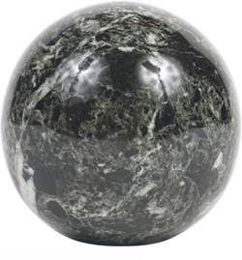
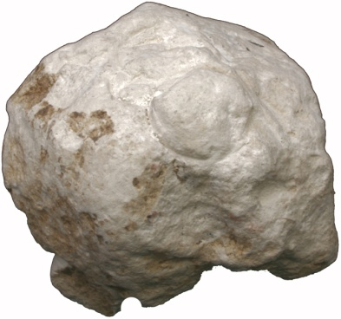
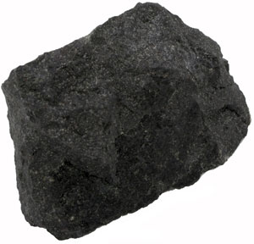
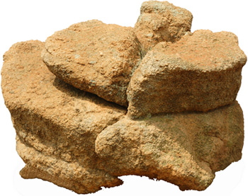
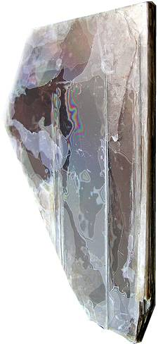
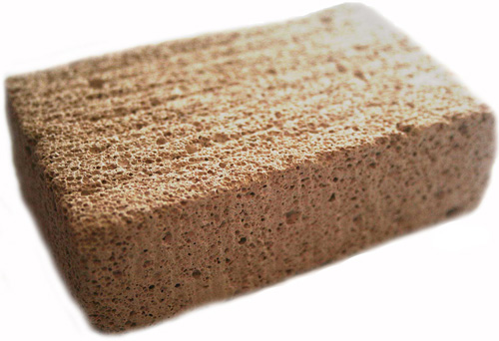
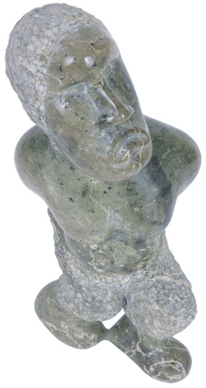
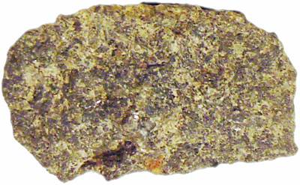
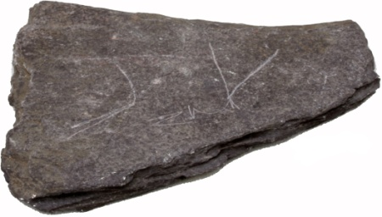
Different types of rock
There are many different types of rocks in the world.
Notes:
Photo credits: basalt, chalk, slate © Dr John Mileham, marble, soapstone © Jupiterimages Corporation 2018, sandstone © David Duncan, pumice © Asif Akbar, mica © Peter Cristofono, gabbro © Dave Dyet

Slide 4
Identifying rocks
Notes:
This slide covers the Science and Engineering Practice:
Planning and Carrying Out Investigations: Plan and conduct an investigation individually and collaboratively to produce data to serve as the basis for evidence, and in the design: decide on types, how much, and accuracy of data needed to produce reliable measurements and consider limitations on the precision of the data (e.g., number of trials, cost, risk, time), and refine the design accordingly.

Slide 5
Identifying rocks: summary
type
examples
description
the softest rock type, containing layers and sometimes fossils
sandstone and limestone
sedimentary
usually harder than sedimentary rocks, containing thin layers and twisted fossils
marble and slate
metamorphic
usually the hardest rock type, containing shiny crystals
basalt and granite
igneous

Slide 6
Different rocks = different uses

Slide 7
Formation of sedimentary rocks
Notes:
This slide covers the Science and Engineering Practice:
Developing and Using Models: Use a model to provide mechanistic accounts of phenomena.

Slide 8
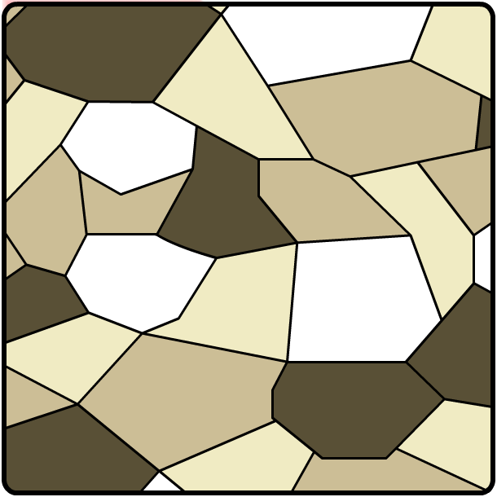
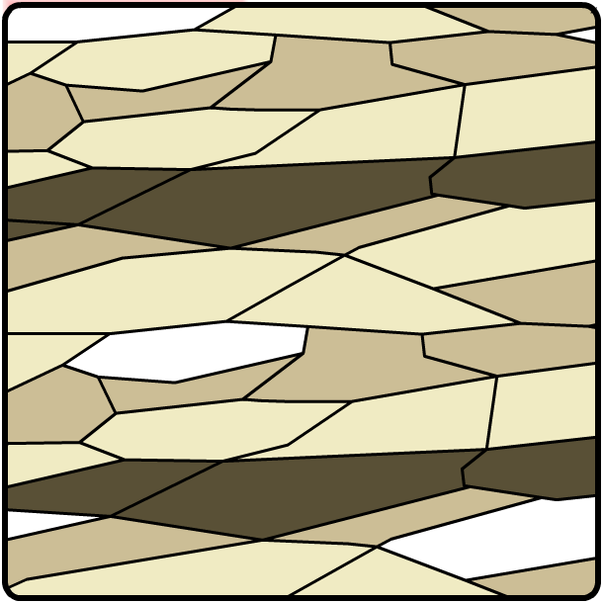
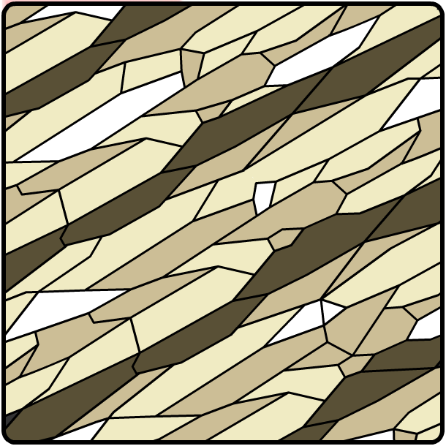
Formation of metamorphic rocks
Sedimentary rocks are turned into metamorphic rocks by the extreme pressures and temperatures deep within the Earth.
These conditions change the structure of the rocks so that new layers are formed.
heat
more heat
pressure
more pressure
Mixture of grains in structure
Heat and pressure compress grains
Grains form orderly layers

Slide 9
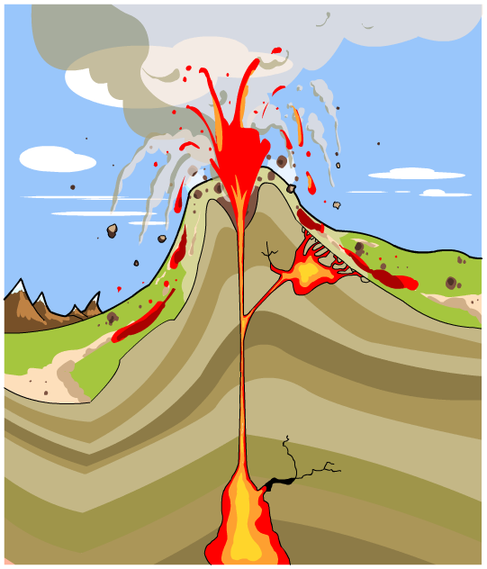
Formation of igneous rock
Magma is a type of molten rock found deep underground. Occasionally magma rises up through the Earth’s surface, causing volcanic eruptions.
Igneous rocks are formed when the magma cools and solidifies.
When magma cools above the surface, extrusive igneous rocks are formed.
extrusive igneous rock
intrusive igneous rock
When magma cools below the surface, intrusive igneous rocks are formed.
magma

Slide 10
Crystal size in igneous rocks

Slide 11
The rock cycle
Notes:
This slide covers the Science and Engineering Practice:
Developing and Using Models: Use a model to provide mechanistic accounts of phenomena.

Slide 12
The rock cycle: in words

Slide 13
The rock cycle: summary

Slide 14
From weathering to sedimentation

Slide 15
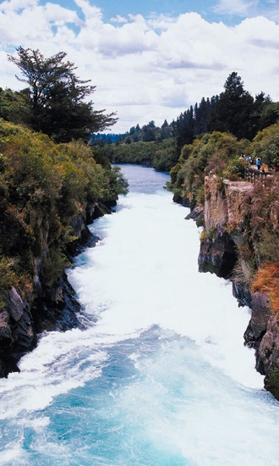
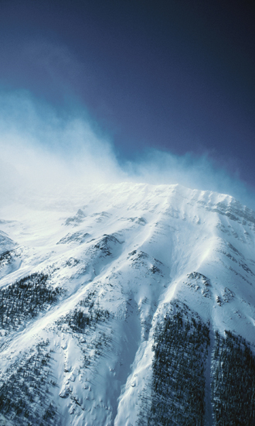
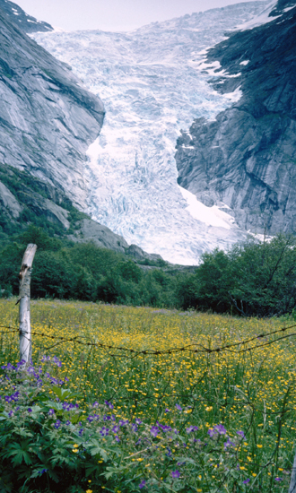
Erosion
As a rock is weathered, pieces of it fall off. This is called erosion. They will then be transported away by water, wind or glaciers.
by water
by wind
by glacier
Notes:
Photo credits: all © Jupiterimages Corporation 2018

Slide 16
Transportation by water
Notes:
This slide covers the Science and Engineering Practice:
Developing and Using Models: Use a model to provide mechanistic accounts of phenomena.

Slide 17
Rock changes during transportation
Notes:
This slide covers the Science and Engineering Practice:
Planning and Carrying Out Investigations: Plan and conduct an investigation individually and collaboratively to produce data to serve as the basis for evidence, and in the design: decide on types, how much, and accuracy of data needed to produce reliable measurements and consider limitations on the precision of the data (e.g., number of trials, cost, risk, time), and refine the design accordingly.

Slide 18
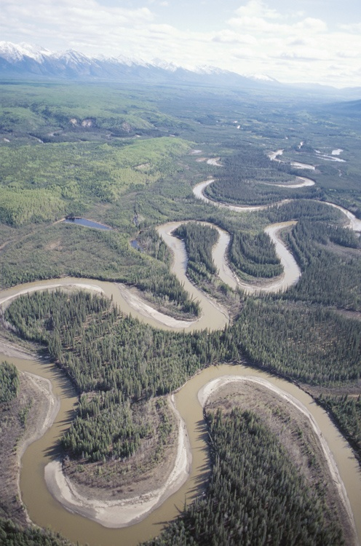
What is deposition?
Deposition occurs after erosion and transportation.
This is the process that occurs when pieces of weathered rock sink to the bottom of the riverbed or ocean, forming sediment.
Eventually this sediment gets so squashed down that it forms new rock, called sedimentary rock.
Notes:
Photo credit: © Jupiterimages Corporation 2018

Slide 19
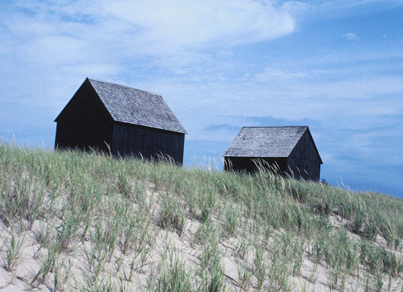
Transportation by wind
Rock particles being transported by the wind cause erosion.
Wind erosion has two major effects:
small particles picked up by the wind are deposited in new places.
For example, this is how sand dunes are formed.
when particles are suspended in the air they can also hit objects and cause them to chip and wear down (think of how sand grains sting when the wind blows them against your skin at the beach).
Notes:
Teacher notes
Particles that are picked up by the wind can be deposited several hundred miles away from their original site.
Photo credit: © Jupiterimages Corporation 2018

Slide 20
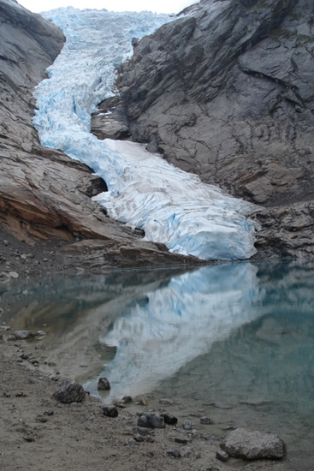
Transportation by glacier
A glacier is a mass of ice that gradually moves overland.
As the glacier moves, the stones and rocks in its path become incorporated into the base. The forward motion of the glacier causes the trapped rocks to rotate, scrape and grind along the ground.
This friction weathers the landscape and causes valleys and fjords to form.
Over time, the smaller pieces of rock are carried into the meltwater streams that surround the glacier, where they are redeposited into the ground.
Notes:
Photo credit: © Nina Schweinsberg

