Slide 1
Volcanoes

Slide 2
Information
Constructing Explanations and Designing Solutions
2. Cause and Effect
7. Stability and Change

Slide 3
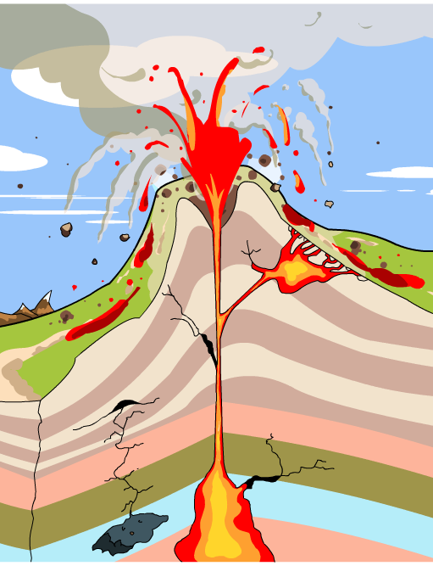
How are volcanoes formed?
Volcanoes form where molten rock (magma) from the mantle pushes upwards through weaknesses in the Earth’s surface. Magma that reaches the surface is known as lava.
crater
lava
central vent
strata (layers)
magma chamber
Notes:
Teacher notes
This slide could be used to introduce the key features of a volcano. Students could be asked to identify the parts of the volcano before the labels are revealed.

Slide 4
Classifying volcano types
Notes:
Teacher notes
This activity provides information about the principal features of the three most common volcano types. While using the activity, the relationship between volcano shape and lava type could be highlighted. The activity could be extended by asking students to research other volcano types.

Slide 5
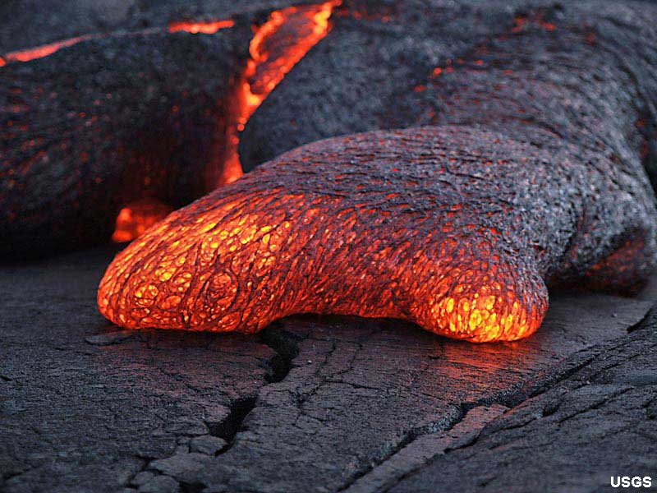
What happens when magma cools?
As magma from the Earth’s mantle cools, it solidifies and crystallizes to form igneous rocks. Granite, basalt and obsidian are examples of igneous rocks.
Rocks formed when expelled lava cools
on the Earth’s surface are called extrusive igneous rocks.
When magma cools below the Earth’s surface, intrusive igneous rocks are formed.
Notes:
Photo credit: U.S. Department of Interior, U.S. Geological Survey
Eye-level view of pahoehoe (basaltic lava) toe at the Kilauea volcano, Hawaii. The solid crust is beginning to form around the lava as it oozes forward. The toe is about 10 cm high.

Slide 6
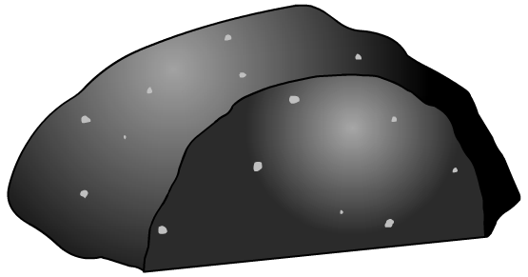
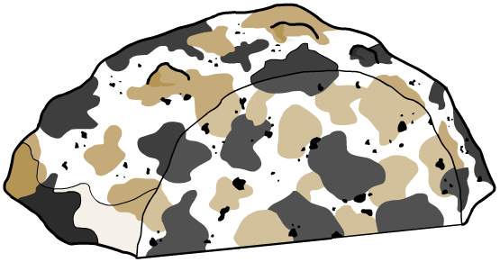
How does cooling affect crystal size?
Magma is full of minerals that turn into crystals under the right conditions. The size of the crystals in an igneous rock is related to the rate at which the molten magma cools.
If magma cools quickly, the crystals do not have very much time to form and so are small in size. Basalt has small crystals.
quick
cooling
On the other hand, if
magma cools slowly, the crystals have more time to grow and so are large. Granite has large crystals.
slow
cooling
Notes:
This slide covers the Science and Engineering Practice:
Constructing Explanations and Designing Solutions: Apply scientific ideas, principles, and/or evidence to provide an explanation of phenomena and solve design problems, taking into account possible unanticipated effects.

Slide 7
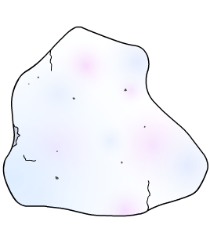
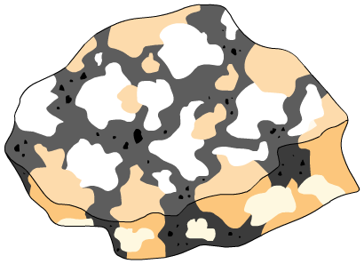
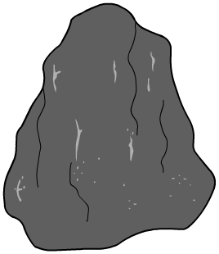
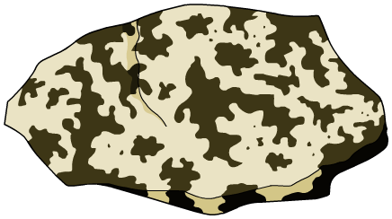
How are different igneous rocks formed?
Are these igneous rocks formed by quick or slow cooling?
rhyolite
granite
Rocks from low-silica lava
quick cooling
slow cooling
basalt
gabbro
Rocks from high-silica lava
quick cooling
slow cooling

Slide 8
Can eruptions be predicted?
Notes:
Teacher notes
This activity explores the methods used to predict volcanic eruptions. While using the activity, the application of scientific methods to the problem of volcanic eruptions could be highlighted.
Tiltmeter: A tiltmeter is a device composed of a liquid bubble encased inside a chamber. A tiltmeter responds to changes in slope, like a spirit level. Vulcanologists use tiltmeters to check the slope of a volcano's side. Increases in the steepness of the slope indicate that the magma chamber is growing and an eruption may occur soon.
Spectrometer: A spectrometer is a device which measures the relative amounts of certain gases in the atmosphere. Vulcanologists use spectrometers to monitor concentrations of sulphur dioxide, which is the main volcanic gas. A spectrometer works by comparing the amount of infrared radiation it receives from the Sun to reference values when it is pointed at a volcanic plume.

Slide 9
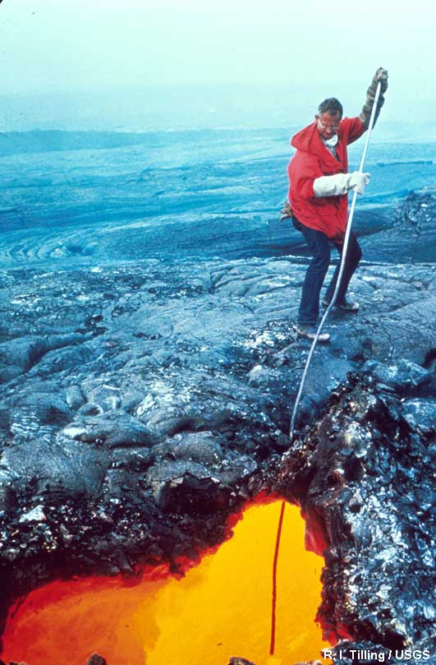
Why are predictions hard to make?
Scientists who study volcanoes are called volcanologists.
They are skilled at monitoring the changes in active volcanoes that can indicate when an eruption might occur.
Monitoring equipment is very expensive and there are not enough resources to observe every active site in the world.
This means that volcanologists cannot always pinpoint exactly when an eruption will happen.
Notes:
Photo credit: R. I. Tilling / USGS
Image shows D.W. Peterson lowering a lava tube at Mauna Ulu during the 1972–1974 eruption of the Kilauea volcano in Hawaii.

Slide 10
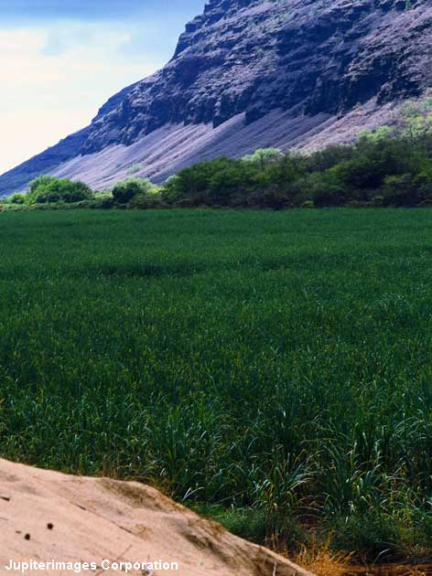
Can volcanoes have benefits?
Volcanoes can be extremely destructive but they are also a creative force.
When volcanic lava cools and solidifies, new land mass is created.
The lava is weathered and breaks down into a fine soil, which is often very fertile.
Volcanoes also produce and transport igneous rocks, which are useful building materials.
Notes:
Photo credit: © Jupiterimages Corporation 2018
Image shows the fertile agricultural land found at the base of an extinct volcano on the island of Kauai, Hawaii.

Slide 11
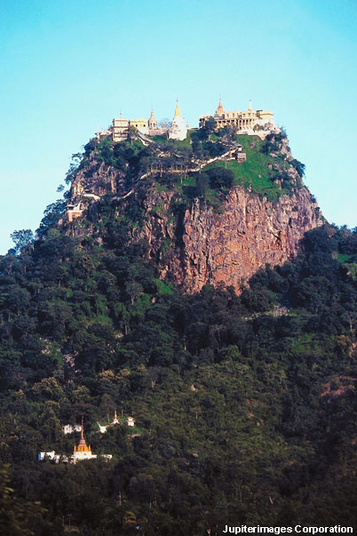
Why do people live at plate boundaries?
Many people chose to live in areas where earthquakes or volcanic eruptions are a threat, despite the risks involved.
Why might people do this?
The soil is often more fertile.
The area attracts tourists.
Power is easily obtained from geothermal vents.
Their culture or religion is based around the area and they do not want to leave.
Notes:
Photo credit: © Jupiterimages Corporation 2018
Image shows a shrine built on the peak of the active volcano Mount Popocatépetl in Mexico.

Slide 12
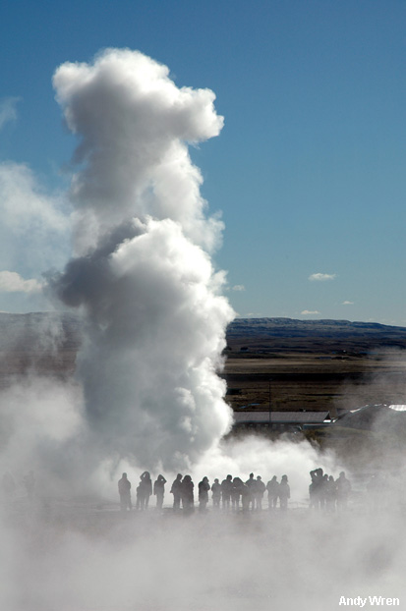
How can geothermal energy be used?
Iceland sits on the boundary of the mid-Atlantic tectonic plates.
A plate boundary is not always a peaceful place, but its location does provide an endless supply of energy.
Icelanders use hot water directly from the Earth to heat their homes and businesses.
The hot water is stored in huge tanks on one of Reykjavik's few hills. Gravity is then used to distribute the water to the city.
Notes:
Photo credit: Andy Wren
Image shows the Strokkur geyser in Iceland, which regularly erupts every 5–10 minutes, releasing boiling water and steam up to 20 meters in the air.

