Slide 1
Water on Earth

Slide 2
Information
Asking Questions and Defining Problems
Developing and Using Models
Planning and Carrying Out Investigations
Constructing Explanations and Designing Solutions
2. Cause and Effect
4. Systems and System Models
5. Energy and Matter

Slide 3
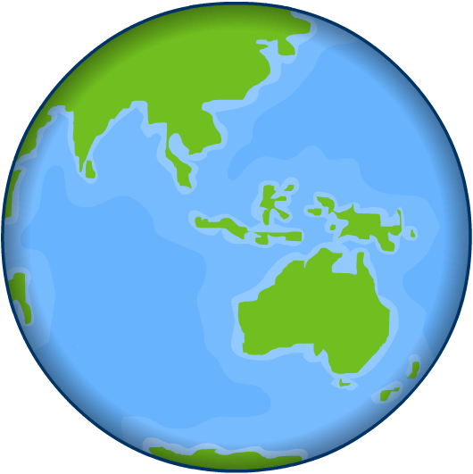
The water cycle
Over 70% of the Earth’s surface is covered by water.
The vast majority of this is stored in the oceans and seas of the world.
Water is neither created nor destroyed. Instead, it is cycled and recycled over and over again in the Earth’s atmosphere.
This recycling of water is called the water cycle.

Slide 4
What happens in the water cycle?
Notes:
This slide covers the Science and Engineering Practice:
Developing and Using Models: Develop, revise, and/or use a model based on evidence to illustrate and/or predict the relationships between systems or between components of a system.

Slide 5
Water cycle processes
Notes:
This slide covers the Science and Engineering Practice:
Developing and Using Models: Develop, revise, and/or use a model based on evidence to illustrate and/or predict the relationships between systems or between components of a system.

Slide 6
Water cycle definitions

Slide 7
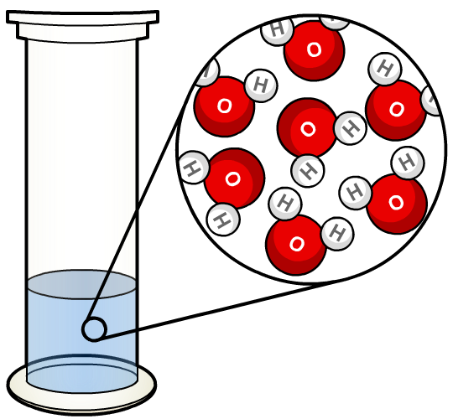
What can water do?
As well as making up our oceans, rivers, and over 50% of our bodies, water has some interesting properties.
It absorbs, stores and releases energy in the form of heat (thermal energy) or movement (kinetic energy).
It expands when it freezes.
It helps erode, dissolve and transport materials, including rocks.
It affects the melting point and other properties of rocks.
In this presentation, you will learn more about each of these properties.

Slide 8
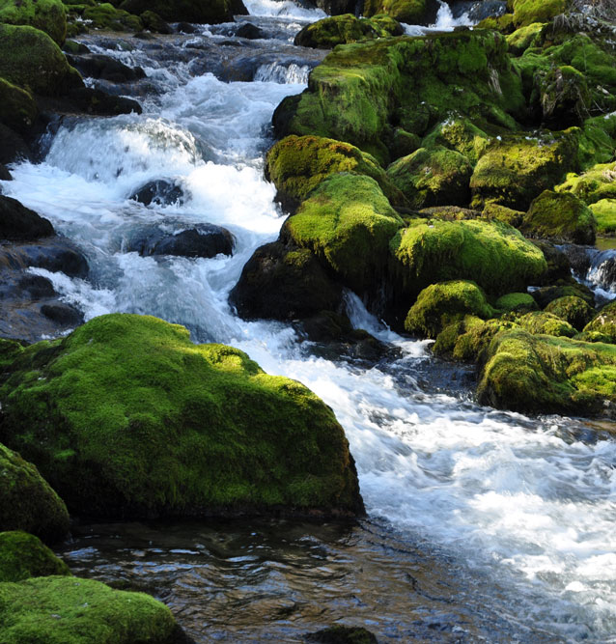
Water and energy
Water has a high capacity for absorbing and storing energy, which means it can store a lot of energy at once.
Some of this energy is thermal. Large volumes of water, such as the oceans, can store huge amounts of thermal energy from the Sun.
Energy in water can also be kinetic. For example, a river flowing down a mountain has a lot of energy, which causes it to move. The movement is the release of kinetic energy.
Notes:
Teacher notes
Students may need to have the difference between thermal energy and temperature defined for them. Thermal energy is the amount of energy stored in a body of water as heat, whereas temperature is the average amount of energy each particle has. For example, a bathtub of water at 86 °F stores more thermal energy than a mug of water at 194 °F. Although the mug has a higher temperature, the amount of thermal energy contained is related to the number of particles in the water.
Photo credit: Flowing river © Andreja Donko, Shutterstock.com 2018

Slide 9
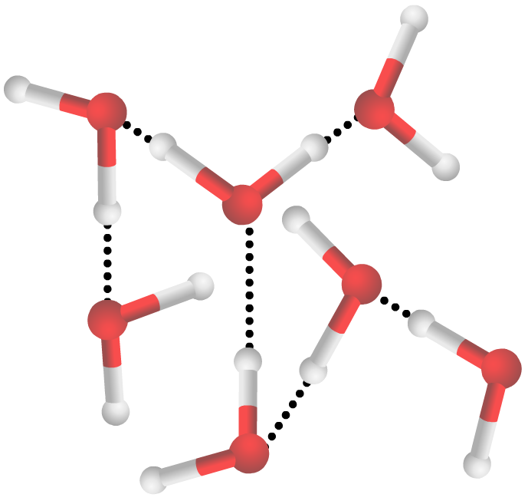
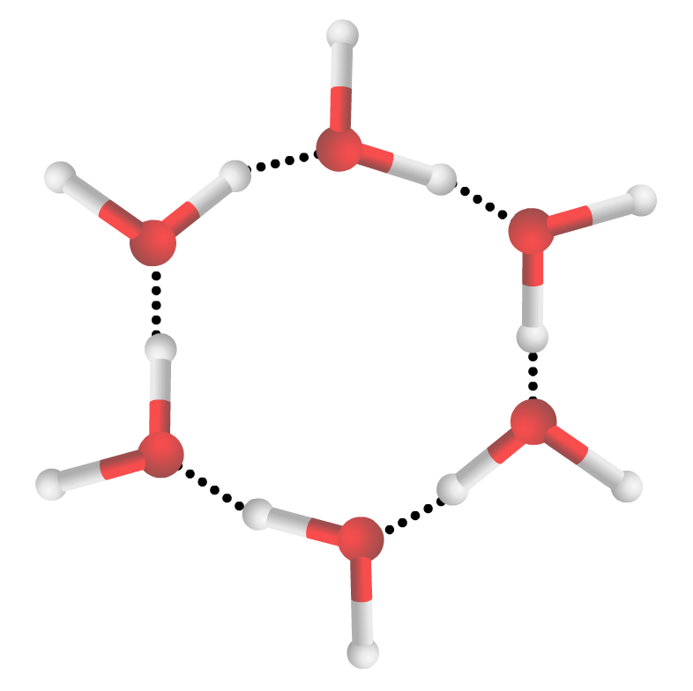
What happens when water freezes?
When water freezes, its molecules form uniform crystalline structures. These structures are less dense than the molecules in liquid water.
Water
So what does this mean?
Ice
This means that when water freezes, it expands by about 9% of its total volume. It also explains why ice cubes float on the surface of your drink: the ice is less dense, so it floats.
Notes:
This slide covers the Science and Engineering Practice:
Constructing Explanations and Designing Solutions: Apply scientific ideas, principles, and/or evidence to provide an explanation of phenomena and solve design problems, taking into account possible unanticipated effects.

Slide 10
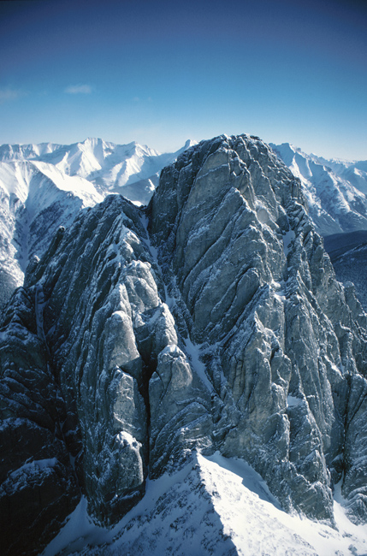
What is freeze-thaw weathering?
When rainwater or melted snow seeps into a crack in a rock and freezes, it can force the crack to expand.
When the ice thaws, the rock contracts and the water moves deeper into the crack. Later, when the water refreezes, the crack is forced apart again.
Over time, the crack widens until the piece of rock breaks apart.
This cycle is called freeze-thaw weathering or frost wedging.
Notes:
Photo credit: © Jupiterimages Corporation 2018

Slide 11
Freeze-thaw weathering in action
Notes:
This slide covers the Science and Engineering Practices:
Developing and Using Models: Use a model to provide mechanistic accounts of phenomena.
Constructing Explanations and Designing Solutions: Apply scientific ideas, principles, and/or evidence to provide an explanation of phenomena and solve design problems, taking into account possible unanticipated effects.

Slide 12
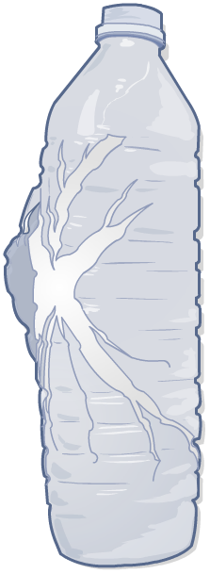
Freeze-thaw weathering investigation
You can see freeze-thaw weathering in action if you put a plastic bottle full of water in the freezer.
What do you think will happen?
The water inside the bottle will expand as it freezes. This will create a lot of pressure in the bottle.
The bottle may crack or burst as the ice tries to expand.
Freezing water can create immense pressure in confined spaces. Can you use this information to explain why water pipes might burst in the winter?
Notes:
Teacher notes
This could be used as a class-wide investigation. Encourage students to create a hypothesis about what they think will happen, before writing a method and carrying out the experiment safely.
This slide covers the Science and Engineering Practice:
Asking Questions and Defining Problems: Ask questions that can be investigated within the scope of the school laboratory, research facilities, or field (e.g., outdoor environment) with available resources and, when appropriate, frame a hypothesis based on a model or theory.

Slide 13
Chemical weathering: rainwater
Natural rainwater is a weak acid because carbon dioxide in the air reacts with water vapor to form carbonic acid.
This weakly acidic rain reacts with minerals in rocks and slowly dissolves them, wearing them away.
Burning fossil fuels produces oxides of sulfur and nitrogen, which make rainwater more acidic. Acid rain reacts quickly with minerals and weathers rocks more rapidly.
These are examples of the role water plays in chemical weathering processes.
Notes:
Teacher notes
For more information on the different types of weathering, please refer to the Weathering presentation.

Slide 14
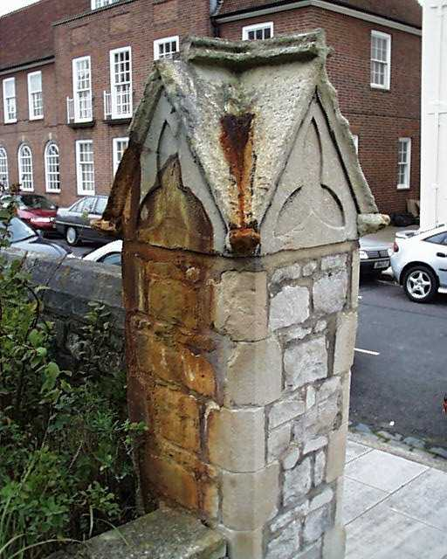
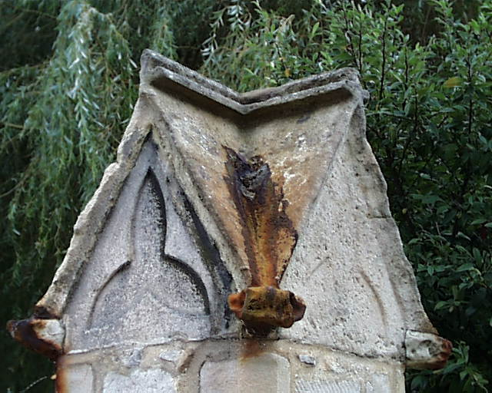
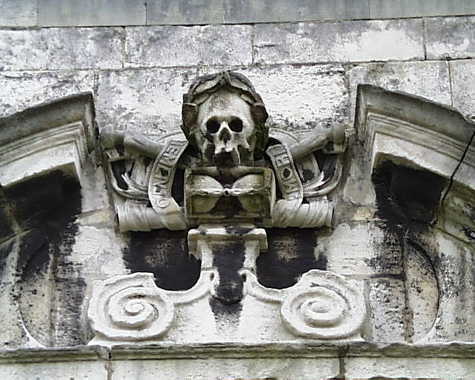
Examples of chemical weathering
How has chemical weathering affected these rocks?
Notes:
This slide covers the Science and Engineering Practice:
Asking Questions and Defining Problems: Ask questions that arise from careful observation of phenomena, or unexpected results, to clarify and/or seek additional information.

Slide 15
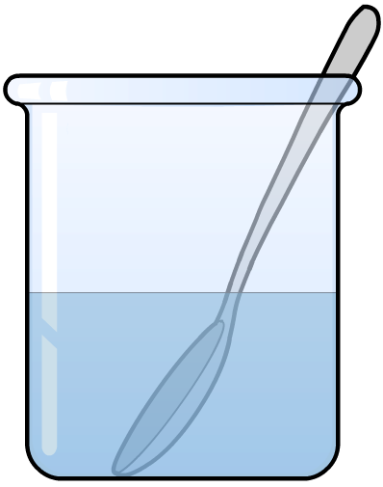
Solubility and dissolving investigation
Sulfur and nitrogen particles dissolve in water to form weak acids that can erode rock when the water vapor falls
as precipitation.
Try testing some of the following solutes to see if they dissolve in water:
salt (pH of 7)
baking soda (pH of 9)
sand (pH of 4.5–6.5).
Are they soluble, insoluble or partially soluble?
Does it make a difference if the water is warm or hot?
Notes:
Teacher notes
Students may need reminding that a pH lower than 7 indicates that a substance is acidic, and a pH higher than 7 indicates that a substance is alkaline, or base. Sulfuric acid in its concentrated form is highly acidic, which means that, even dissolved in small quantities in water, it can erode softer rocks.
As a summary activity, students could be asked to arrange their three beakers in order from most to least acidic. They could test the acidity by using litmus paper.
This slide covers the Science and Engineering Practice:
Planning and Carrying Out Investigations: Plan and conduct an investigation individually and collaboratively to produce data to serve as the basis for evidence, and in the design: decide on types, how much, and accuracy of data needed to produce reliable measurements and consider limitations on the precision of the data (e.g., number of trials, cost, risk, time), and refine the design accordingly.

Slide 16
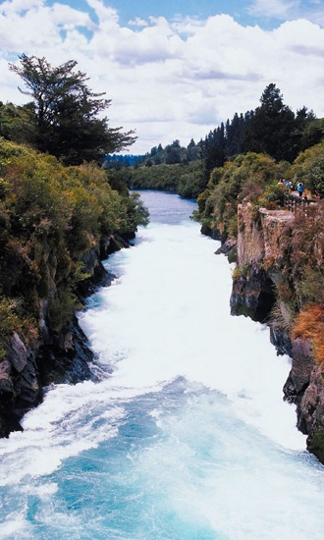
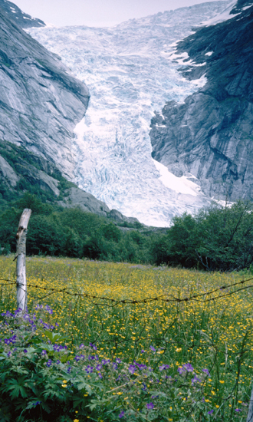
Erosion
As a rock is weathered, pieces of it fall off. This is called erosion. The small pieces of rock are then transported away by liquid water or glaciers.
How are rocks being transported in each of these images?
Are there any ways in which the processes might be similar?
What happens to the rocks as they are being transported?
Notes:
Teacher notes
The transportation process is covered in more detail on the next few slides.
This slide covers the Science and Engineering Practice:
Asking Questions and Defining Problems: Ask questions that arise from careful observation of phenomena, or unexpected results, to clarify and/or seek additional information.
Photo credits: both © Jupiterimages Corporation 2018

Slide 17
Transportation by water
Notes:
This slide covers the Science and Engineering Practices:
Developing and Using Models: Use a model to provide mechanistic accounts of phenomena.
Constructing Explanations and Designing Solutions: Apply scientific ideas, principles, and/or evidence to provide an explanation of phenomena and solve design problems, taking into account possible unanticipated effects.

Slide 18
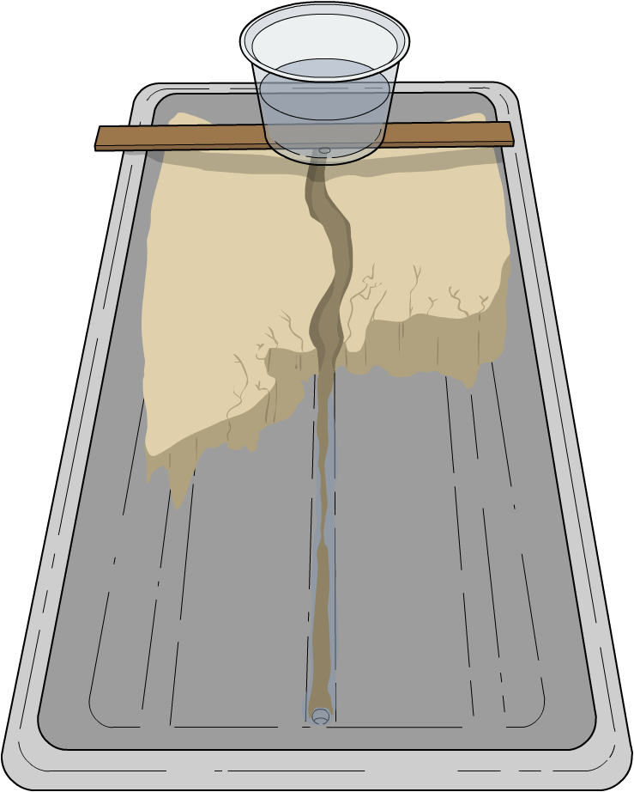
River transportation investigation
You can conduct an investigation into transportation and deposition by using or making your own stream table.
water source
A stream table needs a water source at the top, and a hole at the bottom to allow the water to drain out.
sand
tray
Remember to put a beaker or bucket under the drainage hole to catch the excess water!
drainage hole
Notes:
Teacher notes
This could be used as a whole-class activity or as an extra task for students to complete individually. Encourage students to ask questions such as:
How is sediment deposited?
Which rock particles are transported the farthest and which are deposited first?
How could they describe the water that has drained out of the stream table?
What physical processes are being demonstrated in this model?
This slide covers the Science and Engineering Practice:
Planning and Carrying Out Investigations: Plan and conduct an investigation individually and collaboratively to produce data to serve as the basis for evidence, and in the design: decide on types, how much, and accuracy of data needed to produce reliable measurements and consider limitations on the precision of the data (e.g., number of trials, cost, risk, time), and refine the design accordingly.

Slide 19
Rock changes during transportation
Notes:
This slide covers the Science and Engineering Practices:
Developing and Using Models: Use a model to provide mechanistic accounts of phenomena.
Constructing Explanations and Designing Solutions: Apply scientific ideas, principles, and/or evidence to provide an explanation of phenomena and solve design problems, taking into account possible unanticipated effects.

Slide 20
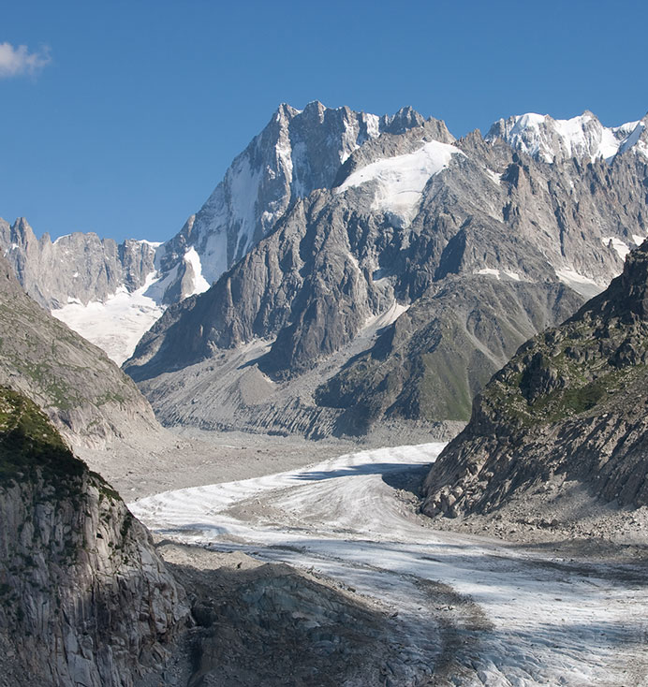
Transportation by glacier
A glacier is a mass of ice that gradually moves over land.
As the glacier moves, rocks in its path are picked up – or plucked – by the ice at its base. The forward movement of the glacier causes the trapped rocks to rotate, scrape and grind along the ground.
This friction weathers the landscape and causes U-shaped valleys and fjords to form.
Over time, the smaller pieces of rock are carried into meltwater streams at the snout of the glacier, where they are deposited.
Notes:
Photo credit: Mer de Glace © Theo Snijder, Shutterstock.com 2018

Slide 21
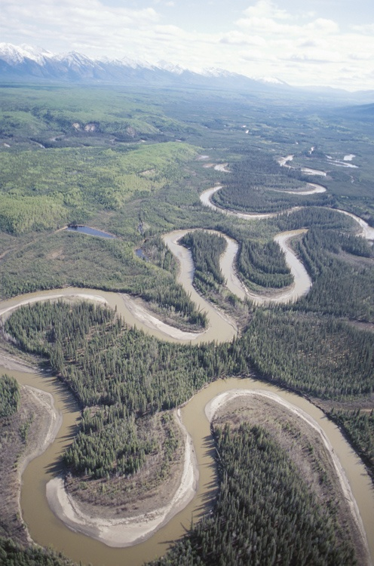
What is deposition?
Deposition occurs after erosion and transportation, when the pieces of rock stop being carried by a river or glacier.
When pieces of weathered rock sink to the bottom of a riverbed or ocean, they form sediment.
Eventually, this sediment gets so squashed down that it forms new rock, called sedimentary rock.
This is one of the key ways in which the water cycle and the rock cycle interact.
Notes:
Photo credit: © Jupiterimages Corporation 2018

Slide 22
How does water affect melting points?
When water molecules mix with other elements or rocks, they are called impurities. Water molecules interfere with the mineral molecules, allowing the mineral to
melt at a lower temperature than usual.
In scientific terms, water lowers the melting point of rock. If a rock has a higher level of water content, its melting point will be lower than the same type of rock with a
lower level of water content.
How might this affect processes within the Earth’s surface?
Why are volcanoes often found along coastlines?
Notes:
Teacher notes
The Earth’s mantle is solid rock, which flows like a liquid over time due to its extremely high temperatures. Volcanoes form along coastlines because ocean water is introduced into the rocks. This is covered in more detail on the next slide.
For more detail about the Earth’s structure and volcanoes, please refer to the Understanding Earth’s Structure and Volcanoes presentations.
This slide covers the Science and Engineering Practice:
Asking Questions and Defining Problems: Ask questions that arise from examining models or a theory, to clarify and/or seek additional information and relationships.

Slide 23
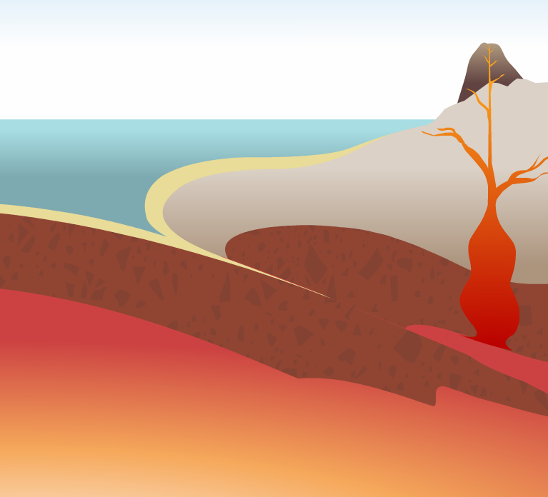
Water and volcanoes
Although the Earth’s mantle flows like a liquid, it is actually a solid. However, the magma that rises to the surface and erupts from volcanoes as lava is a liquid.
At some plate boundaries, dense oceanic plates are subducted underneath lighter continental plates.
Seawater is able to mix with the solid magma underneath, which lowers its melting point. The magma begins to melt, allowing it to rise to the surface in a volcano.
Notes:
Teacher notes
For more information on how oceanic and continental plates interact, please refer to the Plate Tectonics presentation.

Slide 24
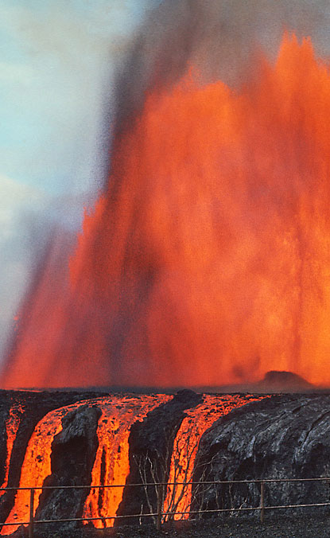
Water and viscosity
Two volcanoes can erupt very different types of lava.
Based on what you learned in the previous slide, can you explain why this might be?
This is because the water content of lava can be high or low. Lava with a low water content is more viscous (thicker), whereas lava with a high water content is more fluid.
Water vapor that has mixed with magma forms pressurized bubbles, much like carbon dioxide in a carbonated soft drink. When the lava reaches the surface, it can froth and spew molten rock.
Notes:
This slide covers the Science and Engineering Practice:
Constructing Explanations and Designing Solutions: Apply scientific ideas, principles, and/or evidence to provide an explanation of phenomena and solve design problems, taking into account possible unanticipated effects.
Photo credit: Mauna Ulu 1969 eruption (Hawaii) image is in the public domain because it is a work of the USGS.

Slide 25
True or false?
Notes:
Teacher notes
This true-or-false activity could be used as a review, or at the start of class to gauge students’ existing knowledge of the subject matter. Colored traffic light cards (red = false, yellow = don’t know, green = true) could be used to make this a whole-class exercise.

