Slide 1
Weather

Slide 2
Information
Planning and Carrying Out Investigations
Constructing Explanations and Designing Solutions
4. Systems and System Models
7. Stability and Change

Slide 3
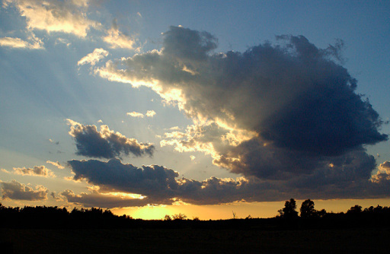
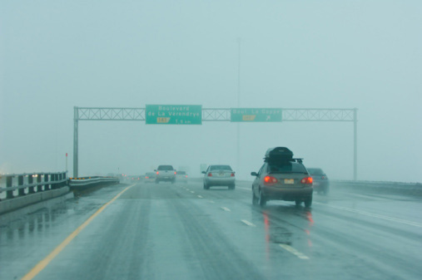
What is weather?
Weather is the state of the atmosphere at any given place at any given time.
Elements of weather include:
Temperature
Wind speed
Precipitation
Cloud cover
Humidity
Wind direction
Air pressure
Notes:
Photo credit: © Jupiterimages Corporation 2018

Slide 4
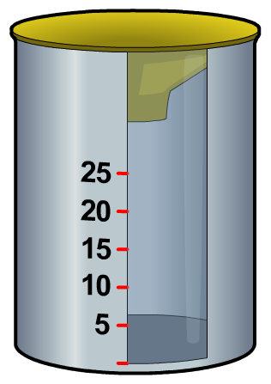
Rainfall
Rain is a type of precipitation.
Precipitation occurs when water vapor in the air cools and condenses into water droplets.
How is rainfall measured?
Rainfall is measured using a rain gauge.
Rainfall is usually measured in millimeters (mm).
Snow, sleet, hail, dew and fog are also types of precipitation.

Slide 5
Make your own rain gauge
Notes:
This slide covers the Science and Engineering Practice:
Planning and Carrying Out Investigations: Select appropriate tools to collect, record, analyze, and evaluate data.

Slide 6
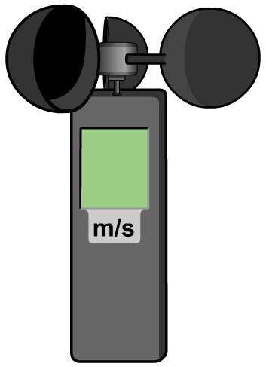
Wind speed
Wind is simply moving air.
Wind speed is a measure of how fast the air is moving.
How is wind speed measured?
Wind speed is measured using an anemometer.
An anemometer has metal cups that rotate in the wind. The stronger the wind, the faster the cups turn.

Slide 7
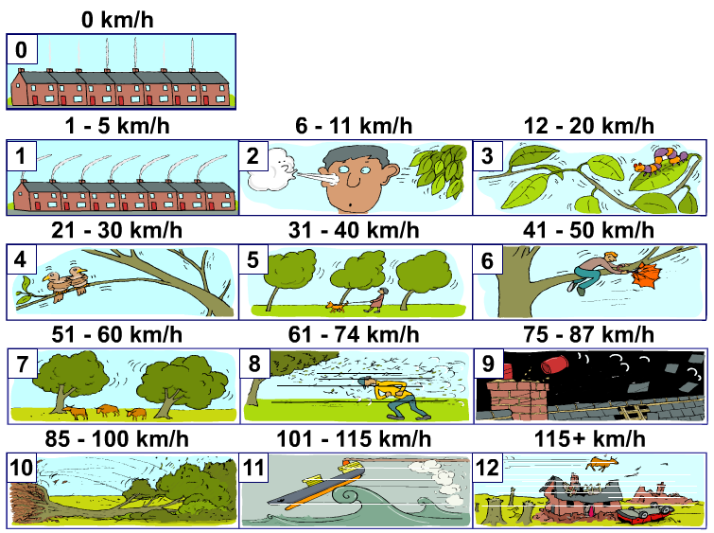
Beaufort scale
How is wind speed estimated without an anemometer?
The Beaufort scale measures wind intensity using the effects of wind to estimate its speed.
It uses a scale from 0 to 12.
0 on the scale means there is no wind.
12 indicates hurricane conditions.
Notes:
Teacher notes
This topic could be extended by asking students to write descriptions of each intensity of wind on the Beaufort scale.

Slide 8
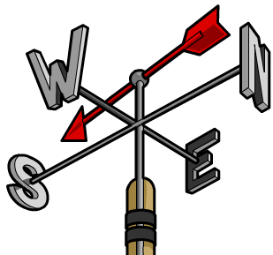
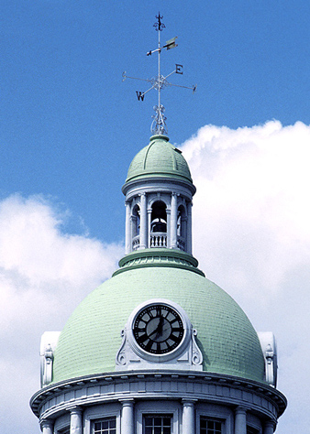
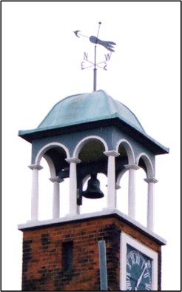
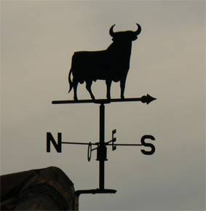
Wind direction
Wind direction can be found using a weather vane. The arrow or pointer turns to point into the wind.
This weather vane is pointing South, so a Southerly wind is blowing.
Can you spot a weather vane in your local area?
Notes:
Photo credits: (from left) © JupiterImages Corporation 2018, © FreeImages.com 2018, © JupiterImages Corporation 2018

Slide 9
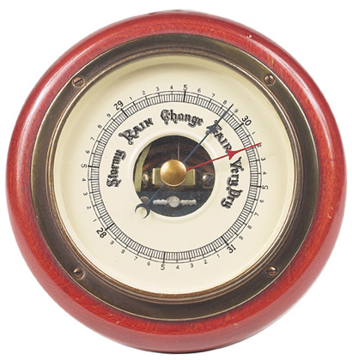
Air pressure
Air pressure is the force exerted on the Earth by the air above.
How is air pressure measured?
Air pressure is measured using a barometer.
Air pressure changes with height.
To see air pressure fall, take your barometer with you as you walk up a hill.
Notes:
Teacher notes
Air pressure usually falls with a gain in altitude because the amount of atmosphere above a point decreases as height increases.
Photo credit: © JupiterImages Corporation 2018

Slide 10
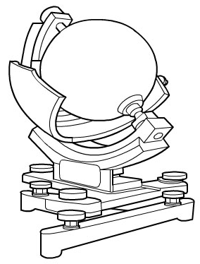
Sunlight
Sunlight is the amount of daylight.
How is sunlight measured?
The duration and intensity of sunlight is measured using a Campbell-Stokes sunshine recorder.
The recorder focuses light from the sun onto a piece of card, where it leaves a burned trace. The longer the sun shines, the longer the line.

Slide 11
Temperature
Temperature is a measure of how warm it is.
The units of temperature are degrees Fahrenheit (°F) or degrees Celsius (°C).
How is temperature measured?
Temperature is measured using a thermometer.
Temperatures are measured in the shade, so the sun’s rays do not heat the instrument being used.
Most thermometers are made so that liquid (mercury or alcohol) in the bulb at the bottom expands as it gets warm and rises up a tube.
Notes:
Photo credit: © FreeImages.com 2018

Slide 12
Weather station instruments
Notes:
This slide covers the Science and Engineering Practice:
Planning and Carrying Out Investigations: Select appropriate tools to collect, record, analyze, and evaluate data.

Slide 13
Virtual weather station
Notes:
Teacher notes
For a detailed explanation of how answers should be entered in the input boxes of this activity please refer to the help text.
The answers for each stage are listed below.
Rain: 0; 5; 20
Temperature (min, max): 2, 12; 3, 8; 5, 7
Wind (speed, direction): 3, west; 9, south; 31, north
Cloud type: cirrus; stratus; cumulonimbus.
This slide covers the Science and Engineering Practice:
Planning and Carrying Out Investigations: Select appropriate tools to collect, record, analyze, and evaluate data.

Slide 14
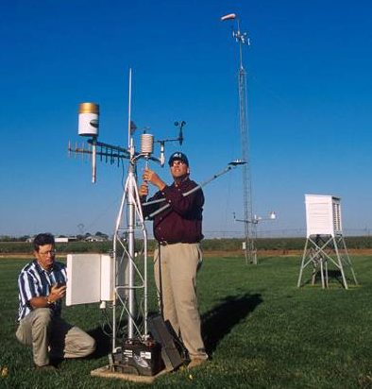
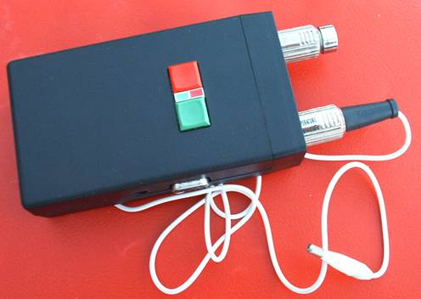
Electronic weather stations and data logging
Most weather conditions can be measured using sensors as well as traditional weather instruments.
Sensors detect weather conditions and produce electronic information that is recorded by a data logger.
Automated weather stations can therefore measure, record and transmit weather data without a human inspecting the instruments.
Electronic weather stations are very useful because they can be located in hard to reach places.
Notes:
Photo credits: measuring weather © Scott Bauer/United State Department of Agriculture, Agricultural Research Service, data logger © FreeImages.com 2018

Slide 15
Weather review
Notes:
Teacher notes
This activity can function as a review of some of the basic weather conditions, or as an introduction to assist in students’ understanding of the factors affecting climate.

Slide 16
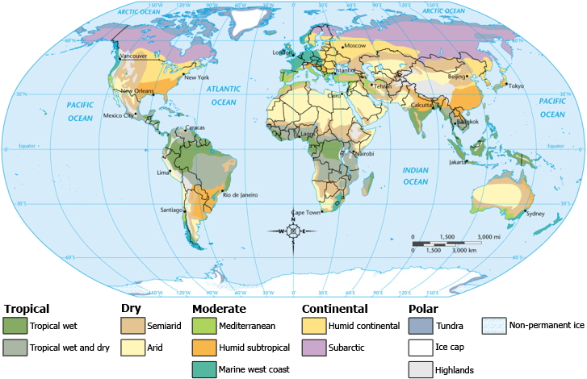
What is climate?
Climate is typically defined as the average weather over a period of 30 years.
Two major indicators of an area’s climate are average temperature and average precipitation.
There are many factors that influence these averages.
By studying these factors, scientists can classify different regions of the world based on climate.
Notes:
Photo credit: This image is reproduced under the terms of the GNU Free Documentation License. A copy of the license can be read at this address: http://commons.wikimedia.org/wiki/Commons:GNU_Free_Documentation_License

Slide 17
Climate graphs

Slide 18
Plot your own climate graph
Notes:
Teacher notes
The following web address will provide students with access to climate graph data for many locations worldwide: https://en.tutiempo.net/
This weblink was working at the time of publication. Boardworks is not responsible for the content of external sites.

Slide 19
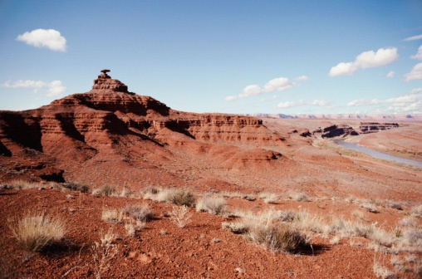
Factors affecting climate
Factors affecting climate include:
latitude
topography
elevation
prevailing winds
nearby water
vegetative cover.
ocean currents
No one factor single-handedly determines the climate of a particular area. Instead, each factor plays an integral part in influencing climate.
Notes:
Photo credit: © Jupiterimages Corporation 2018

Slide 20
Latitude
Latitude measures the distance of a location from the equator. Lines of latitude are imaginary horizontal lines that increase from 0° at the equator to 90° at the poles.
A location’s latitude determines how much solar energy it receives from the Sun. Earth’s angle in relation to the Sun means that regions near the equator receive direct rays from the Sun, resulting in more intense solar energy and higher temperatures.
Regions nearer to the poles receive sunlight at an angle. This results in less intense solar energy and lower temperatures.
Notes:
This slide covers the Science and Engineering Practice:
Constructing Explanations and Designing Solutions: Apply scientific ideas, principles, and/or evidence to provide an explanation of phenomena and solve design problems, taking into account possible unanticipated effects.

Slide 21
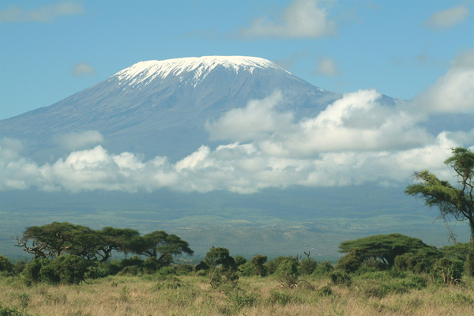
Elevation
Elevation describes the distance of a location from sea level.
As elevation increases, there are fewer air molecules in a given area. This means the air at higher elevations cannot hold as much heat energy, so temperatures are lower.
A good example of this phenomenon is Mount Kilimanjaro in Africa. The base of the 19,340 ft. mountain is covered by rainforests, while the peak is glacial, despite the mountain’s location near the equator.
Notes:
This slide covers the Science and Engineering Practice:
Constructing Explanations and Designing Solutions: Apply scientific ideas, principles, and/or evidence to provide an explanation of phenomena and solve design problems, taking into account possible unanticipated effects.
Photo credit: © Graeme Shannon, Shutterstock.com 2018

Slide 22
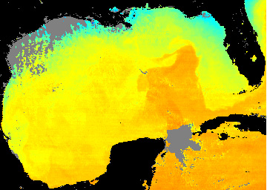
Nearby water
Coastal regions tend to have milder temperatures than areas further inland.
During the summer, large bodies of water act as heat sinks, absorbing some of the Sun’s heat energy.
Deeper, colder water keeps the overall temperature of the water low, cooling the air above it. This cool air then moves ashore, lowering the land temperature.
In winter months, water holds its heat better than land, releasing energy into the air. This warm air heats coastal regions, keeping them warmer than areas further inland.
Notes:
Teacher notes
Along with the oceans, the Great Lakes serve as significant heat sinks for the surrounding land. The Lakes also contribute a great deal of moisture to the air, resulting in humid conditions and snow belts on their downwind shores.
This slide covers the Science and Engineering Practice:
Constructing Explanations and Designing Solutions: Apply scientific ideas, principles, and/or evidence to provide an explanation of phenomena and solve design problems, taking into account possible unanticipated effects.
Photo credit: National Oceanic and Atmospheric Administration
This image represents the surface temperatures in the Gulf of Mexico on January 12, 2000. The turquoise sections closest to the Florida coast represents water of approximately 16 °C (about 61 °F). The yellow sections are about 23 °C and the orange sections are approximately 25 °C.

Slide 23
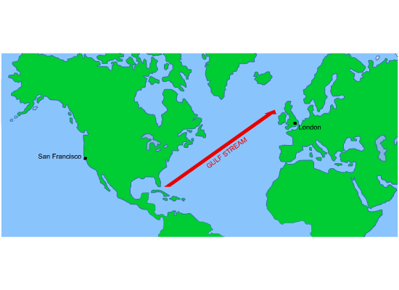
Ocean currents
The movements of ocean currents are another major way that water affects climate.
Ocean currents can move streams of warm or cool water thousands of miles, warming or cooling the air above it.
For example, the Gulf Stream moves warm water from the Gulf of Mexico to the northern Atlantic around Western Europe. This means that the average temperature of London, UK is not much colder than that of San Francisco, CA despite being much farther from the equator.
Notes:
Teacher notes
The direction of ocean currents is determined by factors including wind, the Earth’s rotation, water density and temperature differences.
In some places, wind blows surface water away, resulting in the upwelling of deeper, colder water that then cools surrounding air and land. The occurrence of this phenomenon off the Pacific coast of the U.S. contributes to the moderate average temperatures of San Francisco.
This slide covers the Science and Engineering Practice:
Constructing Explanations and Designing Solutions: Apply scientific ideas, principles, and/or evidence to provide an explanation of phenomena and solve design problems, taking into account possible unanticipated effects.

Slide 24
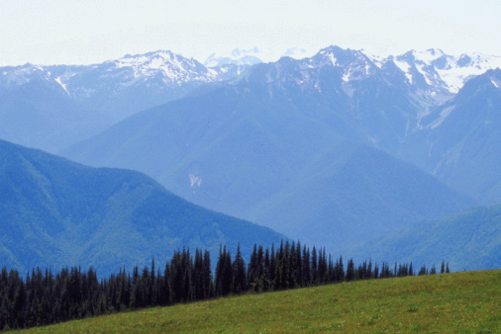
Topography
A region’s topography, or surface features, can impact the amount of precipitation it receives.
As air is blown toward a mountain range, it is forced to rise. The rising air becomes less dense and therefore less able to hold moisture. The moisture condenses and falls in the form of rain or snow.
On the leeward (downwind) side of the mountains, the air descends, becoming more dense and retaining moisture.
This dry area is in the rain shadow of the mountain range.
Notes:
Teacher notes
Students’ understanding of this concept might be improved by the example of the Olympic Mountains in the northwestern United States. West of the Olympic Mountains, Forks, WA receives an annual average rainfall of 120 inches. Fifty miles inland, in the eastern rain shadow of the mountains, Port Angeles, WA receives only about 26 inches of rain per year.
This slide covers the Science and Engineering Practice:
Constructing Explanations and Designing Solutions: Apply scientific ideas, principles, and/or evidence to provide an explanation of phenomena and solve design problems, taking into account possible unanticipated effects.
Photo credit: © Jupiterimages Corporation 2018
Olympic National Park, Washington

Slide 25
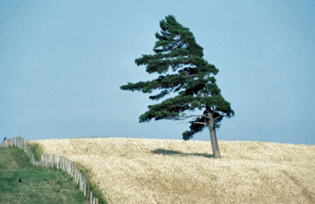
Prevailing winds
Prevailing winds are winds that blow more often from one direction than any other.
Winds that blow inland from the ocean bring moist air to the surrounding land, increasing precipitation, while winds that come from landlocked areas carry drier air.
Therefore, if a region’s prevailing winds come from the ocean, the region will most likely be mild and damp. If a region’s prevailing winds come from a body of land, that region will likely be dry, and might be colder or warmer based on the temperature at the wind’s origin.
Notes:
This slide covers the Science and Engineering Practice:
Constructing Explanations and Designing Solutions: Apply scientific ideas, principles, and/or evidence to provide an explanation of phenomena and solve design problems, taking into account possible unanticipated effects.
Photo credit: © Jupiterimages Corporation 2018

Slide 26
Vegetative cover
Vegetative cover lowers an area’s average temperature by means of evaporative cooling.
The transpiration of water vapor, a natural process of all green plants, cools the surrounding air. High concentrations of vegetation can have a significant overall cooling effect.
This phenomenon has become an important consideration in urban planning. Green roofs and other forms of vegetative cover counter the heating effects of asphalt in large cities.
Notes:
This slide covers the Science and Engineering Practice:
Constructing Explanations and Designing Solutions: Apply scientific ideas, principles, and/or evidence to provide an explanation of phenomena and solve design problems, taking into account possible unanticipated effects.
Photo credit: © Jupiterimages Corporation 2018

Slide 27
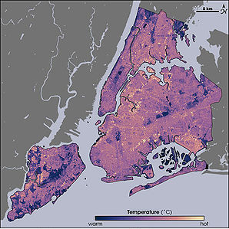
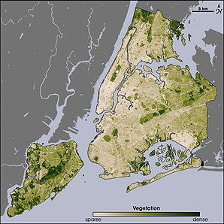
Vegetation and temperature
Look at these two maps of New York City. The map on the left is a thermal map, while the map on the right shows vegetative cover.
Is there a correlation between the two maps?
Notes:
This slide covers the Science and Engineering Practice:
Constructing Explanations and Designing Solutions: Apply scientific reasoning, theory, and/or models to link evidence to the claims to assess the extent to which the reasoning and data support the explanation or conclusion.
Photo credit: This work is in the public domain in the United States because it is a work of the United States Federal Government under the terms of Title 17, Chapter 1, Section 105 of the US Code.
The images show thermal (left) and vegetation (right) maps of New York City. Where vegetation is denser, the temperature is noticeably cooler.

Slide 28
Fill in the blanks

Slide 29
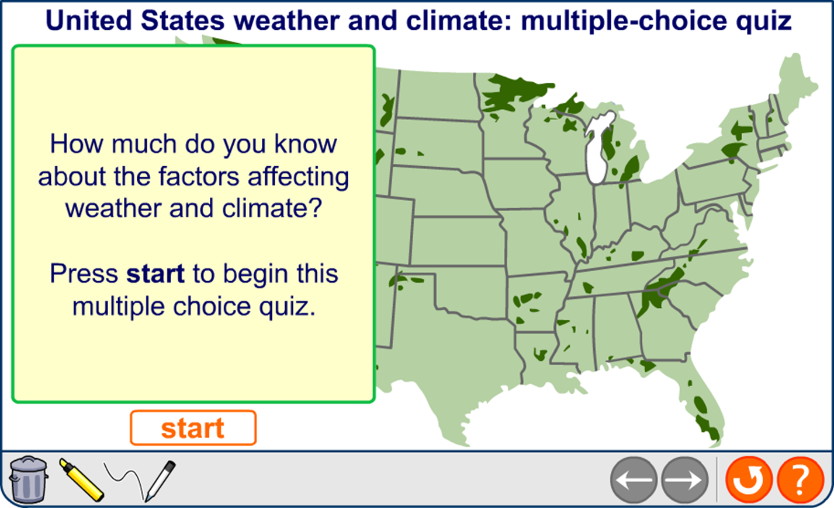
Map quiz
Notes:
Teacher notes
The figures for temperature and precipitation in this activity are based on climate data for 2009, as recorded at http://en.tutiempo.net/.
The low temperature listed for each city is the lowest monthly mean temperature for that city in 2009. The high temperature is the highest monthly mean temperature for that city in 2009.
The average precipitation is calculated as the average amount of precipitation per month for the year 2009.

