Slide 1
Weathering

Slide 2
Information
Constructing Explanations and Designing Solutions
2. Cause and Effect
5. Energy and Matter
7. Stability and Change

Slide 3
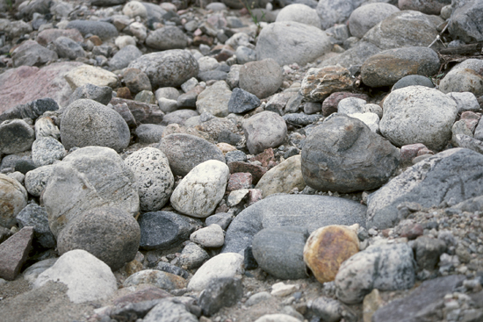
What is weathering?
Rocks are different shapes and sizes because they are changed by the conditions in their environment.
The breakdown of rocks into smaller fragments is called weathering. Eventually, the fragments become soil.
Can you think of anything that could cause weathering?
Rocks can be weathered by temperature change, water, frost and even plants and animals.
Notes:
Photo credit: © Jupiterimages Corporation 2018

Slide 4
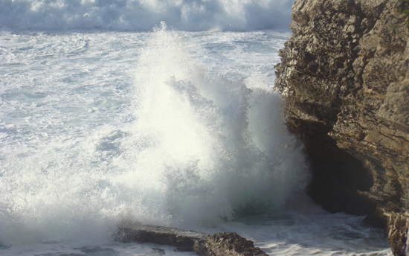
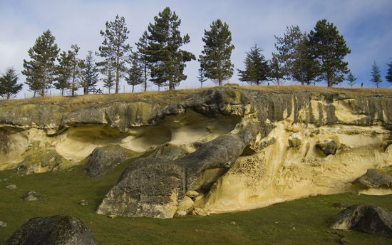
Types of weathering
There are three types of weathering:
physical weathering
biological weathering
chemical weathering.
Which type of weathering is caused by each of these:
temperature change
acid rain
plants and animals?
Notes:
Photo credits: waves © Filipa Allen, acid rain damage © Benjamin Earwicker

Slide 5
Physical weathering
Physical weathering occurs when rock is broken down into smaller pieces by the effects of temperature and water.
Exfoliation weathering (or “onion-skin” weathering) is caused by very hot weather.
Freeze-thaw weathering is caused by the melting and freezing of water.
Exfoliation and freeze-thaw weathering tend to occur in very different types of landscapes.
Which type of weathering do you think will primarily occur in the desert, and which will occur in the mountains?

Slide 6
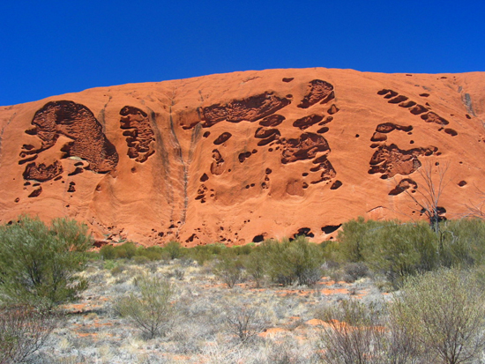
Exfoliation weathering
Exfoliation weathering is common in very hot and dry places like Uluru (Ayers Rock) in Australia.
In these places, the daytime temperature can rise above 40 °C.
While the inner layers of the rocks stay cool, the outer layers of rocks heat up and expand in the baking heat.
At night, when the temperature falls, the outer layers of rocks cool down again and contract. Eventually, the repeated expansion and contraction of the rock causes the outer layers to peel like an onion skin.
Notes:
This slide covers the Science and Engineering Practice:
Constructing Explanations and Designing Solutions: Apply scientific ideas, principles, and/or evidence to provide an explanation of phenomena and solve design problems, taking into account possible unanticipated effects.
Photo credit: © Michel Meynsbrughen

Slide 7
Exfoliation weathering in action
Notes:
This slide covers the Science and Engineering Practice:
Constructing Explanations and Designing Solutions: Apply scientific ideas, principles, and/or evidence to provide an explanation of phenomena and solve design problems, taking into account possible unanticipated effects.

Slide 8
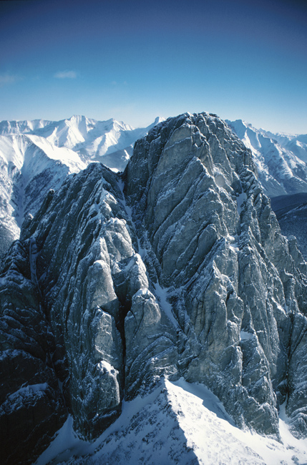
Freeze-thaw weathering
When rain water or melted snow seeps into the cracks in a rock and freezes, it can force the crack to expand.
When the ice thaws, the rock contracts and the water moves deeper into the crack. Later, when the water refreezes, the crack widens again.
Over time, the crack widens until the piece of rock breaks apart.
This slow cycle is called freeze-thaw weathering.
Notes:
This slide covers the Science and Engineering Practice:
Constructing Explanations and Designing Solutions: Apply scientific ideas, principles, and/or evidence to provide an explanation of phenomena and solve design problems, taking into account possible unanticipated effects.
Photo credit: © Jupiterimages Corporation 2018

Slide 9
Freeze-thaw weathering in action
Notes:
This slide covers the Science and Engineering Practice:
Constructing Explanations and Designing Solutions: Apply scientific ideas, principles, and/or evidence to provide an explanation of phenomena and solve design problems, taking into account possible unanticipated effects.

Slide 10
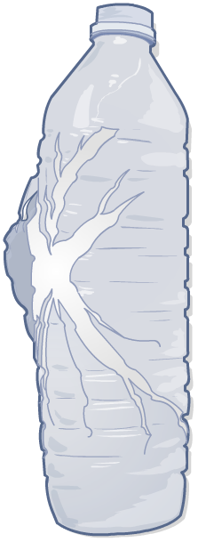
How can freezing water cause damage?
You can see freeze-thaw weathering in action if you leave a bottle full of water in the freezer for too long.
The water inside the bottle expands as it freezes.
The ice that is formed creates pressure within the bottle, which causes it to break!
Because water expands as it freezes it can create immense pressure in confined spaces. Does this explain why water pipes often burst in the winter?
Notes:
This slide covers the Science and Engineering Practice:
Constructing Explanations and Designing Solutions: Apply scientific ideas, principles, and/or evidence to provide an explanation of phenomena and solve design problems, taking into account possible unanticipated effects.

Slide 11
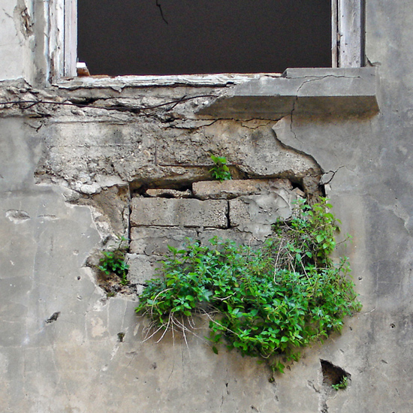
Biological weathering – plants
Have you ever seen plants growing in the cracks of a sidewalk, wall or rock? This happens because plants often use the wind to spread out their seeds.
When a seed falls into a crack it quickly germinates because of the moist and sheltered conditions.
However, as the seedling and its roots grow, they put pressure on the crack, causing it to become deeper and/or wider.
Plants like ivy cause similar damage because they cling to buildings by root systems that penetrate cracks between bricks.
Notes:
This slide covers the Science and Engineering Practice:
Constructing Explanations and Designing Solutions: Apply scientific ideas, principles, and/or evidence to provide an explanation of phenomena and solve design problems, taking into account possible unanticipated effects.
Photo credit: © H. Assaf

Slide 12
Plants and weathering in action
Notes:
This slide covers the Science and Engineering Practice:
Constructing Explanations and Designing Solutions: Apply scientific ideas, principles, and/or evidence to provide an explanation of phenomena and solve design problems, taking into account possible unanticipated effects.

Slide 13
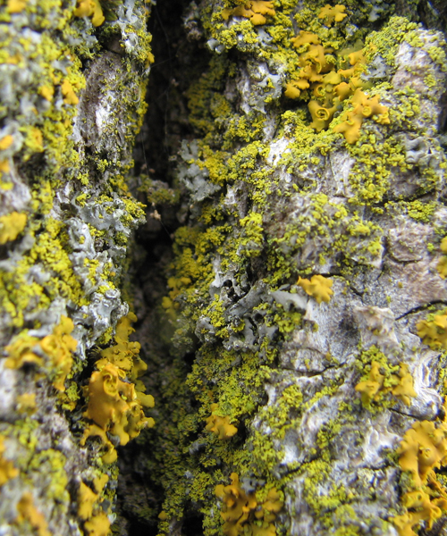
Biological weathering – microorganisms
Lichen are a combination of algae and fungi that live together like a single organism.
Each organism provides resources that the other benefits from. For example, while the fungus provides shelter for the alga, the alga uses sunlight to make energy, which it shares with the fungus.
Lichen slowly break down rocks at the molecular level, using the minerals released from the stone as nutrients.
Notes:
Photo credit: © Bill Ault

Slide 14
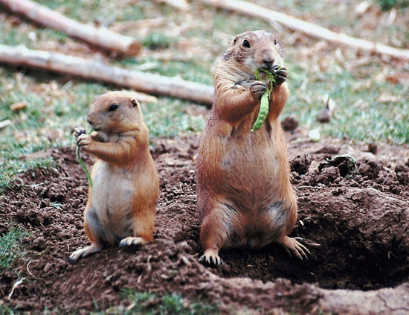
Animals and weathering
Many types of animals, such as rabbits and moles, dig holes to look for food, or to create burrows for shelter.
If an animal digs into a crack in a rock it can cause it to shatter, split and break. The rock is then vulnerable to the freeze-thaw process and weathering by plants.
When an animal burrows, it can also bring buried material to the surface, exposing it to weathering.
Rock can also be weathered by animals scratching it with their hooves or teeth while grazing.
Notes:
This slide covers the Science and Engineering Practice:
Constructing Explanations and Designing Solutions: Apply scientific ideas, principles, and/or evidence to provide an explanation of phenomena and solve design problems, taking into account possible unanticipated effects.
Photo credit: © Jupiterimages Corporation 2018

Slide 15
What is chemical weathering?
Slow chemical weathering
Rainwater is naturally a weak acid because carbon dioxide in the air reacts with rainwater to form carbonic acid.
This weakly acidic rain reacts with minerals in rocks and slowly wears them away.
Rapid chemical weathering
The burning of fossil fuels produces oxides of sulfur and nitrogen, which make rainwater more acidic.
Acid rain reacts quickly with minerals, so the rocks get weathered more rapidly.

Slide 16
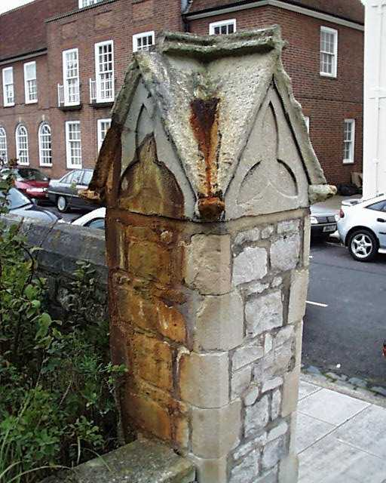
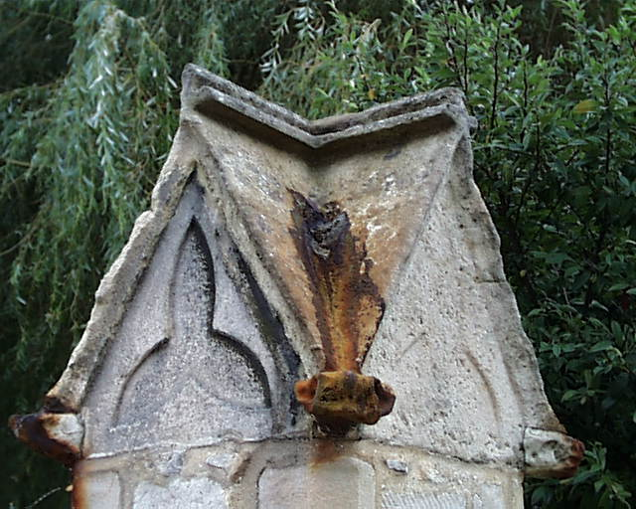
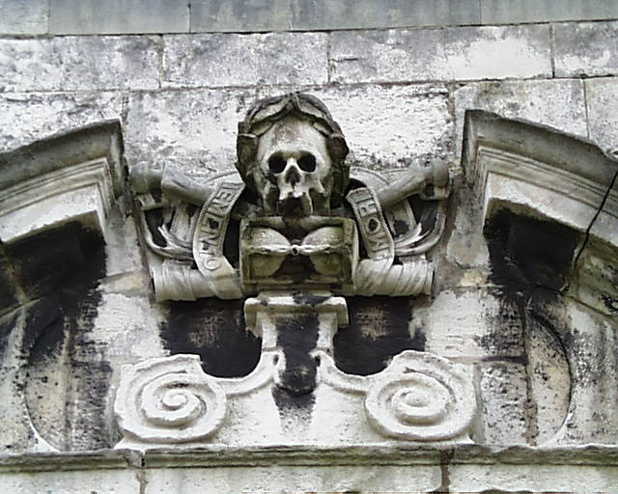
Examples of chemical weathering
How has chemical weathering affected these rocks?

Slide 17
Which type of weathering?

