Slide 1
Adaptations

Slide 2
Information
Constructing Explanations and Designing Solutions
Engaging in Argument from Evidence
Obtaining, Evaluating and Communicating Information
1. Patterns
2. Cause and Effect
6. Structure and Function

Slide 3
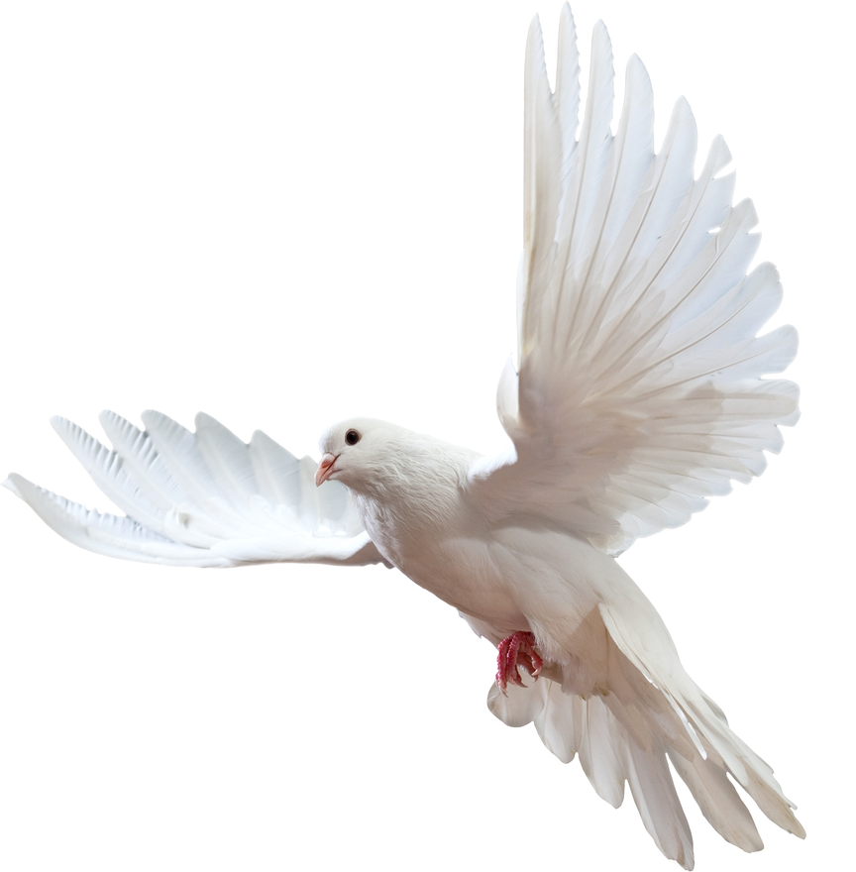
What is adaptation?
All organisms are adapted to life in general, such as having legs for walking, wings for flying or leaves for photosynthesizing.
These are general adaptations.
Organisms also have
specific adaptations.
These are special features or behaviors that have evolved to make an organism particularly suited to its environmental niche.
A niche is the position and role of an organism within its ecosystem. It includes both biotic and abiotic factors.
Notes:
Photo credit: © Tischenko Irina, Shutterstock.com 2018

Slide 4
General and specific adaptations

Slide 5
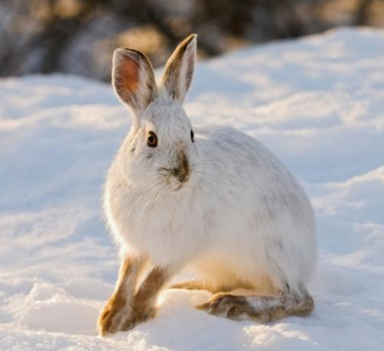
Structural adaptation
Structural adaptation
Some adaptations are physical, such as the shape of a bird’s beak or the size of plant leaves. These are called structural adaptations.
Other structural adaptations include:
fur thickness
body shape
teeth size and shape
internal organization, such as muscle structure.
Notes:
Teacher notes
White snowshoe rabbits show several structural adaptations, including large ears for hearing danger and large feet that allow it to move easily on snow.
Photo credit: © Howard Sandler, Shutterstock.com 2018

Slide 6
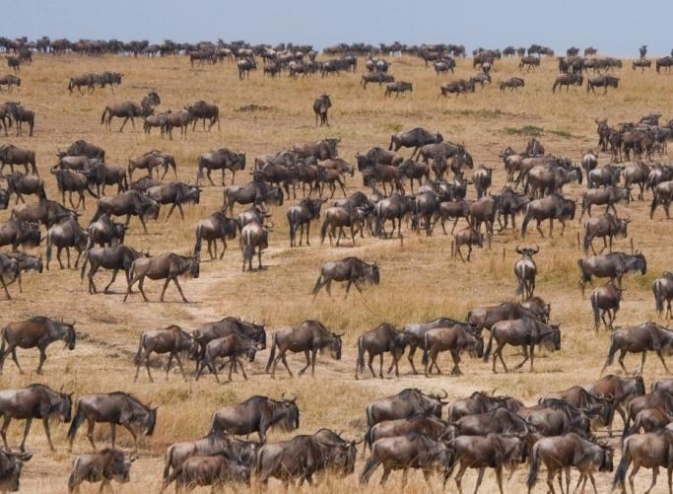
Behavioral adaptation
Behavoral adaptation
Activities that an organism does to help it survive are called behavioral adaptations. These include:
searching for food
during winter, hibernation
the herding of animals in large groups
vocalizations, such as bird calls.
Behavioral adaptations can be learned or inherited.
Inherited behavior is instinctive and genetic. Learned behavior must first be taught, or learned, from experience.
Notes:
Teacher notes
Turtles hatch on the beach, and must find their way to the ocean across the sand. This is an example of an inherited behavioral adaptation. It is not learned, but is inherited from their parents.
Using tools is a behavior that is learned, for example a child learning how to use a knife and fork.
Photo credit: © GUDKOV ANDREY, Shutterstock.com 2018

Slide 7
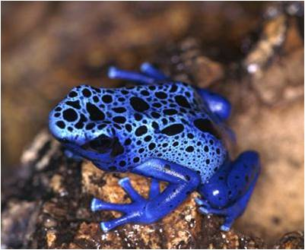
Functional adaptation
Functional adaptation
Adaptations relating to a feature, or a group of features, that allows an organism to perform a specific function are called functional adaptations.
For example, making slime, controlling body temperature and secreting poison.
Certain tropical frogs have poisonous skin that can make predators very ill or even die.
Functional adaptations aid the survival of an individual. They are controlled by genes, so can be passed down from generation to generation.
Notes:
Teacher notes
There are many species of poisonous frogs throughout the rainforests of Central and South America. They are often brightly colored, with red, yellow, pink, blue, green, purple or gold markings, and are usually very small. The bright colors deter predators from trying to attack them.
Photo credit: © Photos.com 2018

Slide 8
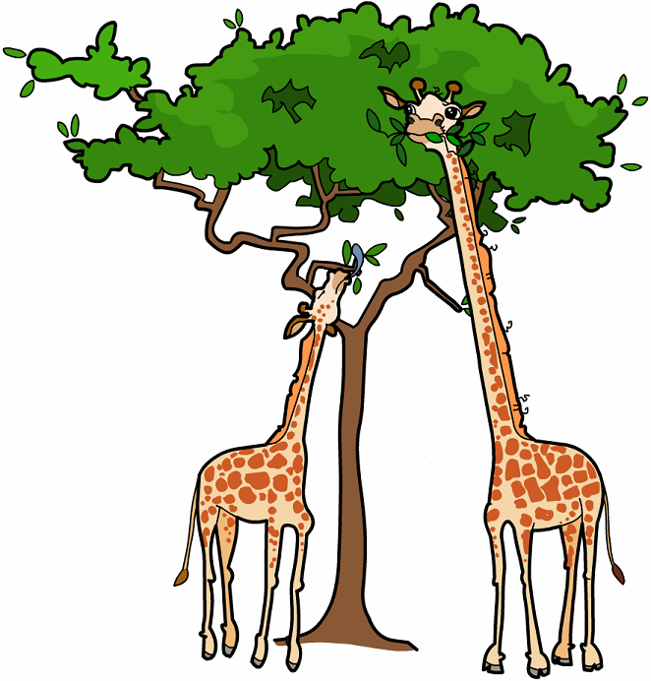
The importance of adaptation
Why is it important that organisms are adapted to their environment?
The better adapted an organism is to its habitat, the more successful it will be when competing for resources such as food and mates.
This increases the organism’s chance of survival, and therefore its chance of reproducing and passing on its genes.
Notes:
Teacher notes
Help students to draw on their understanding of natural selection to answer the question.
This slide covers the Science and Engineering Practices:
Constructing Explanations and Designing Solutions: Apply scientific ideas, principles, and/or evidence to provide an explanation of phenomena and solve design problems, taking into account possible unanticipated effects.
Obtaining, Evaluating, and Communicating Information: Communicate scientific and/or technical information or ideas (e.g. about phenomena and/or the process of development and the design and performance of a proposed process or system) in multiple formats (including orally, graphically, textually, and mathematically).

Slide 9
True or false?
Notes:
Teacher notes
This true-or-false activity could be used as an introductory or summary activity on adaptation, or at the start of the lesson to gauge students’ existing knowledge of the subject matter. Colored traffic light cards (red = false, yellow = don’t know, green = true) could be used to make this a whole-class exercise.

Slide 10
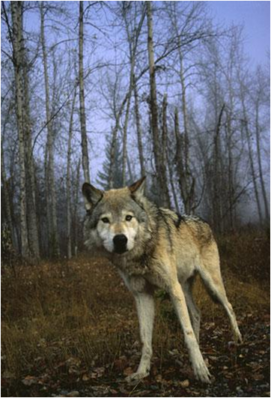
Predator or prey?
A predator is an animal that hunts and kills other animals for food.
Predators can be either:
carnivorous (eat meat only) e.g. wolves
omnivorous (eat meat and vegetation) e.g. humans.
A prey animal is one that is attacked and eaten by a predator. Prey often live in groups for protection.
What adaptations do you think predators and prey will have?
Notes:
Teacher notes
Discuss students’ ideas for the question before showing the examples on the following slides. Encourage students to justify their suggestions.
Prey tend to have eyes positioned to the side of the head (monocular vision) to give a wide field of view. This contrasts to predators who tend to have binocular vision (eyes to the front of the head).
This slide covers the Science and Engineering Practices:
Constructing Explanations and Designing Solutions: Apply scientific ideas, principles, and/or evidence to provide an explanation of phenomena and solve design problems, taking into account possible unanticipated effects.
Obtaining, Evaluating, and Communicating Information: Communicate scientific and/or technical information or ideas (e.g. about phenomena and/or the process of development and the design and performance of a proposed process or system) in multiple formats (including orally, graphically, textually, and mathematically).
Photo credit: © Photos.com 2018

Slide 11
Predator or prey: activity
Notes:
Teacher notes
Appropriately colored voting cards could be used with this classification activity to increase class participation.
This slide is accompanied by the worksheet Adaptations.

Slide 12
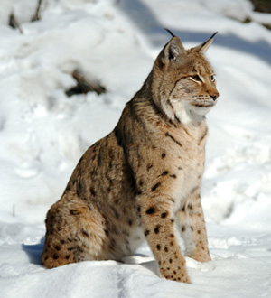
Adaptations of the lynx
How are lynxes adapted for catching snowshoe hares?
warm thick furry coat protects from the cold
Excellent binocular vision for judging distances
very strong hind leg muscles capable of pouncing 6.5 meters!
sharp teeth and claws for puncturing flesh
extra large paws act as snow shoes
Are these structural or behavioral adaptations?
Notes:
Teacher notes
Discuss students’ ideas for the question before showing the labels.
This slide covers the Science and Engineering Practices:
Constructing Explanations and Designing Solutions: Apply scientific ideas, principles, and/or evidence to provide an explanation of phenomena and solve design problems, taking into account possible unanticipated effects.
Engaging in Argument from Evidence: Construct, use, and/or present an oral and written argument or counter-arguments based on data and evidence.
Obtaining, Evaluating, and Communicating Information: Communicate scientific and/or technical information or ideas (e.g. about phenomena and/or the process of development and the design and performance of a proposed process or system) in multiple formats (including orally, graphically, textually, and mathematically).
Photo credit: © Eduard Kyslynskyy, Shutterstock.com 2018

Slide 13
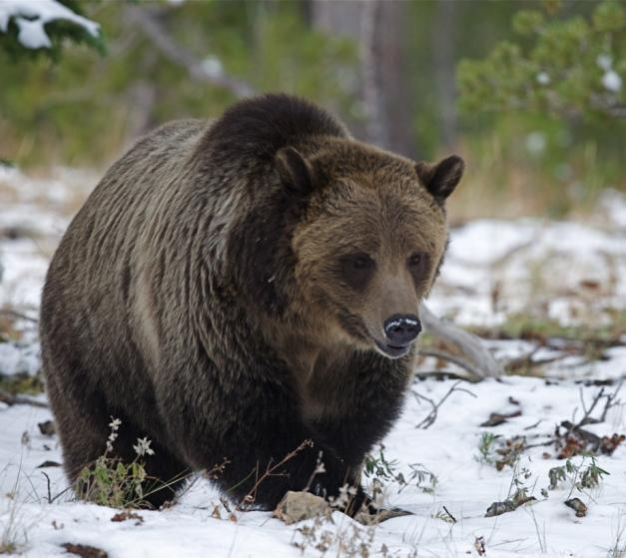
Adaptations of brown bears
Adaptations of the brown bear
How are brown bears adapted to survive in the forests of North America?
Some adaptations include:
thick fur for insulation
strong arms to defend themselves from predators and to dig for food
sharp claws to catch fish
hibernation in winter to survive when food is scarce.
Are these adaptations structural or behavioral?
Notes:
Teacher notes
Discuss students’ ideas for the question before showing the explanations.
This slide covers the Science and Engineering Practices:
Constructing Explanations and Designing Solutions: Apply scientific ideas, principles, and/or evidence to provide an explanation of phenomena and solve design problems, taking into account possible unanticipated effects.
Engaging in Argument from Evidence: Construct, use, and/or present an oral and written argument or counter-arguments based on data and evidence.
Obtaining, Evaluating, and Communicating Information: Communicate scientific and/or technical information or ideas (e.g. about phenomena and/or the process of development and the design and performance of a proposed process or system) in multiple formats (including orally, graphically, textually, and mathematically).
Photo credit: © Tom Reichner, Shutterstock.com 2018

Slide 14
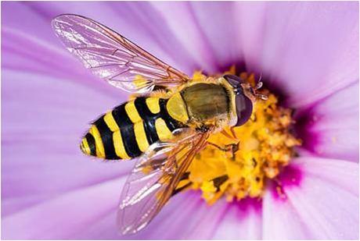
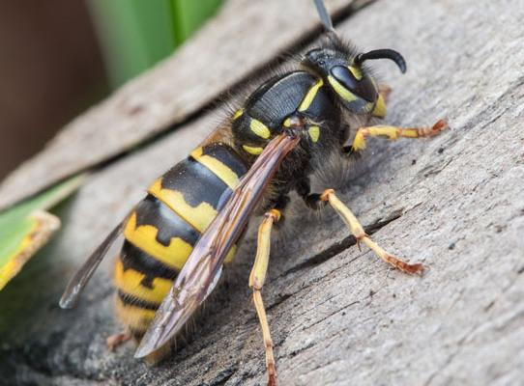
Mimicry
Some harmless organisms have become adapted to look like dangerous species. This is called mimicry.
For example, stingless hoverflies have black and yellow bands on their bodies that resemble those on wasps or bees.
This warns predators to stay away, even though the hoverfly is incapable of stinging.
Notes:
Photo credits: hoverfly (left) © Kseniya Lanzarote, and common wasp (right) © Timin both at Shutterstock.com 2018

Slide 15
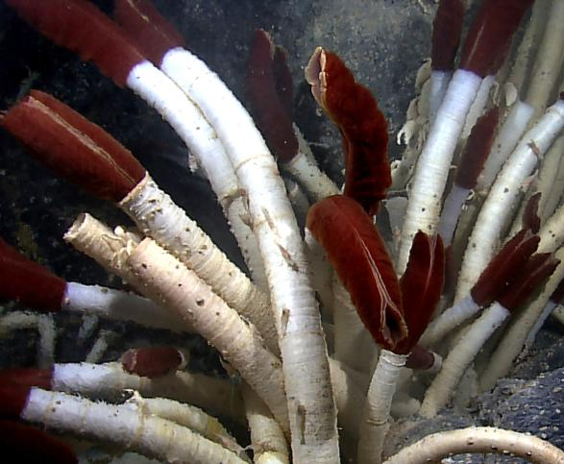
Living on the edge
Some organisms live in extreme environments, e.g. where there are high levels of salt, high or low temperatures or high pressures. These organisms are known as extremophiles.
Deep in the ocean there are hydrothermal vents where heated seawater escapes from cracks in the Earth’s crust. This environment has high temperatures, high pressure and no sunlight.
Some organisms have adapted to survive these extreme conditions. For example, giant tube worms survive by feeding on nutrients produced by bacteria living inside them.
Notes:
Teacher notes
The bacteria convert hydrogen sulfide in the deep sea water into nutrients which they release into the tube worm. The red region seen in the photo is the tube worm’s breathing device. The giant tube worms can grow up to 8 feet long!
Photo credit: giant tubeworms © NOAA Okeanos Explorer Program, Galapagos Rift Expedition licensed under Creative Commons 2.0 2018
A copy of the license can be found here: https://creativecommons.org/licenses/by/2.0/

Slide 16
How is a polar bear adapted?
Notes:
Teacher notes
Encourage students to identify and explain adaptations before showing the explanations. The adaptations to find are:
Fur: greasy to repel water; white to camouflage with snow; thick to insulate from the cold
Body surface: thick layer of fat to insulate from the cold; small body surface area to volume ratio to prevent heat loss
Feet: large and wide to spread the load over the snow; fur on soles for insulation and grip; sharp claws to kill prey and rip meat
Teeth: sharp to kill prey and rip meat
Ears: small to reduce surface area and prevent heat loss
Eyes: on the front of the head to judge distance and speed; brown irises to reduce glare from the sun reflecting off the snow
Legs: strong for running and swimming.
This slide covers the Science and Engineering Practices:
Constructing Explanations and Designing Solutions: Apply scientific ideas, principles, and/or evidence to provide an explanation of phenomena and solve design problems, taking into account possible unanticipated effects.
Engaging in Argument from Evidence: Construct, use, and/or present an oral and written argument or counter-arguments based on data and evidence.
Image credit: © Shaber, Shutterstock.com 2018

Slide 17
Desert environments
Notes:
Teacher notes
The main adaptations of a camel to its desert environment are:
Hump: fat is stored in the hump rather than under the skin, to reduce overheating
Fur: sandy colored for camouflage
Skin: little water is lost through sweating or urination. A camel can tolerate large rises in temperature.
Legs: long, thin legs help to increase body surface area and increase heat loss
Feet: wide feet spread out body weight on shifting sand
Ears: furry ears prevent sand and dust from getting in
Eyelashes: long eyelashes prevent sand and dust from getting in
Nostrils: lined with hair to trap sand and can be closed for protection during sandstorms
Teeth: can cope with a very varied diet, ranging from grass and bark to thorns and bones
This slide covers the Science and Engineering Practices:
Constructing Explanations and Designing Solutions: Apply scientific ideas, principles, and/or evidence to provide an explanation of phenomena and solve design problems, taking into account possible unanticipated effects.
Engaging in Argument from Evidence: Construct, use, and/or present an oral and written argument or counter-arguments based on data and evidence.

Slide 18
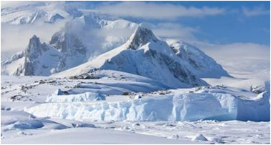
Microorganism adaptations
Microorganisms have a range of adaptations to enable them to live in a variety of conditions.
For example, thermophiles are able to survive at very high temperatures, such as those found in deep sea hydrothermal vents.
Psychrophiles can survive at very low temperatures, such as those in the Arctic.
Other microorganisms are adapted to salty habitats, acidic conditions or environments with very low nutrient levels.
Notes:
Photo credit: © Volodymr Goinyk, Shutterstock.com 2018

Slide 19
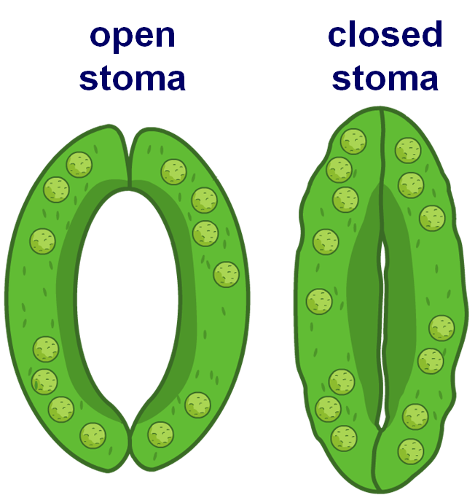
Plant adaptations
Individual plants cannot move to a more suitable environment. It is therefore important they are adapted to the environment in which they live.
The exchange of gases and water with the surroundings can be altered in order for a plant to adapt to changing environments. This is done through guard cells which alter the size of the stomata.
During drought, the stomata remain closed in order to conserve water.
Notes:
Teacher notes
During photosynthesis, the guard cells swell and cause the stomata to open. This allows carbon dioxide to enter and oxygen to leave the leaves of the plant. When the stomata open, water can escape.
For more information about plants and stomata, please refer to the Plant Tissues and Organs presentation.

Slide 20
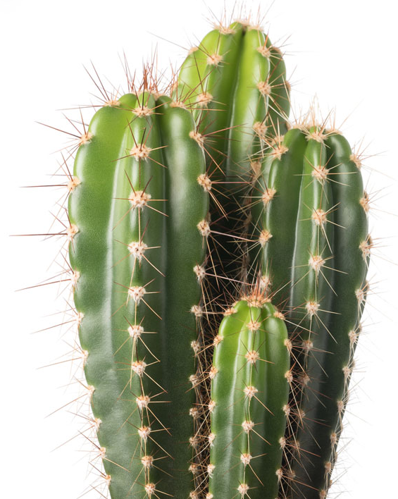
How is a cactus adapted?
How is a cactus adapted to life in a very hot, dry climate?
Water is stored in a fleshy stem, and a thick, waxy cuticle reduces water loss.
Leaves are narrow spines to reduce water loss.
Rounded shape means that the surface area to volume ratio is low, and this reduces water loss.
The stomata open at night to minimize water loss.
Roots are either very deep, or shallow and widespread to catch surface water.
Notes:
Teacher notes
Discuss students’ ideas for the question before showing the explanations. Plants adapted to live in hot desert environments keep their stomata closed during the day to limit water loss and store water in their trunks, stems and leaves.
The spines on a cactus also provide a defense against predators.
This slide covers the Science and Engineering Practices:
Constructing Explanations and Designing Solutions: Apply scientific ideas, principles, and/or evidence to provide an explanation of phenomena and solve design problems, taking into account possible unanticipated effects.
Engaging in Argument from Evidence: Construct, use, and/or present an oral and written argument or counter-arguments based on data and evidence.
Obtaining, Evaluating, and Communicating Information: Communicate scientific and/or technical information or ideas (e.g. about phenomena and/or the process of development and the design and performance of a proposed process or system) in multiple formats (including orally, graphically, textually, and mathematically).
Photo credit: © Scisetti Alfio, Shutterstock.com 2018

Slide 21
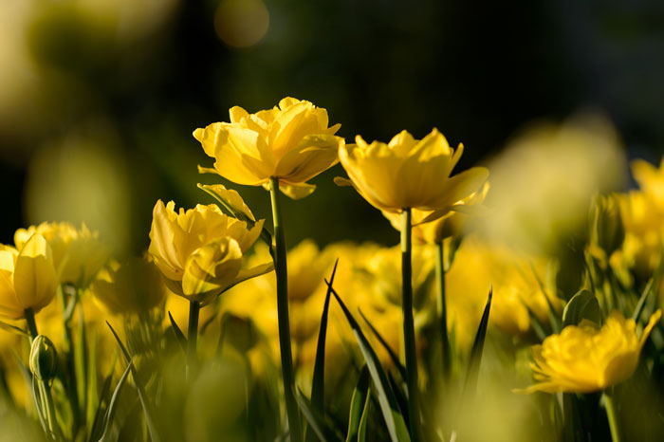
What do flowers do?
Flowers enable plants to reproduce sexually. For this to happen, pollen from the male part of a flower must be carried to the female part of the flower.
This is called pollination.
In what ways can pollination take place?
Pollen can be carried by insects from one flower to another.
Pollen can be blown by the wind from one flower to another.
Notes:
Photo credit: © EvgenySHCH, Shutterstock.com 2018

Slide 22
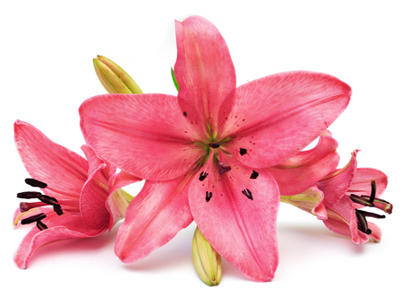
Adaptations for insect pollination
How are flowers adapted for pollination by insects, such as bees and butterflies?
nectar, a source of food for insects, is deep within the flower
large, sticky pollen grains become attached to the insect’s body
stiff anthers and stigmas are positioned where insects must brush past them
colorful, scented petals attract insects
Notes:
Teacher notes
Discuss students’ ideas for the question before showing the labels. The anther is the part of the flower that produces pollen. The stigma is sticky and is the part of the flower to which pollen must attach for pollination to take place.
How bees pollinate flowers:
The color and scent of the petals attract a bee. Many petals also have “guidelines,” sometimes invisible to humans, that guide the bee into the centre of the flower.
Nectar is produced by the petals and used by bees to make honey, an energy-rich food source.
The nectar is located deep within the flower, so the bee must brush past the anthers and stigma.
As the bees brushed the anthers, large, sticky pollen grains rub off onto the bee’s body.
The bee flies off to another flower to collect more nectar.
As the bees brushes past the stigma, the pollen grains are rubbed off – this is pollination.
This slide covers the Science and Engineering Practices:
Constructing Explanations and Designing Solutions: Apply scientific ideas, principles, and/or evidence to provide an explanation of phenomena and solve design problems, taking into account possible unanticipated effects.
Engaging in Argument from Evidence: Construct, use, and/or present an oral and written argument or counter-arguments based on data and evidence.
Obtaining, Evaluating, and Communicating Information: Communicate scientific and/or technical information or ideas (e.g. about phenomena and/or the process of development and the design and performance of a proposed process or system) in multiple formats (including orally, graphically, textually, and mathematically).
Photo credit: © ultimatule, Shutterstock.com 2018

Slide 23
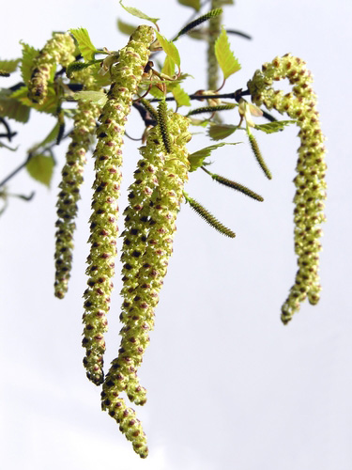
Adaptations for wind pollination
How are flowers adapted for pollination by the wind?
huge numbers of light, tiny pollen grains
small, dull-colored petals
anthers hang loosely outside flower so wind can blow pollen
long, feathery stigma hanging outside flower so pollen can be trapped
Notes:
Teacher notes
Discuss students’ ideas for the question before showing the labels.
This slide covers the Science and Engineering Practices:
Constructing Explanations and Designing Solutions: Apply scientific ideas, principles, and/or evidence to provide an explanation of phenomena and solve design problems, taking into account possible unanticipated effects.
Engaging in Argument from Evidence: Construct, use, and/or present an oral and written argument or counter-arguments based on data and evidence.
Obtaining, Evaluating, and Communicating Information: Communicate scientific and/or technical information or ideas (e.g. about phenomena and/or the process of development and the design and performance of a proposed process or system) in multiple formats (including orally, graphically, textually, and mathematically).
Photo credit: © Brzostowska, Shutterstock.com 2018

Slide 24
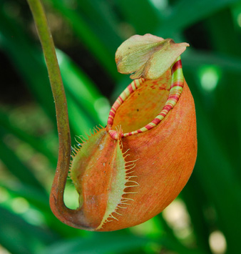
Unusual plant adaptations
Plants can live in acidic or waterlogged soils, where there is little nitrate. Some plants have evolved a rather cunning adaptation to obtain the nutrients they need.
Pitcher plants have large hollow leaves filled with fluid. This traps insects or other small organisms that may fall in.
Hairs on the slippery inside of the plant are angled down to ensure that the victim cannot escape!
The plant digests its victims to absorb the nitrates it needs.
Notes:
Photo credit: © chai kian shin, Shutterstock.com 2018

