Slide 1
Biochemistry

Slide 2
Information
Developing and Using Models
Constructing Explanations and Designing Solutions
1. Patterns
4. Systems and System Models

Slide 3
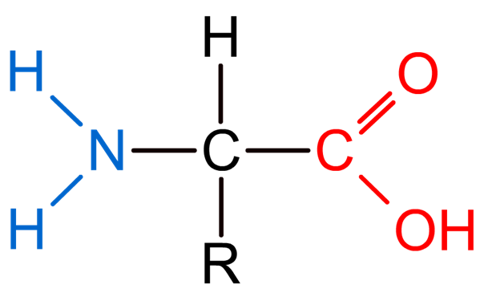
Amino acids
Proteins are a group of large polymer molecules. They are made up of long chains of monomers called amino acids.
There are 20 different types of amino acids that are used to make proteins in organisms.
general structure
All 20 amino acids have the same general structure.
Despite this, the different amino acids have different properties and so behave in different ways.
Notes:
Teacher notes
Other amino acids have been found to exist in other organisms.
For more information about polymers, please refer to the Physical Science: Polymers presentation.

Slide 4
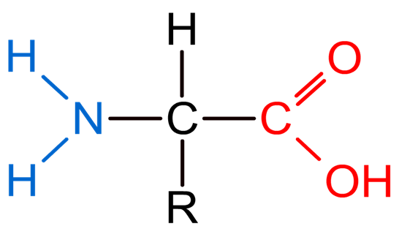
Amino acid structure
All amino acids contain the same two functional groups: an amine group (–NH₂) and a carboxyl group (–COOH). A hydrogen atom is also bound to the central carbon atom of all amino acids.
amino acid
central carbon
amine group
carboxyl group
R group
A third functional group, the R group, is also attached to the central carbon atom. The R group is an atom or group of atoms that is different in each amino acid.
Notes:
Teacher notes
The functional groups determine how the amino acids behave in chemical reactions.
This slide covers the Science and Engineering Practice:
Developing and Using Models: Develop, revise, and/or use a model based on evidence to illustrate and/or predict the relationships between systems or between components of a system.

Slide 5
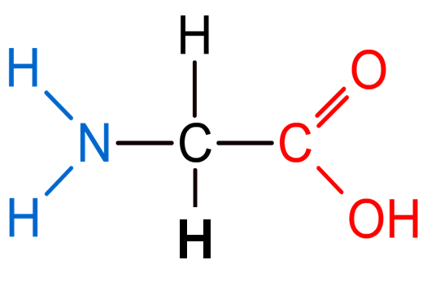
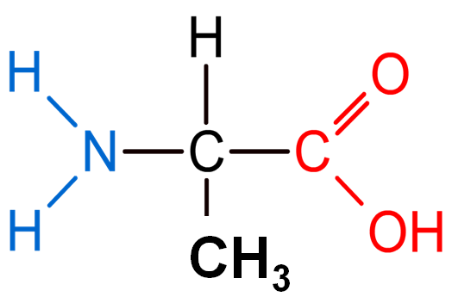
The R group
The R group is an atom or group of atoms that gives amino acids their different properties. For example, the R group can be:
small chains
long chains
positively charged
acidic – have a COOH group
The simplest amino acids are glycine, where R = H, and alanine, where R = CH₃.
glycine
alanine

Slide 6
How do amino acids join together?
Notes:
This slide covers the Science and Engineering Practices:
Developing and Using Models: Develop, revise, and/or use a model based on evidence to illustrate and/or predict the relationships between systems or between components of a system.
Constructing Explanations and Designing Solutions: Apply scientific ideas, principles, and/or evidence to provide an explanation of phenomena and solve design problems, taking into account possible unanticipated effects.

Slide 7
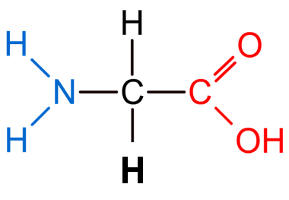
Glycine polymerization
Multiple glycine molecules can polymerize in a condensation reaction to form a polypeptide.
+
+
+ . . .
glycine
glycine
glycine
The polymer formed can be represented by the following structure, where n is the total number of glycine monomers in the polymer.
Notes:
This slide covers the Science and Engineering Practice:
Developing and Using Models: Develop, revise, and/or use a model based on evidence to illustrate and/or predict the relationships between systems or between components of a system.

Slide 8
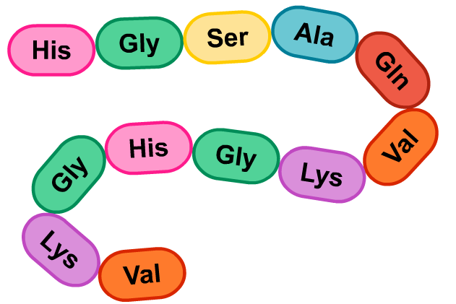
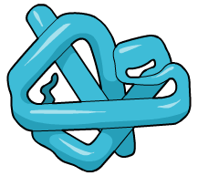
Polypeptides
Different amino acid monomers can join together to form long chains, called polypeptides.
It is the different combinations of amino acids that produces different polypeptides.
The polypeptide chain folds to form the final protein.
Notes:
Teacher notes
Top right image: protein polypeptide chain made up of multiple amino acids joined together via covalent bonds.
Bottom right image: A polypeptide chain folded into the final protein structure.
This slide covers the Science and Engineering Practice:
Developing and Using Models: Develop, revise, and/or use a model based on evidence to illustrate and/or predict the relationships between systems or between components of a system.

Slide 9
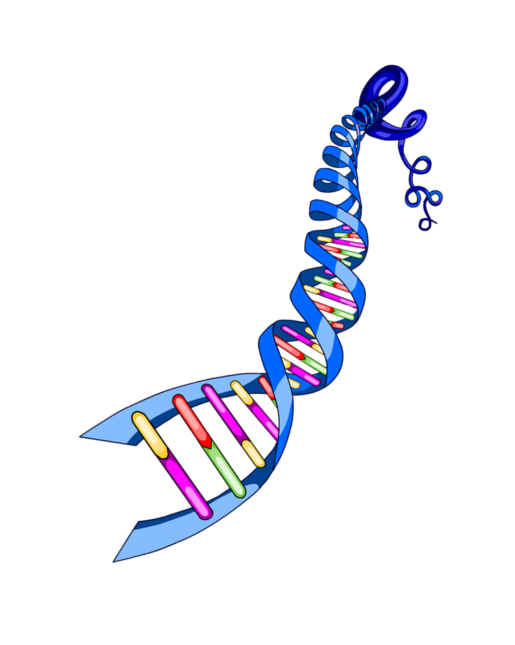
What is DNA?
DNA (deoxyribonucleic acid) is a polymer found in the nucleus of a cell. It is essential for the development and functioning of living organisms and viruses.
DNA encodes the genetic information of all living organisms. It is the DNA that is passed on to new cells and the next generation of organisms.
Because DNA is such a long molecule, it must be coiled into short molecules in the nucleus.

Slide 10
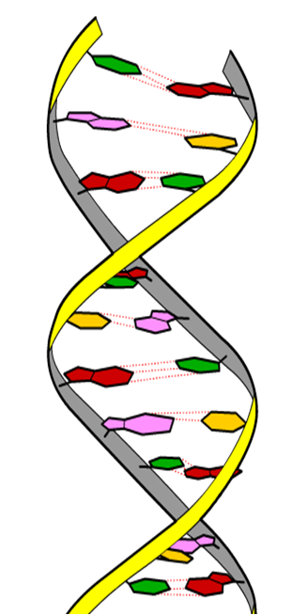
DNA: a polymer of nucleotides
DNA is a polymer made from monomers called nucleotides. Nucleotides are nitrogen-containing substances that can be joined together by covalent bonds.
DNA contains four types of nucleotide bases which polymerize to form the long strands of DNA.
Two strands of nucleotides join together to form a DNA molecule.
The two strands coil around each other to form a double helix structure.

Slide 11
Forming polynucleotides
Nucleotides are the basis of DNA. They can polymerize to form polymers called polynucleotides.
Two nucleotides join in a condensation reaction.
polynucleotide
condensation
nucleotides
+ H₂O
reaction
More nucleotides are added to the chain to form the final strand of DNA.
Notes:
Teacher notes
It is the sequence of nucleotide bases in DNA that determines the order of amino acids in a protein.
This slide covers the Science and Engineering Practice:
Developing and Using Models: Develop, revise, and/or use a model based on evidence to illustrate and/or predict the relationships between systems or between components of a system.

Slide 12
Carbohydrates
Carbohydrates are the most abundant class of biological molecules in living organisms. They consist of carbon, hydrogen and oxygen.
Carbohydrates have three main roles:
energy storage, such as starch in plants, and glycogen in animals
structural support, such as cellulose in plants
components of other biological molecules.

Slide 13
Polymers of sugars
Carbohydrates are polymers made from sugar monomers, such as glucose. Sugars are the most basic carbohydrate.
Two sugar monomers can be joined together by covalent bonds in a condensation reaction.
Multiple sugars can polymerize to form long carbohydrate polymers.
covalent bond
sugar

Slide 14
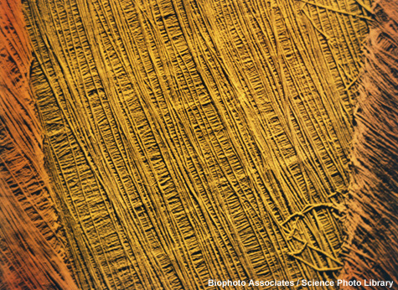
Starch and cellulose
Both starch and cellulose are carbohydrates found in plants.
They are formed from the polymerization of glucose. Despite this, starch and cellulose have very different roles.
Starch is the major energy reserve in plants. It can be converted back into glucose monomers when needed.
Unlike starch, cellulose is very strong. It provides structural support to plant cell walls.
Notes:
Teacher notes
Glucose is the major energy source for plants and is stored as an insoluble form, starch. At night, when light levels are low, photosynthesis will decrease. This results in less glucose production via photosynthesis. The plant therefore uses its starch as a source of glucose.
The glucose chains in cellulose are linear and form rope-like structures, which are layered to form a network. This makes cellulose very strong and allows it to prevent a cell from bursting when it takes in excess water.
Photo credit: © Biophoto Associates/Science Photo Library, 2018
Colored scanning electron micrograph of cellulose microfibrils in a plant cell wall. Cellulose is the main component of a plant cell wall.

