Slide 1
Biodiversity

Slide 2
Information
Constructing Explanations and Designing Solutions
Engaging in Argument from Evidence
Obtaining, Evaluating and Communicating Information
1. Patterns
2. Cause and Effect
7. Stability and Change

Slide 3
What is biodiversity? (1)
Notes:
Teacher notes
Drag the slider to change the level of biodiversity in the scene. Help students to interpret the images shown to come up with a definition for biodiversity. Suitable prompts could include:
What happens to the number of species?
What happens to the quality of the environment?
This slide covers the Science and Engineering Practice:
Engaging in Argument from Evidence: Construct, use, and/or present an oral and written argument or counter-arguments based on data and evidence.

Slide 4
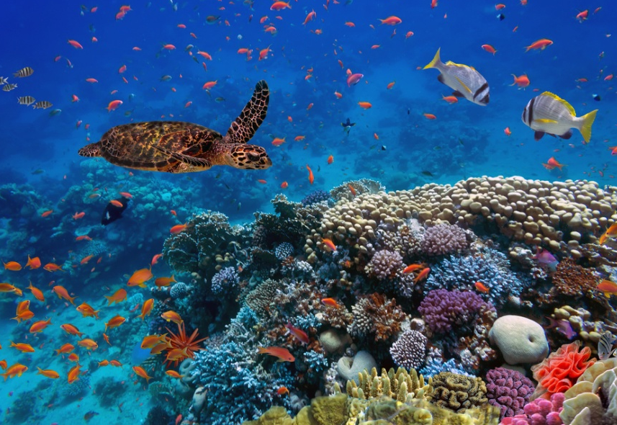
What is biodiversity? (2)
Biodiversity is the variety of all the different species of organisms on Earth, or within an ecosystem.
The greater the number of different species in an ecosystem, the higher its biodiversity.
Tropical rainforests and coral reefs are considered to have the highest biodiversities on earth.
Can you name a type of ecosystem that has a relatively low biodiversity?
Notes:
Teacher notes
Deserts and polar regions have a relatively low biodiversity. You could ask students to suggest why they think this is. They might want to consider environmental conditions needed to support life.
Photo credit: © Vlad61, Shutterstock.com 2018

Slide 5
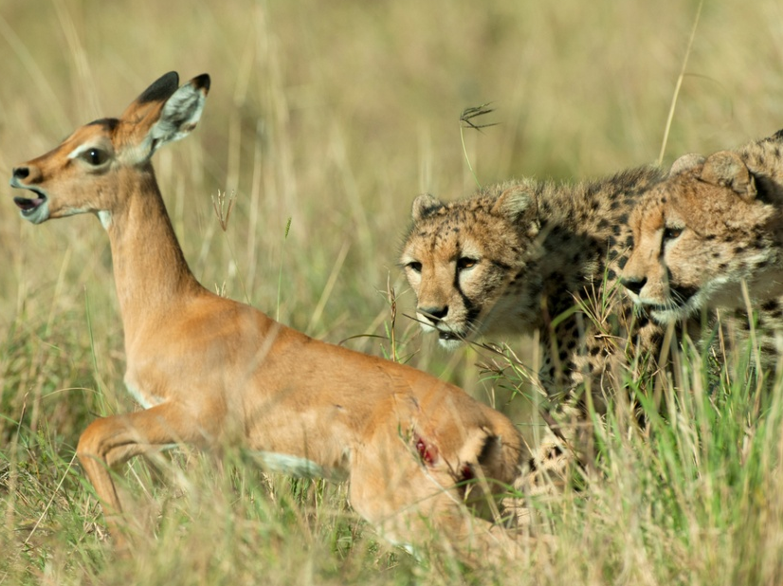
Why is biodiversity important? (1)
Biodiversity is important in maintaining the stability of an ecosystem and protecting it from environmental change.
Different types of species living in an ecosystem interact and rely on one another for resources, including food and shelter. This is known as interdependency.
Food webs contain many species. Each species relies on several others as a source of food.
This means that if one species becomes extinct, those remaining can adapt by eating more of a different species.
Notes:
Teacher notes
Remind students what extinction means; the complete loss of all individuals in a species.
Extinction leads to a reduction in biodiversity.
Photo credit: © Albie Venter, Shutterstock.com 2018

Slide 6
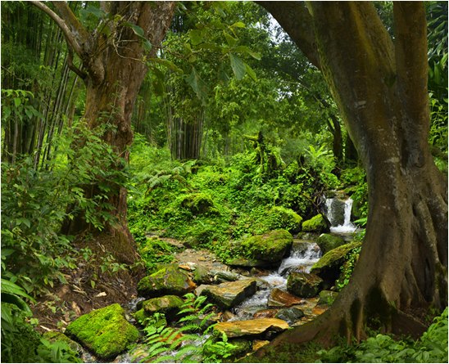
Why is biodiversity important? (2)
Biodiversity also plays an important role in maintaining the physical environment. This includes an ecosystem’s climate, water supply and soil quality.
Nutrient cycles, such as the carbon cycle and nitrogen cycle, rely on the presence of many different species of animals, plants and microorganisms to function effectively.
All living species rely on nutrient cycles for their survival, as they are what ultimately provide organisms with the energy they need for growth.
Notes:
Photo credit: © Quick Shot, Shutterstock.com 2018

Slide 7
Humans and biodiversity (1)
Over the past 200 years the human population has rapidly increased, with 7 billion humans living on Earth today.
The future of the human species on Earth relies on us maintaining a high level of biodiversity.
Just like other species, we depend on ecosystems and the species they contain for resources such as food and shelter.
Can you think of an example of how humans rely on biodiversity?
Notes:
Teacher notes
Discuss students’ ideas for the question. Examples of how humans rely on biodiversity include:
The importance of sea biodiversity for fishing
Diversity in plant species used for food
Diversity in insect species for pollination of crops
The role of species in nutrient cycles and decomposition.
This slide covers the Science and Engineering Practices:
Constructing Explanations and Designing Solutions: Apply scientific ideas, principles, and/or evidence to provide an explanation of phenomena and solve design problems, taking into account possible unanticipated effects.
Obtaining, Evaluating, and Communicating Information: Communicate scientific and/or technical information or ideas (e.g. about phenomena and/or the process of development and the design and performance of a proposed process or system) in multiple formats (including orally, graphically, textually, and mathematically).
Photo credit: © voyata, Shutterstock.com 2018

Slide 8
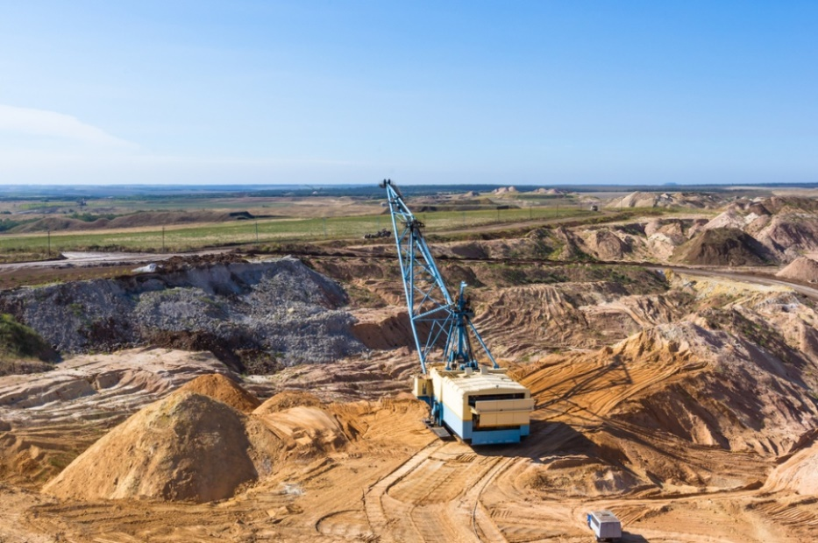
Humans and biodiversity (2)
Many human activities are reducing biodiversity in various ecosystems across the world. Such activities include:
quarrying
farming
building
dumping waste.
It is only recently that measures have been taken to prevent human activity from negatively affecting ecosystems and to restore biodiversity.
What do you think can be done to improve biodiversity?
Notes:
Teacher notes
Discuss students’ ideas for the question, encouraging them to justify their suggestions by linking actions to their expected impacts. Potential ways to increase biodiversity include:
organic farming
recycling to reduce landfill
conservation projects
breeding programs
nature reserves to protect land.
This slide covers the Science and Engineering Practices:
Constructing Explanations and Designing Solutions: Apply scientific ideas, principles, and/or evidence to provide an explanation of phenomena and solve design problems, taking into account possible unanticipated effects.
Obtaining, Evaluating, and Communicating Information: Communicate scientific and/or technical information or ideas (e.g. about phenomena and/or the process of development and the design and performance of a proposed process or system) in multiple formats (including orally, graphically, textually, and mathematically).
Photo credit: © wingedbull, Shutterstock.com 2018

