Slide 1
Biomass Transfers

Slide 2
Information
Developing and Using Models
Using Mathematics and Computational Thinking
Constructing Explanations and Designing Solutions
Engaging in Argument from Evidence
1. Patterns
2. Cause and Effect
3. Scale, Proportion, and Quantity
4. Systems and System Models
5. Energy and Matter

Slide 3
Food chains
A food chain is a sequence that describes the feeding relationships in a group of organisms.
leaf
caterpillar
bird
fox
producer
primary
consumer
secondary
consumer
tertiary
consumer
In a food chain, biomass is transferred from one organism to another in the direction of the arrows.
Notes:
Teacher notes
For more information on food chains, please refer to the Feeding Relationships presentation.

Slide 4
Biomass
Plants and algae produce the biomass in most food chains.
They use photosynthesis to do this.
During photosynthesis, light energy is used to combine molecules from the environment into glucose.
Plants use glucose to build other molecules that make up their cells and tissues.
This living material is known as biomass.
Photosynthetic organisms are the main source of biomass for all life on Earth.
Notes:
Teacher notes
For more information on the production of glucose by photosynthesis, please refer to the Photosynthesis presentation.
Photo credit: © amenic181, Shutterstock.com 2018

Slide 5
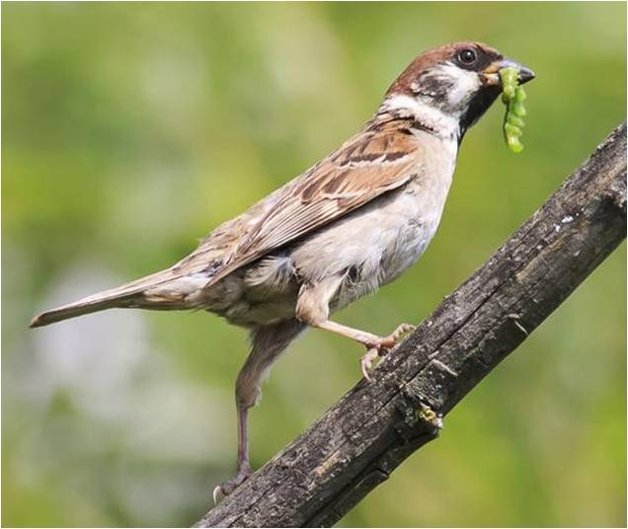
Biomass transfer
When an organism is eaten by a consumer, its biomass is transferred to the consumer.
This means that the matter it is made up of becomes available for the consumer to use.
Biomass is transferred again if the consumer is eaten by another consumer.
Notes:
Photo credit: © Bachkova Natalia, Shutterstock.com 2018

Slide 6
Using biomass
Consumers use transferred biomass to grow and survive.
The transferred biomass is broken down into small molecules that can be used by the consumer.
Some of these are used to make new cells and tissues for the consumer.
Others are broken down further in cellular respiration to release energy for the consumer.
Notes:
Teacher notes
For more information on cellular respiration, please refer to the Cellular Respiration presentation.
Photo credit: © g-stockstudio, Shutterstock.com 2018

Slide 7
Cellular respiration
Cellular respiration
The equation for aerobic cellular respiration is shown below.
carbon
dioxide
glucose
+
oxygen
+
water
(+ energy)
Can you use what you know about respiration and biomass transfer to explain how biomass is being used here?
For consumers, the glucose in this reaction comes from biomass that has been transferred from the previous level in the food chain.
Producers carry out cellular respiration too. They use the glucose they made themselves during photosynthesis.
Notes:
This slide covers the Science and Engineering Practices:
Constructing Explanations and Designing Solutions: Apply scientific ideas, principles, and/or evidence to provide an explanation of phenomena and solve design problems, taking into account possible unanticipated effects.
Engaging in Argument from Evidence: Construct, use, and/or present an oral and written argument or counter-arguments based on data and evidence.

Slide 8
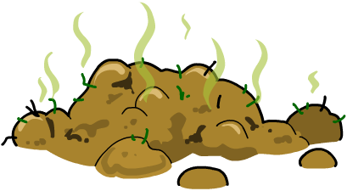
Losing biomass
Only around 10% of biomass is transferred to the next level of a food chain. Can you think of any reasons for this?
Sometimes only parts of an organism are consumed.
Biomass used for cellular respiration cannot be passed to the next level of the food chain.
Only some of the transferred biomass can be absorbed or used by consumers. Waste biomass is excreted.
This means that the amount of available biomass decreases along a food chain.

Slide 9
What happens to the waste?
Notes:
This slide covers the Science and Engineering Practices:
Constructing Explanations and Designing Solutions: Apply scientific ideas, principles, and/or evidence to provide an explanation of phenomena and solve design problems, taking into account possible unanticipated effects.

Slide 10
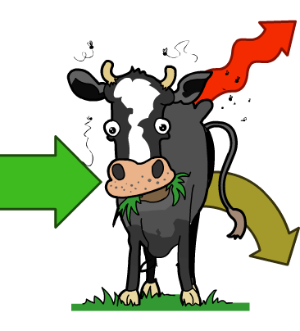
Energy loss in a food chain
Biomass stores energy that originates from the Sun. When biomass is lost from a food chain, so is the stored energy.
heat
Energy is lost during the removal of waste, such as urine and feces, and through heat.
food
In fact, only around 10% of energy is passed on to the next trophic level.
urine and feces

Slide 11
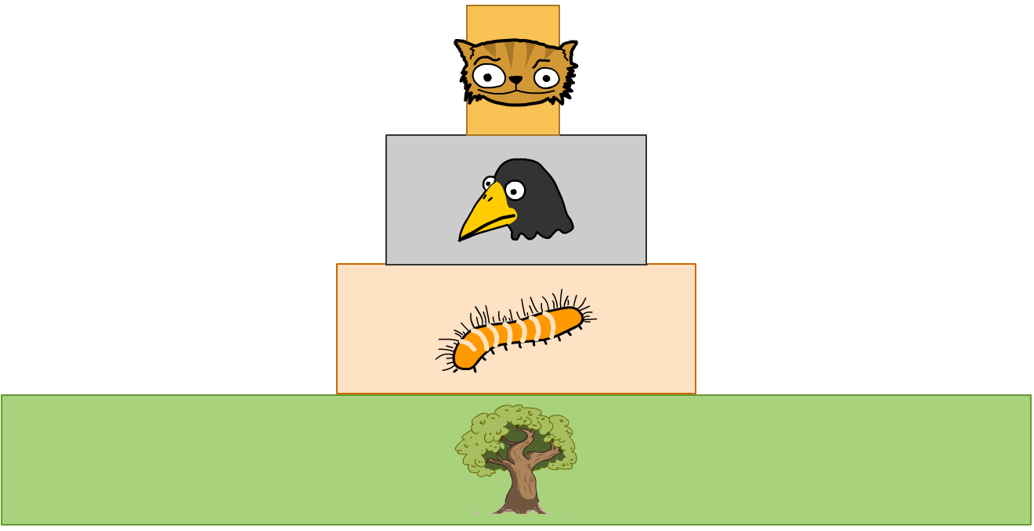
Pyramids of biomass
A pyramid of biomass is a scale drawing of the biomass present at each trophic level in a food chain. The area of a bar represents the amount of biomass in a specific level.
cat
bird
caterpillar
tree
At each trophic level, the amount of biomass and energy available is reduced, giving a pyramid shape.
Notes:
Teacher notes
It should be highlighted to students that each bar in the pyramid of biomass must be labelled with the type of organism at that trophic level.
This slide covers the Science and Engineering Practice:
Developing and Using Models: Develop, revise, and/or use a model based on evidence to illustrate and/or predict the relationships between systems or between components of a system.

Slide 12
Why are pyramids of biomass useful?
Pyramids of biomass are a quantitative way of representing food chains.
They show the biomass of organisms at each trophic level in a food chain – starting at the bottom with producers who form trophic level 1.
Why is measuring biomass more accurate than using the number of organisms at each trophic level?
Pyramids of numbers only give an accurate impression of the flow of energy in a food chain if the organisms are of similar size. A pyramid of biomass is more accurate as it shows the loss of biomass along a food chain.
Notes:
Teacher notes
Discuss students’ ideas for the question shown before moving on to the answer.
This slide covers the Science and Engineering Practice:
Developing and Using Models: Evaluate merits and limitations of two different models of the same proposed tool, process, mechanism, or system in order to select or revise a model that best fits the evidence or design criteria.

Slide 13
The problem with pyramids
Pyramids of biomass are a very simplified way of representing food chains and can be inaccurate.
For example, some animals may belong to more than one trophic level. This cannot be shown properly using a pyramid of biomass.
It is also very difficult to accurately measure biomass. Samples are taken from an ecosystem and dried out. This can raise ethical issues, such as removing endangered species from their habitats.
Notes:
Teacher notes
Humans can be primary, secondary and even tertiary consumers. For example:
When a human eats vegetables they are a primary consumer. Vegetables are plants.
When a human eats beef they are a secondary consumer. Cattle eat grass.
When a human eats tuna they are a tertiary consumer. Tuna eat smaller fish.

Slide 14
Constructing pyramids of biomass
Notes:
Teacher notes
This activity could be used to test understanding of constructing pyramids of biomass. Students must fill in the grid with the correct number of squares in response to the information shown for each question. There are four questions to answer.
This slide covers the Science and Engineering Practices:
Developing and Using Models: Develop, revise, and/or use a model based on evidence to illustrate and/or predict the relationships between systems or between components of a system.
Using Mathematics and Computational Thinking: Use mathematical, computational, and/or algorithmic representations of phenomena or design solutions to describe and/or support claims and/or explanations.

Slide 15
Biomass transfer in a food chain
The amount of biomass available to each trophic level can be shown in a food chain:
grass
cow
tick
10,000 g
500 g
10 g
10,000 g is the amount of biomass available to the cow and 500 g is the amount of biomass available to the tick.
10 g is the amount of biomass that has been used by the tick.

Slide 16
Efficiency of biomass transfer (1)
The efficiency of biomass transfer between two trophic levels can be calculated as a percentage:
For example, what is the efficiency of biomass transfer between the grass and the cow in the following food chain?
grass
cow
tick
10,000 g
500 g
10 g
Notes:
Teacher notes
The producer is the grass. This has a biomass of 10,000 g
The primary consumer is the cow. This has a biomass of 500 g.
The efficiency of biomass transfer between the grass and the cow = (500 g/10,000 g) × 100 = 0.05 × 100 = 5%
This slide is accompanied by the worksheet Biomass Transfers.
This slide covers the Science and Engineering Practices:
Developing and Using Models: Develop, revise, and/or use a model based on evidence to illustrate and/or predict the relationships between systems or between components of a system.
Using Mathematics and Computational Thinking: Use mathematical, computational, and/or algorithmic representations of phenomena or design solutions to describe and/or support claims and/or explanations.

Slide 17
Efficiency of biomass transfer (2)
efficiency of biomass transfer
biomass transferred to next level
=
× 100
biomass available at previous level
grass
cow
tick
10,000 g
500 g
10 g
500 g of biomass has been transferred to the cow for use.
10,000 g is the biomass of grass available to the cow.
Efficiency of biomass transfer = (500 g ÷ 10,000 g) × 100
Efficiency of biomass transfer = 5%
Notes:
This slide covers the Science and Engineering Practices:
Developing and Using Models: Develop, revise, and/or use a model based on evidence to illustrate and/or predict the relationships between systems or between components of a system.
Using Mathematics and Computational Thinking: Use mathematical, computational, and/or algorithmic representations of phenomena or design solutions to describe and/or support claims and/or explanations.

Slide 18
Biomass transfer calculations
Notes:
Teacher notes
This calculation activity could be used as a summary exercise to check students’ ability to calculate biomass efficiency in food chains.
This slide covers the Science and Engineering Practices:
Developing and Using Models: Develop, revise, and/or use a model based on evidence to illustrate and/or predict the relationships between systems or between components of a system.
Using Mathematics and Computational Thinking: Use mathematical, computational, and/or algorithmic representations of phenomena or design solutions to describe and/or support claims and/or explanations.

Slide 19
Efficiency of energy transfer
The efficiency of energy transfer between trophic levels can be calculated using the following equation:
For example, if grass receives 1,000,000 kJ of energy from the Sun and uses 10,000 kJ of energy for growth, then:
10,000 kJ
% efficiency
=
× 100
= 1%
1,000,000 kJ
The grass is 1% efficient at converting the energy it takes in from the Sun into energy it passes on to a consumer.
Notes:
This slide covers the Science and Engineering Practices:
Developing and Using Models: Develop, revise, and/or use a model based on evidence to illustrate and/or predict the relationships between systems or between components of a system.
Using Mathematics and Computational Thinking: Use mathematical, computational, and/or algorithmic representations of phenomena or design solutions to describe and/or support claims and/or explanations.

Slide 20
How many organisms in a trophic level?
The efficiency of biomass and energy transfers between trophic levels is usually very low.
This results in a reduction in the total amount of biomass and energy available to consumers further along the food chain.
This means that the total mass of organisms at each trophic level reduces along the food chain.

Slide 21
Food chains and pyramids
Notes:
Teacher notes
This completing sentences activity provides the opportunity for some informal assessment of students’ understanding of food chains and pyramids.

