Slide 1
Biotechnology

Slide 2
Information
Constructing Explanations and Designing Solutions
Engaging in Argument from Evidence
Obtaining, Evaluating and Communicating Information
2. Cause and Effect
3. Scale, Proportion, and Quantity
6. Structure and Function

Slide 3
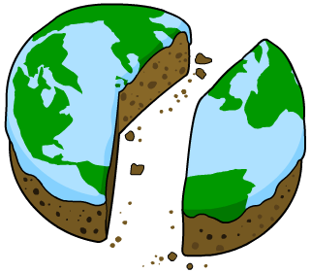
Human population and food availability
The increase in human population is stretching global food availability. With more people to feed, the likelihood of food shortages will increase.
There are currently millions of people who do not receive enough food to meet their nutritional requirements.
This can lead to people suffering from malnutrition and starvation.
Biotechnology is working to meet the increasing demand for food.
Notes:
Teacher notes
With an increasing global population, there is a decrease in land available for crops.

Slide 4
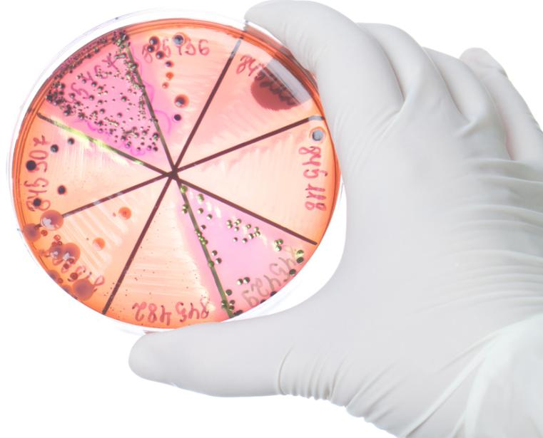
What is biotechnology?
Biotechnology uses biological processes and living organisms to develop and make products for industrial purposes.
It is particularly useful in developing products in the agricultural and medical industries.
Microorganisms with desirable characteristics are used extensively in biotechnology. These include bacteria and fungi.
It is also possible to use specific molecules taken from organisms, such as enzymes.
Notes:
Photo credit: © Alexander Gospodinov, Shutterstock.com 2018

Slide 5
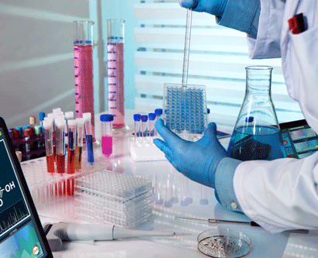
Overcoming the increasing demand for food
Biotechnology is used in the agricultural industry to improve and increase food production.
Different solutions have been put in place so that the agricultural industry can meet the growing human population. These involve:
genetic modification
fertilizers and pest control
biological controls
hydroponics.
Notes:
Photo credit: © angellodeco, Shutterstock.com 2018

Slide 6
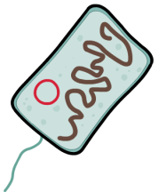
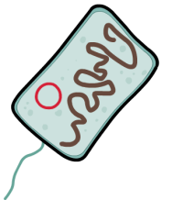
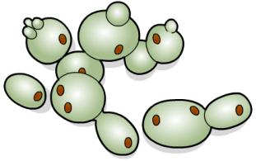
Using microorganisms in food production
Microorganisms are very small living organisms that can be both harmful and useful to humans. Some useful microorganisms can be cultured for food production.
Bacteria are used in the production of yoghurt and cheese.
Fungi include yeast, molds and mushrooms. They are used in the manufacture of bread, alcohol and mycoprotein.
Notes:
Teacher notes
There are other types of microorganisms, including viruses and protozoa.

Slide 7
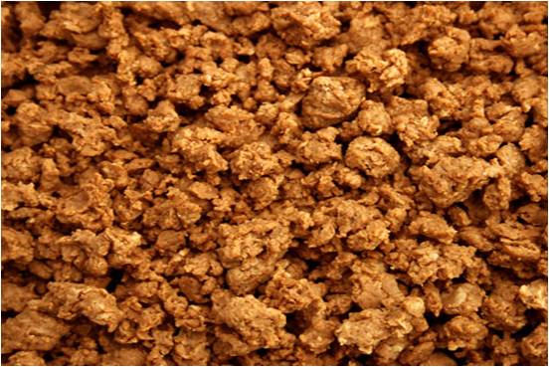
Using fungi to produce mycoprotein
Mycoprotein is a protein-rich food that has been developed as an alternative to meat. It is produced using a fungus called Fusarium.
The fungus is grown in aerobic conditions with a source of carbohydrate for food.
After growth, the biomass is harvested and purified. It can then be flavored and shaped into food products.
Notes:
Teacher notes
In order to inhibit the growth of bacteria, the fungus is grown at a low pH. The equipment is sterilized before use to reduce the risk of contamination.
To grow, the fungus requires oxygen-rich water, a carbon source, such as glucose, and a nitrogen-source, such as ammonia.
Photo credit: © Lestodd, Shutterstock.com 2018

Slide 8
Making mycoprotein
Notes:
Teacher notes
Stage 6: RNA from the fungal cells is destroyed during heating. This is to prevent the RNA from causing humans to develop gout.
Stage 7: A centrifuge is used to remove the excess water. This involves spinning the mixture at a high speed.
This slide covers the Science and Engineering Practice:
Constructing Explanations and Designing Solutions: Apply scientific ideas, principles, and/or evidence to provide an explanation of phenomena and solve design problems, taking into account possible unanticipated effects.

Slide 9
Pros and cons of mycoprotein

Slide 10
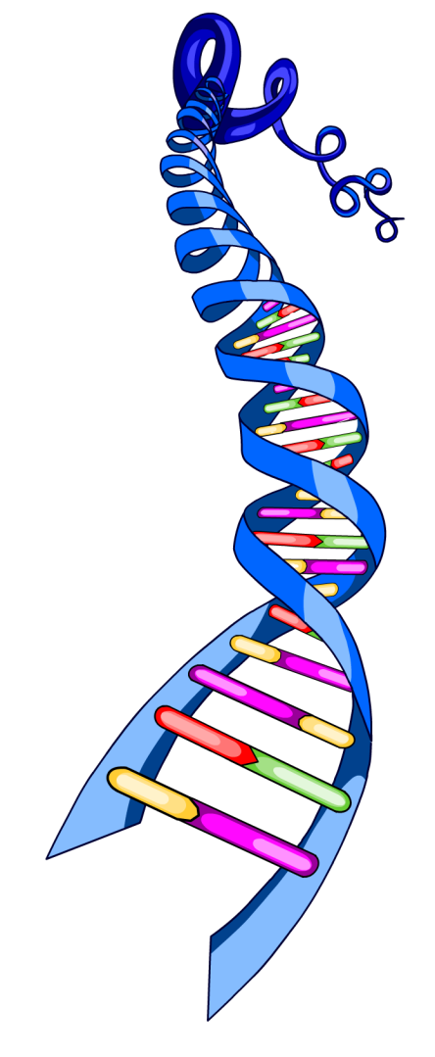
Genetic engineering
It is possible to alter the genes in a living organism to make them produce a desired product. This is called genetic engineering and has been utilized in both the medical and agricultural industries.
Genetic engineering involves transferring selected genes from one organism to another. This results in an organism with an altered characteristic.
The organism is said to have been genetically modified.
Notes:
Teacher notes
For more information about genetic engineering, please refer to the Genetic Engineering presentation.
Photo credit: © stocksolutions, Shutterstock.com 2018

Slide 11
How does genetic engineering work?
Genetic engineering involves four main stages.
​Select the desired product or characteristic.
​Isolate the genes in specialist cells that produce this characteristic.
​Insert the genes into target cells.
​Replicate the modified cells containing the desired gene.
The modified cells can be used to produce large amounts of the desired product.

Slide 12
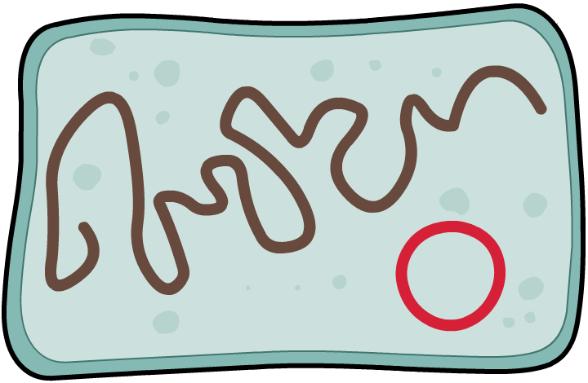
Genetically engineering bacteria
Bacteria are often genetically engineered to produce useful substances. This is because their DNA is loose in the cytoplasm, making it easier to modify.
loose strand of main DNA
plasmid: a small ring of
additional DNA
A new gene can be inserted into the plasmid. This is a ring of additional DNA also free in the cytoplasm. The bacteria can then produce the substance for which the gene codes.
Notes:
Teacher notes
Since bacteria grow and replicate quickly, they can be used to produce large amounts of the desired substance relatively fast.

Slide 13
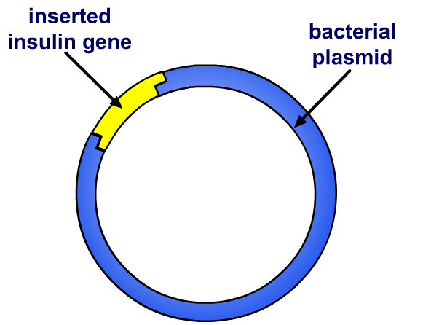
Using bacteria to treat diabetes
Insulin is a hormone needed to control blood glucose levels. People who suffer from type 1 diabetes are unable to produce their own insulin.
This means they must have frequent insulin injections.
Bacteria are genetically engineered to produce large amounts of insulin by inserting the human insulin gene into bacterial plasmids.
The insulin can then be harvested and processed for use in treating people with type 1 diabetes.
Notes:
Teacher notes
For more information about Type 1 diabetes and insulin, please refer to the Glucoregulation presentation.

Slide 14
How can bacteria produce insulin?
Notes:
This slide covers the Science and Engineering Practice:
Constructing Explanations and Designing Solutions: Apply scientific ideas, principles, and/or evidence to provide an explanation of phenomena and solve design problems, taking into account possible unanticipated effects.

Slide 15
Advantages of using bacteria
There are many advantages in genetically engineering bacteria to produce a desired product:
they grow and reproduce rapidly which allows them to produce the desired product on a large scale
they can be grown on waste products from industrial processes
fewer ethical issues are associated with their use compared to plants and animals.
Notes:
Teacher notes
An additional advantage of using bacteria is that they contain circular pieces of DNA called plasmids. Specific genes can be inserted into plasmids, which can then be added to other cells to transfer this gene. In this way, the plasmid can act as a vector.

Slide 16
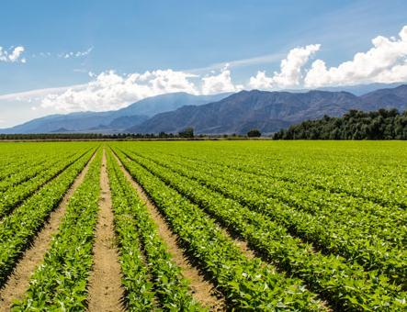
What are GM crops?
Crop plants can be genetically engineered with genes from other organisms to provide them with useful characteristics. They are known as genetically modified (GM) crops.
What characteristics might be useful in crops?
pest resistance
frost/drought resistance
disease resistance
herbicide resistance
addition of nutrients
longer shelf-life.
Notes:
Teacher notes
Several different types of genetically modified crops are currently being grown throughout the world. These include:
herbicide resistant crops
pest resistant crops – these include insect-resistant crops that have been engineered to produce a bacterial toxin that kills a specific pest
disease resistant crops
crops with increased nutritional value – these include Golden Rice.
Photo credit: © veeterzy, Shutterstock.com 2018

Slide 17
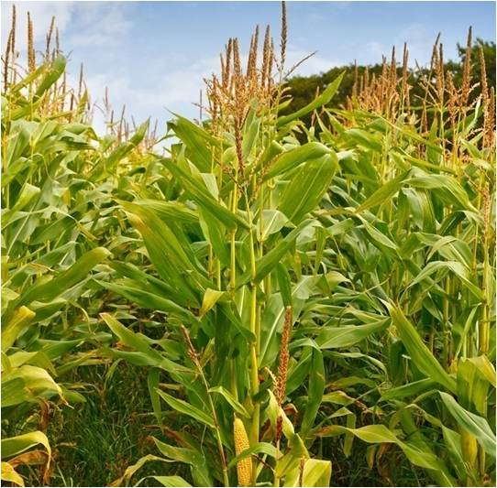
GM crops and food production
Genetically modified crops that are better able to survive adverse conditions will help to increase crop yield.
This could be very useful for increasing food availability to help to feed the world’s growing population.
For example, corn plants have been genetically modified to be drought resistant.
These plants contain a gene from bacteria that helps them resist the effects of drought.
Notes:
Teacher notes
Drought-resistant corn could decrease starvation in countries that are unable to produce enough food due to long periods of drought.
Photo credit: © stocksolutions, Shutterstock.com 2018.

Slide 18
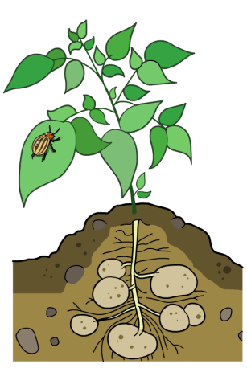
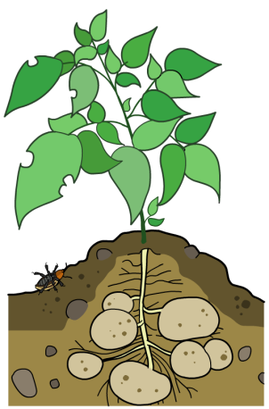
Pest resistant GM crops
Some plants have been genetically modified so they are toxic to pests. These plants are pest resistant.
The bacteria Bacillus thuringiensis produces a protein that is toxic to many insects. The gene for this protein was introduced into crop plants, allowing plants to produce the toxic protein.
The GM plants are pest resistant: if a pest tries to eat the GM plant, it is killed by the toxin.
How might this benefit the environment?
Notes:
Teacher notes
Help students to identify that pest resistant crops do not need to be treated with pesticides. Encourage them to explain the impacts of this, i.e. a reduction in the negative effects of pesticides on the environment, such as reduced biodiversity and pollution of water sources.
Potato plants have been genetically engineered with the Bacillus thuringiensis protein so that they are toxic to the Colorado beetle.
This slide covers the Science and Engineering Practices:
Constructing Explanations and Designing Solutions: Apply scientific ideas, principles, and/or evidence to provide an explanation of phenomena and solve design problems, taking into account possible unanticipated effects.
Obtaining, Evaluating, and Communicating Information: Communicate scientific and/or technical information or ideas (e.g. about phenomena and/or the process of development and the design and performance of a proposed process or system) in multiple formats (including orally, graphically, textually, and mathematically).

Slide 19
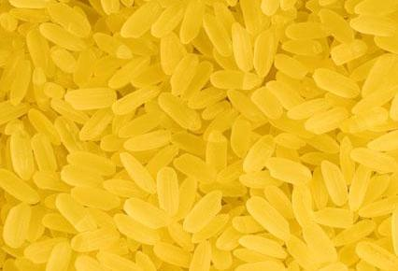
Golden Rice
Rice can be genetically modified to make beta-carotene, a substance that is converted into vitamin A in the body.
This is achieved by transferring the gene from carrots that controls beta-carotene production. The rice is called “Golden Rice” due to its color, which indicates how much beta-carotene it contains.
Golden Rice is being developed to help fight vitamin A deficiency in developing countries.
Notes:
Teacher notes
Vitamin A deficiency can lead to blindness and so growing golden rice in these countries could help prevent this.
Carrots have high levels of beta-carotene, making them a good source for the production of Golden Rice.
Photo credit: © Kirill Kurashov, Shutterstock.com 2018

Slide 20
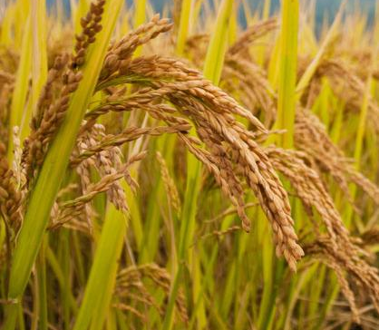
The production of Golden Rice
Rice plants naturally contain the gene for beta-carotene. However, it is not produced in the part of the plant that is eaten (the grain).
The production of beta-carotene relies on the presence of several enzymes. However, not all of the enzymes are naturally available in the grain.
In order to trigger the production of beta-carotene in the grain, scientists inserted two genes from carrots into the rice genome. These provided the missing enzymes in the rice.
Notes:
Teacher notes
The genes taken from carrots are phytoene synthase, extracted from daffodil plants, and crt1 enzyme taken from soil bacteria.
Photo credit: © Lorcel, Shutterstock.com 2018

Slide 21
Issues of genetic engineering
Notes:
Photo credit: © Elena Elisseeva, Shutterstock.com 2018

Slide 22
Advantages of GM organisms
What are some advantages of genetic engineering to produce GM organisms?
Crops with desirable features can be created.
Crop quantity (yield) and quality can be increased to improve food availability.
Decreased environmental impact due to reduced use of pesticides and fertilizers.
GM crops could help reduce starvation and malnutrition in developing countries.
Notes:
Teacher notes
Discuss students’ ideas for the question before revealing the remaining content. They should be able to communicate and potentially extend the ideas discussed on the previous slides.
This slide covers the Science and Engineering Practices:
Engaging in Argument from Evidence: Construct, use, and/or present an oral and written argument or counter-arguments based on data and evidence.
Obtaining, Evaluating, and Communicating Information: Communicate scientific and/or technical information or ideas (e.g. about phenomena and/or the process of development and the design and performance of a proposed process or system) in multiple formats (including orally, graphically, textually, and mathematically).

Slide 23
Should GM crops be allowed?
Notes:
This slide covers the Science and Engineering Practice:
Engaging in Argument from Evidence: Respectfully provide and/or receive critiques on scientific arguments by probing reasoning and evidence and challenging ideas and conclusions, responding thoughtfully to diverse perspectives, and determining what additional information is required to resolve contradictions.

Slide 24
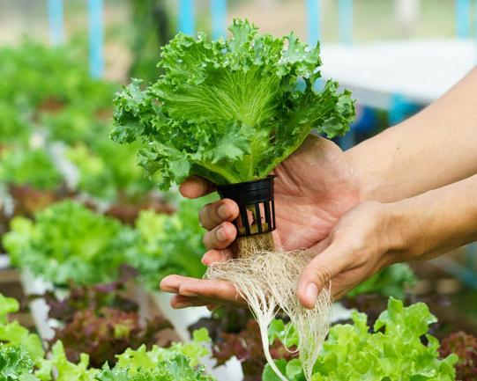
Hydroponics
Another method of increasing crop yield is hydroponics.
Hydroponics involves growing plants in greenhouses without using soil. Instead, they are grown in a mineral solution that is pumped around the roots.
The amount and type of minerals can be adjusted to allow the farmer to control plant growth.
Hydroponics also helps reduce the risk of disease from pests that live in soil.
Notes:
Teacher notes
As the plants are grown indoors, light intensity, temperature and carbon dioxide availability can also be controlled during hydroponics.
Photo credit: © piya Sukchit, Shutterstock.com 2018

Slide 25
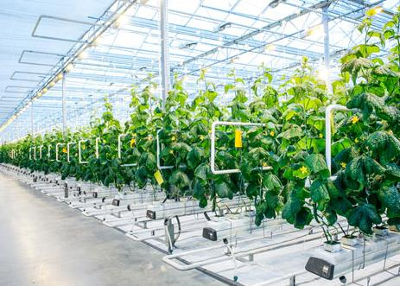
Using hydroponics
Hydroponics allows the growth of plants in areas where it would normally be impossible or impractical.
For example, hydroponic systems could be used in desert regions to grow crops.
This could help increase food production to meet the increasing demands of the growing human population.
However, hydroponic systems are very expensive to run, and not all plants are able to grow using this method.
Notes:
Photo credit: © 279photo Studio, Shutterstock.com 2018

Slide 26
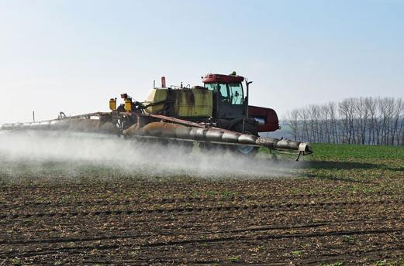
Fertilizers
Fertilizers contain minerals essential for plant growth. They are used to improve the growth rate and quality of plants to increase the crop yield.
Land that is repeatedly used to grow crops can become depleted of nutrients. Fertilizers are used to replace these nutrients.
However, fertilizers can have detrimental effects on the environment.
For example, rain water can wash fertilizers into rivers, leading to eutrophication.
Notes:
Teacher notes
There are different types of fertilizers, including natural and artificial. Natural fertilizers come from organic plant or animal material, such as manure. Artificial fertilizers are made in the laboratory and are normally faster acting than natural fertilizers.
Photo credit: © Meryll, Shutterstock.com 2018

Slide 27
What are pesticides?
Pests are organisms that damage or compete with plants.
The plant must use energy to repair or replace the affected plant tissue. This reduces the energy available for plant growth.
Pesticides can be sprayed on plants to destroy or repel pests. This means plants have more energy available to grow, helping to improve crop yield.
Different types of pests require different types of pesticides.
insecticides
kill insects
herbicides
kill unwanted plants (i.e. weeds)
fungicides
kill fungi (e.g. molds and mildews)
Notes:
Teacher notes
Some pests, such as glasshouse whitefly, have developed resistance to certain pesticides.

Slide 28
How pesticides affect crop yield

Slide 29
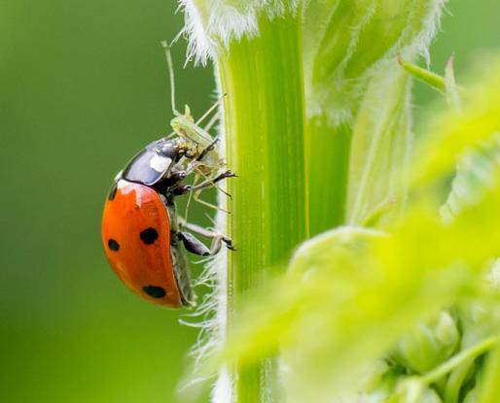
Biological control
An alternative to using pesticides is biological control. This involves the use of living organisms, such as parasites, pathogens and predators, to manage pests.
The biological control is introduced to the environment in which the plant is growing, and will infect or prey on the target pest.
This should result in the death of the pest.
For example, ladybugs are natural predators of aphids, which are pests. They can be bought and released onto aphid infested plants.
Notes:
Photo credit: © Jolanda Aalbers, Shutterstock.com 2018

Slide 30
Pros and cons of using biological controls
What are the advantages of using biological controls?
They can be specific to a particular pest, unlike many pesticides that will also kill beneficial insects and plants.
There is no risk of pests developing resistance.
Biological controls reduce the need to use pesticides.
What are the disadvantages of using biological controls?
Biological controls do not completely remove the pests.
Time is needed for the biological control to breed.
There may be unknown effects on the environment.
Notes:
Teacher notes
Discuss students’ ideas for the questions before revealing the answers. There are other advantages and disadvantages of using biological controls, not discussed here. These include:
Once the control is introduced, it can be left to breed and increase in population. This means time is needed for the control to multiply and so they ideally need to be introduced before pest levels become too high.
Many biological controls require certain conditions in order to survive. The introduction of a new species to an ecosystem may have detrimental effects on the population of other species.
Research is required into different biological controls before they are used. This is an expensive process; however, once the control is introduced, little upkeep is required, which keeps costs low.
This slide covers the Science and Engineering Practices:
Constructing Explanations and Designing Solutions: Apply scientific ideas, principles, and/or evidence to provide an explanation of phenomena and solve design problems, taking into account possible unanticipated effects.
Obtaining, Evaluating, and Communicating Information: Communicate scientific and/or technical information or ideas (e.g. about phenomena and/or the process of development and the design and performance of a proposed process or system) in multiple formats (including orally, graphically, textually, and mathematically).

