Slide 1
Cancer

Slide 2
Information
Constructing Explanations and Designing Solutions
Engaging in Argument from Evidence
Obtaining, Evaluating and Communicating Information
1. Patterns
2. Cause and Effect
6. Structure and Function
7. Stability and Change

Slide 3
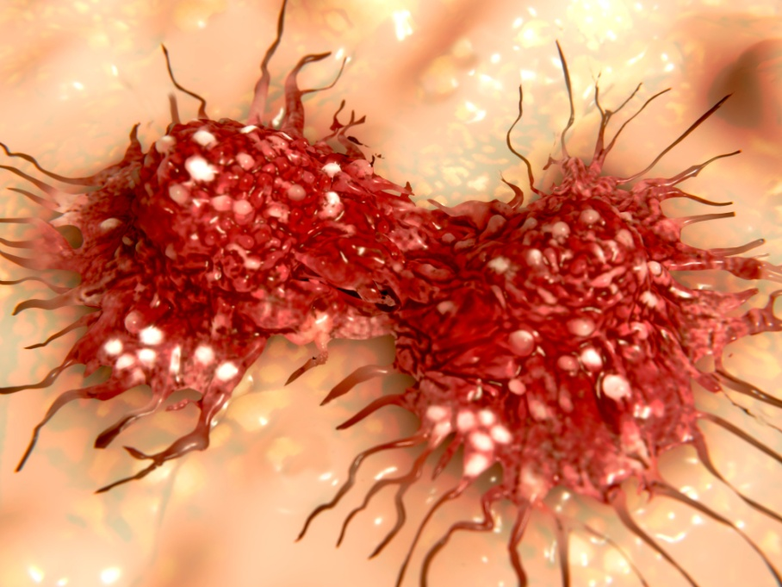
What is cancer?
Cancer is a type of non-communicable disease.
This means it is not infectious and cannot be passed on to other individuals by touch or bodily fluids.
Cancer is the growth of an abnormal mass of cells, which invade healthy parts of the body.
Cancer is caused by changes in the DNA of cells that lead to uncontrolled cell division.
Notes:
Photo credit: dividing cancer cell © Juan Gaertner, Shutterstock.com 2018

Slide 4
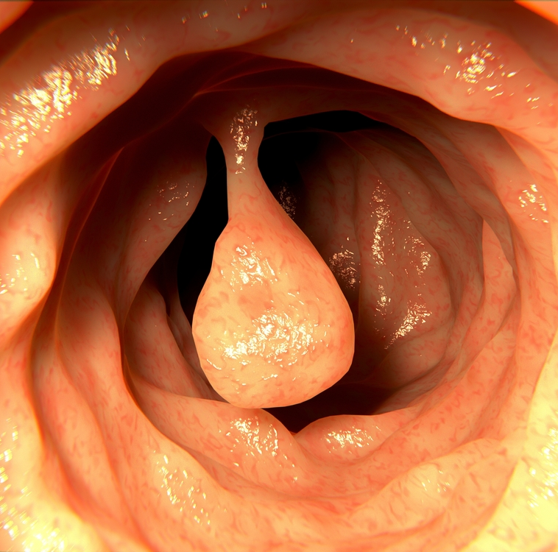
Benign tumors (1)
A mass of cells caused by abnormal cell division is called a tumor.
There are two types of tumor: benign and malignant.
Benign tumors are masses of cells contained in one area of the body.
Benign tumors are not cancerous as they are unable to invade other parts of the body.
Notes:
Photo credit: intestinal polyp © Juan Gaertner, Shutterstock.com 2018

Slide 5
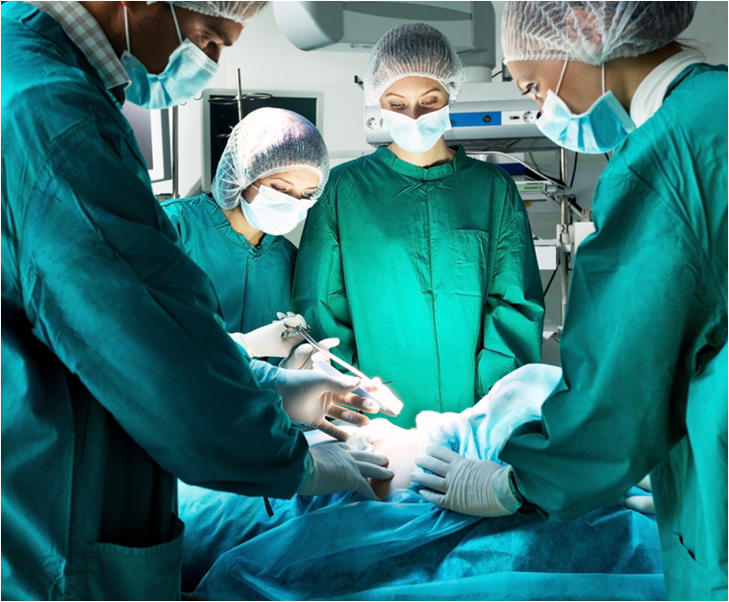
Benign tumors (2)
Benign tumors have the potential to develop into cancers if left untreated.
They can also cause other problems, such as blockages, or squashing other tissues.
The most common method to remove benign tumors is surgery, where the affected tissue is cut away.
Notes:
Photo credit: © Kotin, Shutterstock.com 2018

Slide 6
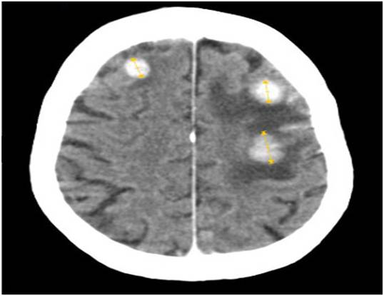
Malignant tumors (1)
Malignant tumors cause cancer. This is because they are able to invade surrounding tissues to form new tumors elsewhere.
The new tumors formed are called secondary tumors.
Malignant tumor cells can break off from the original tumor and travel in the circulatory system or lymphatic system to other parts of the body.
This image shows a CT scan of three brain tumors that have spread from breast cancer tissue.
Notes:
Photo credit: © Jmarchn, https://commons.wikimedia.org/wiki/File:BrainMetastasisFromBreastCancer.jpg
This image is reproduced under the terms of the Creative Commons License. A copy of the license can be read at this address: https://creativecommons.org/licenses/by-sa/3.0/deed.en. Image was cropped from original.

Slide 7
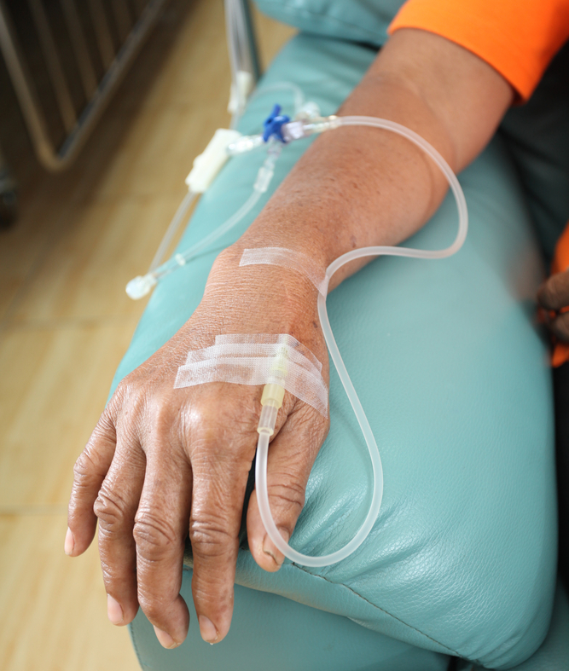
Malignant tumors (2)
Malignant tumors can be treated in a number of different ways depending on the type of cancer, its location and stage.
Surgery is often combined with other treatments.
Some cancers are treated with drugs to kill the fast-growing cancer cells. This is chemotherapy.
Radiation therapy uses ionizing radiation to to kill cancer cells by damaging their DNA.
Notes:
Teacher notes
Chemotherapy targets all fast-growing cells, including hair follicles and bone marrow. This means chemotherapy has a number of side effects, including hair loss and decreased red blood cell production. As a result, chemotherapy can lead to a weakened immune system.
Radiation therapy can be targeted to specific body parts by aiming radiation beams onto the malignant tumor, whilst trying to avoid surrounding healthy tissue. However, radiation is not precise, which means that healthy cells are often damaged during treatment.
Photo credit: © Blue Planet Earth, Shutterstock.com 2018

Slide 8
Benign and malignant tumors

Slide 9
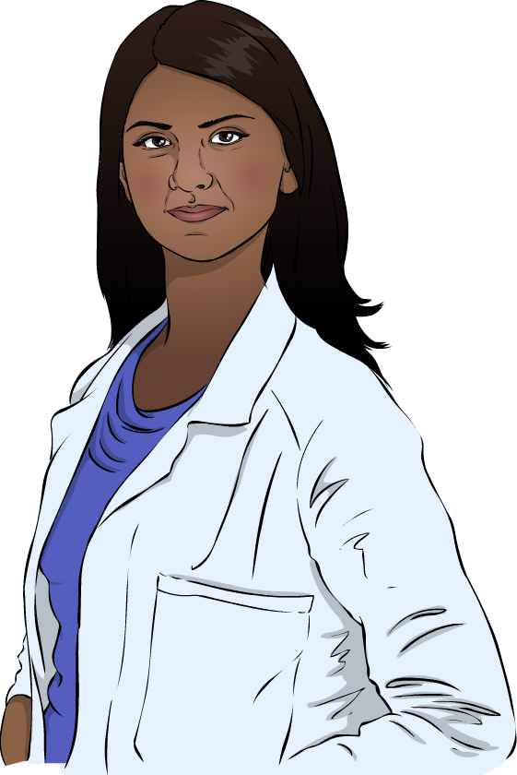
The cell cycle
The cell cycle is an important process in healthy animals and plants, allowing them to grow, and to replace old or damaged tissues.
After one complete cell cycle, one body cell will have divided to produce two body cells.
The process of cell division is called mitosis.
Mitosis and the cell cycle are normally very tightly controlled.
Notes:
Teacher notes
Mitosis and the cell cycle are covered in more detail in the presentation Mitosis and the Cell Cycle.

Slide 10
Mutations
The cell cycle is controlled by genes in an organism’s DNA.
Sometimes, mutations occur in these important genes. A mutation is a change in the DNA of an organism.
Mutations can stop a gene from working as it should.
This can cause control of the cell cycle to break down.
This allows cell division to take place in an uncontrolled manner, leading to abnormal tissue growth known as cancer.

Slide 11
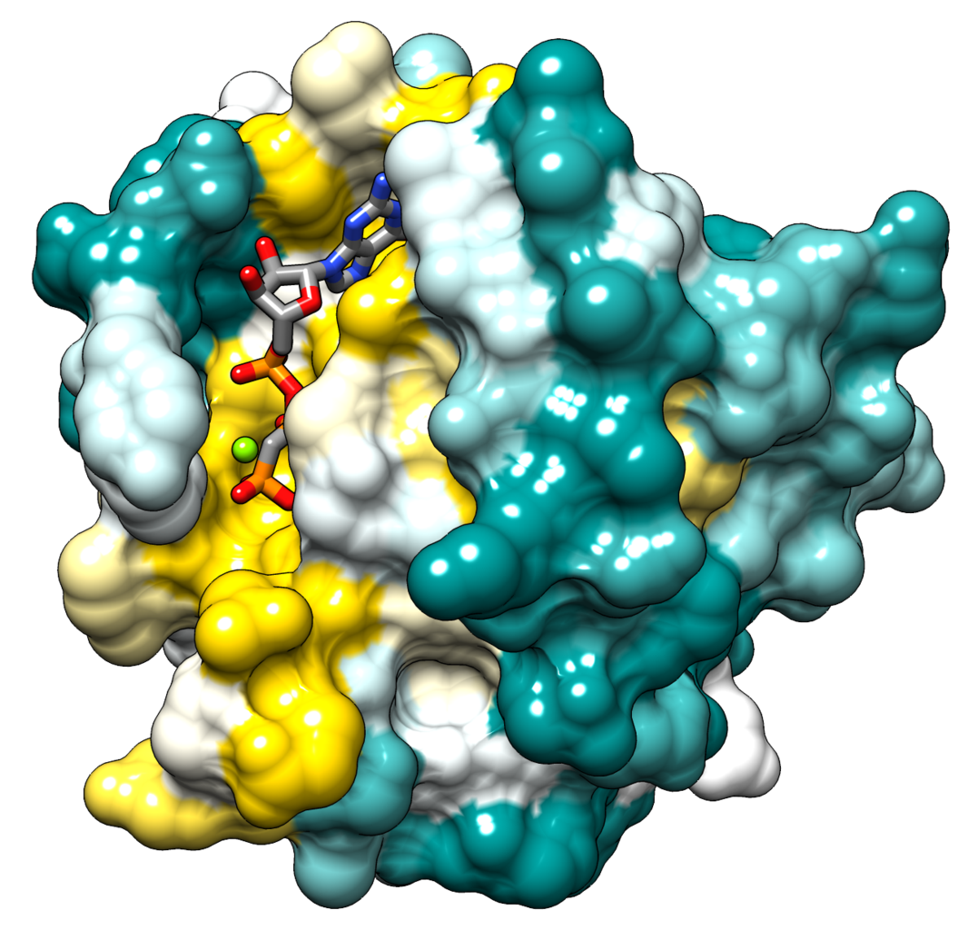
Mutation example
One example of a common mutation that leads to cancer is in a set of genes that code for a family of proteins called Ras.
In healthy cells, the job of Ras proteins is to carry signals about when the cell should begin to divide.
Mutations in the genes for Ras proteins can lead to a damaged protein that tells the cell to divide all the time.
Mutated Ras genes are found in around 20% of human cancers.
Notes:
Teacher notes
The image shows a model of the HRas enzyme, which is a protein encoded by one of the genes in the Ras family.
Photo credit: ElaineMeng. This image is reproduced under the terms of the Creative Commons License. A copy of the license can be read at this address: https://creativecommons.org/licenses/by-sa/3.0/deed.en.

Slide 12
What causes cancer?
The way we live can affect the risk of developing cancer.
Lifestyle risk factors that can increase the risk of various types of cancer include:
poor diet
being overweight
smoking
alcohol consumption
exposure to some viruses
over-exposure to UV radiation.
Can you identify any mechanisms that might cause these factors to increase the risk of cancer?
Notes:
Teacher notes
A risk factor is anything that increases the likelihood of a disease. Discuss students’ ideas for the question before covering the content on the following slides. Students should be able to identify that some of these factors increase the likelihood of cancer-causing mutations occurring in cellular DNA.
This slide covers the Science and Engineering Practices:
Constructing Explanations and Designing Solutions: Apply scientific ideas, principles, and/or evidence to provide an explanation of phenomena and solve design problems, taking into account possible unanticipated effects.
Engaging in Argument from Evidence: Construct, use, and/or present an oral and written argument or counter-arguments based on data and evidence.
Obtaining, Evaluating, and Communicating Information: Communicate scientific and/or technical information or ideas (e.g. about phenomena and/or the process of development and the design and performance of a proposed process or system) in multiple formats (including orally, graphically, textually, and mathematically).
Photo credit: © Sergey Skleznev, Shutterstock.com 2018

Slide 13
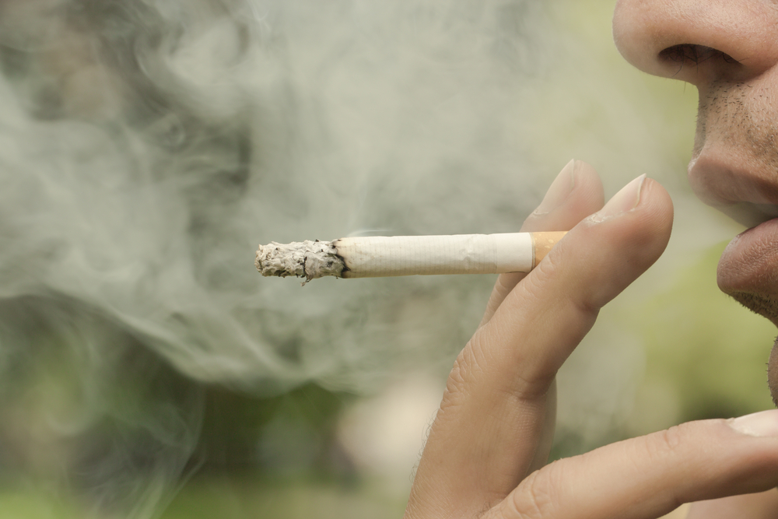
Smoking and cancer
Cigarette smoke contains more than 5,000 chemicals, of which over 70 have been shown to cause cancer.
When the smoke is breathed into the body it comes into contact with tissue cells.
Cancer-causing chemicals in the smoke can cause mutations in the genes involved in cell division.
Smoking increases the risk of several types of cancer, including lung, mouth, throat and esophagus cancer.
Notes:
Teacher notes
The figures relating to chemicals in cigarette smoke were taken from http://www.cancerresearchuk.org/about-cancer/causes-of-cancer/smoking-and-cancer/smoking-facts-and-evidence#smoking_facts6
This weblink was working at the time of publication. Boardworks is not responsible for the content of third party sites.
Photo credit: © Ehab Edward, Shutterstock.com 2018

Slide 14
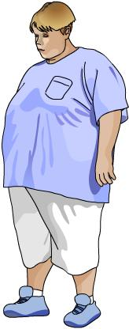
Weight and cancer
Obesity increases the risk of several types of cancer, including breast, bowel, kidney and esophagus cancer.
Fat cells produce hormones and chemicals which can influence the activity of genes.
If a person is obese then too many of these chemicals can be produced due to excess fat.
The chemicals may interfere with normal gene activity, which can lead to uncontrolled cell division and cancer.

Slide 15
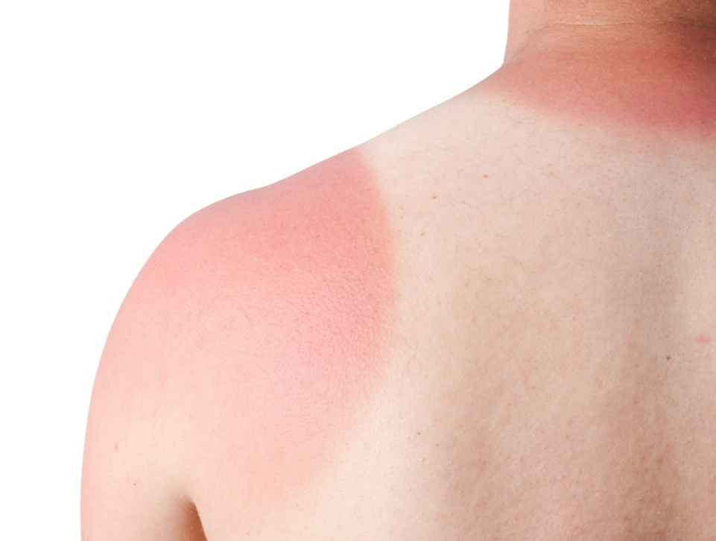
Environmental risk factors (1)
Sunlight contains UV radiation. Exposure to excessive UV radiation can cause skin cancer.
When UV radiation comes into contact with the skin it can cause mutations in the DNA of skin cells, which can lead to uncontrolled cell division.
The risk of overexposure to UV radiation can be controlled by using sunscreen, covering up using clothing and staying out of the sun when it is at its strongest – around midday.
Notes:
Photo credit: © juefraphoto, Shutterstock.com 2018

Slide 16
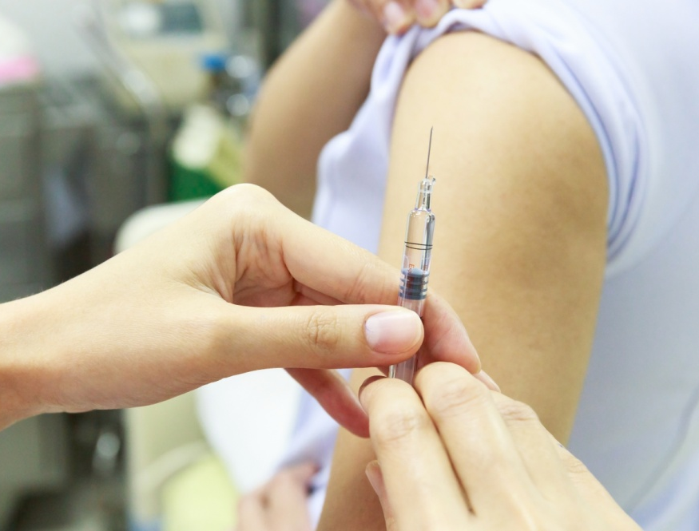
Environmental risk factors (2)
Viruses replicate inside the cells they infect and are able to cause changes to the cell’s DNA.
Sometimes viruses make changes to the genes that control cell division. This can lead to cancer.
Some types of the HPV virus can cause cervical cancer.
In many countries, a vaccination is available that protects against HPV, and therefore reduces the risk of cervical cancer.
Notes:
Teacher notes
HPV stands for human papilloma virus.
Photo credit: © Komsan Loonprom, Shutterstock.com 2018

Slide 17
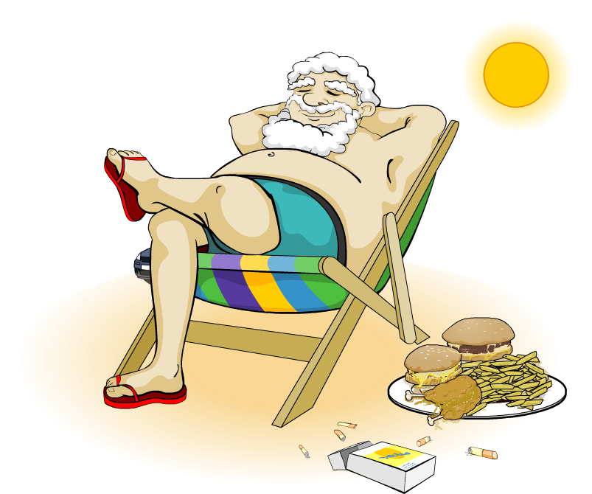
Cancer and lifestyle
The way we live can increase or decrease the risk of cancer.
This picture shows Patrick during a typical day.
Can you think of any ways Patrick could reduce his risk of developing cancer?
Notes:
Teacher notes
Suggested answers could refer to:
Diet – Patrick could eat less meat and more fruit and vegetables to reduce his risk of colon cancer. Red meat, in particular, may increase the risk of colon, stomach and pancreatic cancer.
Sun – Patrick should cover up and wear sun cream to reduce his exposure to UV-radiation which is linked to an increased risk of skin cancer.
Smoking – cigarette smoke contains many chemicals that cause cancer. Stopping smoking would reduce his risk of cancer, especially lung cancer.
Obesity and exercise – reducing his weight and increasing the amount of exercise would reduce Patrick’s risk of cancer.
This slide covers the Science and Engineering Practices:
Constructing Explanations and Designing Solutions: Apply scientific ideas, principles, and/or evidence to provide an explanation of phenomena and solve design problems, taking into account possible unanticipated effects.
Engaging in Argument from Evidence: Construct, use, and/or present an oral and written argument or counter-arguments based on data and evidence.
Obtaining, Evaluating, and Communicating Information: Communicate scientific and/or technical information or ideas (e.g. about phenomena and/or the process of development and the design and performance of a proposed process or system) in multiple formats (including orally, graphically, textually, and mathematically).

Slide 18
Genetic risks for cancer
The risk of cancer is also influenced by genetic factors.
Genetic information is inherited by offspring from their parents.
A family history of cancer suggests there are genes being inherited that increase the risk of cancer in the next generation of the family.
The family may have a faulty form of a gene involved in the control of cell division. If this form of the gene is inherited it could lead to uncontrolled cell division, increasing the risk of developing cancer.
Notes:
Teacher notes
25% of heritable breast cancers are caused by abnormal version of two genes; BRCA1 and BRCA2. The BRCA genes are involved in repairing cell damage. Ask students why they think a faulty version of these genes could cause cancer.
For more information see: http://www.cancer.gov/about-cancer/causes-prevention/genetics/brca-fact-sheet#q1
This weblink was working at the time of publication. Boardworks is not responsible for the content of third party sites.

