Slide 1
Carbon Cycle

Slide 2
Information
Developing and Using Models
Using Mathematics and Computational Thinking
Constructing Explanations and Designing Solutions
Engaging in Argument from Evidence
Obtaining, Evaluating and Communicating Information
2. Cause and Effect
3. Scale, Proportion, and Quantity
4. Systems and System Models
5. Energy and Matter
7. Stability and Change

Slide 3
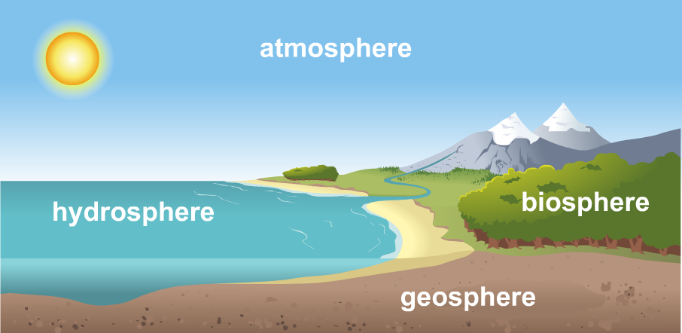
Earth’s systems
Carbon is a common element on Earth.
It is found in the atmosphere, the geosphere, the biosphere and the hydrosphere.
Can you explain what these terms mean?
Notes:
Teacher notes
Help students to apply their understanding of Earth sciences to describe the terms: atmosphere as the layer of gases that surrounds the Earth, geosphere as the solid parts of the Earth, hydrosphere as the water on Earth, and biosphere as the living parts of Earth.

Slide 4
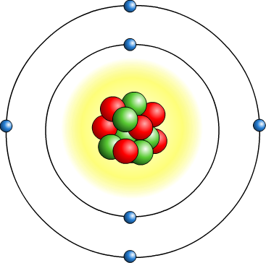
Carbon
Carbon is rarely found on its own. It is usually combined with other elements to form compounds.
Carbon atoms can easily form bonds with other atoms because of their chemical structure.
Can you explain why?
Carbon is present in different compounds in each of Earth’s systems.
Notes:
Teacher notes
Discuss students’ ideas for the question. Help them to apply their understanding of chemistry to identify that carbon can form four covalent chemical bonds. A more complete explanation requires an understanding of relative atom size and orbitals.
This slide covers the Science and Engineering Practices:
Constructing Explanations and Designing Solutions: Apply scientific ideas, principles, and/or evidence to provide an explanation of phenomena and solve design problems, taking into account possible unanticipated effects.
Engaging in Argument from Evidence: Construct, use, and/or present an oral and written argument or counter-arguments based on data and evidence.
Obtaining, Evaluating, and Communicating Information: Communicate scientific and/or technical information or ideas (e.g. about phenomena and/or the process of development and the design and performance of a proposed process or system) in multiple formats (including orally, graphically, textually, and mathematically).

Slide 5
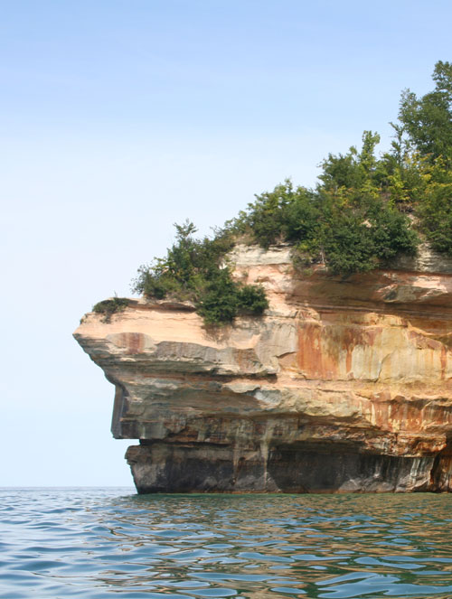
Carbon in Earth’s systems
In the atmosphere, carbon is found combined with oxygen in the compound carbon dioxide, CO₂, which is a gas.
In the hydrosphere, carbon is found as dissolved carbon dioxide and other compounds.
In the geosphere, carbon is found in fossil fuels and rocks such as limestone and chalk.
In the biosphere, carbon is found in living tissues. It is a building block in biological molecules, such as carbohydrates, fats and proteins.
Notes:
Photo credit: © Lindsey Moore, Shutterstock.com 2018

Slide 6
Movement of carbon
The amount of carbon on Earth always stays the same. No carbon atoms are created or destroyed.
Instead, carbon moves between Earth’s systems in a constant cycle called the carbon cycle.
The rate at which carbon moves between parts of the cycle is very variable.
Carbon can remain stored in a particular system for millions of years, or sometimes just a few days, before moving to the next part of the cycle.

Slide 7
Processes that move carbon
Carbon moves between Earth’s systems in several ways:
process | carbon moved from | carbon moved to
photosynthesis | atmosphere (or hydrosphere) | biosphere
cellular respiration | biosphere | atmosphere
decomposition | biosphere | atmosphere
combustion | biosphere | atmosphere
sedimentation | biosphere | geosphere
volcanic activity | geosphere | atmosphere
diffusion | atmosphere / hydrosphere | hydrosphere / atmosphere

Slide 8
Biosphere: Photosynthesis
Plants and algae remove carbon dioxide from the atmosphere.
Using energy from the Sun, they combine carbon dioxide with water to make glucose. This process is known as photosynthesis.
carbon dioxide
+
water
glucose
+
oxygen
Glucose is a sugar that contains carbon. Plants use it to make other biological molecules. This produces biomass.
Carbon has now been stored in living tissues.
Notes:
Teacher notes
For more information on the process of photosynthesis please refer to the Photosynthesis presentation.

Slide 9
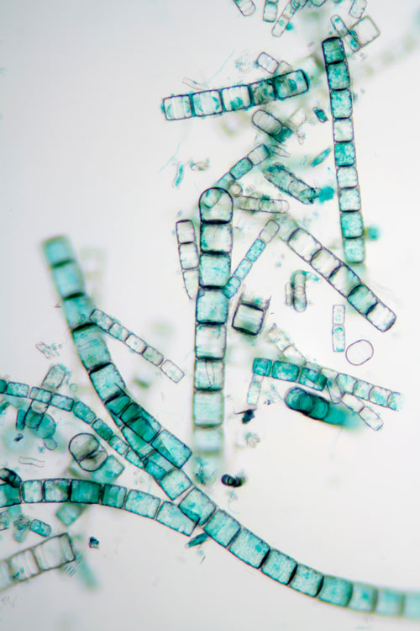
Biosphere: Interaction with hydrosphere
Much of the photosynthesis occurring on Earth takes place in the oceans.
Around 70% of the oxygen in Earth’s atmosphere comes from photosynthetic marine organisms.
Phytoplankton are microscopic organisms such as algae that carry out photosynthesis.
They are very common in parts of the oceans, and they form the start of many marine food chains.
Notes:
Photo credit: © ggw, Shutterstock.com 2018

Slide 10
Biosphere: Cellular respiration
The biomass from photosynthetic organisms is eaten by other organisms. As a result, carbon passes through the food chain.
Living organisms use cellular respiration to release energy from glucose.
glucose
+
oxygen
carbon dioxide
+
water
This releases carbon dioxide back into the atmosphere.
Do all living organisms carry out cellular respiration using the equation above?
Notes:
Teacher notes
The equation for aerobic cellular respiration is shown here; anaerobic respiration is a different chemical process. In animals, anaerobic respiration produces lactic acid instead of carbon dioxide. The lactic acid is later oxidized to produce carbon dioxide and water. In plants and yeasts, anaerobic respiration produces carbon dioxide and ethanol.
For more information on cellular respiration, please refer to the Cellular Respiration presentation.
This slide covers the Science and Engineering Practices:
Constructing Explanations and Designing Solutions: Apply scientific ideas, principles, and/or evidence to provide an explanation of phenomena and solve design problems, taking into account possible unanticipated effects.
Obtaining, Evaluating, and Communicating Information: Communicate scientific and/or technical information or ideas (e.g. about phenomena and/or the process of development and the design and performance of a proposed process or system) in multiple formats (including orally, graphically, textually, and mathematically).

Slide 11
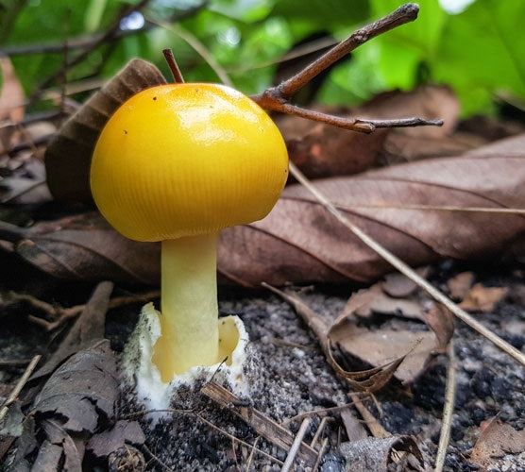
Biosphere: Decomposition
When organisms die or produce waste, the biomass is broken down by organisms that feed on it.
The digested products can then be absorbed and used for respiration.
The process of breaking down dead matter is called
decay or decomposition.
It releases the carbon locked in dead matter back into the atmosphere as carbon dioxide.
Notes:
Teacher notes
For more information on decomposition and the cycling of materials through ecosystems, please refer to the Cycling Materials presentation.
Photo credit: © ppopla, Shutterstock.com 2018

Slide 12
Missing words: Carbon in the biosphere
Notes:
This slide covers the Science and Engineering Practice:
Constructing Explanations and Designing Solutions: Apply scientific ideas, principles, and/or evidence to provide an explanation of phenomena and solve design problems, taking into account possible unanticipated effects.

Slide 13
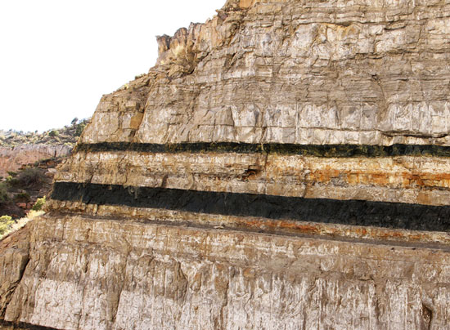
Geosphere: Fossil fuels
Sometimes, biomass from dead organisms is not broken down properly.
This can happen when dead matter is buried in sediment or submerged in water that lacks oxygen. This prevents decomposition from occurring.
Over time, pressure can cause the organic matter to form fossil fuels such as coal, gas or oil.
Fossil fuels can store carbon underground for millions of years.
Notes:
Teacher notes
For more information on fossilization, please refer to the Earth and Space Sciences: Fossils presentation.
Photo credit: © Lee Prince, Shutterstock.com 2018

Slide 14
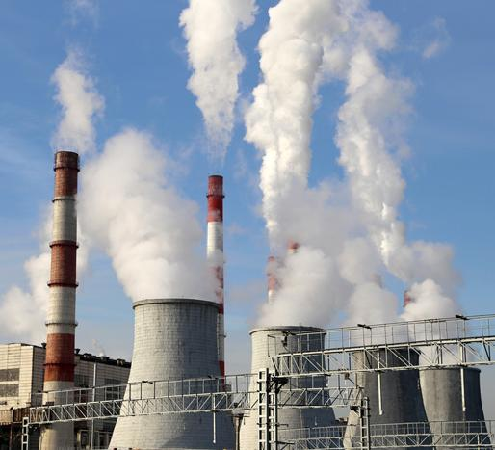
Biosphere: Humans
Humans extract fossil fuels and burn them to release energy. This process is called combustion.
fossil fuel
+
oxygen
carbon dioxide
+
water
Combustion releases carbon dioxide back into the atmosphere.
The combustion of fossil fuels releases carbon that has been stored in the geosphere for millions of years.
Notes:
Teacher notes
For more information on combustion, please refer to the Physical Science: Hydrocarbons presentation.
Photo credit: © VLADJ55, Shutterstock.com 2018

Slide 15
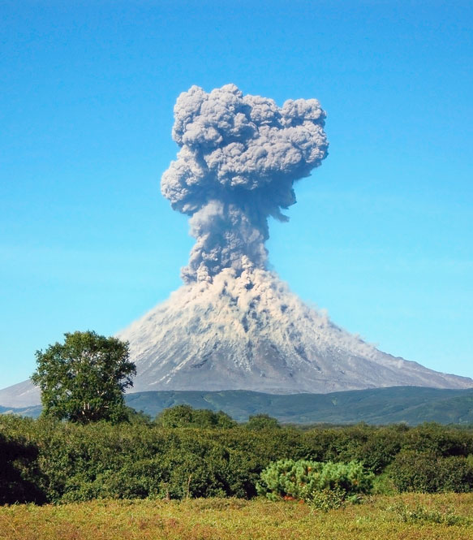
Geosphere: Volcanoes
The carbon locked away in the geosphere can be released back into the atmosphere by volcanoes.
Temperatures in some parts of the Earth’s crust and mantle are hot enough to melt the rocks they contain.
Volcanoes release molten rock and gases, including carbon dioxide, onto the Earth’s surface.
Do you think volcanoes or humans release more carbon into the atmosphere?
Notes:
Teacher notes
Discuss students’ ideas for the question, and encourage students to justify them. At present, volcanoes release between 130 and 380 million metric tons of carbon dioxide each year. Humans emit about 30 billion tons of carbon dioxide per year through the combustion of fossil fuels. This is between 100 and 300 times more than volcanoes.
This slide covers the Science and Engineering Practice:
Constructing Explanations and Designing Solutions: Apply scientific ideas, principles, and/or evidence to provide an explanation of phenomena and solve design problems, taking into account possible unanticipated effects.
Photo credit: © LukaKikina, Shutterstock.com 2018

Slide 16
Processes in the carbon cycle
Notes:
Teacher notes
This nine-stage animation provides an illustrated guide to the carbon cycle. While viewing the animation, students could be asked to identify which processes release carbon dioxide back into the atmosphere and which processes store carbon.
This slide covers the Science and Engineering Practice:
Developing and Using Models: Develop, revise, and/or use a model based on evidence to illustrate and/or predict the relationships between systems or between components of a systems.

Slide 17
Labeling the carbon cycle
Notes:
This slide covers the Science and Engineering Practice:
Developing and Using Models: Develop, revise, and/or use a model based on evidence to illustrate and/or predict the relationships between systems or between components of a systems.

Slide 18
Oceans: Diffusion
Carbon dioxide is soluble in water.
Can you think of any common examples that show this?
Carbon dioxide can dissolve into Earth’s oceans.
When there is a difference between the concentration of carbon dioxide in the atmosphere and in the ocean, the gas moves by diffusion to the area of lower concentration.
This means that carbon can be exchanged in both directions between the ocean and atmosphere.
Notes:
Teacher notes
Discuss students’ ideas for the question. Help them to identify carbonated drinks as an example of water containing dissolved carbon dioxide gas (and other solutes).
This slide covers the Science and Engineering Practice:
Constructing Explanations and Designing Solutions: Apply scientific ideas, principles, and/or evidence to provide an explanation of phenomena and solve design problems, taking into account possible unanticipated effects.
Photo credit: © Strejman, Shutterstock.com 2018

Slide 19
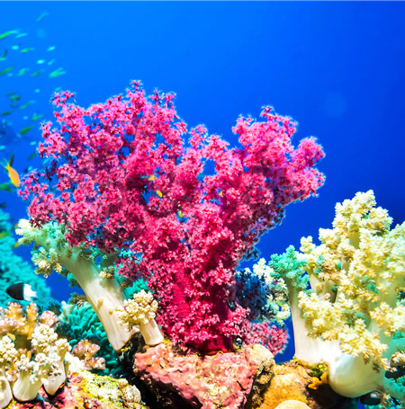
Oceans: Interaction with biosphere
Some carbon dioxide stays in the ocean as dissolved gas. However, some of it is used in other chemical processes.
Dissolved carbon dioxide can react with water to form carbonic acid, H₂CO_{3.}
Carbonic acid breaks down to form other chemicals.
Organisms that live in the oceans can use these to build their shells or hard parts.
This moves the dissolved carbon into the biosphere.
Notes:
Teacher notes
The dissociation products of carbonic acid include bicarbonate and carbonate ions.
Photo credit: © Nikolay 007, Shutterstock.com 2018

Slide 20
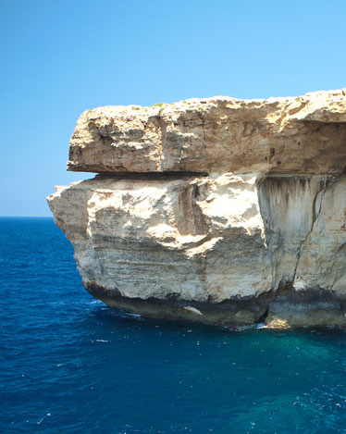
Oceans: Interaction with geosphere
When marine organisms die, their hard parts can fall to the ocean floor and accumulate over time.
Over millions of years, layers of these hard parts can become cemented together, forming rocks such as limestone and chalk.
These are sedimentary rocks known as carbonate rocks.
Carbonate rocks can store carbon in the geosphere for millions of years.
Notes:
Photo credit: © CoolR, Shutterstock.com 2018

Slide 21
The carbon cycle: Summary
Notes:
This slide covers the Science and Engineering Practice:
Developing and Using Models: Develop, revise, and/or use a model based on evidence to illustrate and/or predict the relationships between systems or between components of a systems.

Slide 22
Absorbing or releasing carbon

Slide 23
How much carbon?
Carbon dioxide only makes up 0.041% of Earth’s atmosphere. However, this small percentage nonetheless holds over 800 billion tons of carbon.
The oceans hold much more, around 40,000 billion tons of carbon.
These numbers are so large that they are difficult to visualize.
How could you make them easier to understand?
Notes:
Teacher notes
In 1850, the percentage of carbon dioxide in the atmosphere was 0.029% (often written as 290 parts per million). This has since risen to the figure we see today, 0.041%, or 410 parts per million, and it continues to increase. This change is discussed in later slides.
Discuss students’ ideas for the question. One suggestion would be to place the figures in the context of more familiar objects. A metric ton is 1,000 kg. A large car weighs around 1.5 metric tons, an elephant around 5 metric tons, a blue whale around 140 metric tons and a full airplane up to around 590 metric tons. You could suggest that students research their own objects to use in this comparison.
This slide covers the Science and Engineering Practices:
Using Mathematics and Computational Thinking: Use mathematical, computational, and/or algorithmic representations of phenomena or design solutions to describe and/or support claims and/or explanations.
Obtaining, Evaluating, and Communicating Information: Communicate scientific and/or technical information or ideas (e.g. about phenomena and/or the process of development and the design and performance of a proposed process or system) in multiple formats (including orally, graphically, textually, and mathematically).

Slide 24
Global flows of carbon
Notes:
Teacher notes
Before the data is revealed, students could be asked to think about the values they might expect. For example, where would they expect most of the carbon to be present? Which of the carbon stores will not show an equal input and output of carbon? How might the current flows of carbon be different from those before the industrial revolution?
Data source: Woods Hole Research Center
This slide covers the Science and Engineering Practices:
Developing and Using Models: Develop, revise, and/or use a model based on evidence to illustrate and/or predict the relationships between systems or between components of a system.
Using Mathematics and Computational Thinking: Use mathematical, computational, and/or algorithmic representations of phenomena or design solutions to describe and/or support claims and/or explanations.

Slide 25
Changes to the carbon cycle
Over time, the balance of carbon in Earth’s systems has changed.
This means that the atmosphere, oceans, biosphere and geosphere may each contain more or less carbon than they do today.
The concentration of carbon dioxide in the atmosphere has increased over the last few hundred years.
The rate of this increase is greater than would be expected as a result of natural processes.

Slide 26
Changes to atmospheric carbon
Notes:
Teacher notes
The second graph suggests an increase in CO₂ levels since the Industrial Revolution.
This slide covers the Science and Engineering Practices:
Using Mathematics and Computational Thinking: Use mathematical, computational, and/or algorithmic representations of phenomena or design solutions to describe and/or support claims and/or explanations.
Constructing Explanations and Designing Solutions: Make a quantitative and/or qualitative claim regarding the relationship between dependent and independent variables.
Engaging in Argument from Evidence: Construct, use, and/or present an oral and written argument or counter-arguments based on data and evidence.
Data: Historical CO₂ data from the Vostok ice core, courtesy of NOAA and WDC Paleo (www.ncdc.noaa.gov/paleo/icecore/antarctica/vostok/vostok_co2.html).
Petit, JR et al. 1999. Climate and atmospheric history of the past 420,000 years from the Vostok ice core, Antarctica. Nature 399: 429-436.
CO₂ from 1860: 1861-1958 Etheridge, D. M. et. al., 1998, Historical CO2 record derived from a spline fit (20 year cutoff) of the Law Dome DE08 and DE08-2 ice cores, courtesy of CDIAC (http://cdiac.esd.ornl.gov/ftp/trends/co2/lawdome.smoothed.yr20)
1959-2003 from the Mauna Loa observatory, Hawaii, courtesy of NOAA. Continuous measurement of CO₂ levels began in 1958.

Slide 27
Changes caused by human activities
Since the industrial revolution, human activities have added over 1,000 billion tons of carbon dioxide to the atmosphere.
Can you explain where this carbon dioxide has come from?
Can you suggest what has happened to the carbon in these emissions?
The oceans have absorbed around 50% of this carbon.
Much of the rest has contributed to an increase in the atmospheric concentration of carbon dioxide.
Notes:
Teacher notes
Help students to identify human activities that have added carbon to the atmosphere. They should be able to name the combustion of fossil fuels, and explain that this returns to the atmosphere carbon that has been locked away for millions of years. They may also be able to discuss the rate of change: fossil fuels took millions of years to form, but are being released by humans at a much greater rate.
Other human activities include deforestation, which reduces the ability of photosynthesis to remove carbon from the atmosphere.
Help students to apply their understanding of the carbon cycle to suggest what has happened to the additional carbon in the atmosphere. An increased concentration of carbon dioxide in the atmosphere would be expected to increase diffusion into the oceans. Help students to apply their understanding of concentration gradients to establish why this is the case.
This slide covers the Science and Engineering Practices:
Constructing Explanations and Designing Solutions: Apply scientific ideas, principles, and/or evidence to provide an explanation of phenomena and solve design problems, taking into account possible unanticipated effects.
Obtaining, Evaluating, and Communicating Information: Communicate scientific and/or technical information or ideas (e.g. about phenomena and/or the process of development and the design and performance of a proposed process or system) in multiple formats (including orally, graphically, textually, and mathematically).

Slide 28
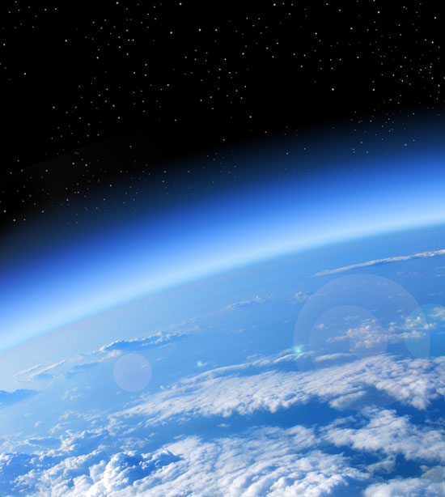
Impact of increased atmospheric CO₂ (1)
What effect do you think an increase in atmospheric carbon will have on Earth?
Carbon dioxide is a greenhouse gas.
The increase is enhancing the greenhouse effect, causing Earth to trap more of the Sun’s radiation.
This is changing Earth’s climate.
Notes:
Teacher notes
Discuss students’ ideas for the question before revealing the rest of the content. Students should be able to apply their understanding of climate change to answer the question. Some students may be able to suggest other effects, such as ocean acidification. This is discussed on the next slide.
For more information on the greenhouse effect, please refer to the Earth and Space Sciences: The Greenhouse Effect presentation.
This slide covers the Science and Engineering Practices:
Constructing Explanations and Designing Solutions: Apply scientific ideas, principles, and/or evidence to provide an explanation of phenomena and solve design problems, taking into account possible unanticipated effects.
Obtaining, Evaluating, and Communicating Information: Communicate scientific and/or technical information or ideas (e.g. about phenomena and/or the process of development and the design and performance of a proposed process or system) in multiple formats (including orally, graphically, textually, and mathematically).
Photo credit: © Studio23, Shutterstock 2018

Slide 29
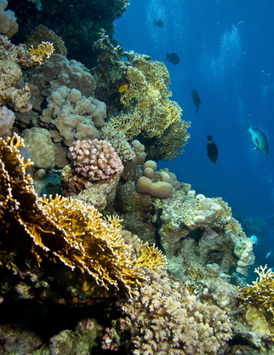
Impact of increased atmospheric CO₂ (2)
The increased amount of carbon dioxide in the oceans has led to an increase in carbonic acid.
Carbonic acid is acidic, which means that the oceans are becoming more acidic.
The hard parts of many marine organisms are made from carbonates, which can dissolve in more acidic ocean conditions.
What damage do you think ocean acidification could cause to marine ecosystems?
Notes:
Teacher notes
A report published by the Royal Society in 2005 predicted a drop in pH of 0.5 units by 2100 (from the current pH of 8.05) as carbon dioxide concentration in the atmosphere rises. An ocean of this pH would be more acidic than at any time in the last 420,000 years. The pH of the ocean is thought to have already decreased by an average of 0.1 units over the last 200 years.
Help students to apply their understanding of ecosystems to answer the question. Discuss whether all organisms are likely to be affected in the same way. Organisms such as coral and molluscs are likely to struggle more than organisms that do not have hard parts, such as seaweed or sea grasses. Corals provide habitats for a large range of marine organisms.
This slide covers the Science and Engineering Practices:
Constructing Explanations and Designing Solutions: Apply scientific ideas, principles, and/or evidence to provide an explanation of phenomena and solve design problems, taking into account possible unanticipated effects.
Obtaining, Evaluating, and Communicating Information: Communicate scientific and/or technical information or ideas (e.g. about phenomena and/or the process of development and the design and performance of a proposed process or system) in multiple formats (including orally, graphically, textually, and mathematically).
Photo credit: © Tyler Olson, Shutterstock.com 2018

Slide 30
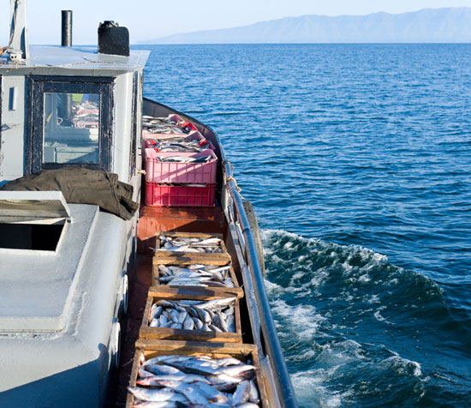
Carbon cycle activity
Describe and explain the parts of the carbon cycle involved in this image of a fishing boat.
You should refer to the movement of carbon between Earth’s systems.
Support your work with your own research and present your ideas clearly.
Notes:
This slide covers the Science and Engineering Practices:
Constructing Explanations and Designing Solutions: Apply scientific ideas, principles, and/or evidence to provide an explanation of phenomena and solve design problems, taking into account possible unanticipated effects.
Engaging in Argument from Evidence: Construct, use, and/or present an oral and written argument or counter-arguments based on data and evidence.
Obtaining, Evaluating, and Communicating Information: Gather, read, and evaluate scientific and/or technical information from multiple authoritative sources, assessing the evidence and usefulness of each source.
Obtaining, Evaluating, and Communicating Information: Communicate scientific and/or technical information or ideas (e.g. about phenomena and/or the process of development and the design and performance of a proposed process or system) in multiple formats (including orally, graphically, textually, and mathematically).
Photo credit: © withGod, Shutterstock.com 2018

