Slide 1
DNA and the Genome

Slide 2
Information
Constructing Explanations and Designing Solutions
Obtaining, Evaluating and Communicating Information
1. Patterns
2. Cause and Effect
3. Scale, Proportion, and Quantity
6. Structure and Function

Slide 3
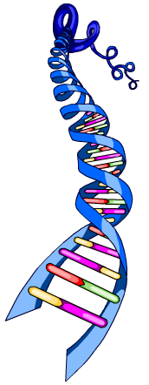
What is the genome?
The genome is the term used to describe the entire genetic material of an organism.
The genetic material of an organism
is made from a chemical called DNA.
DNA stands for
Deoxyribonucleic acid.
DNA molecules carry the genetic code that controls the function of cells and the characteristics of an organism.

Slide 4
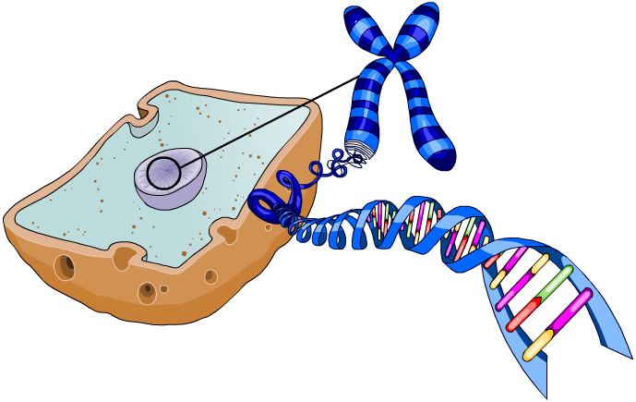
Where is DNA found?
DNA is located inside the nucleus of cells in the form
of chromosomes.
Each chromosome is made from one long molecule of DNA.
nucleus
chromosome
A gene is a small section of DNA on a chromosome.
DNA
Each gene provides the instructions to make a particular type of protein.
gene
Notes:
Teacher notes
Human body cells contain 46 chromosomes in 23 pairs.

Slide 5
Where are genes located?
Notes:
Teacher notes
This zoom activity could be used to lead students on a step-by-step journey down to the level of the genes. It could also be used to review prior knowledge. Students could be asked to say where genes are found and then additional questions could be posed to move them up or down the hierarchy towards a more precise understanding of their location.
For more information on cells, tissues and organs, please refer to the Multicellular Organisms presentation.

Slide 6
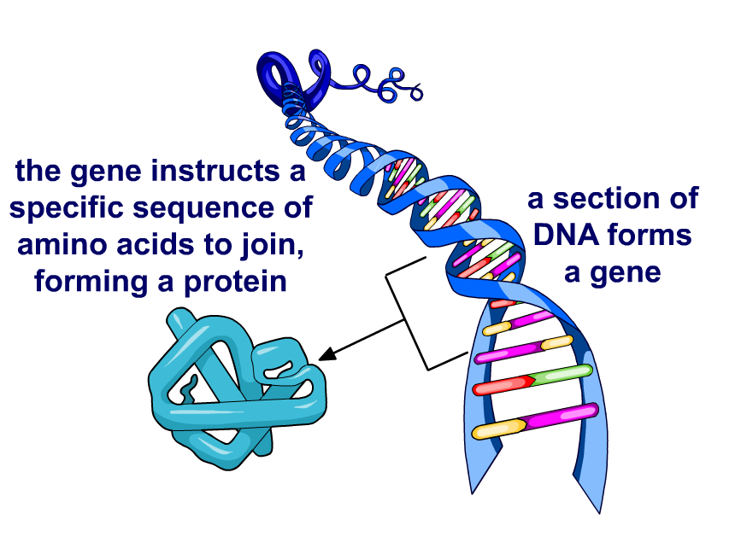
Producing proteins
The genome contains the instructions to make all the proteins in an organism.
Each gene provides instructions for a specific sequence of amino acids. These then join together to produce a particular type of protein.
Proteins control the
activity of cells. As a
result, proteins are
essential in determining
how an organism grows, develops and functions.

Slide 7
How do genes control characteristics?
Notes:
This slide covers the Science and Engineering Practice:
Constructing Explanations and Designing Solutions: Apply scientific ideas, principles, and/or evidence to provide an explanation of phenomena and solve design problems, taking into account possible unanticipated effects.

Slide 8
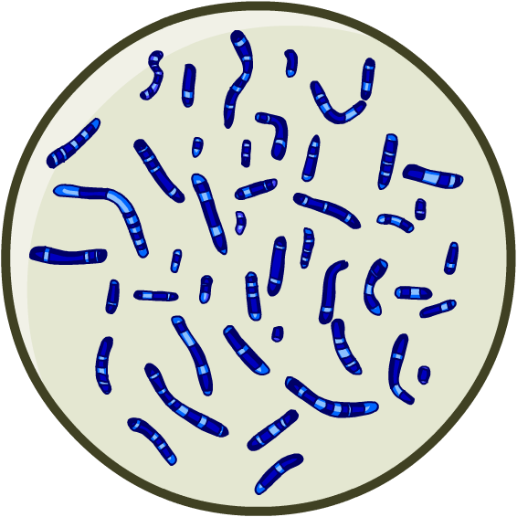
Genotype and phenotype
The genome forms the genotype of an organism – the genetic information in the genome that contributes to the characteristics of an organism.
The genome interacts with the environment to form an organism’s phenotype – the set of observable characteristics of an organism.
The phenotype depends on both genes and the environment.
Most characteristics rely on instructions in the genome,
but they are modified as a result of the interaction between the organism and its environment.
Notes:
Teacher notes
For more information about the interaction between genes and the environment, please refer to the Variation presentation.

Slide 9
Genes and the environment
How can we observe the interaction between the genotype and the environment?
Imagine a pair of identical twins. They have exactly the
same genotype, yet their observable characteristics can differ.
This is because a person’s phenotype is a result of the interaction between their genes and the environment.
Notes:
Teacher notes
Discuss students’ ideas for the question before revealing the remaining content. Ask students to suggest aspects of the environment that could interact with the genotype to influence phenotype. For example:
diet
exercise
smoking
stress
disease
piercings/tattoos
haircut/make-up
This slide covers the Science and Engineering Practices:
Constructing Explanations and Designing Solutions: Apply scientific ideas, principles, and/or evidence to provide an explanation of phenomena and solve design problems, taking into account possible unanticipated effects.
Obtaining, Evaluating, and Communicating Information: Communicate scientific and/or technical information or ideas (e.g. about phenomena and/or the process of development and the design and performance of a proposed process or system) in multiple formats (including orally, graphically, textually, and mathematically).
Photo credit: © holbox, Shutterstock.com 2018

Slide 10
Passing on genetic information
In all living things, characteristics are passed on in the chromosomes that offspring inherit from their parents.
Chromosomes are found in pairs inside the nucleus. In each pair, one chromosome comes from the father and the other from the mother.
chromosome pair
Each of the chromosomes
in a pair contain different
versions of the same genes.
These are called alleles,
and each version is called
a variant.
allele for brown
eyes
allele for blue
eyes
Notes:
Teacher notes
For more information on alleles, please refer to the Inheritance presentation.

Slide 11
The genome: true or false?

Slide 12
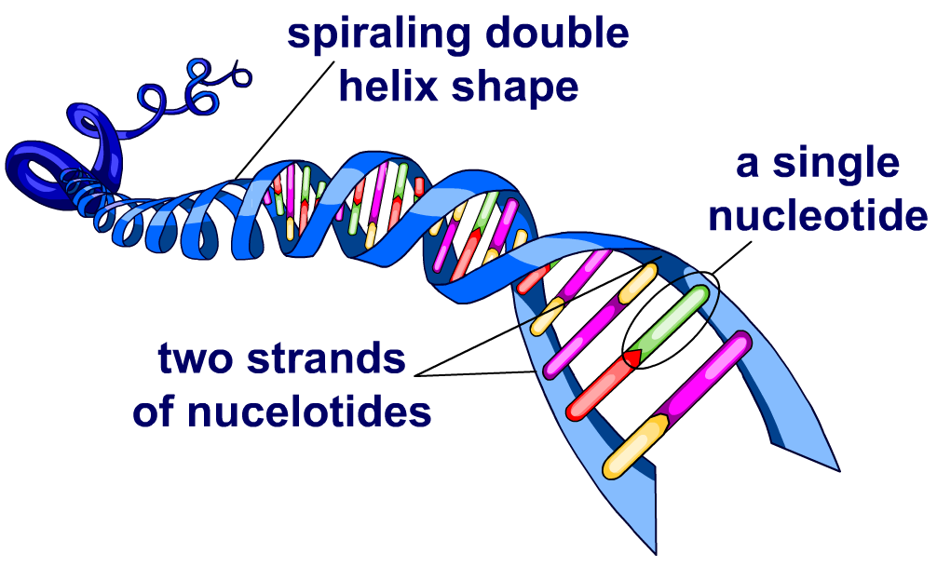
The structure of DNA
DNA is a polymer. This means it is a large molecule made of many smaller units joined together.
Each of these smaller units is called a nucleotide.
Every molecule of DNA is made from two strands.
Each of the two strands is made from thousands of nucleotides.
DNA molecules form a special spiraling shape called a double helix.

Slide 13
Genetic terms
Notes:
Teacher notes
This matching activity could be used as an introductory or summary exercise on genetic terms.

Slide 14
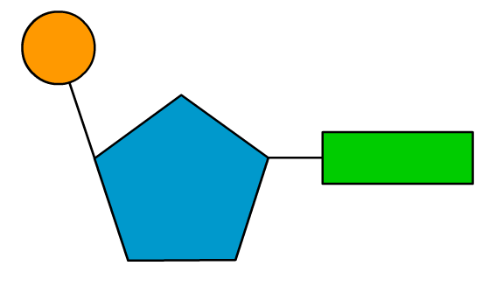
Structure of nucleotides (1)
DNA is made from four different types of nucleotides.
Each nucleotide consists of three main parts:
a phosphate group
phosphate group
a sugar
base
sugar
a base.
The base is the only part of a nucleotide that can vary.
There are four different bases, each producing a different type of nucleotide.

Slide 15
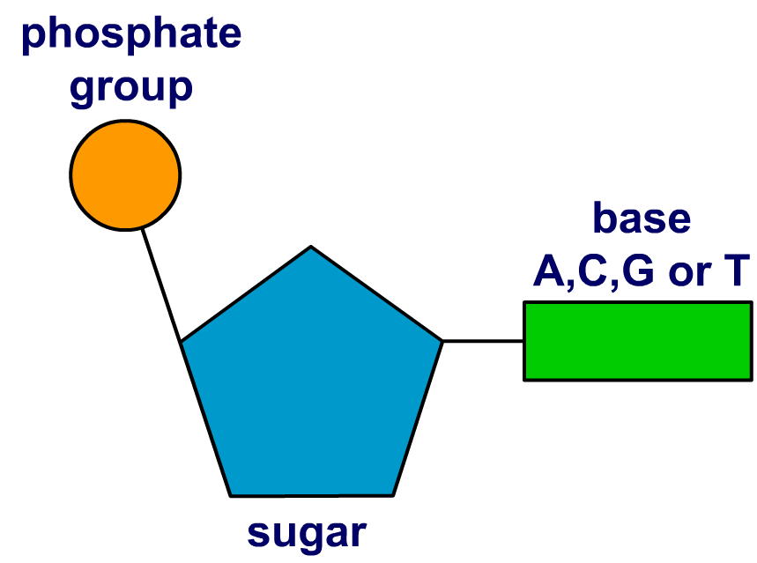
Structure of nucleotides (2)
The four different bases are called:
adenine
cytosine
guanine
thymine.
These are usually shortened to just their first letter: A, C, G and T.
The bases of different nucleotides can interact with each other.

Slide 16
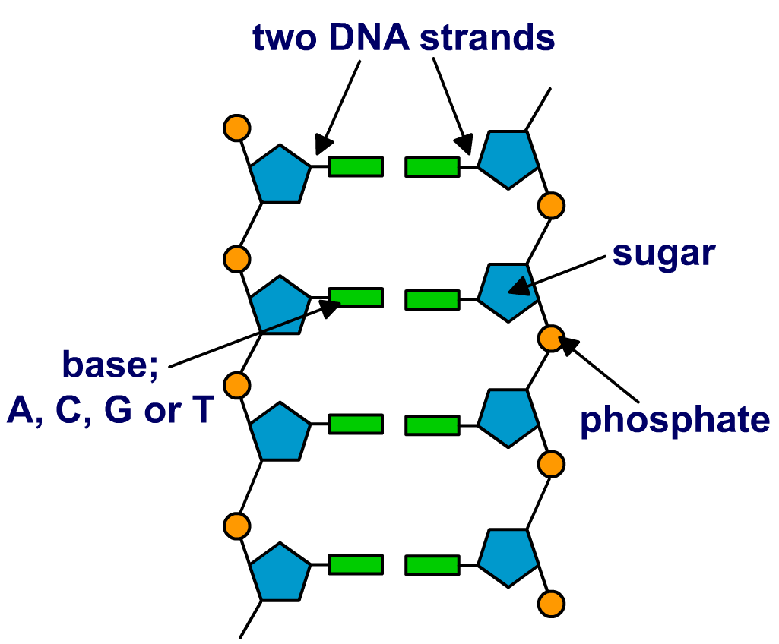
The DNA backbone
When nucleotides join together, their sugar and phosphate sections form long strands. A single DNA molecule is made of two strands of nucleotides.
This forms the “backbone”
of a DNA molecule.
The bases on each nucleotide face inward, toward each other.
This allows bases on opposite strands to interact, keeping the two strands together.

Slide 17
What is a complementary base pair?
DNA molecules are double-stranded. The base of a nucleotide on one DNA strand can interact with the base of the nucleotide opposite it on the other strand of the DNA molecule.
If this happens, the two nucleotides are said to have formed a complementary base pair.
Only certain pairs of bases can interact to form complementary base pairs:
base A can interact to pair with base T.
A
T
base C can interact to pair with base G.
C
G
Notes:
Teacher notes
You may want to remind students of the bases' full names:
adenine (A)
thymine (T)
cytosine (C)
guanine (G)
You may also want to remind students that every nucleotide consists of a phosphate group, a sugar and a base (A, T, C or G).

Slide 18
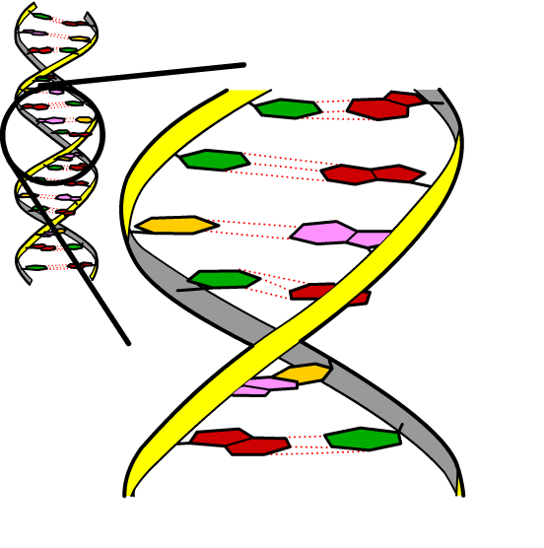
Bonding between complementary bases
Weak hydrogen bonds form between complementary
base pairs.
The hydrogen bonds hold the two strands of nucleotides together and maintain the double helix shape of DNA.
Hydrogen bonds are not as strong as chemical bonds. This means they can be easily broken by heat.
C pairs with G
If DNA is exposed to high heat, the hydrogen bonds between the strands break and the molecule loses its structure.
A pairs with T
Notes:
Teacher notes
On the diagram, the dotted lines represent hydrogen bonds.
There are 2 hydrogen bonds between A and T, and 3 hydrogen bonds between C and G.

Slide 19
What is the structure of DNA?

Slide 20
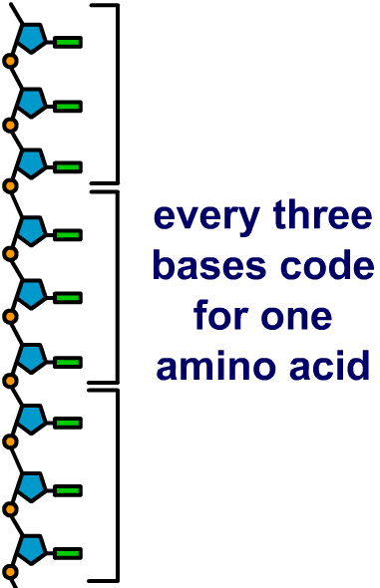
Order matters
The type of protein produced by a gene depends of the order of bases in that section of DNA.
A sequence of three bases codes for a particular amino acid. This means that the order of bases controls the order in which amino acids are assembled.
The order of amino acids determines the type of protein produced, and how it folds to form its specific shape.
Shape is very important to the function of proteins. For example, the shape of an enzyme’s active site determines what type of reaction it is able to catalyze.
Notes:
Teacher notes
For more information on enzymes, please refer to the Enzymes presentation.

Slide 21
DNA and protein synthesis
Notes:
Teacher notes
This three-stage sequence introduces the link between genes and proteins before the mechanism of protein synthesis is explored in the next section.
This slide covers the Science and Engineering Practice:
Constructing Explanations and Designing Solutions: Apply scientific ideas, principles, and/or evidence to provide an explanation of phenomena and solve design problems, taking into account possible unanticipated effects.

Slide 22
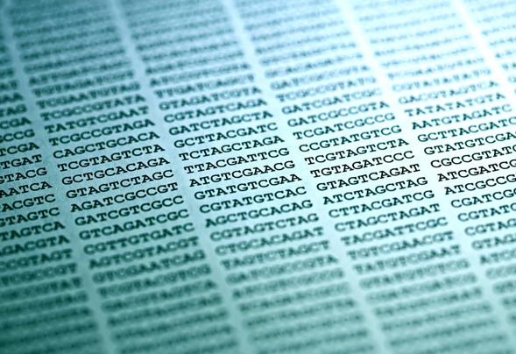
Mapping the human genome
The Human Genome Project (HGP) was an international, publicly funded scientific research project. Its aim was to sequence the entire human genome and map the location of genes on the chromosomes.
The project was completed in 2003 and revealed that the human genome is made up of around three billion bases forming 25,000 genes.
Information revealed by the HGP has enabled further discoveries relating to medicine, biotechnology
and human evolution.
Notes:
Photo credit: © isak55, Shutterstock.com 2018

Slide 23
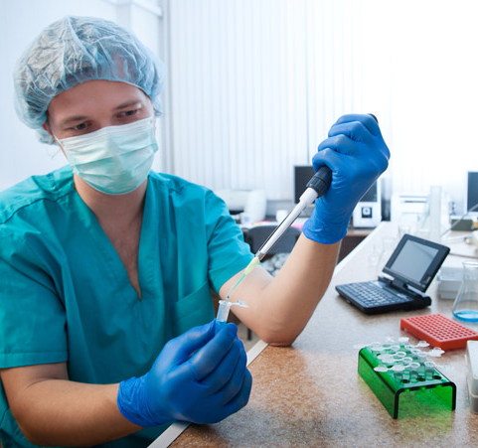
Medicine and the human genome
Access to the human genome sequence has led to research to try to link diseases to specific regions of the genetic code.
The HGP has enabled the discovery of over 1,800 genes that are thought to be involved in disease.
In the future, it is hoped some diseases could be diagnosed before symptoms appear.
This could be done by analyzing a person’s DNA sequence to see if they carry any genes identified as a risk for disease.
Notes:
Teacher notes
Diseases that could be diagnosed before symptoms appear using genetic testing include Huntingdon’s disease, Alzheimer's disease and some types of cancer.
Photo credit: © Vasiliy Koval, Shutterstock.com 2018

Slide 24
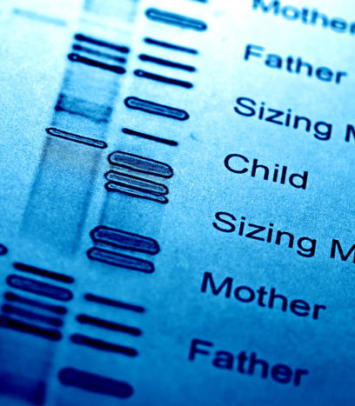
Inherited disorders
The HGP has helped scientists to understand how diseases that run in families are inherited.
If a disease can be linked to a specific gene, then genetic tests can be carried out to see if a person has the disease gene.
Genetic tests can be useful to people who know they have a family background of inherited disorders by determining whether they carry the faulty gene.
The results from a genetic test can help an individual make decisions concerning their own future health as well as whether to have children.
Notes:
Teacher notes
For more information on inherited disorders, please refer to the Inherited Disorders presentation.
Photo credit: © isak55, Shutterstock.com 2018

Slide 25
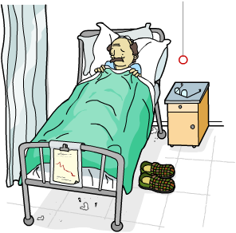
Targeted drugs
Our increased understanding of the human genome has helped to develop drugs that target genes to treat disease.
Genes are involved in many diseases. Using drugs that target such genes is a very powerful technique as it allows medicines to act with great precision.
Cancer therapy is one area benefiting from targeted drugs.
Drugs have been designed that target genes involved in abnormal cell division, with the aim of stopping tumors from growing and spreading to other parts of the body in patients.
Notes:
Teacher notes
For more information on cancer, please refer to the Cancer presentation.

Slide 26
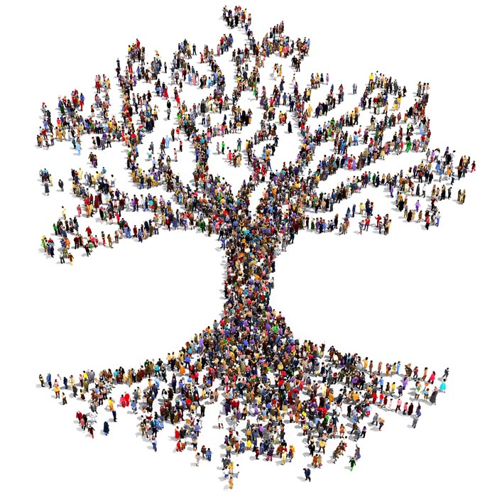
Human evolution
The Human Genome Project has enabled scientists to study how humans have migrated across the world over our history.
DNA samples have been taken from populations around the world.
These have been used to research similarities and differences in DNA sequence between populations living in different countries.
It is now possible to take a genetic test to trace where an individual’s ancestors came from hundreds, and even thousands, of years ago.
Notes:
Photo credit: © Arthimedes, Shutterstock.com 2018

