Slide 1
Discovering Genetics

Slide 2
Information
Developing and Using Models
1. Patterns
2. Cause and Effect
4. Systems and System Models

Slide 3
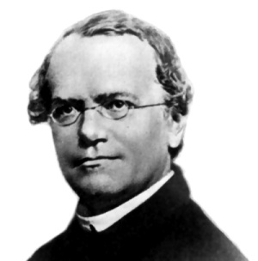
Genetics and Gregor Mendel
Genetics is the study of inherited characteristics.
In 1866, a Czech monk named Gregor Mendel published an article called “Experiments in Plant Hybridization.”
This article reported on Mendel's work investigating patterns of inheritance observed in pea plants.
Between 1856 and 1863, Mendel grew thousands of plants at his monastery and studied how particular characteristics were inherited.
What characteristics did Mendel study in his pea plants?
Notes:
Teacher notes
Mendel is most know for studying the shape of peas produced by the plants, in particular whether they were wrinkly or smooth in appearance.
He also looked at other characteristics, including:
flower color
pod shape
unripe pod color
flower location
plant height.
For more information about patterns of inheritance, please refer to the Inheritance presentation.
Photo credit: This image is in the public domain

Slide 4
The life and work of Gregor Mendel

Slide 5
Mendel’s experiments
Mendel investigated the inheritance of a single characteristic at a time. This type of breeding experiment is called a monohybrid cross.
There are two alleles controlling pea shape. One allele is dominant, while the other allele is recessive.
This means that there are three possible genotypes offspring could inherit, leading to two possible phenotypes.
Mendel observed that the smooth pea characteristic was dominant over the recessive wrinkled pea characteristic.
Notes:
Teacher notes
Remind students that Mendel did not know about the existence of genes or alleles. He was only able to investigate inheritance by observing visible characteristics.
For more information about genetic crosses, please refer to the Inheritance presentation.
Photo credit: © Jiang-Hongyan, Shutterstock.com 2018

Slide 6
Inheritance of pea shape (1)
Can you complete this table for pea shape?
 | genotype | phenotype
homozygous dominant
homozygous recessive
heterozygous
SS
smooth
ss
?
wrinkled
?
?
Ss
smooth
Mendel observed a particular pattern to the inheritance of pea shape when two heterozygous pea plants were crossed.
What is the ratio of smooth pea plants to wrinkled pea plants in the offspring of two heterozygous plants?
Notes:
Teacher notes
The ratio of smooth pea plants to wrinkled pea plants in the offspring of two heterozygous pea plants for pea shape is 3:1.
On average, crossing two plants heterozygous for pea shape produces three smooth offspring for every one wrinkled offspring. In other words, when two heterozygous plants are crossed, there is a 75% chance of a single offspring producing smooth peas and a 25% chance of a single offspring producing wrinkled peas.
This slide covers the Science and Engineering Practice:
Using Mathematics and Computational Thinking: Use mathematical, computational, and/or algorithmic representations of phenomena or design solutions to describe and/or support claims and/or explanations.

Slide 7
Inheritance of pea shape (2)
Mendel noticed that the ratio of smooth pea plants to wrinkled pea plants in the offspring of two heterozygous plants was 3:1.
The pattern of inheritance for pea shape was predictable.
From his experiments, Mendel
concluded that the inheritance of
each characteristic of an organism
is determined by “units” that are
passed on to offspring unchanged.
At the time, Mendel did not uncover
what these “units” were. Today, we
call them genes.
Notes:
Teacher notes
For more information about working out patterns of inheritance, please refer to the Inheritance presentation.
Photo credit: © NatalieJean, Shutterstock.com 2018

Slide 8
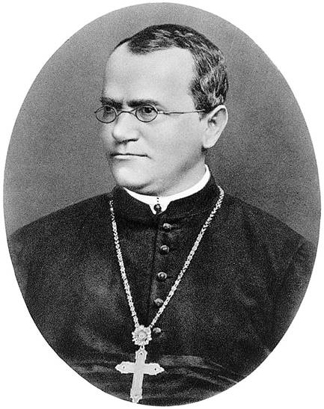
The “loss” of Mendel’s work
Despite the importance of Mendel’s experiments, his work
went largely unnoticed by the scientific community at the time.
It is thought that, if Mendel’s work had received more attention, genes and their role in inheritance could have been discovered much sooner.
Scientists did not rediscover Mendel’s work until 1900. His experiments were repeated and led to further discoveries about genetics.
As a result of his research, Mendel
has since been named the “Father
of Genetics.”
Notes:
Photo credit: © Wellcome Library, licensed under Creative Commons 4.0

Slide 9
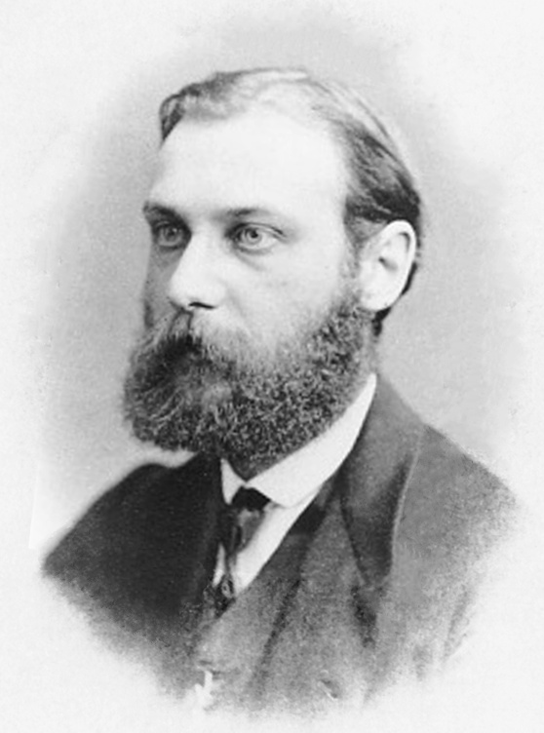
Discovering chromosomes
In the late 19th century, a German scientist called Walther Fleming identified thread-like structures inside the nucleus of cells and observed their movement during the process
of cell division.
Following work by other scientists, these structures were later named chromosomes.
However, at this time, Mendel’s
article had yet to be rediscovered.
As a result, the connection was not made that it was chromosomes that carried the “units” of inheritance.
Notes:
Photo credit: Walther Fleming, this image is in the public domain.

Slide 10
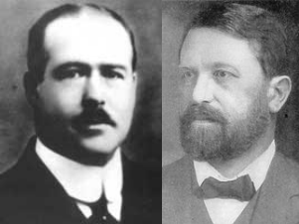
Discovering the role of chromosomes
In 1900, Mendel’s research on inheritance was rediscovered.
Subsequently, in the early 20th century, an American scientist called Walter Sutton and a German scientist called Theodor Boveri independently identified that chromosomes carried the “units” of inheritance.
Their research showed that
chromosomes are found in pairs.
This supported Mendel’s idea
that each characteristic was determined by pairs of factors that could be either dominant
or recessive.
Notes:
Photo credit: Walter Sutton (left) and Theodor Boveri (right), these images are in the public domain.

Slide 11
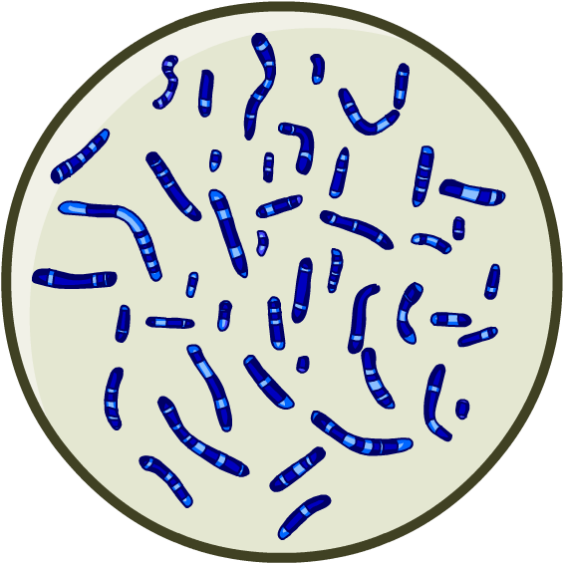
Genes and DNA
The term “gene” was coined in 1909 to describe the individual units of inheritance found on chromosomes.
However, it was still not understood what genes were made from. Many scientists believed they were proteins.
In the 1940s, three American scientists
discovered that the genetic material
forming chromosomes was made of
a chemical called DNA.
Their research revealed that DNA was
responsible for inherited characteristics.
Notes:
Teacher notes
DNA stands for deoxyribonucelic acid.

Slide 12
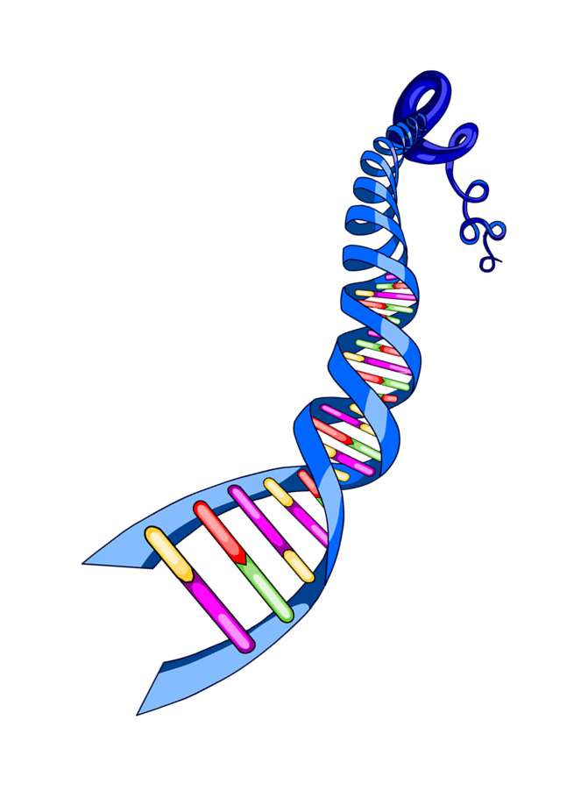
The structure of DNA (1)
Once DNA had been identified as the physical basis of inheritance, many scientists began to try to work out
its structure.
In 1953, American scientist James Watson
and British scientist Francis Crick published
a joint scientific article.
The article reported on their model which showed that DNA has a double-helix structure.
In 1962, they received a Nobel
prize for their discovery.
Notes:
Teacher notes
For more information about the structure of DNA, please refer to the DNA and the Genome presentation.

Slide 13
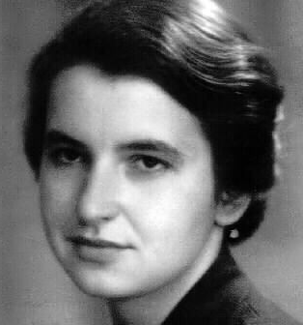
The structure of DNA (2)
The double-helix structure of DNA was supported by the work of other scientists, including Rosalind Franklin and Maurice Wilkins.
Between the late 1940s and early 1950s, these scientists used X-rays to image the structure of DNA.
Crick and Watson used some of these images to help them work out the double-helix model of DNA.
Further scientific research concluded that genes are made of short sections of DNA located on chromosomes.
Notes:
Photo credit: Rosalind Franklin, this image is in the public domain.

Slide 14
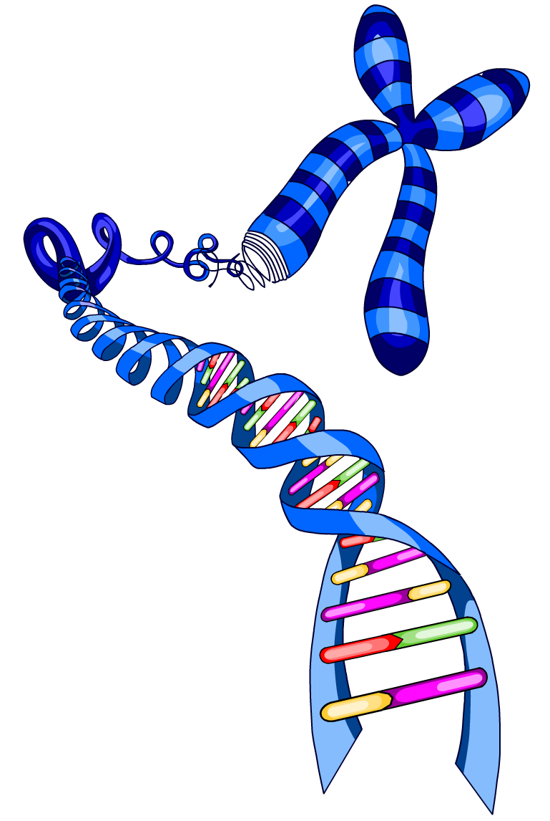
Modern genetics
The development of the gene theory is the result of scientific work carried out by many researchers over the past two centuries.
Modern genetic research continues to increase our knowledge of genes, DNA and inheritance.
DNA sequencing is one of the biggest
breakthroughs of modern genetics.
It is a technique that is used to determine
the order of nucleotides in DNA.
Notes:
Teacher notes
For more information about nucleotides, please refer to the DNA and the Genome presentation.

Slide 15
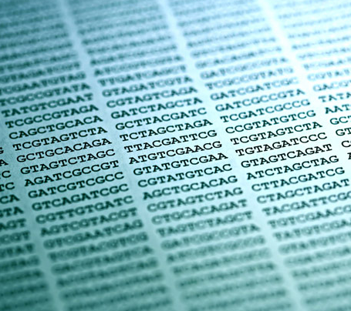
Genome sequencing
DNA sequencing techniques can be used to determine the order of nucleotides forming the entire human genome.
This is known as genome sequencing.
In 1990, the Human Genome Project was launched. By 2003, the entire human genome had been successfully sequenced.
The information it revealed has since enabled further discoveries about human genetics.
In particular, it is hoped that genome
sequencing will help develop new
treatments for genetic disorders.
Notes:
Teacher notes
For more information about the human genome project and its impact on medicine, please refer to the DNA and the Genome presentation.
Photo credit: © isak55, Shutterstock.com 2018

