Slide 1
Excretion

Slide 2
Information
Developing and Using Models
Constructing Explanations and Designing Solutions
Obtaining, Evaluating and Communicating Information
1. Patterns
2. Cause and Effect
6. Structure and Function
7. Stability and Change

Slide 3
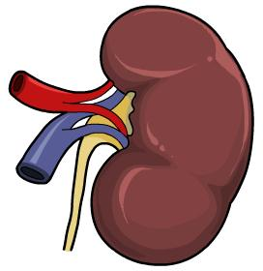
What is excretion?
Excretion is the removal of waste products produced by cellular processes in the body.
If waste products were allowed to build up in the body, they could become toxic and disrupt normal cell function.
What are some of these waste products?
carbon dioxide
excess ions
urea
excess water
Excess water, excess ions and urea can all be removed from the body via the kidneys.
Notes:
Teacher notes
Help students to draw on their understanding of other life science topics to answer the question.
This slide covers the Science and Engineering Practices:
Constructing Explanations and Designing Solutions: Apply scientific ideas, principles, and/or evidence to provide an explanation of phenomena and solve design problems, taking into account possible unanticipated effects.
Obtaining, Evaluating, and Communicating Information: Communicate scientific and/or technical information or ideas (e.g. about phenomena and/or the process of development and the design and performance of a proposed process or system) in multiple formats (including orally, graphically, textually, and mathematically).

Slide 4
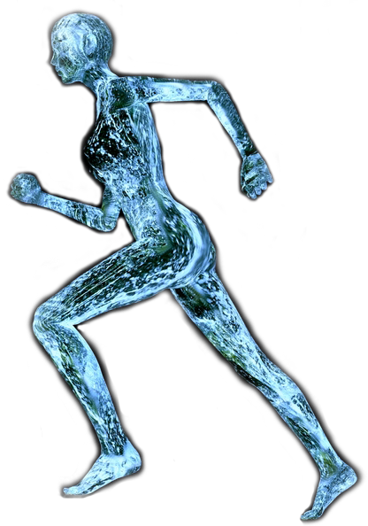
Why is water important?
Body fluids contain water molecules and ions which are essential for all life processes. The body is 60–70% water.
Their concentration affects the movement of water in and out of the body cells by osmosis, which affects cell size.
Water is constantly being gained and lost by the body.
The water content of body fluids must be carefully controlled to ensure cells can continue to work properly.
This process is called osmoregulation.
Notes:
Teacher notes
Water can be lost from the body in sweat, feces and urine.
Water can be gained by the body through eating and drinking.
For more information about osmosis, please refer to the Cell Transport presentation.
Photo credit: © andesign101, Shutterstock.com 2018

Slide 5
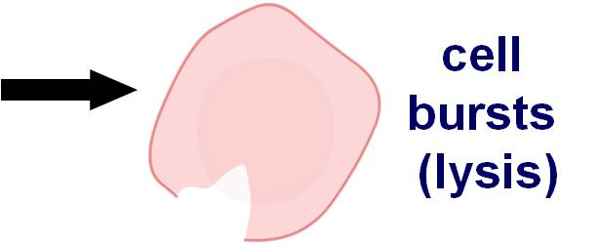
How does osmosis affect cells?
The concentration of ions and water in body fluids affects the movement of water in and out of cells by osmosis.
If too much water leaves a cell by osmosis it will shrink.
If too much water enters a cell by osmosis it will swell and eventually burst in a process called lysis.
The body must be able to monitor and respond to osmotic changes in body fluids to prevent these changes in cell size.
Notes:
Teacher notes
Lysis only occurs in animals cells. In plant cells, the cell wall prevents this from occurring.

Slide 6
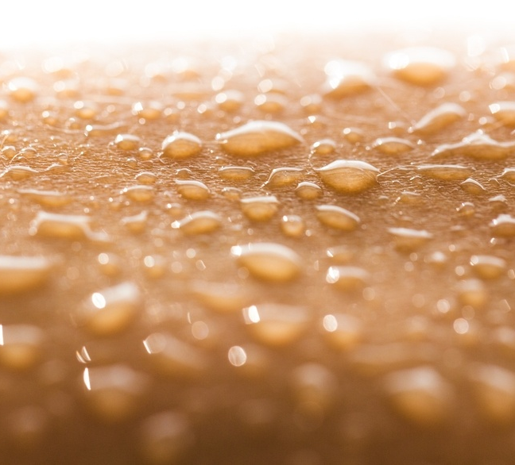
How is water gained and lost?
How is water gained and lost by the body?
Water is gained by the body from food and drink. It is also produced during cellular respiration.
Water is lost from the body via the lungs during exhalation. Water, ions and urea are all lost in sweat, urine and feces.
There is no control over water, ion or urea lost by the lungs or skin.
The only way to regulate water balance is via the kidneys.
This is achieved by varying the volume and concentration of urine they produce.
Notes:
Teacher notes
Help students to draw on their understanding of other life science topics to answer the question. Encourage them to remember that water is a waste product of cellular respiration, which is a reaction that releases energy from glucose, and occurs in all living cells.
For more information on cellular respiration, please refer to the Cellular Respiration presentation.
This slide covers the Science and Engineering Practices:
Constructing Explanations and Designing Solutions: Apply scientific ideas, principles, and/or evidence to provide an explanation of phenomena and solve design problems, taking into account possible unanticipated effects.
Obtaining, Evaluating, and Communicating Information: Communicate scientific and/or technical information or ideas (e.g. about phenomena and/or the process of development and the design and performance of a proposed process or system) in multiple formats (including orally, graphically, textually, and mathematically).
Photo credit: © Billion Photos, Shutterstock.com 2018

Slide 7
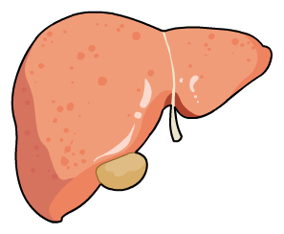
Making and excreting urea
When proteins are digested, they are broken down into amino acids. These are then absorbed into the blood.
Most of the amino acids are used to make new proteins. Any excess amino acids are transported to the liver to be broken down.
First, the amino acids undergo deamination to form ammonia.
However, ammonia is very toxic so it is converted into urea, which is less toxic to the body.
The urea is then transported in the blood to the kidneys, where it is excreted from the body in the urine.
Notes:
Teacher notes
Deamination is the removal of the amino group found in amino acids. The amino group goes on to form ammonia (NH₃). The ammonia then reacts with carbon dioxide to form urea (CH₄N₂O).
If urea is not excreted properly it can build up in the body. If the concentration of urea in the blood becomes too high, it can lead to the condition uremia. This is usually caused by the kidneys being unable to effectively remove urea from the blood. Symptoms include tiredness, vomiting and weight loss. Without treatment, uremia can lead to death.

Slide 8
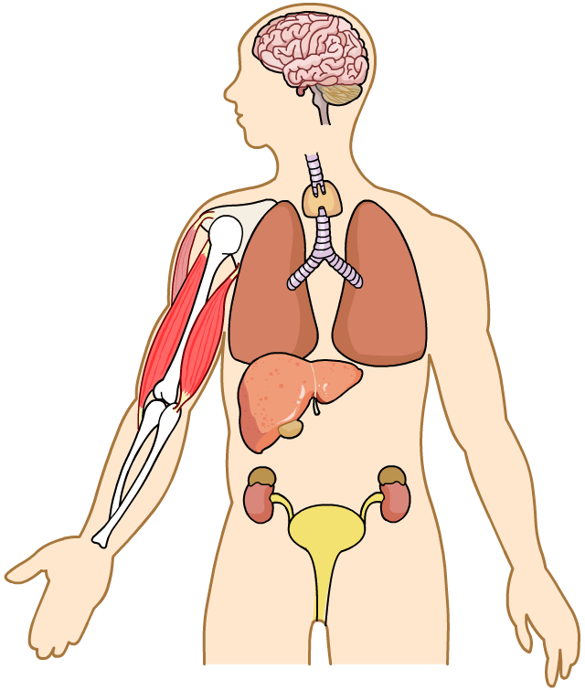
The role of the kidneys
The kidneys filter the blood. Some substances are excreted, while others are selectively reabsorbed.
Useful substances reabsorbed include glucose, some ions and water.
kidneys
Urea, excess water and excess ions are excreted.
bladder
The substances excreted go on to form urine. This is stored in the bladder before being removed from the body.
Notes:
Teacher notes
Ask students to identify the location of the kidneys and the bladder on the image, before revealing their labels.

Slide 9
The kidneys: true or false?

Slide 10
The urinary system
The urinary system is the organ system of the body responsible for the production and excretion of urine.
renal artery: takes blood to the kidneys
renal vein: takes blood away from the kidneys
ureters: take urine from the kidneys to the bladder
kidney: filters waste products from the blood, producing urine
urethra: takes urine out of the body
bladder: stores urine
Notes:
Teacher notes
Waste products are filtered from the blood as it passes through the kidney. The urine produced is transported along the ureters from the kidneys to the bladder, where it is temporarily stored. The urine later leaves the bladder and the body via the urethra.
Unfiltered blood enters the kidney via the renal artery. Filtered blood leaves the kidney in the renal vein.
Photo credit: © O2creationz, Shutterstock.com 2018

Slide 11
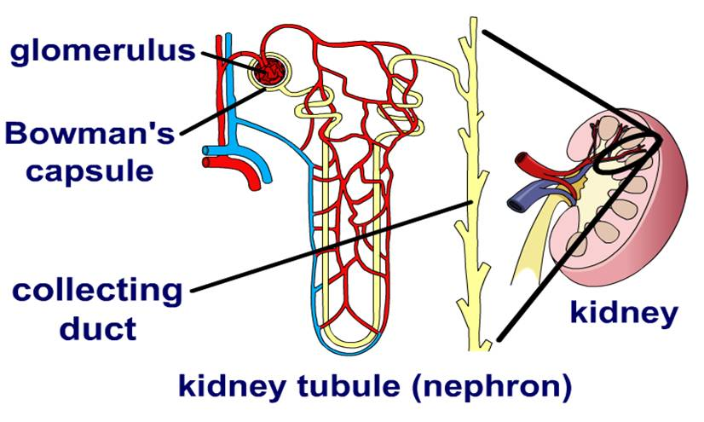
Structure of the kidney
The kidney contains many kidney tubules called nephrons.
In the glomerulus, substances are filtered out of the blood into the first part of the nephron tubule, called Bowman’s capsule.
Along the tubule, some substances are selectively reabsorbed.
Most water reabsorption occurs at the end of the tubule, called the collecting duct.
The remaining filtered substances form the urine, which travels out of the kidney to the bladder.
Notes:
Teacher notes
The glomerulus is a ball of blood vessels. As blood passes through these blood vessels it is filtered and the filtered substances enter Bowman’s capsule – the start of the nephron.
The collecting duct is at the end of the nephron. Its permeability to water is controlled by a hormone called ADH.

Slide 12
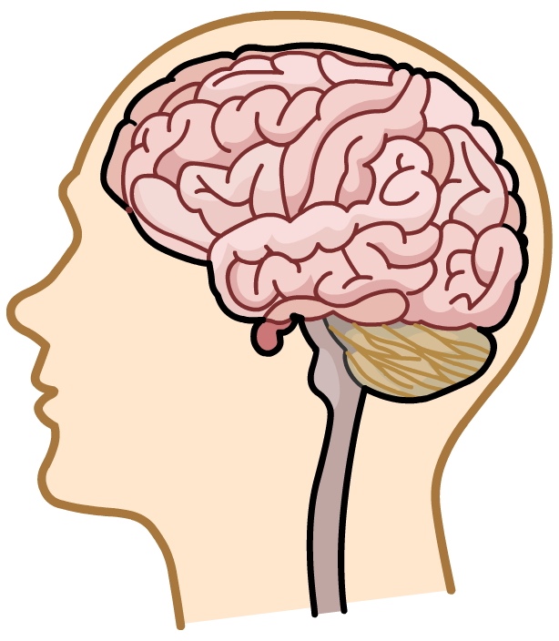
ADH and urine production
The production of urine is regulated by a hormone called antidiuretic hormone (ADH).
ADH is produced by the pituitary gland in the brain. It is secreted into the blood and transported to the kidney where it alters the permeability of the kidney tubules.
pituitary gland
The secretion of ADH is determined by receptors in the brain that monitor water balance.
The concentration of ADH in the blood determines how much water is reabsorbed from the tubule, and therefore how much urine is produced.
Notes:
Teacher notes
Ask students to identify the location of the pituitary gland on the image, before revealing its label.
For more information on hormones, please refer to The Endocrine System presentation.

Slide 13
How does ADH affect the kidney?
Notes:
Teacher notes
This activity could be used to explain how ADH alters the permeability of the kidney tubules to maintain water balance. Students could also be asked how negative feedback is involved in this control system.
This slide covers the Science and Engineering Practice:
Constructing Explanations and Designing Solutions: Apply scientific ideas, principles, and/or evidence to provide an explanation of phenomena and solve design problems, taking into account possible unanticipated effects.

Slide 14
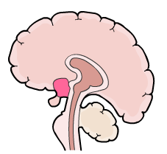
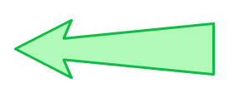
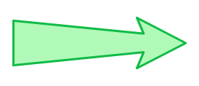
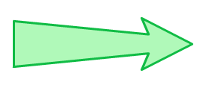
ADH is controlled by negative feedback
pituitary gland releases more ADH
change detected by receptors in the brain
kidney tubules become more permeable to water
thirst is increased
must reabsorb more water
increase in salt concentration, too little water in body
normal salt concentration of blood
concentrated urine
dilute urine
decrease in salt concentration, too much water in body
must excrete more water
kidney tubules become less permeable to water
thirst is reduced
change detected by receptors in the brain
pituitary gland releases less ADH
Notes:
Teacher notes
Negative feedback is when a change from the normal level leads to a response to oppose the change, which returns the level back to normal.
ADH is controlled by a negative feedback mechanism.
When there is too little water in the body, the pituitary gland produces more ADH. This makes the kidney tubules more permeable to water, which means more water can be reabsorbed from the kidney tubule into the blood. As a result, a more concentrated and smaller volume of urine is produced.
When there is too much water in the blood, the pituitary gland produces less ADH. This makes the kidney tubules less permeable to water, which means less water can be reabsorbed from the kidney tubule into the blood. As a result, a more dilute (less concentrated) and larger volume of urine is produced.
Most water is reabsorbed from the collecting duct – the end of the kidney tubule. This is where ADH has its greatest effect on the permeability of the kidney tubule.
For more information on negative feedback, please refer to the Homeostasis presentation.
This slide covers the Science and Engineering Practice:
Developing and Using Models: Develop, revise, and/or use a model based on evidence to illustrate and/or predict the relationships between systems or between components of a system.

Slide 15
Factors affecting urine production
Notes:
Teacher notes
These factors all present osmotic challenges to the body.
This slide is accompanied by the worksheet Excretion.

Slide 16
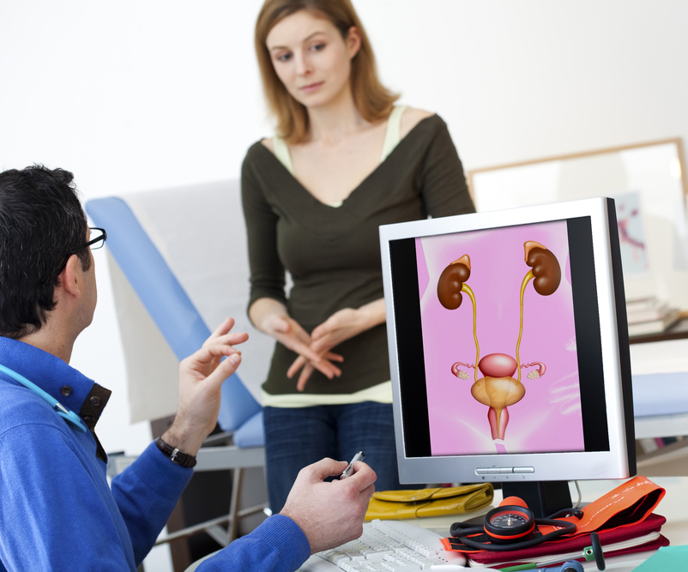
What happens if the kidneys fail?
Kidney failure can occur due to infection, diabetes, high blood pressure or damage following an accident.
If left untreated, waste products such as urea build up in the blood. This affects the function of body cells, which can lead to further health problems.
Kidney failure is a serious condition as it affects all other parts of the body.
There are two main methods to treat kidney failure:
kidney dialysis
kidney transplant
Notes:
Teacher notes
Symptoms of kidney failure include weight loss, swelling and high blood pressure.
Photo credit: © Image Point Fr, Shutterstock.com 2018

Slide 17
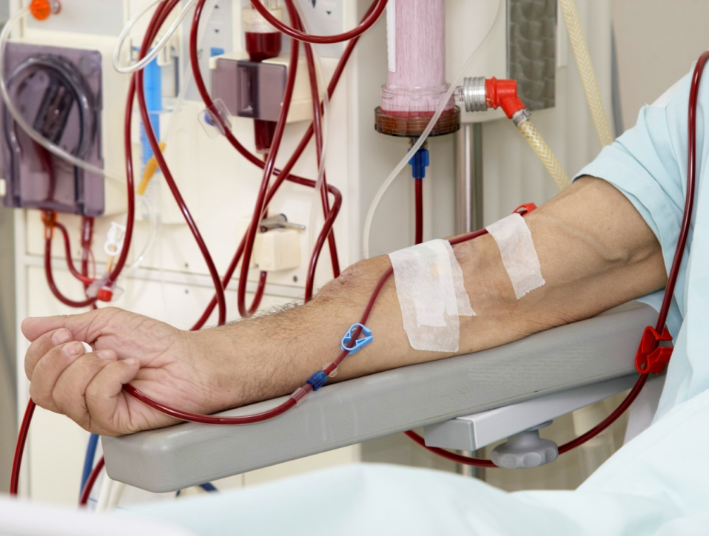
What is dialysis?
Dialysis involves filtering the blood outside the body in a machine which acts as an artificial kidney.
The tube is inserted into the patient’s arm, taking their blood to the dialysis machine.
Inside the machine, the blood passes across a special membrane. This removes waste products from the blood before returning it to the body.
Dialysis has to be carried out regularly to prevent the build up of waste products in the blood, often several times a week.
Notes:
Teacher notes
Kidney dialysis is used to reduce the concentration of urea and salts in a patient’s blood. High concentrations of these substances can cause organ damage.
Dialysis has a huge affect on a patient’s lifestyle. They must make frequent hospital visits to receive treatment and be careful of what they eat and drink.
Photo credit: © Picsfive, Shutterstock.com 2018

Slide 18
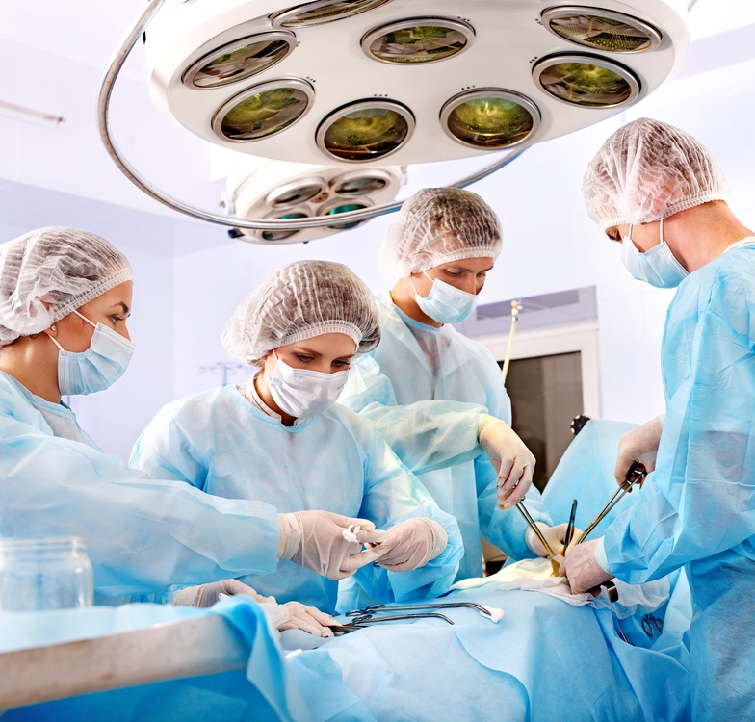
Kidney transplantation
Kidney failure can also be treated by giving a patient a kidney transplant. This involves replacing the damaged kidney with a healthy kidney from a donor.
Organs can come from living or recently deceased donors.
The donated kidney must be a close tissue match to the patient. This reduces the risk of rejection, which can cause a transplant to fail.
If the transplant is successful, the patient should no longer need to have dialysis. Kidney transplants last for around 10 years.
Notes:
Teacher notes
Often the donor organ is taken from a family member of the patient. They are likely to be a good tissue match as they will share many genes with the patient. This means the patient’s immune system is less likely to react to the new organ, reducing the risk of rejection.
Photo credit: © Poznyakov, Shutterstock.com 2018

