Slide 1
Extinction

Slide 2
Information
Constructing Explanations and Designing Solutions
Obtaining, Evaluating and Communicating Information
1. Patterns
2. Cause and Effect
6. Structure and Function
7. Stability and Change

Slide 3
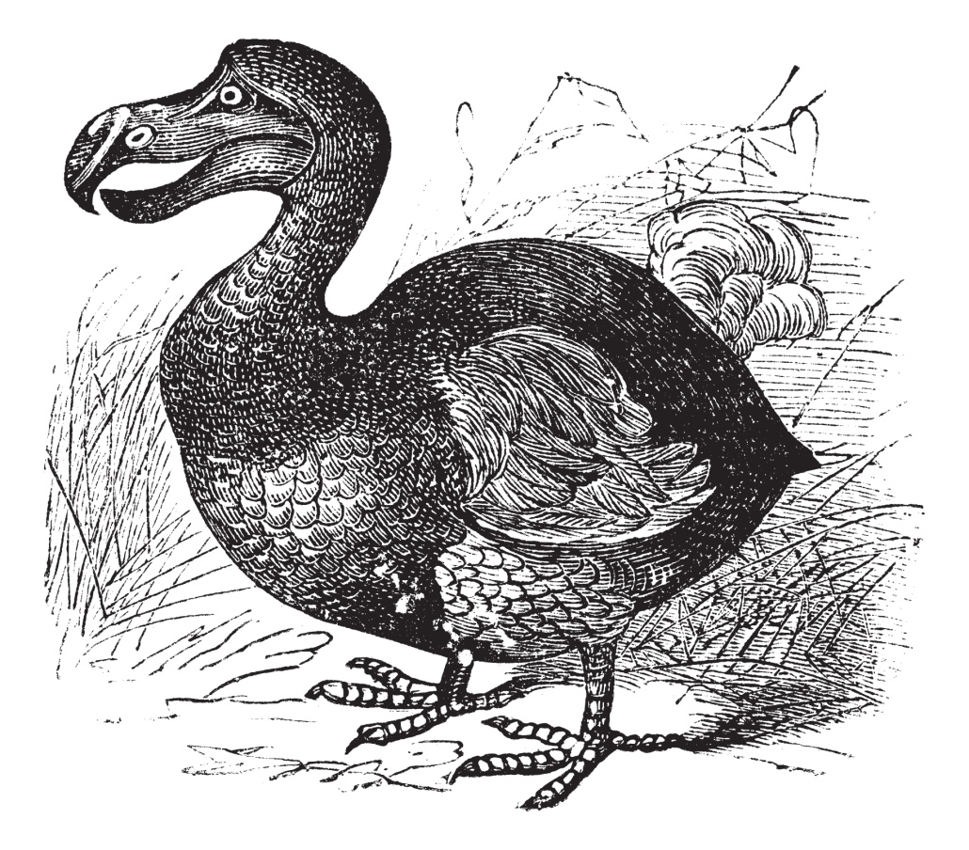
What is extinction?
Extinction occurs when there are no remaining individuals of a species still alive.
Rare species have a low population size, which increases their risk of extinction.
Extinction can be caused by changes in the environment that a species lives in.
Can you name any examples of these type of changes?
Notes:
This slide covers the Science and Engineering Practices:
Constructing Explanations and Designing Solutions: Apply scientific ideas, principles, and/or evidence to provide an explanation of phenomena and solve design problems, taking into account possible unanticipated effects.
Obtaining, Evaluating, and Communicating Information: Communicate scientific and/or technical information or ideas (e.g. about phenomena and/or the process of development and the design and performance of a proposed process or system) in multiple formats (including orally, graphically, textually, and mathematically).
Photo credit: vintage engraving of a dodo (Raphus cucullatus) © Morphart Creation, Shutterstock.com 2018

Slide 4
What changes can cause extinction?

Slide 5
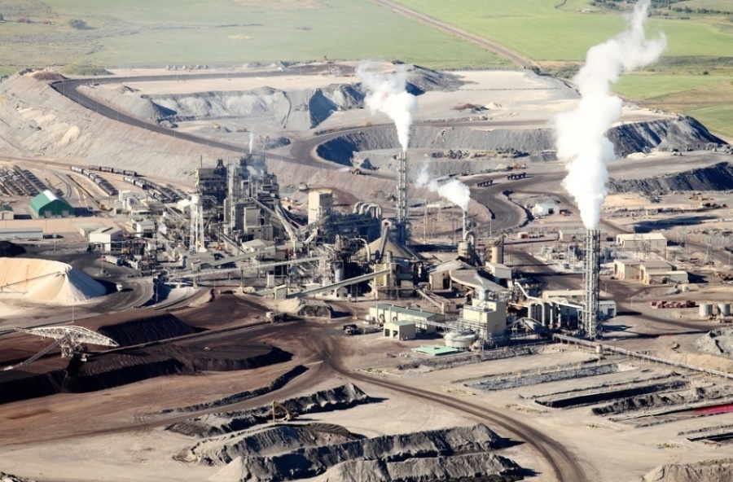
Human causes of extinction (1)
Humans are one of the main causes of habitat destruction.
Mining, logging, farming and building are all linked to the loss, destruction and pollution of habitats.
The rising human population is causing all these activities to increase to meet the growing demand.
If a species loses or becomes unable to survive in its habitat, its risk of extinction increases.
Notes:
Photo credit: © B Brown, Shutterstock.com 2018

Slide 6
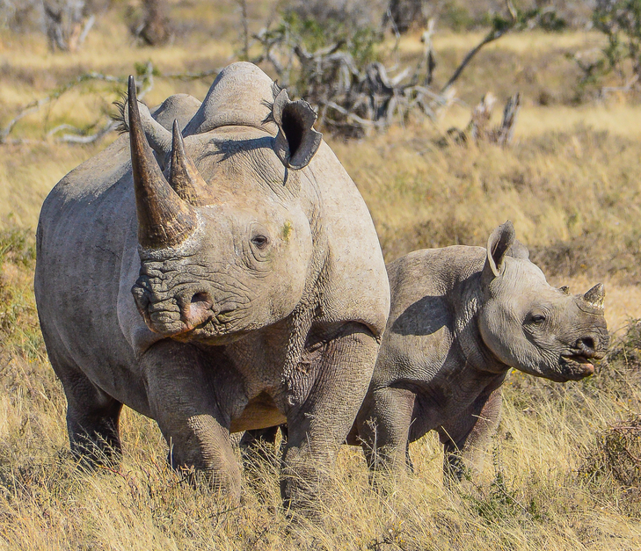
Human causes of extinction (2)
Over-hunting and poaching can also cause extinction.
In Africa, the poaching of black rhinos led to their population size dropping by 96%, from 65,000 individuals in 1970 to just 2,300 in 1993.
Conservation programs are trying to prevent the species from becoming extinct.
The current population of black rhinos has risen to just over 5,000 individuals. However, they are still endangered and could become extinct if more isn’t done to increase numbers.
Notes:
Teacher notes
The figure referring to the population size of black rhinos in Africa was taken from the following website:
https://www.savetherhino.org/rhino_info/rhino_population_figures
This weblink was working at the time of publication. Boardworks is not responsible for the content of third party sites.
Photo credit: © Cathy Withers-Clarke, Shutterstock.com 2018

Slide 7
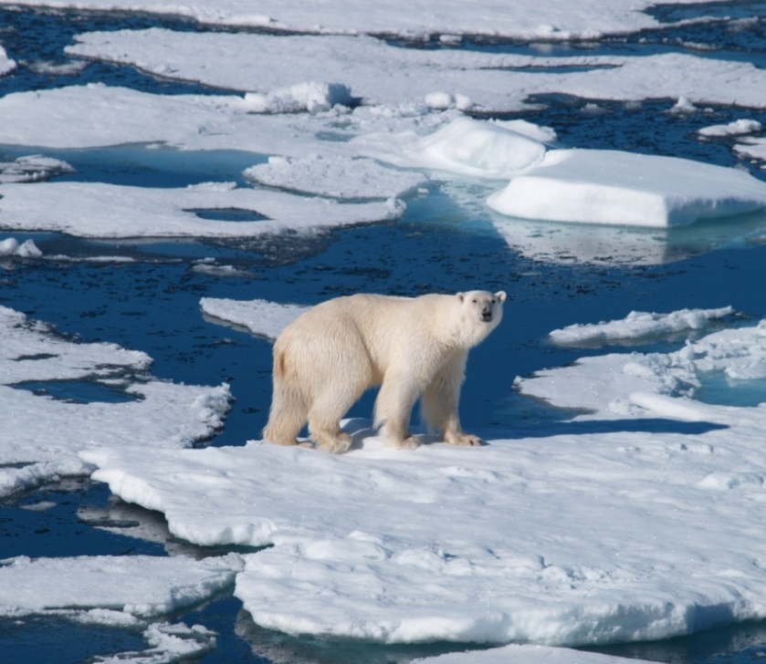
Climate change and extinction
Climate change has been linked to changing weather patterns which can increase the risk of extinction.
Changes in rainfall can affect a species’ food supply. If there is drought or flooding a species might not have access to its usual resources.
Climate change can also lead to habitat loss.
Rising sea temperatures have increased the melting of ice caps. This has reduced the habitat for species including the polar bear.
Notes:
Photo credit: © Yvonne Pijnenburg-Schonewille, Shutterstock.com 2018

Slide 8
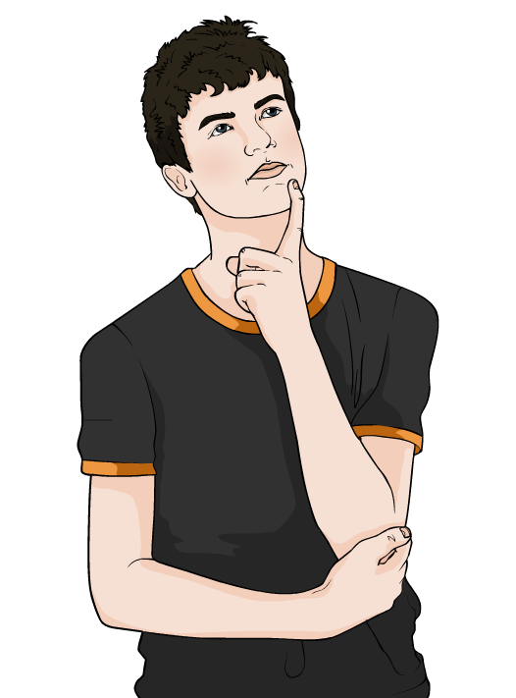
Adapting to change
Members of the species need to be able to cope with a change, or adjust to it, if the species is to survive.
How do you think this can happen?
Natural selection acts on variation in species members.
If any individuals happen to have a trait that helps them to live in their new environment, they are more likely to survive and reproduce.
Over time, the species may evolve to adjust to the change.
Notes:
Teacher notes
Discuss students’ ideas for the question before revealing the answer. Help them to apply their understanding of natural selection and evolution to provide an explanation.
This slide covers the Science and Engineering Practices:
Constructing Explanations and Designing Solutions: Apply scientific ideas, principles, and/or evidence to provide an explanation of phenomena and solve design problems, taking into account possible unanticipated effects.
Obtaining, Evaluating, and Communicating Information: Communicate scientific and/or technical information or ideas (e.g. about phenomena and/or the process of development and the design and performance of a proposed process or system) in multiple formats (including orally, graphically, textually, and mathematically).

Slide 9
Natural selection in action
Notes:
This slide covers the Science and Engineering Practice:
Constructing Explanations and Designing Solutions: Apply scientific ideas, principles, and/or evidence to provide an explanation of phenomena and solve design problems, taking into account possible unanticipated effects.

Slide 10
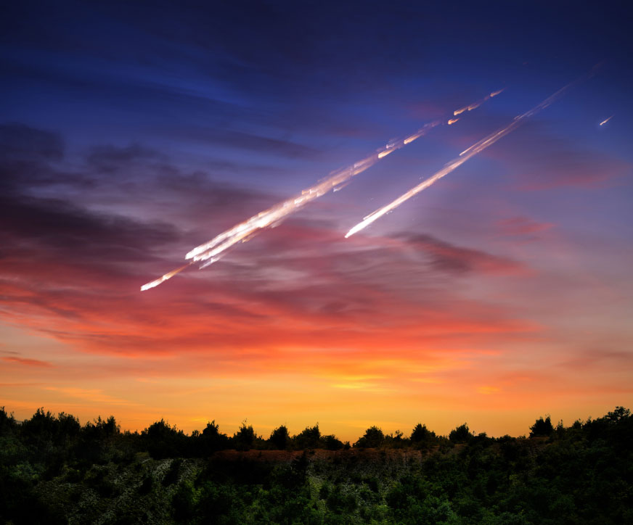
Environmental change
If an environmental change is too fast, or too large, then members of the species will not be able to adjust to it.
Why do you think this is?
Natural selection cannot act quickly enough to give enough individuals the characteristics they need to survive and reproduce.
Can you name any examples of changes that might be too fast or too large for species to adapt to them?
Notes:
This slide covers the Science and Engineering Practices:
Constructing Explanations and Designing Solutions: Apply scientific ideas, principles, and/or evidence to provide an explanation of phenomena and solve design problems, taking into account possible unanticipated effects.
Obtaining, Evaluating, and Communicating Information: Communicate scientific and/or technical information or ideas (e.g. about phenomena and/or the process of development and the design and performance of a proposed process or system) in multiple formats (including orally, graphically, textually, and mathematically).
Photo credit: © Triff, Shutterstock.com 2018

Slide 11
Climate change and extinction
Notes:
Teacher notes
This animation could be used as a starting point for discussing how different species may be affected by climate change.
This slide covers the Science and Engineering Practice:
Constructing Explanations and Designing Solutions: Apply scientific ideas, principles, and/or evidence to provide an explanation of phenomena and solve design problems, taking into account possible unanticipated effects.

Slide 12
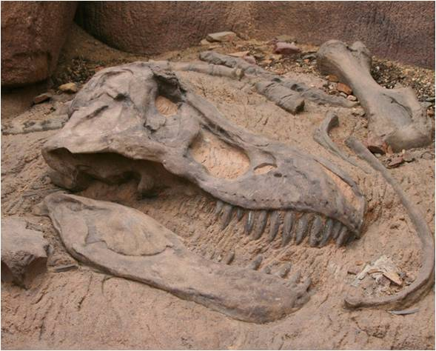
Mass extinction
Over evolutionary history there have been several mass extinction events. During a mass extinction, many species go extinct over the same relatively short time period.
Mass extinctions occur on a global scale, with extinctions taking place over a large area.
They are usually caused by a single catastrophic event, such as a volcanic eruption or a comet striking Earth.
The K–T extinction event 65 million years ago led to the extinction of the dinosaurs.
Notes:
Teacher notes
The K–T extinction led to the loss of around 75% of the Earth’s plant and animal species. It is thought to have been caused by an asteroid that hit Earth and led to changes in global weather patterns. Evidence suggests the asteroid caused a prolonged period of cold weather, while dust and ash emitted into the atmosphere by the impact reduced the amount of sunlight reaching the Earth, affecting photosynthesis.
Photo credit: © Styve Reineck, Shutterstock.com 2018

