Slide 1
Feeding Relationships

Slide 2
Information
Developing and Using Models
Constructing Explanations and Designing Solutions
Obtaining, Evaluating and Communicating Information
1. Patterns
2. Cause and Effect
4. Systems and System Models
5. Energy and Matter

Slide 3
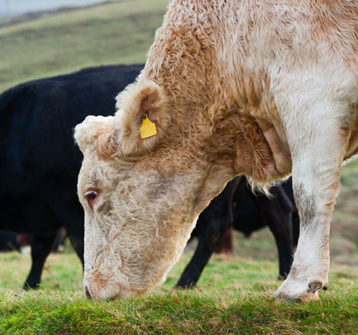
Feeding types
Organisms can be grouped in several ways. One grouping system is based on how organisms obtain their food.
Some organisms produce their own food. They are called producers.
Plants produce their own food using light energy from the Sun.
Some types of bacteria can also make their own food by using light or chemical reactions.
Other organisms cannot make their own food. They are called consumers.
grass is a producer
the cow is a consumer
Notes:
Photo credit: © Richardzz, Shutterstock.com 2018

Slide 4
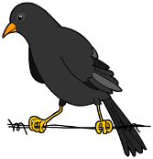
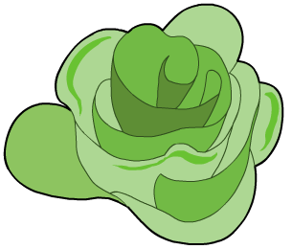
Food chains (1)
A food chain is a sequence that describes the feeding relationships in a group of organisms.
leaf
caterpillar
bird
fox
What does this food chain show?
A leaf is eaten by a caterpillar, which is then eaten by a bird, which is then eaten by a fox.
Energy is transferred from one organism to another in the direction of the arrow.
Notes:
This slide covers the Science and Engineering Practices:
Developing and Using Models: Develop, revise, and/or use a model based on evidence to illustrate and/or predict the relationships between systems or between components of a system.
Obtaining, Evaluating, and Communicating Information: Communicate scientific and/or technical information or ideas (e.g. about phenomena and/or the process of development and the design and performance of a proposed process or system) in multiple formats (including orally, graphically, textually, and mathematically).

Slide 5
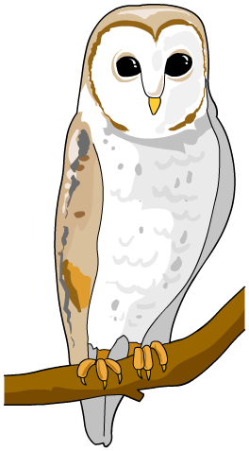
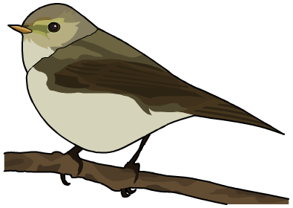
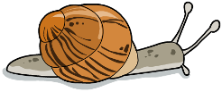
Food chains (2)
Food chains always start with a producer.
If the producer is a plant, only a small part of it might be involved in the food chain, such as its seeds, fruits, leaves or even dead leaves.
From a food chain, we can tell if an organism is a producer or a consumer.
leaf
snail
bird
owl

Slide 6
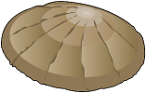
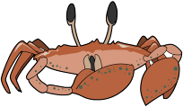
Ranking consumers
Consumers eat plants or animals, or both. A food chain can be used to rank different types of consumers.
seaweed
limpet
crab
human
producer
primary
consumer
secondary
consumer
tertiary
consumer
Producers make their own food.
Primary consumers eat producers.
Secondary consumers eat primary consumers.
Tertiary consumers eat secondary consumers.

Slide 7
What is the feeding type?
Notes:
This slide is accompanied by the worksheet Feeding Relationships.
This slide covers the Science and Engineering Practice:
Developing and Using Models: Develop, revise, and/or use a model based on evidence to illustrate and/or predict the relationships between systems or between components of a system.

Slide 8
Trophic levels
The position of an organism in a food chain is called a trophic level. A trophic level describes an organism’s role in a feeding relationship. Biomass is transferred between trophic levels.
These different levels are represented by numbers, starting at level 1 with the lowest organism in the food chain.
All food chains have the same basic trophic levels:
level 3
producers
level 2
consumers – primary, secondary and tertiary
decomposers.
level 1
Notes:
Teacher notes
The number of trophic levels depends on the size and organization of the ecosystem. Ecosystems with a smaller number of species are likely to have fewer trophic levels than ecosystems with more species.

Slide 9
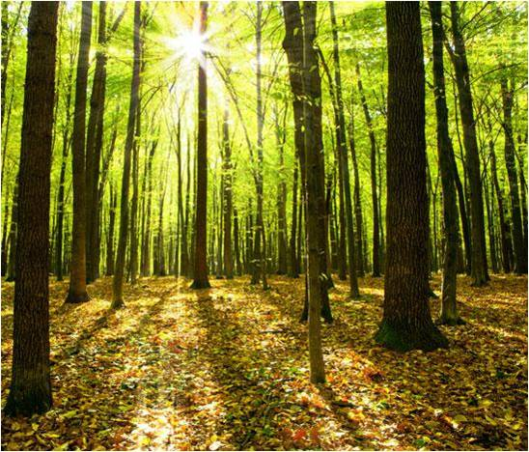
Level 1: producers
Organisms at the first trophic level use energy from an external source to produce their own food. They are producers.
Producers include plants, algae and some bacteria.
Plants and algae produce their own food using light energy from the Sun.
This process is called photosynthesis.
Notes:
Teacher notes
For more information on photosynthesis, please refer to the Photosynthesis presentation.
Photo credit: © vovan, Shutterstock.com 2018

Slide 10
Level 2: primary consumers
Organisms at the second trophic level are called primary consumers.
Remember, primary consumers eat producers.
Organisms found at this trophic level include cows, rabbits and caterpillars.
Because these animals only eat plants they can also be known as herbivores.
Notes:
Photo credit: © Valentin Valkov, Shutterstock.com 2018

Slide 11
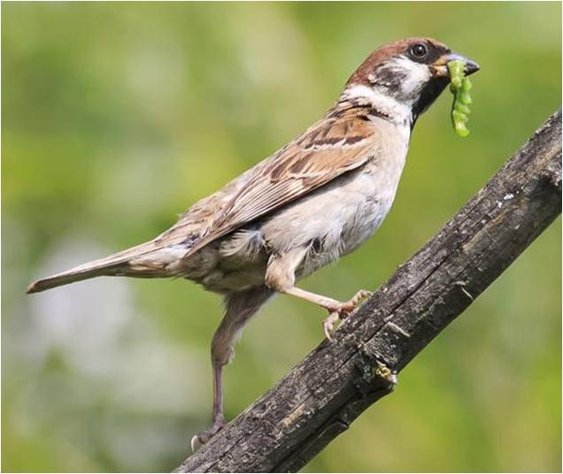
Level 3: secondary consumers
Organisms at the third trophic level are called secondary consumers.
These organisms eat primary consumers.
Organisms found at this trophic level include snakes, frogs and some birds.
Because these animals only eat other animals they can also be known as carnivores.
Notes:
Photo credit: © Bachkova Natalia, Shutterstock.com 2018

Slide 12
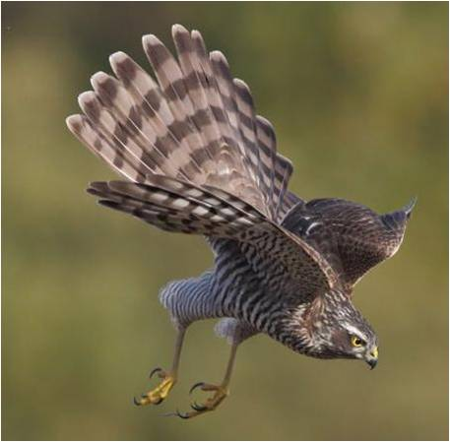
Level 4: tertiary consumers
Organisms at the fourth trophic level are tertiary consumers.
These organisms eat secondary consumers.
Sparrowhawks are an example of a tertiary consumer. They eat blue tits and sparrows, which are secondary consumers.
Subsequent trophic levels are numbered according to where the organism is located in a food chain.
Apex predators are found at the top of their food chain. They are carnivores that have no predators.
Notes:
Teacher notes
Apex predators include:
humans
lions
tigers
killer wales.
Photo credit: © Szczepan Klejbuk, Shutterstock.com 2018

Slide 13
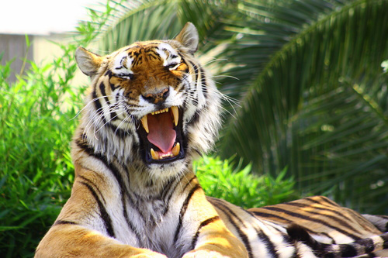
The length of food chains
A tiger is an apex predator, which means it is at the final level in a food chain.
Most food chains only contain four or five species, or fewer.
Why do you think this is?
Energy is lost at all levels in food chains.
For example, plants cannot actually absorb all of the energy available to them from the Sun.
If a food chain was very long, animals at the top of it would not get enough energy to survive.
Notes:
This slide covers the Science and Engineering Practices:
Constructing Explanations and Designing Solutions: Apply scientific ideas, principles, and/or evidence to provide an explanation of phenomena and solve design problems, taking into account possible unanticipated effects.
Obtaining, Evaluating, and Communicating Information: Communicate scientific and/or technical information or ideas (e.g. about phenomena and/or the process of development and the design and performance of a proposed process or system) in multiple formats (including orally, graphically, textually, and mathematically).
Photo credit: © evrenkalinbacak, Shutterstock.com 2018

Slide 14
Building an Antarctic food chain
Notes:
This slide covers the Science and Engineering Practice:
Developing and Using Models: Develop, revise, and/or use a model based on evidence to illustrate and/or predict the relationships between systems or between components of a system.

