Slide 1
Homeostasis

Slide 2
Information
Developing and Using Models
1. Patterns
2. Cause and Effect
4. Systems and System Models
6. Structure and Function
7. Stability and Change

Slide 3
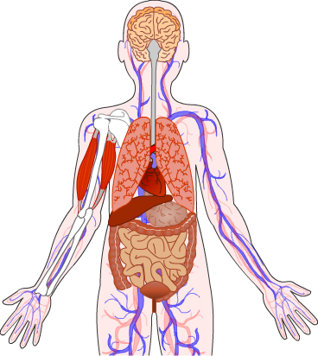
What is homeostasis? (1)
Homeostasis is the regulation of the internal conditions of a cell or organism to maintain optimum conditions for function.
For this to be achieved, the cell or organism must be able to sense and respond to changes in internal and external conditions.
Homeostasis maintains optimal conditions for the activity of enzymes.
This ensures the metabolic reactions they catalyze occur at the appropriate rate, which enables cells to function properly.
Notes:
Teacher notes
For more information on metabolic reactions, please refer to the Metabolism presentation.

Slide 4
What is homeostasis? (2)
Notes:
Teacher notes
This three-stage animation can be used to introduce the concept of homeostasis in terms of responding to changes in external conditions.
This slide covers the Science and Engineering Practice:
Developing and Using Models: Develop, revise, and/or use a model based on evidence to illustrate and/or predict the relationships between systems or between components of a system.

Slide 5
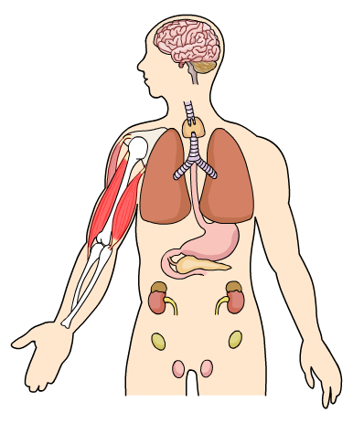
Achieving homeostasis (1)
Internal conditions are maintained by automatic control systems in the body. All control systems include:
Receptor cells, which detect changes in the environment called stimuli.
Coordination centers, which receive and process information from receptors. These include the brain, spinal cord and pancreas.
Effectors, which bring about responses to maintain optimal conditions. These include muscles and endocrine glands.
Notes:
Teacher notes
For more information about endocrine glands, please refer to The Endocrine System presentation.

Slide 6
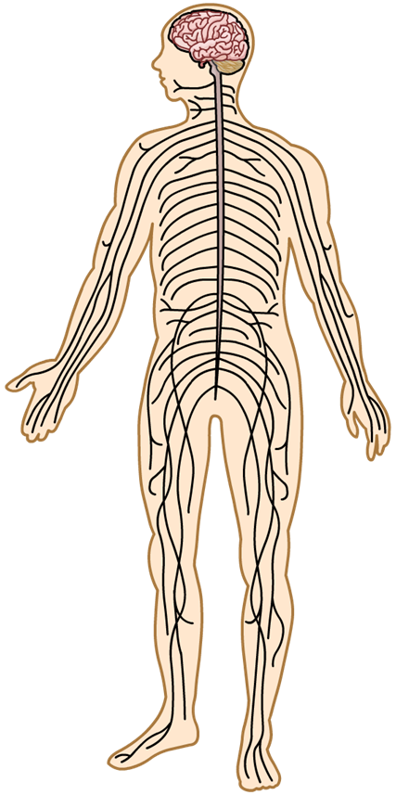
Achieving homeostasis (2)
Automatic control systems may involve nervous or chemical responses to maintain internal conditions.
The nervous system uses electrical impulses to carry information between receptors, coordination centers and effectors.
Glands in the endocrine system can secrete hormones. These act as chemical messengers that are able to bring about responses that restore optimal conditions.
Notes:
Teacher notes
For more information about hormones, please refer to The Endocrine System presentation.

Slide 7
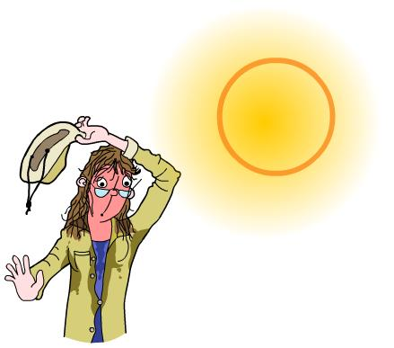
Controlling body conditions
Many body conditions are maintained at their optimum level through homeostasis, including:
core body temperature
blood glucose levels
water levels
mineral ion levels.
Can you name some of the organs involved in the control of these body conditions?
Notes:
Teacher notes
Organs involved in the control of body conditions include:
core body temperature – the skin, muscles and blood vessels
water levels – the kidney
blood glucose levels – the pancreas, liver and muscles
mineral ion levels – the kidneys
For more information about controlling blood glucose concentration, please refer to the Glucoregulation presentation.
For more information about controlling core body temperature, please refer to the Thermoregulation presentation.
For more information about controlling water and mineral ion levels, please refer to the Excretion presentation.

Slide 8
The organs of homeostasis
Notes:
Teacher notes
Before clicking on each of the organs, students could be asked which they think is responsible for the regulation of water, temperature, glucose, ions and carbon dioxide.

Slide 9
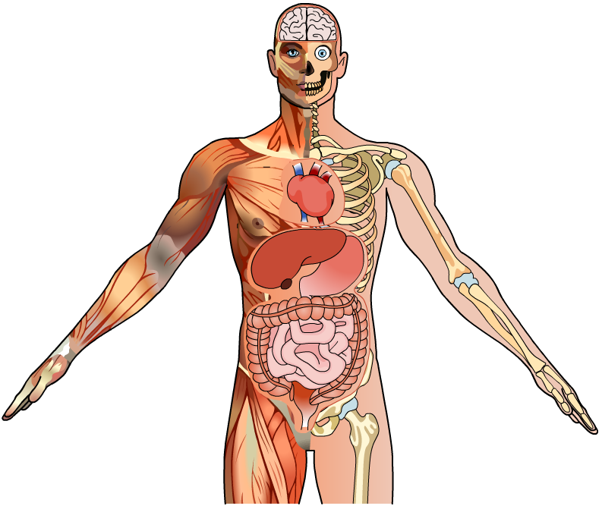
Negative feedback
Automatic control systems use negative feedback to restore optimal levels following a change in conditions.
Negative feedback is when a change in conditions leads to a response that reverses the change. This response returns conditions back to their optimum.
Body temperature, blood glucose levels and water balance are all maintained by automatic control systems using negative feedback.

Slide 10
Incubators: negative feedback
Notes:
Teacher notes
This five-stage animation can be used to introduce the general principle of negative feedback.
This slide covers the Science and Engineering Practice:
Developing and Using Models: Develop, revise, and/or use a model based on evidence to illustrate and/or predict the relationships between systems or between components of a system.

