Slide 1
Humans and the Environment

Slide 2
Information
Developing and Using Models
Constructing Explanations and Designing Solutions
Engaging in Argument from Evidence
Obtaining, Evaluating and Communicating Information
2. Cause and Effect
3. Scale, Proportion, and Quantity
4. Systems and System Models
7. Stability and Change

Slide 3
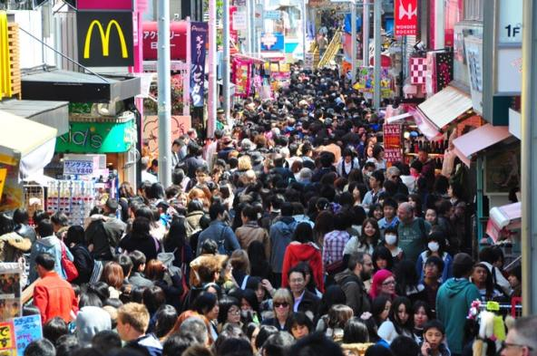
Human population growth
The size of the human population has increased rapidly over the past century. There were 1.5 billion humans in 1900, compared to over 7 billion alive today.
Alongside this, the average standard of living has also increased, meaning people own more material goods.
As a result, increasingly more resources are being used and more waste is produced – putting huge pressure on the environment and biodiversity of ecosystems.
Can you think of some natural resources that humans use?
Notes:
Teacher notes
Examples of natural resources used by humans include:
fossil fuels
wood
metals mined from the ground
rock quarried for building
fish and animals for food.
Population figures taken from https://ourworldindata.org/world-population-growth/
This weblink was working at the time of publication. Boardworks is not responsible for the content of third party sites.
Photo credit: © Perati Komson, Shutterstock.com 2018

Slide 4
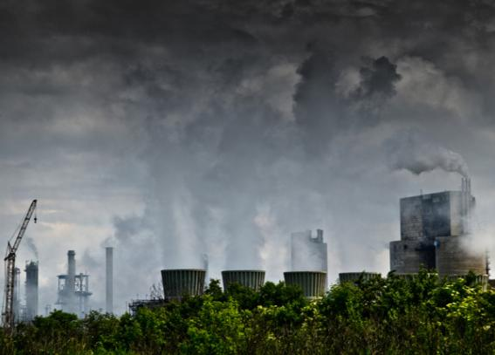
Pollution
Many human activities produce large amounts of substances that are harmful to the environment.
Environmental pollution happens when these substances are not handled properly.
Pollution has negative impacts on habitats and the species they contain. It can cause a reduction in biodiversity.
Pollutants often persist in the environment for many years.
Can you name any human activities that cause pollution?
Notes:
Teacher notes
You may wish to remind students what a habitat is: the natural environment in which an organism normally lives.
Examples of activities that cause pollution include: burning fossil fuels, mining, exhaust fumes from vehicles and littering.
Photo credit: © Balu, Shutterstock.com 2018

Slide 5
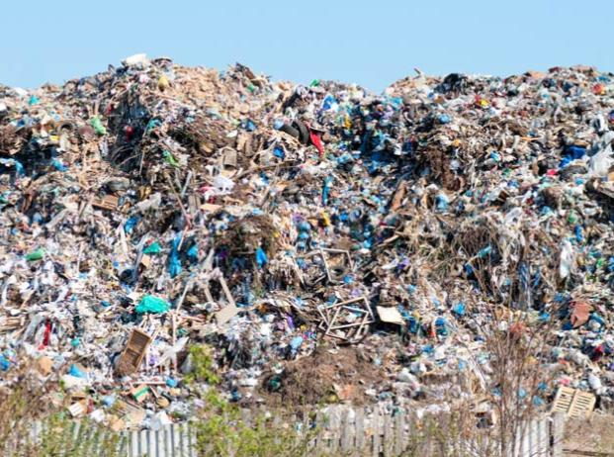
Land pollution
Land pollution causes damage to the Earth’s surface. Landfill sites are areas where human rubbish is dumped and buried. They often lead to land pollution.
Rubbish can take many years to break down. Some types of rubbish also release toxic chemicals as they break down, which can enter the soil.
This leads to soil pollution. As a result, plants may be unable to grow on the land.
The growing human population means more landfill sites will be needed in the future to handle waste.
Notes:
Photo credit: © yevgeniy11, Shutterstock.com 2018

Slide 6
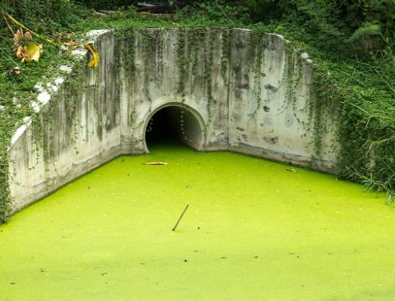
Water pollution
Sewage and toxic chemicals can enter lakes, rivers and seas via surface run-off or pipes leading directly into water supplies.
Sometimes, artificial fertilizers used in farming enter lakes. This can lead to a process called eutrophication.
Fertilizers can cause algae to grow rapidly on the lake’s surface. The algae blocks the light, causing plants growing in the lake to die.
The dead plants decay, causing oxygen levels in the water to fall.
If there is too little oxygen in the water, fish and other organisms living in the lake may die.
Notes:
Teacher notes
Surface run-off is when water flows from the land into water supplies including lakes, rivers and seas.
Artificial fertilizers are synthetic chemicals that are spread on crops to improve their growth. Many artificial fertilizers are high in nitrates, which are used by plants to make proteins and grow.
Photo credit: algae growing on water surface © Lodimup, Shutterstock.com 2018

Slide 7
What is eutrophication?
Notes:
Teacher notes
This five-stage animation illustrates the process of eutrophication. Suitable prompts could include:
Why do fertilizers make algae grow?
Increased amount of algae will reduce the amount of sunlight reaching plants. What effect will this have?
What will happen to the dead plants?
Why will bacterial decomposition of plants affect fish and other animal life in the lake?
Students can investigate eutrophication for themselves. Jars can be set up with a set amount of algae and different amount of phosphate in each. They can be left for a few days and then an oxygen probe used to measure the amount of dissolved oxygen in the water in each jar.

Slide 8
What happens during eutrophication?
Notes:
Teacher notes
This ordering activity could be used as an introductory or summary activity on eutrophication. Mini-whiteboards could be used to make this a whole-class exercise.
This slide covers the Science and Engineering Practice:
Constructing Explanations and Designing Solutions: Apply scientific ideas, principles, and/or evidence to provide an explanation of phenomena and solve design problems, taking into account possible unanticipated effects.

Slide 9
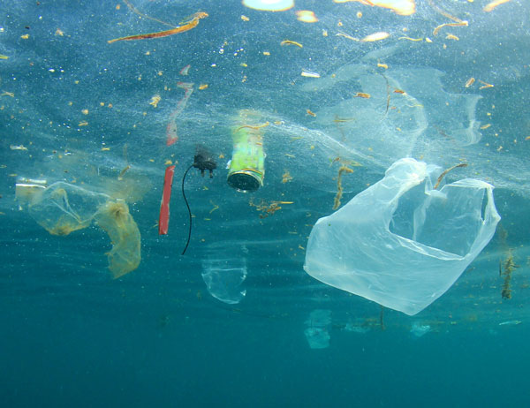
Ocean plastic pollution
Waste plastic sometimes escapes normal disposal routes and enters the environment. An estimated 9 million tons of plastic enters the world’s oceans each year.
Plastic does not break down properly in the environment. Over many years it breaks into smaller pieces. However, these cannot be broken down fully.
Organisms can become tangled in larger pieces of plastic waste. They can also mistake it for food.
Small plastic pieces, or microplastics, can be eaten by organisms further down marine food chains.
Notes:
Teacher notes
Ocean currents can carry waste plastic thousands of miles from its source. Larger marine organisms such as cetaceans (whales, dolphins, porpoises), sharks and turtles can become fatally tangled in waste fishing gear and other large plastic pollutants. Other items such as plastic bags and bottles are mistaken for food, as they can look similar to an organism’s natural food source. One example is plastic bags, which sea turtles find difficult to distinguish from jellyfish.
Microplastics are small enough to be inhaled through the breathing mechanisms of marine animals. They can also release chemicals into the ocean, and attract other chemical pollutants from the surrounding water. The study of microplastics is relatively new. Little is known about how these particles interact with ecosystems. It is also not known whether they will ever fully break down.
This slide is accompanied by the worksheet Humans and the Environment.
Photo credit: © Rich Carey, Shutterstock.com 2018

Slide 10
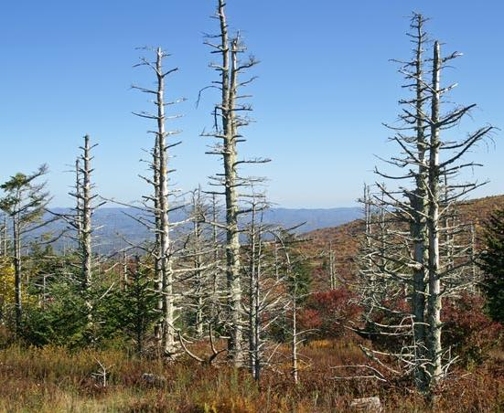
Air pollution
Air pollution occurs when harmful chemicals and materials, such as smoke from burning fuels and acidic gases produced by industrial activities, enter the Earth’s atmosphere.
Acidic gases can dissolve in the water held in clouds, leading to acid rain.
When the rain falls, it can cause changes in the pH of the soil and natural water resources.
If plant and animal species in the affected area are unable to cope with the increase in acidity, they may die. This can lead to population decline and a reduction in biodiversity.
Notes:
Photo credit: forest loss due to acid rain © Mary Terribery, Shutterstock.com 2018

Slide 11
What is acid rain?
Notes:
Teacher notes
This six-stage animation can be used to illustrate the principles of acid rain. The final stage of the animation shows that the effects of acid rain are not limited to the country causing the pollution. This could be used to stimulate a small group or whole-class discussion.

Slide 12
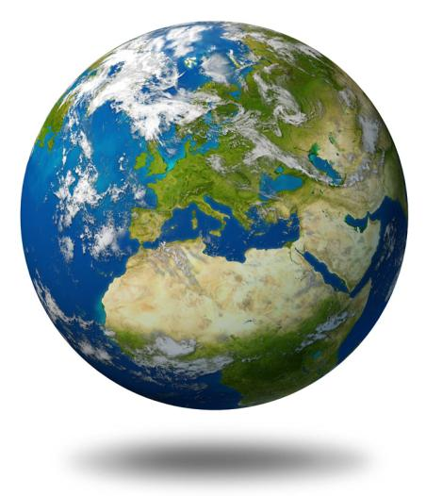
Global warming
Global warming describes the increase in the average temperature of the Earth’s atmosphere and oceans.
Human activities are releasing an increasing amount of carbon dioxide and methane into the atmosphere. Both these gases contribute to global warming.
Biological consequences of global warming include:
melting ice caps, causing rising sea levels
changes in weather patterns, leading to droughts and flooding
habitat loss, leading species to become endangered or extinct.
Notes:
Photo credit: © Lightspring, Shutterstock.com 2018

Slide 13
What is the greenhouse effect?
Notes:
Teacher notes
This four-stage animation can be used to illustrate the principles of the greenhouse effect. Students could be asked to consider the impact of rising greenhouse gases on the natural phenomenon of the greenhouse effect.
This slide covers the Science and Engineering Practice:
Developing and Using Models: Develop, revise, and/or use a model based on evidence to illustrate and/or predict the relationships between systems or between components of a system.

Slide 14
Possible effects of global warming
Notes:
Photo credits: flooding © Photos.com 2018; ocean © jeff gynane, glacier © kkaplin, agriculture © dusko, insect © Kletr, birds © Edwin Verin, plants © fotofriends, animals © kristian sekulic, all at Shutterstock.com 2018

Slide 15
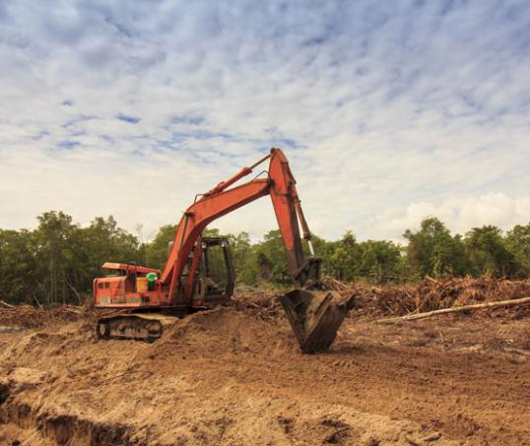
Land use and habitat loss
Many human activities lead to the damage or complete loss of habitats. This is a problem across the world.
Can you think of any human activities that result in the destruction of habitats?
building roads
quarrying
dumping waste
farming
The increasing human population means that the extent of these activities is growing. This is causing an increase in habitat loss.
Notes:
Photo credit: © Rich Carey, Shutterstock.com 2018

Slide 16
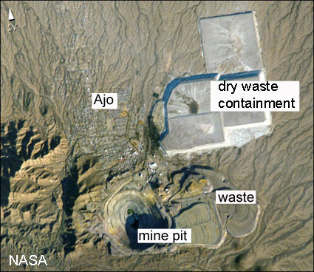
How does extraction affect the environment?
Open-cast mining removes ores using explosives. It produces dust and can scar the landscape. This disused copper mine in Ajo, Arizona, measures one mile wide.
Extracting metals causes huge amounts of waste. Copper production discards 99.5% of the extracted ore.
Harmful waste gases, including sulfur dioxide, carbon dioxide and carbon monoxide, are produced by extraction.
Extraction, especially electrolysis, also uses a lot of electricity.
Notes:
Teacher notes
More statistics about metal extraction are available at http://www.ourplanet.com/aaas/pages/population04.html
(American Association for the Advancement of Science)
Photo credit: NASA
The image was taken by astronauts aboard the International Space Station and shows the New Cornelia Mine, just south of Ajo, Arizona. The disused pit measures one mile wide and over one thousand feet deep.

Slide 17
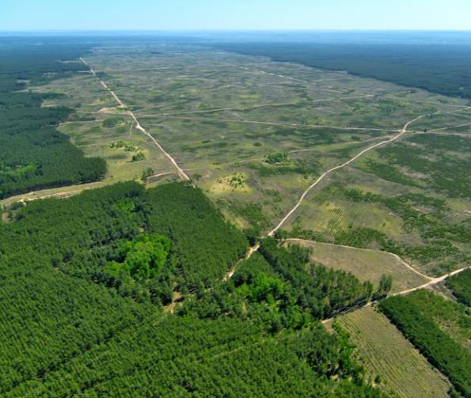
Deforestation
Deforestation is the removal of forest habitats to make alternative use of the land. This is often to make way for human activities, such as agriculture and cattle farming.
Replacing natural vegetation with crops reduces the number of plant species.
This can cause the populations of animal species that depend on the trees for food or habitat to decline.
As a result, deforestation leads to a reduction in biodiversity.
Notes:
Photo credit: © Fedorov Oleksiy, Shutterstock.com 2018

Slide 18
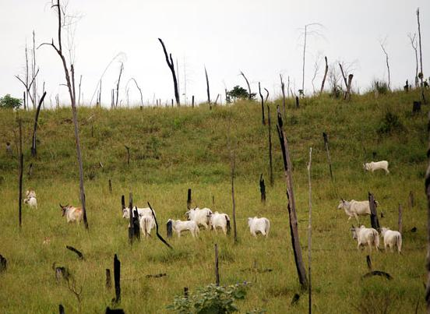
Tropical deforestation
Tropical deforestation is a particular concern, with 80% of the world’s species estimated to live in rainforests.
In the Amazon, the main reason for deforestation has been to provide land for cattle ranches and soybean crops.
Much of the meat produced by cattle, and biofuel made from soybeans, is exported to other countries. This is because there is a growing global demand for food and fuel.
In South East Asia, rainforests have been replaced by rice fields. The rice is used to feed the growing human population.
Notes:
Photo credit: © Frontpage, Shutterstock.com 2018

Slide 19
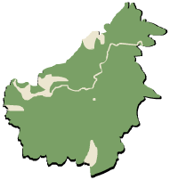
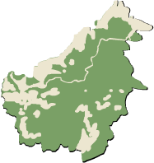
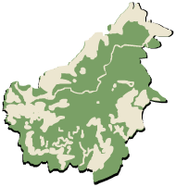
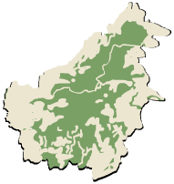
The effect of deforestation
Deforestation can mean species are unable to find the resources they need to survive. As a result, they may become endangered or even extinct.
In Borneo, the orangutan population is slowly declining as forests are removed to make way for food crops, like rice, and biofuel crops, such as palm oil.
1950
1985
2000
2005
What might happen if deforestation continues in Borneo?
Notes:
Teacher notes
The diagrams above represent the change in land use in Borneo over 55 years. Green represents land covered in forest, whilst gray indicates land without trees.
Between 1950 and 2005, 40% of Borneo’s rainforest was lost to deforestation.
This slide covers the Science and Engineering Practices:
Engaging in Argument from Evidence: Construct, use, and/or present an oral and written argument or counter-arguments based on data and evidence.
Obtaining, Evaluating, and Communicating Information: Communicate scientific and/or technical information or ideas (e.g. about phenomena and/or the process of development and the design and performance of a proposed process or system) in multiple formats (including orally, graphically, textually, and mathematically).
Data taken from: http://www.tropical-rainforest-animals.com/borneo-rainforest.html
This weblink was working at the time of publication. Boardworks is not responsible for the content of third party sites.

Slide 20
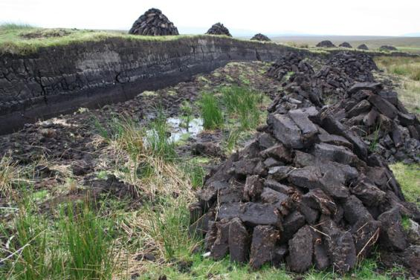
Peat bogs
Peat is formed in waterlogged bogs from partially decayed plant matter that has accumulated over thousands of years.
Peat bogs cover around 2% of the Earth’s land surface. However, the destruction of peat bogs is reducing the area of this habitat.
This reduces biodiversity by endangering the species of plants, animals and microorganisms that live there.
The peat removed is often used to produce garden compost. It can also be burnt as a fuel, which releases carbon dioxide into the atmosphere.
Notes:
Teacher notes
Ask students what effect they think burning peat would have on global warming.
Burning peat releases carbon dioxide, which is a greenhouse gas and contributes to global warming.
Photo credit: © Gary Andrews, Shutterstock.com 2018
Piece of peat dug up to be used later for burning.

Slide 21
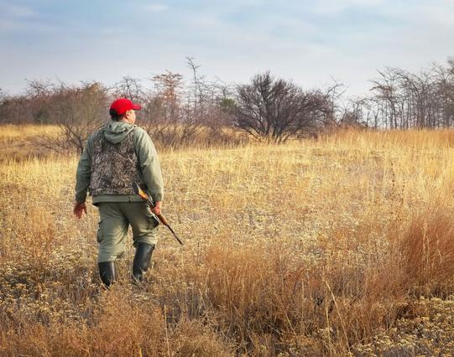
Hunting
Across the world, wild animals are hunted for both food and sport.
If the number of animals killed is not properly managed, it can lead to the population size of the species falling. As a result, the species can become endangered, or even extinct.
This can affect other species living in the same area that depend on the hunted species.
As a result, the area’s ecosystem may become unstable and cause biodiversity to fall.
Notes:
Photo credit: © ESOlex, Shutterstock.com 2018

Slide 22
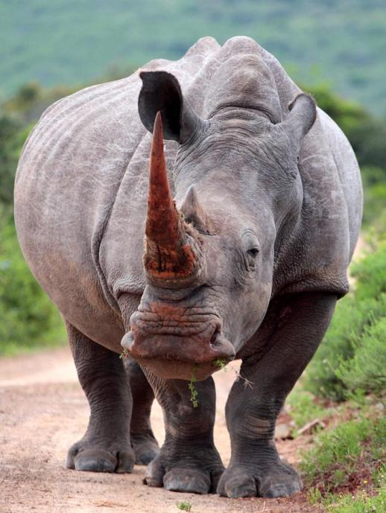
Poaching
Poaching is the illegal hunting of animals. It is a problem all over the world, which can lead to species becoming endangered, or even extinct.
In 2011, the Western black rhino was declared extinct, with poaching given as the main reason. All five remaining species of rhino in Africa are endangered.
Poaching continues to be a major threat: in 2015, over 1,300 rhinos were killed in Africa by poachers.
Species of elephant, tiger and gorilla are all at risk from poaching.
Notes:
Teacher notes
The main reason for rhino poaching is the demand from South East Asia for their horns, which are used in traditional remedies.
Extinction leads to an irreversible loss of biodiversity.
Statistics taken from: https://www.savetherhino.org/rhino_info/poaching_statistics
This weblink was working at the time of publication. Boardworks is not responsible for the content of third party sites.
Photo credit: white rhino © Jonathan Pledger, Shutterstock.com 2018

Slide 23
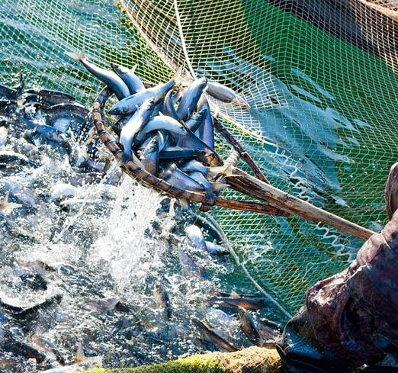
Overfishing (1)
Fishing is a commercial business, providing food for humans. In 2013, over 100 million tons of fish were caught globally.
The demand for fish has put huge pressure on fish populations across the world. Currently, almost 30% of populations fished commercially are overfished.
Ultimately, overfishing leads to population decline. This can lead to a fish species to become endangered or extinct.
For example, in 1992, overfishing caused a crash in the population of Atlantic cod.
Notes:
Teacher notes
Overfishing of Atlantic cod was blamed on the introduction of new fishing techniques over the 50 years prior to 1992. Modern technology allowed much larger numbers of fish to be caught compared to traditional fishing techniques.
Statistics taken from http://www.fishforward.eu/en/topics/facts-figures/
This weblink was working at the time of publication. Boardworks is not responsible for the content of third party sites.
Photo credit: © withGod, Shutterstock.com 2018

Slide 24
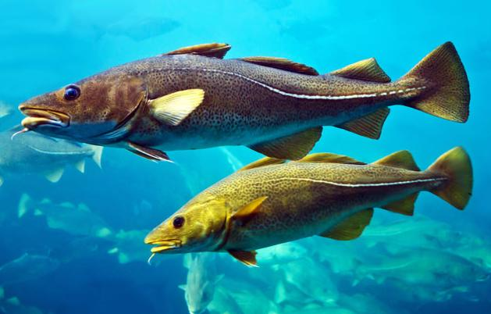
Overfishing (2)
Different types of regulations and controls can be used to help commercial fishing take place at a sustainable level.
For example, quotas can be used to set a maximum number of fish that can be caught over a given period of time.
Marine protected areas (MPAs) are another method. These are areas of sea where human activities, including fishing, are restricted. Some of these include “no-take” zones where no fishing is allowed.
Notes:
Photo credit: cod fish © Valentina Photo, Shutterstock.com 2018

Slide 25
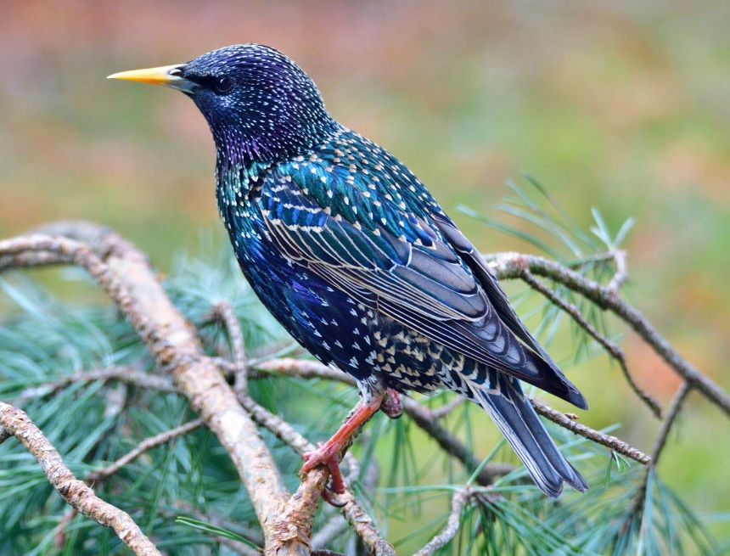
Introducing non-indigenous species (1)
A non-indigenous species is the term used to describe a species living in an area that it is not native to.
Humans have caused the introduction of many species to regions they would not be found naturally – sometimes by accident, other times intentionally.
Non-indigenous species can have unwanted effects on the local ecosystem.
They may eat native species, outcompete them for resources, or bring new diseases that native species cannot fight against.
Notes:
Teacher notes
The European starling was introduced to the US in 1890, when 60 starlings were released in Central Park, New York as part of the American Acclimatization Society’s project to introduce to the US all of the birds mentioned in the works of Shakespeare.
Photo credit: © Karin Jaehne, Shutterstock.com 2018

Slide 26
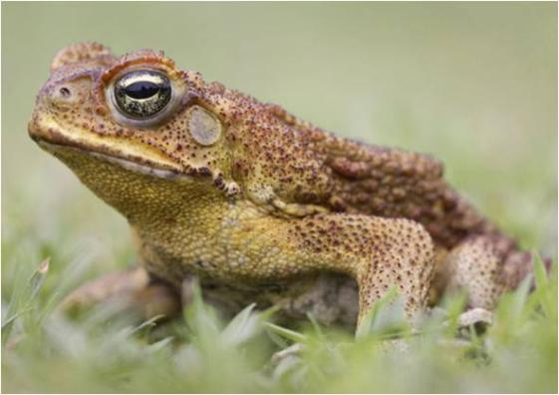
Introducing non-indigenous species (2)
Cane toads were introduced to Australia from Hawaii in the 1930s. They were brought over in an attempt to control native beetle populations, which were eating sugar crops.
However, the cane toads were found to produce toxins that Australia's native reptiles could not tolerate. This has led to many native species of crocodile and turtle being put at risk.
Although attempts have been made to control the cane toad population, none have been successful so far. As a result, cane toads continue to threaten Australia's natural wildlife.
Notes:
Photo credit: © Chris Ison, Shutterstock.com 2018

Slide 27
What’s the threat to different species?
Notes:
Teacher notes
This matching activity could be used as an introductory or summary activity on how different species are threatened.
Photo credit: © Maceofoto, Shutterstock.com 2018

