Slide 1
Investigating Ecosystems

Slide 2
Information
Planning and Carrying Out Investigations
Analyzing and Interpreting Data
Constructing Explanations and Designing Solutions
Engaging in Argument from Evidence
1. Patterns
2. Cause and Effect
7. Stability and Change

Slide 3
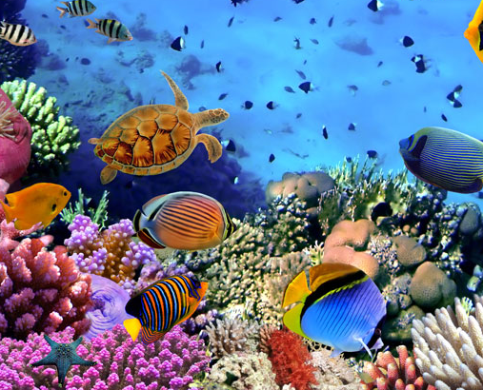
Ecosystems
Ecosystems
An ecosystem is made up of living organisms and the physical area in which they live.
There is a huge range of different ecosystems around you. For example, forests, deserts, and coral reefs.
These ecosystems vary by:
The distribution of organisms – the organization of species in their habitat.
The abundance of organisms – the number of individuals of a species.

Slide 4
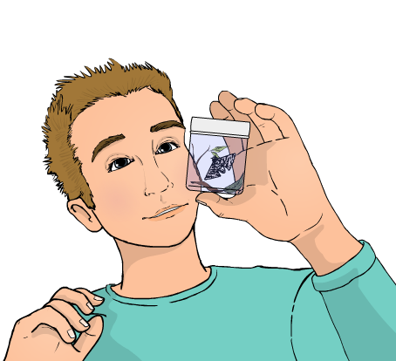
Investigating ecosystems
Investigating ecosystems
The distribution and abundance of an organism within an ecosystem are affected by different factors, such as light intensity and temperature.
Experimental methods are used to measure the distribution and abundance of species within a habitat. For example, counting the number of different species within a defined area.
The data gathered allows scientists to monitor the effect of external factors, such as human activity, on an ecosystem.

Slide 5
Investigating biodiversity
Notes:
This slide covers the Science and Engineering Practice:
Planning and Carrying Out Investigations: Plan and conduct an investigation individually and collaboratively to produce data to serve as the basis for evidence, and in the design: decide on types, how much, and accuracy of data needed to produce reliable measurements and consider limitations on the precision of the data (e.g., number of trials, cost, risk, time), and refine the design accordingly.

Slide 6
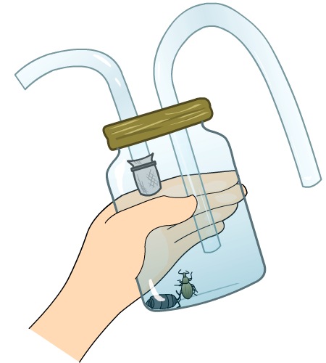
Sampling in a habitat
It is often not possible to count all the individuals of a species in a habitat by hand. Instead, we obtain a sample from a small area and calculate an estimate of the total population.
Common sampling methods include:
quadrats
belt and line transects.
Animals are harder to sample than plants because they move around. Methods used to collect animals include:
pooters
pit-fall traps
nets, such as sweep nets.
Notes:
Teacher notes
Sweep nets measure insect population by capturing insects, such as butterflies.
The image shows a pooter, which is used to collect insects. The user breathes through the mouthpiece and sucks the insect into the holding chamber.

Slide 7
Counting plants and animals
Notes:
This slide covers the Science and Engineering Practice:
Planning and Carrying Out Investigations: Plan and conduct an investigation or test a design solution in a safe and ethical manner including considerations of environmental, social, and personal impacts.

Slide 8
Estimating population size
The total population size is the number of individuals in a habitat. This is often too large to count, and so an estimate is calculated from samples.
Once you have collected your samples, you can estimate the number of organisms in the entire habitat:
Step 1: Calculate the average (mean) number of individuals in the samples.
Step 2: Scale up – multiply the mean by the total area of the habitat.

Slide 9
Estimating population size: example
The total population of daisies in a 50 m² field is estimated by taking 5 samples with a 1 m² quadrat.
Step 1: Calculate the mean number of daisies in the samples:
sum of all daisies in samples
mean =
number of daisies
total number of samples
sample
4 + 3 + 5 + 4 + 5 21
1
4
mean =
=
= 4.2
5
5
2
3
Step 2: Scale up – multiply the mean by the total area of the habitat:
3
5
4
4
5
5
4.2 × 50 m² = 210 daisies in the field
Notes:
This slide covers the Science and Engineering Practice:
Analyzing and Interpreting Data: Analyze data using tools, technologies, and/or models (e.g., computational, mathematical) in order to make valid and reliable scientific claims or determine an optimal design solution.

Slide 10
Random sampling and quadrats
Notes:
Teacher notes
Students should understand that using quadrats is suitable only for analyzing species that cannot move, e.g. plants.
This slide covers the Science and Engineering Practice:
Planning and Carrying Out Investigations: Plan and conduct an investigation individually and collaboratively to produce data to serve as the basis for evidence, and in the design: decide on types, how much, and accuracy of data needed to produce reliable measurements and consider limitations on the precision of the data (e.g., number of trials, cost, risk, time), and refine the design accordingly.

Slide 11
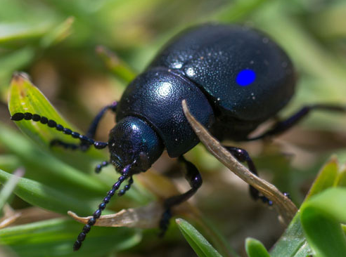
Capture–recapture
When estimating the size of an animal population, you can use capture–recapture methods, then calculate the total population size.
For example, a sample of organisms are captured using a pooter. They are counted and marked, then released back into the environment.
A second sample is taken at a later time.
The total number of marked and unmarked organisms in the second sample is recorded.
Notes:
Teacher notes
The beetle shown here has been marked with a blue spot of paint.
Photo credit: © IanRedding, Shutterstock 2018

Slide 12
Capture–recapture and population size
Following capture–recapture, the population size can be calculated using the equation:
no. in 1st sample × no. in 2nd sample
population size =
no. in 2nd sample previously marked
It is unlikely all individuals of a population can be captured. This means the population size calculated is an estimate.
The greater the sample size captured, the more accurate the estimate will be!
Notes:
Teacher notes
Capture–recapture methods can be simulated to work out the number of white beads in a population of black beads. Students should be given about 100 beads. They can then take two samples from this number, and use the formula to calculate the number of white beads. They can then actually count the beads to see how accurate they were.
This slide covers the Science and Engineering Practice:
Analyzing and Interpreting Data: Analyze data using tools, technologies, and/or models (e.g., computational, mathematical) in order to make valid and reliable scientific claims or determine an optimal design solution.

Slide 13
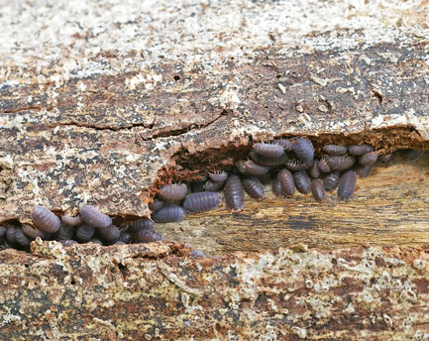
Assumptions with capture–recapture
For the capture–recapture method to work, certain assumptions must be made:
The population size has remained the same – no deaths or animals moving to or from the habitat.
The sampling methods used each time are identical.
Marking an organism does not affect its survival. For example, by making it more obvious to predators.
Notes:
Photo credit: © Decha Thapanya, Shutterstock 2018

Slide 14
Hints for investigating ecosystems
When carrying out ecological investigations, it is important that your methods are valid. When designing an investigation you should consider:
reproducibility of data – if possible, repeat your experiment several times. If your results are not similar, your experiment may not be reproducible.
sample size – this should be large to ensure findings are reproducible. For example, when using capture–recapture methods, a small sample size will mean that few animals will be captured in both samples.
type of method used – ensure the method is suitable for the organisms you are studying.
Notes:
Teacher notes
For example, line transects can be problematic if there are many plants touching the line, or if it is difficult to count the individual plants, as in the case of grass.
This slide covers the Science and Engineering Practice:
Planning and Carrying Out Investigations: Plan and conduct an investigation individually and collaboratively to produce data to serve as the basis for evidence, and in the design: decide on types, how much, and accuracy of data needed to produce reliable measurements and consider limitations on the precision of the data (e.g., number of trials, cost, risk, time), and refine the design accordingly.

Slide 15
Measuring species distribution
Measuring species distribution
Notes:
This slide covers the Science and Engineering Practices:
Planning and Carrying Out Investigations: Plan and conduct an investigation individually and collaboratively to produce data to serve as the basis for evidence, and in the design: decide on types, how much, and accuracy of data needed to produce reliable measurements and consider limitations on the precision of the data (e.g., number of trials, cost, risk, time), and refine the design accordingly.
Constructing Explanations and Designing Solutions: Make a quantitative and/or qualitative claim regarding the relationship between dependent and independent variables.

Slide 16
Sampling aquatic indicator species
Notes:
This slide covers the Science and Engineering Practice:
Planning and Carrying Out Investigations: Plan and conduct an investigation or test a design solution in a safe and ethical manner including considerations of environmental, social, and personal impacts.

Slide 17
Biological indicators
Notes:
Teacher notes
Other indicator species include trout, which are very sensitive to oxygen and pH levels.
This slide covers the Science and Engineering Practice:
Constructing Explanations and Designing Solutions: Apply scientific ideas, principles, and/or evidence to provide an explanation of phenomena and solve design problems, taking into account possible unanticipated effects.

Slide 18
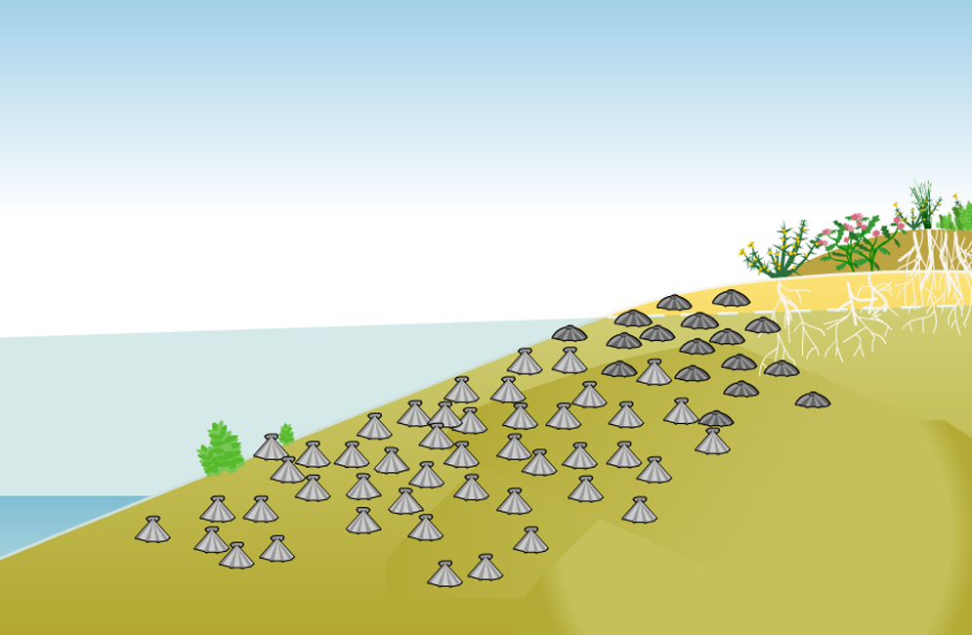
Zonation
What can you observe about the distribution of barnacles on this shoreline? What do you think might have caused this?
Zonation occurs in habitats such as sea shores and wetlands.
A gradual change in an abiotic factor, such as water availability, leads to a gradual change in the distribution of species across the habitat. This is zonation.
high tide
low tide
Notes:
Teacher notes
Students should notice that there is little overlap between the populations, with adult Chthamalus found only near the top of the high tide zone and adult Semibalanus found lower down in the high tide zone and in the low tide zone. They should understand that this difference is the result of zonation.
In the instance of these particular species, J.H. Connell (1961) found Semibalanus competed with Chthamalus by smothering or crushing it. This meant that Semibalanus was dominant in the low tide zone. However, Chthamalus was better able to compete for water in the upper parts of the high tide zone, where Semibalanus dried out and was unable to survive.
This slide covers the Science and Engineering Practices:
Constructing Explanations and Designing Solutions: Apply scientific ideas, principles, and/or evidence to provide an explanation of phenomena and solve design problems, taking into account possible unanticipated effects.
Engaging in Argument from Evidence: Construct, use, and/or present an oral and written argument or counter-arguments based on data and evidence.

Slide 19
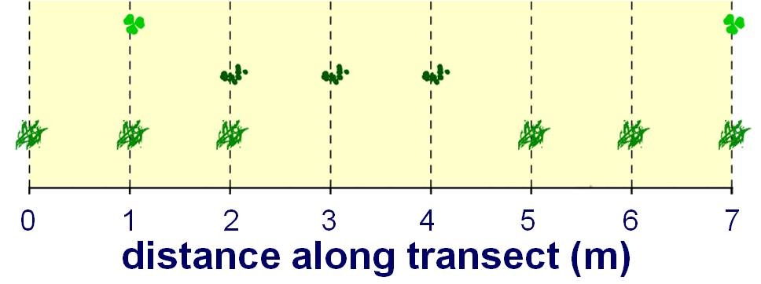
Mapping line transects
A line transect is useful for examining the effect of zonation on biodiversity. The positions of any plants along the tape can be plotted in a diagram.
key:
grass
This diagram shows the position of each species of plant along the line transect.
duckweed
clover
What does the diagram tell you?
A line transect does not reflect the number of each species along the line, so it is only useful as a basic experimental tool.
Notes:
Teacher notes
The diagram represents the different species of plant and their positions along the line transect. The diagram shows a change in distribution of grass across the line transect. This is likely caused by a change in abiotic factors. The growth of duckweed suggests a river or lake is present, which likely resulted in zonation – the change in distribution of grass across the ecosystem.
This slide covers the Science and Engineering Practices:
Constructing Explanations and Designing Solutions: Apply scientific ideas, principles, and/or evidence to provide an explanation of phenomena and solve design problems, taking into account possible unanticipated effects.
Engaging in Argument from Evidence: Construct, use, and/or present an oral and written argument or counter-arguments based on data and evidence.

Slide 20
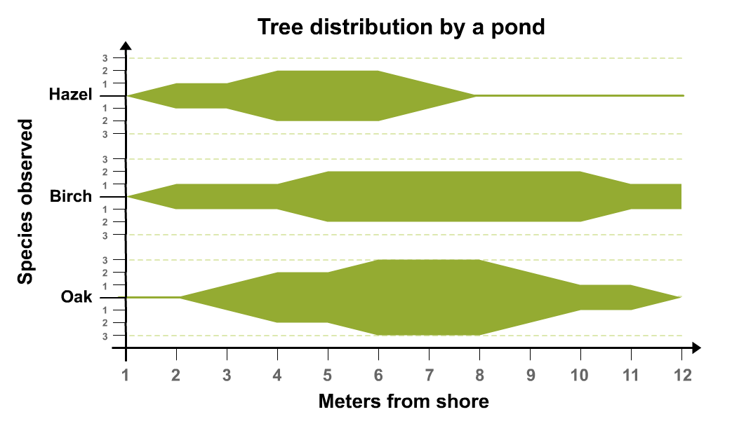
Kite diagrams
Kite diagrams show the distribution and abundance of different species in a particular area or habitat.
The percentage of each species is plotted against distance along the transect.
When plotting the population data, you should plot half the population above the line and half below, then join the points to form a kite shape.
Notes:
Teacher notes
Make sure students realize they need to add together the distance above and below each species label to get the number of organisms. Also point out that the lines between each measurement point are approximations.
Suitable questions include:
At what distance from the shore was the population of hazel trees greatest? (Between 4 and 6 meters.)
How many birch trees were found 3 meters from the shore? (Two: the area extends one above the axis and one below.)
Which tree is most dense at 7 meters from the shore? (The oak tree: there are six oaks there.)
Which tree seems least able to live further away from ready water? (Hazel.)

