Slide 1
Maintaining Biodiversity

Slide 2
Information
Planning and Carrying Out Investigations
Constructing Explanations and Designing Solutions
Engaging in Argument from Evidence
Obtaining, Evaluating and Communicating Information
1. Patterns
2. Cause and Effect
6. Structure and Function
7. Stability and Change

Slide 3
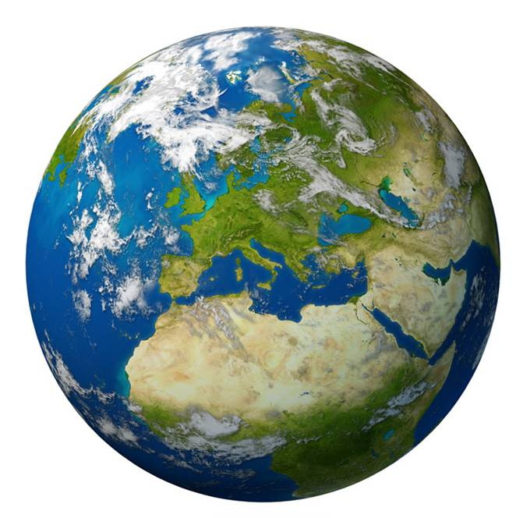
What is conservation?
Conservation is the action of protecting a species, habitat or ecosystem to prevent its decline or extinction.
Thousands of conservation programs exist across the world. Although programs may vary in their target species or ecosystem, all aim to maintain or improve biodiversity.
As a result, conservation has an important role in reversing or
reducing the negative effect of
human activities on biodiversity.
Notes:
Teacher notes
Remind students that biodiversity is the variety of different species living in a particular habitat or ecosystem.
Photo credit: © Lightspring, Shutterstock.com 2018

Slide 4
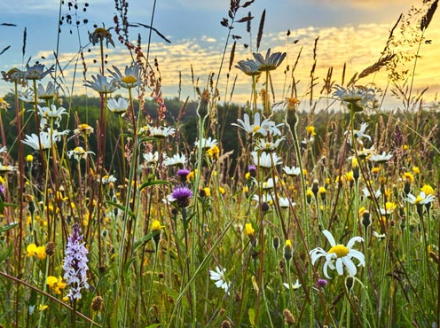
Why is conservation important?
There are many reasons for conservation, including:
ensuring there will be enough food and natural resources for future generations, despite population increases
maintaining nutrient cycles and ecosystem stability
preventing species from becoming extinct
cultural and social reasons, such as maintaining forests where people like to walk
preserving plant species in case they are found to contain useful medicinal products.
Notes:
Photo credit: © Matthew J Thomas, Shutterstock.com 2018

Slide 5
Methods of protecting biodiversity
Actions to protect biodiversity are taken at many different levels in human societies.
Governments make laws to protect parts of the environment against damaging human activities. Governments sometimes work together internationally.
Non-profit organizations work to protect or advance a particular cause.
Communities run projects that protect the environment in their local area.
Individuals can take their own actions to protect biodiversity.

Slide 6
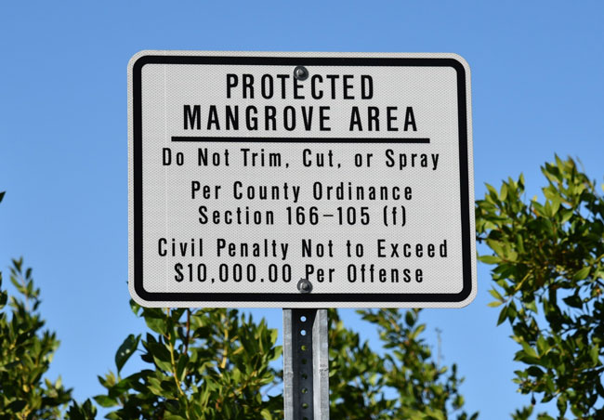
Protected areas
Many countries have protected areas in which some human activities are restricted for conservation purposes.
Protected areas are established by governments and protected by national laws.
The US has over 25,000 protected areas on land, amounting to 14% of the total land area.
The level of protection in these areas varies widely. Some areas allow more human activity than others.
Notes:
Photo credit: © Stasy, Shutterstock.com 2018

Slide 7
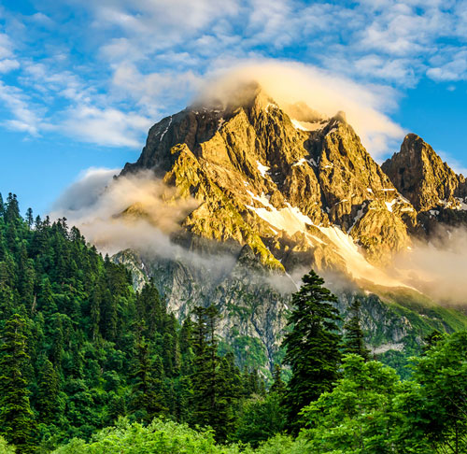
Strict nature reserves
Some protected areas are managed as strict nature reserves.
These areas are created and managed to preserve ecosystems in their natural state.
Human activities are strictly regulated and many types of activities are forbidden.
There are over 750 strict nature reserves in the US.
Notes:
Photo credit: © Rusla Ruseyn, Shutterstock.com 2018

Slide 8
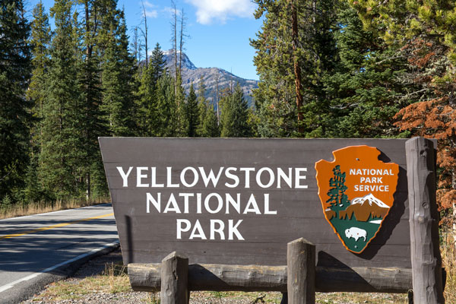
National parks
National parks are protected land areas in which human activities are regulated in order to protect the natural landscape.
National parks allow more human activities than strict nature reserves do.
Tourism is often popular in these areas, and other commercial activities such as farming and mining may be allowed.
Yellowstone National Park is considered to be the oldest in the world.
Notes:
Photo credit: © blvdone, Shutterstock.com 2018

Slide 9
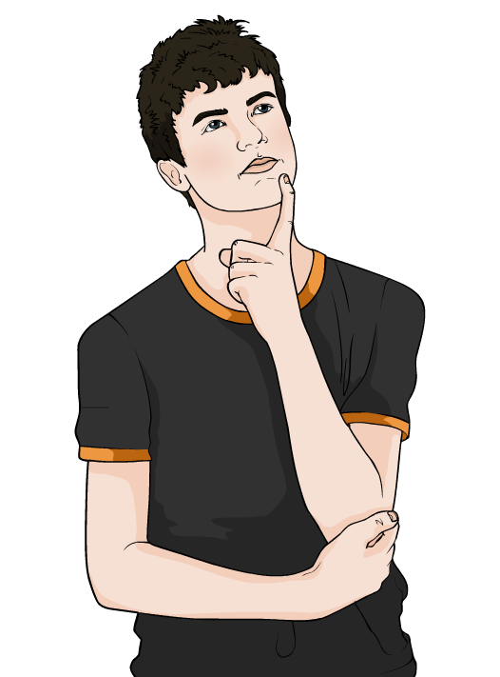
Impact of protected areas
What impact do you think protected areas will have on biodiversity?
By restricting activities that would alter or damage ecosystems, protected areas help to conserve biodiversity.
However, creating protected areas is not enough to protect biodiversity.
The area must be carefully managed for biodiversity to thrive.
Notes:
Teacher notes
Discuss students’ ideas for the question. Help them to explain that protected areas should help to protect biodiversity, and have them justify their answers with scientific ideas.
This slide covers the Science and Engineering Practices:
Constructing Explanations and Designing Solutions: Apply scientific ideas, principles, and/or evidence to provide an explanation of phenomena and solve design problems, taking into account possible unanticipated effects.
Obtaining, Evaluating, and Communicating Information: Communicate scientific and/or technical information or ideas (e.g. about phenomena and/or the process of development and the design and performance of a proposed process or system) in multiple formats (including orally, graphically, textually, and mathematically).

Slide 10
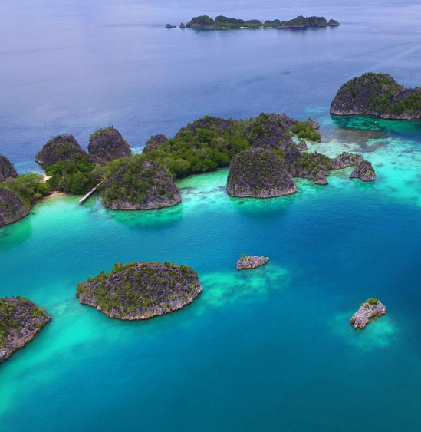
Protecting the seas
Marine protected areas (MPAs) are areas of the Earth’s seas that are protected against some human activities.
The US has 787 marine protected areas, amounting to 12% of the country’s marine area.
Like protected areas on land, the level of protection given by MPAs is very variable.
Some MPAs are managed as strict nature reserves, whereas others allow commercial activities such as fishing and oil or gas extraction.
Notes:
Teacher notes
The image shows part of the Raja Ampat Marine Protected Area in Indonesia.
Photo credit: © Misbachul Munir, Shutterstock.com 2018

Slide 11
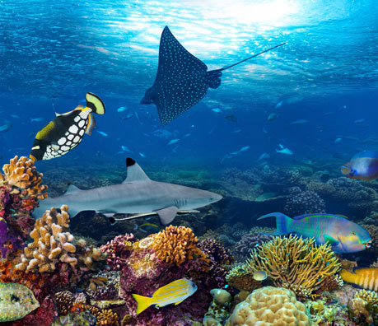
The impact of MPAs
Protection for the Earth’s seas is recent. The large majority of marine protected areas (MPAs) have been established within the past 20 years.
Since their creation, MPAs have been well studied to understand their impact on biodiversity.
MPAs with strict protections that have been effectively enforced show significant improvements in biodiversity.
They have more species in larger numbers and larger sizes than the same area before protection.
Notes:
Photo credit: © stockphoto-graf, Shutterstock.com 2018

Slide 12
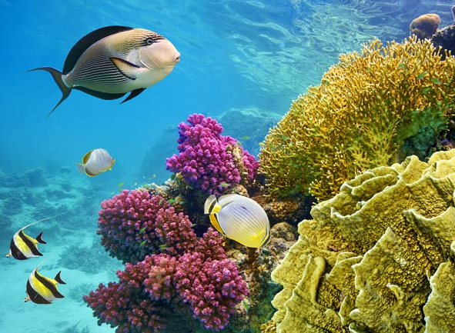
Coral reefs
Many places with high biodiversity are not in protected areas.
Coral reefs are areas of high biodiversity. They contain 25% of the world’s marine species, but make up less than 0.25% of marine habitats.
Coral reefs face a variety of threats from humans, including damage from fishing practices, overfishing, pollution and climate change.
Around 18% of coral reefs are in protected areas. Less than 0.01% of coral reefs are in areas with strict protections.
Notes:
Teacher notes
Coral reefs provide important ecological functions such as breeding grounds for visiting marine organisms.
Photo credit: © Helen Hotson, Shutterstock.com 2018

Slide 13
The role of science
Science has a large role in maintaining biodiversity.
The study of ecosystems and the impact of human activities has improved our understanding of how biodiversity can be affected.
By monitoring biodiversity, scientists can also determine the effectiveness of measures taken to protect it.
Scientists’ findings can be used by governments, organizations and individuals to inform future actions.

Slide 14
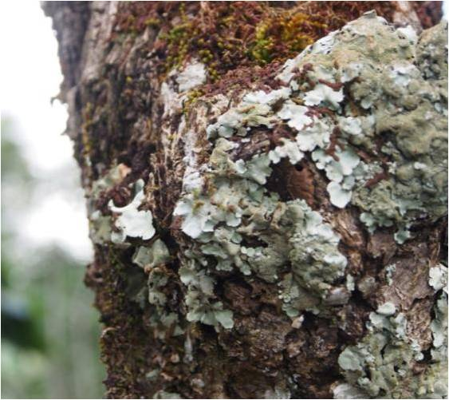
Study example: indicator species
An indicator species is a species that can provide information about the quality of a habitat or health of an ecosystem.
Some species are very sensitive to changes in their environment. This makes them good indicator species.
Monitoring populations of indicator species can provide information about how ecosystems are being affected by human activities.
This information can be used to help inform changes that minimize the impact of human activities.
Notes:
Teacher notes
Lichen are useful indicator species as their distribution is affected by levels of nitrogen oxide pollutants. Fewer nitrogen oxide sensitive lichen are found in areas where there is a high level of nitrogen oxide pollution. This allows lichen to be used as an indicator of air quality. The pollution does not directly cause an increase in nitrogen oxide tolerant lichen. However, a decrease in the population of nitrogen oxide sensitive lichen provides space for the growth of the tolerant lichen.
Photo credit: © Kimmim, Shutterstock.com 2018

Slide 15
Sampling aquatic indicator species
Notes:
This slide covers the Science and Engineering Practice:
Planning and Carrying Out Investigations: Plan and conduct an investigation or test a design solution in a safe and ethical manner including considerations of environmental, social, and personal impacts.

Slide 16
Interpreting results
Notes:
Teacher notes
Other indicator species include trout, which are very sensitive to oxygen and pH levels.
This slide covers the Science and Engineering Practices:
Constructing Explanations and Designing Solutions: Make a quantitative and/or qualitative claim regarding the relationship between dependent and independent variables.
Constructing Explanations and Designing Solutions: Apply scientific ideas, principles, and/or evidence to provide an explanation of phenomena and solve design problems, taking into account possible unanticipated effects.

Slide 17
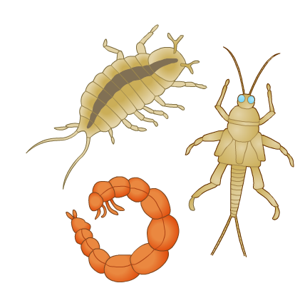
Indicator species activity
Write a report to describe the impact of sewage pollution on aquatic biodiversity.
Your report should describe investigations on indicator species and explain their conclusions.
Support your work with your own research from appropriate sources.
Present your findings clearly.
Notes:
This slide covers the Science and Engineering Practices:
Constructing Explanations and Designing Solutions: Apply scientific ideas, principles, and/or evidence to provide an explanation of phenomena and solve design problems, taking into account possible unanticipated effects.
Engaging in Argument from Evidence: Construct, use, and/or present an oral and written argument or counter-arguments based on data and evidence.
Obtaining, Evaluating, and Communicating Information: Gather, read, and evaluate scientific and/or technical information from multiple authoritative sources, assessing the evidence and usefulness of each source.
Obtaining, Evaluating, and Communicating Information: Communicate scientific and/or technical information or ideas (e.g. about phenomena and/or the process of development and the design and performance of a proposed process or system) in multiple formats (including orally, graphically, textually, and mathematically).

Slide 18
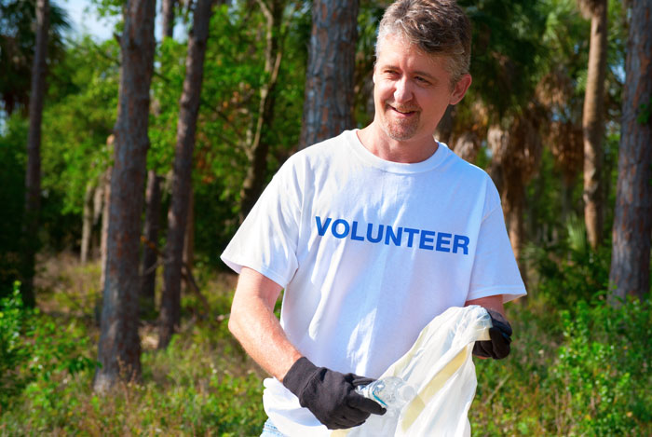
Action against pollution
Pollution reduces biodiversity. Can you explain how, giving examples of specific pollutants in your answer?
Measures that reduce pollution exist at many levels, including incentives and laws from governments, actions of businesses and non-profit organizations, and responsible choices by individuals. For example:
international targets for reducing specific pollutants
fines for individuals and businesses causing pollution
clean-up projects
reducing, reusing and recycling.
Notes:
Teacher notes
Help students to apply their understanding of biodiversity to answer the question, and have them justify their answers with scientific ideas.
This slide covers the Science and Engineering Practices:
Constructing Explanations and Designing Solutions: Apply scientific ideas, principles, and/or evidence to provide an explanation of phenomena and solve design problems, taking into account possible unanticipated effects.
Obtaining, Evaluating, and Communicating Information: Communicate scientific and/or technical information or ideas (e.g. about phenomena and/or the process of development and the design and performance of a proposed process or system) in multiple formats (including orally, graphically, textually, and mathematically).
Photo credit: © Mike Focus, Shutterstock.com 2018

Slide 19
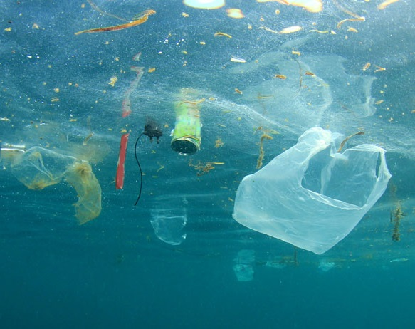
Reducing plastic pollution
Plastic pollution is a current threat to biodiversity for many of Earth’s ecosystems.
Can you describe any measures that reduce plastic pollution and explain their impact on biodiversity?
Some companies have started to use biodegradable plastics, which can be broken down by bacteria.
However, this process needs specific conditions, such as certain temperatures and oxygen levels.
If these conditions are not met, the packaging will not biodegrade.
Notes:
Teacher notes
Students should be able to apply examples from their everyday lives to answer the question. Many countries have taken steps to limit their use of single-use plastic bags. Some countries have banned these altogether, whereas others impose a charge. Other examples may include recycling, community-based clean-up projects, and biodegradable or compostable plastics. Biodegradable plastics that pollute ocean environments may not break down as intended, as many are designed to break down in terrestrial conditions.
This slide covers the Science and Engineering Practices:
Constructing Explanations and Designing Solutions: Apply scientific ideas, principles, and/or evidence to provide an explanation of phenomena and solve design problems, taking into account possible unanticipated effects.
Obtaining, Evaluating, and Communicating Information: Communicate scientific and/or technical information or ideas (e.g. about phenomena and/or the process of development and the design and performance of a proposed process or system) in multiple formats (including orally, graphically, textually, and mathematically).
Photo credit: © Rich Carey, Shutterstock.com 2018

Slide 20
Opinions on packaging
Notes:
This slide covers the Science and Engineering Practice:
Engaging in Argument from Evidence: Respectfully provide and/or receive critiques on scientific arguments by probing reasoning and evidence and challenging ideas and conclusions, responding thoughtfully to diverse perspectives, and determining what additional information is required to resolve contradictions.

Slide 21
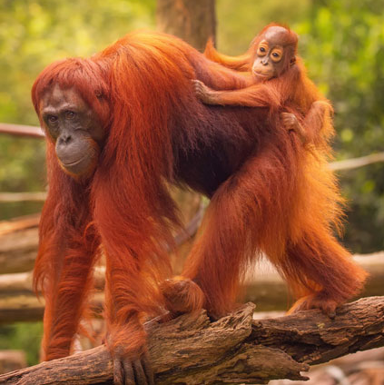
Endangered species
Endangered species are those with such a low population size that they are at risk of extinction.
What effect does extinction have on biodiversity?
Measures that help endangered species include:
protecting the habitats where species live
creating banks of seeds from endangered plants
educating people about protecting the species
breeding animals in captivity.
Notes:
Teacher notes
Help students to apply their understanding of biodiversity to answer the question. They should be able to explain that extinction directly reduces biodiversity and may have impacts on other organisms in the same ecosystem.
This slide covers the Science and Engineering Practices:
Constructing Explanations and Designing Solutions: Apply scientific ideas, principles, and/or evidence to provide an explanation of phenomena and solve design problems, taking into account possible unanticipated effects.
Obtaining, Evaluating, and Communicating Information: Communicate scientific and/or technical information or ideas (e.g. about phenomena and/or the process of development and the design and performance of a proposed process or system) in multiple formats (including orally, graphically, textually, and mathematically).
Photo credit: © Boule, Shutterstock.com 2018

Slide 22
Breeding programs
Breeding programs involve humans planning and encouraging species to reproduce, in the wild or in captivity.
Their aim is to increase population sizes, in an attempt to protect endangered species from extinction.
Some species only exist today because breeding programs have saved them from dying out.
In 1987, there were just 217 California condors. As a result of breeding programs, there were 435 in 2015, 268 of which were living in the wild.
Notes:
Photo credit: California condor © kojihirano, Shutterstock.com 2018

Slide 23
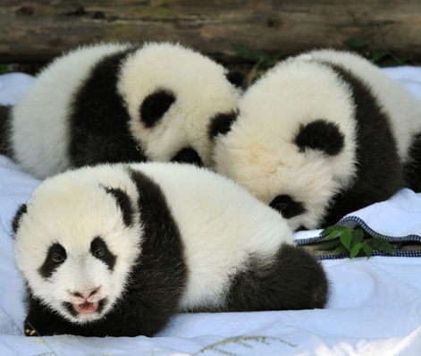
Captive breeding
Captive breeding is carried out in environments controlled by humans, such as wildlife reserves and zoos.
Some animals raised in captivity are later released into the wild. However, this is not always successful as the animals often have not developed the behavioral skills, such as hunting, to survive without human help.
As a result, the animals often have to remain in the zoo or reserve for the rest of their lives.
Captive breeding programs have been aimed at animals such as giant pandas, cheetahs and land snails.
Notes:
Photo credit: © Hung Chung Chih, Shutterstock.com 2018

Slide 24
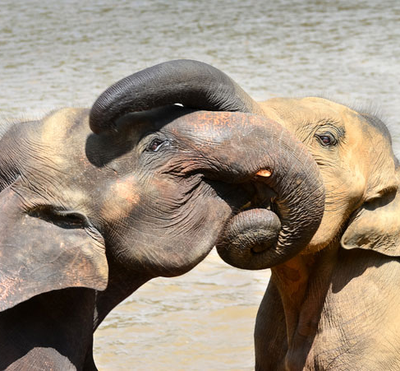
Problems with captive breeding (1)
If very few animals are involved in a captive breeding program, it can lead to inbreeding. This is when closely related individuals produce offspring together.
Inbreeding can increase susceptibility to disease and reduce life expectancy in the offspring.
Zoos and nature reserves often exchange breeding animals. This reduces the likelihood of related individuals breeding together.
Notes:
Photo credit: © Saman527, Shutterstock.com 2018

Slide 25
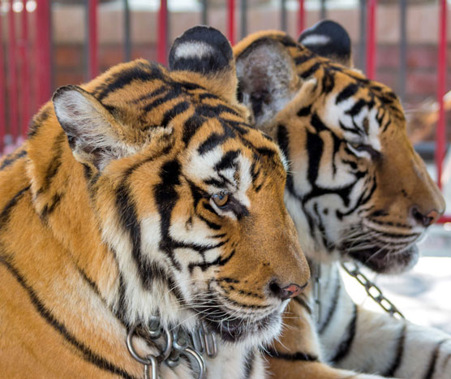
Problems with captive breeding (2)
Another problem is that the reproduction rate of captive animals is often lower than it is in the wild.
This can be due to behavioral changes that occur when an animals is kept outside of its natural habitat.
Sometimes captive animals show increased aggression, which makes them less likely to breed successfully.
Some zoos use artificial breeding techniques to increase the chances of animals reproducing.
Notes:
Photo credit: © UKRID, Shutterstock.com 2018

Slide 26
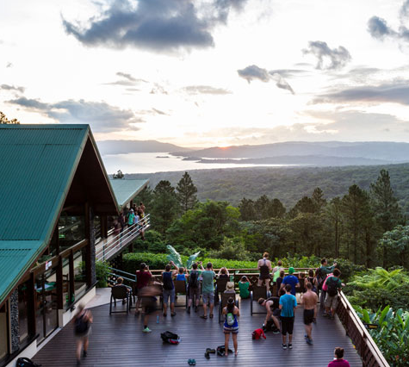
Ecotourism
Ecotourism is a type of tourism that focuses on the natural environment and usually supports conservation projects and sustainable development.
Its aim is to enable local people to benefit economically from their natural surroundings, whilst maintaining or even improving the area’s biodiversity.
Costa Rica has a huge ecotourism industry, attracting tourists who come to see some of the 500,000 species that live there.
As a result of the industry’s growth, 23% of the country’s land area is involved in protected area projects.
Notes:
Photo credit: © Wollertz, Shutterstock.com 2018

Slide 27
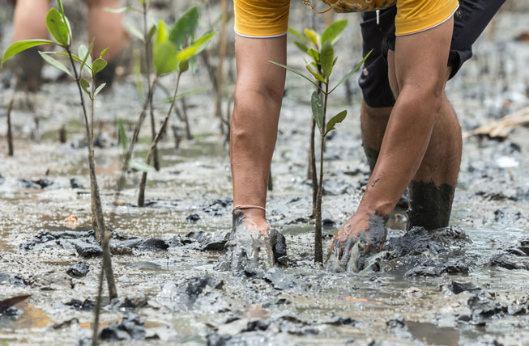
Reforestation
Reforestation is the replacement of trees in a forest habitat following deforestation. Reforestation projects are one way of restoring biodiversity to a previously forested area.
It is important that native tree species are used, as they are most likely to support the other species in the area.
This requires careful planning as tropical forests contain thousands of different types of trees, each with a role in supporting the survival of other species.
How might biodiversity be affected if only one tree species was used for reforestation?
Notes:
Teacher notes
Discuss students’ ideas for the question. A mixture of tree species is often needed for a reforestation project to succeed in increasing an area’s biodiversity. If only one tree species is used, the new forest will be unable to support as many different species as if several tree species had been planted. This is because different species rely on different types of trees for resources such as food and shelter.
This slide covers the Science and Engineering Practices:
Constructing Explanations and Designing Solutions: Apply scientific ideas, principles, and/or evidence to provide an explanation of phenomena and solve design problems, taking into account possible unanticipated effects.
Engaging in Argument from Evidence: Construct, use, and/or present an oral and written argument or counter-arguments based on data and evidence.
Obtaining, Evaluating, and Communicating Information: Communicate scientific and/or technical information or ideas (e.g. about phenomena and/or the process of development and the design and performance of a proposed process or system) in multiple formats (including orally, graphically, textually, and mathematically).
Photo credit: © Freedom_Studio, Shutterstock.com 2018

Slide 28
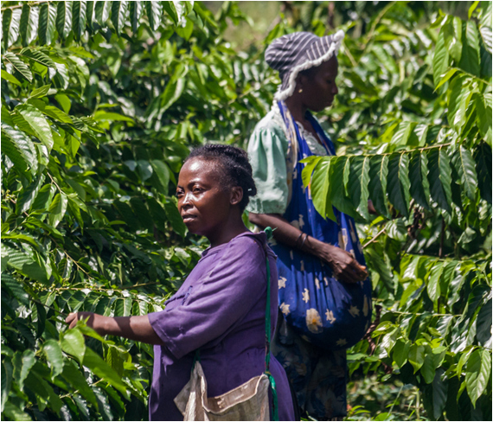
Other methods to conserve forests
Where logging continues, reduced impact logging methods can be used. These techniques allow specific trees to be cut down, whilst minimizing damage to surrounding trees.
People living in forests are encouraged to manage forest land sustainably through community projects.
Products, such as cocoa beans and timber, grown sustainably can be given a special stamp which enables them to be sold at a higher price. This allows local people to make a living while protecting biodiversity.
Notes:
Photo credit: © Pierre-Yves Babelon, Shutterstock.com 2018

Slide 29
Conservation issues
Can you think of any problems that conservation projects may encounter?
Projects often involve cooperation between conservation organizations, commercial businesses and local people. As a result, it can take a long time for everyone to reach an agreement on what a particular scheme will involve.
Once a project has started, it can be difficult to evaluate whether it is successful.
Continual monitoring is often required to make sure that the scheme is having a positive effect on biodiversity.
Notes:
This slide covers the Science and Engineering Practices:
Constructing Explanations and Designing Solutions: Apply scientific ideas, principles, and/or evidence to provide an explanation of phenomena and solve design problems, taking into account possible unanticipated effects.
Engaging in Argument from Evidence: Construct, use, and/or present an oral and written argument or counter-arguments based on data and evidence.
Obtaining, Evaluating, and Communicating Information: Communicate scientific and/or technical information or ideas (e.g. about phenomena and/or the process of development and the design and performance of a proposed process or system) in multiple formats (including orally, graphically, textually, and mathematically).
Photo credit: © tsyhun, Shutterstock.com 2018

Slide 30
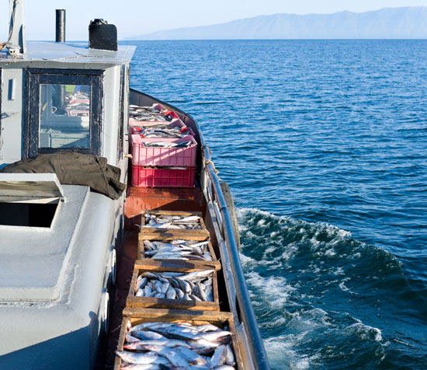
Potential conflicts
Conservation projects can cause conflicts with businesses and people who have other interests, such as:
farming and fishing
construction
fossil fuel extraction.
These people rely on making use of land and its resources for their livelihoods. Conservation projects can put restrictions on their businesses.
Can you suggest why a commercial fishing business might come into conflict with a conservation project?
Notes:
This slide covers the Science and Engineering Practices:
Constructing Explanations and Designing Solutions: Apply scientific ideas, principles, and/or evidence to provide an explanation of phenomena and solve design problems, taking into account possible unanticipated effects.
Engaging in Argument from Evidence: Construct, use, and/or present an oral and written argument or counter-arguments based on data and evidence.
Obtaining, Evaluating, and Communicating Information: Communicate scientific and/or technical information or ideas (e.g. about phenomena and/or the process of development and the design and performance of a proposed process or system) in multiple formats (including orally, graphically, textually, and mathematically).
Photo credit: © withGod, Shutterstock.com 2018

