Slide 1
Meiosis

Slide 2
Information
Constructing Explanations and Designing Solutions
Obtaining, Evaluating and Communicating Information
2. Cause and Effect
6. Structure and Function
7. Stability and Change

Slide 3
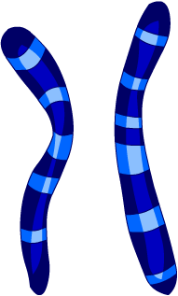
Chromosomes in body cells
Different types of organisms have different numbers of chromosomes in the nuclei of their cells.
Chromosomes are found in pairs. In each pair, one chromosome has been inherited from the mother and one from the father.
chromosome from the mother
chromosome from the father
chromosome pair
Human body cells have 46 chromosomes. This is the diploid number of chromosomes.
How many pairs of chromosomes do human body cells have?
Notes:
Teacher notes
The nucleus of a diploid cell contains a full set of chromosome pairs.
Human body cells contain 23 pairs of chromosomes.

Slide 4
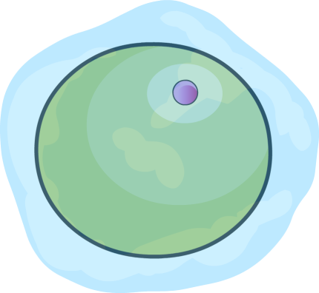
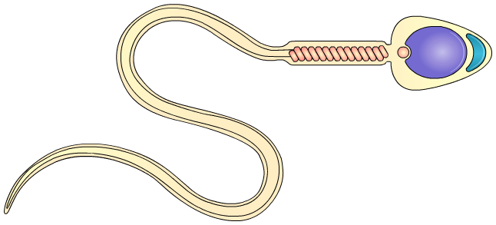
Chromosomes in sex cells
Sex cells in animals and plants are called gametes.
Gametes contain half the number of chromosomes found in normal body cells. This means they are haploid.
Gametes are produced by cells in the reproductive organs.
In humans, egg cells are produced by females in the ovaries and sperm cells are produced by males in the testes.
haploid number of chromosomes in the nucleus
egg cell
sperm cell
How many chromosomes are in human gametes?
Notes:
Teacher notes
Human gametes contain 23 chromosomes. This is half the number found in normal diploid body cells (which contain 46 chromosomes, in 23 pairs).

Slide 5
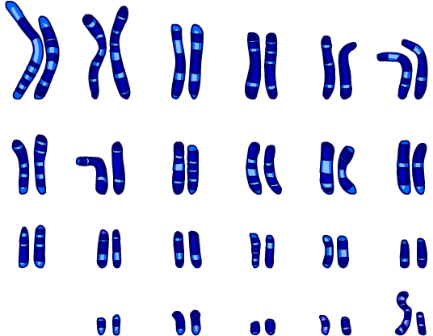
Why are gametes haploid?
If gametes had the same number of chromosomes as body cells, what problem would this cause at fertilization?
When the male and female gametes fuse during fertilization, the zygote produced would have double the normal number of chromosomes.
In humans this would form a zygote with 92, rather than 46 chromosomes.
To prevent this, gametes are haploid. When gametes are formed, only one chromosome from each pair in the parent cell is transferred to each of the gametes produced.
The process that produces gametes is called meiosis.
Notes:
Teacher notes
Discuss students’ ideas for the question before revealing the answer.
This slide covers the Science and Engineering Practices:
Constructing Explanations and Designing Solutions: Apply scientific ideas, principles, and/or evidence to provide an explanation of phenomena and solve design problems, taking into account possible unanticipated effects.
Obtaining, Evaluating, and Communicating Information: Communicate scientific and/or technical information or ideas (e.g. about phenomena and/or the process of development and the design and performance of a proposed process or system) in multiple formats (including orally, graphically, textually, and mathematically).

Slide 6
What is meiosis?
Meiosis is a type of cell division that produces gametes.
Meiosis produces four genetically different, haploid daughter cells. Each daughter cell is an individual gamete.
Why is it important to produce genetically unique gametes?
Genetically unique gametes produce genetically unique offspring. This ensures genetic variation within a species.
Notes:
Teacher notes
A daughter cell is the term used to describe the new cells produced when a cell (the parent cell) undergoes cell division. Daughter cells are produce in mitosis and meiosis.
Discuss students’ ideas for the question before revealing the answer. Encourage them to draw connections with their understanding of natural selection.
Ask students to consider how the products of mitosis and meiosis compare:
the number of daughter cells produced
the number of chromosomes within each daughter cell
the genetic similarity between daughter cells.
This slide covers the Science and Engineering Practices:
Constructing Explanations and Designing Solutions: Apply scientific ideas, principles, and/or evidence to provide an explanation of phenomena and solve design problems, taking into account possible unanticipated effects.
Obtaining, Evaluating, and Communicating Information: Communicate scientific and/or technical information or ideas (e.g. about phenomena and/or the process of development and the design and performance of a proposed process or system) in multiple formats (including orally, graphically, textually, and mathematically).
Photo credit: © Andi Berger, Shutterstock.com 2018

Slide 7
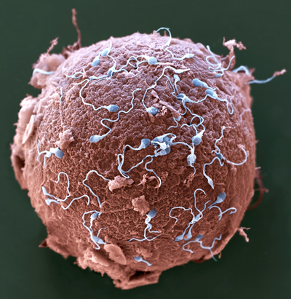
What happens during fertilization?
Fertilization is the stage of sexual reproduction in which the male and female gametes fuse.
In humans, when an egg cell is fertilized by a sperm cell, the haploid nuclei of each gamete combine to form a diploid zygote.
This means the zygote contains the full number of chromosomes.
The zygote then undergoes cell division through mitosis to become an embryo.
Notes:
Teacher notes
For more information about sexual reproduction, please refer to the Sexual Reproduction and Asexual Reproduction presentation.
For more information about mitosis, please refer to the Mitosis and the Cell Cycle presentation.
Photo credit: © Eye of Science / Science Photo Library 2018
Colored scanning electron micrograph (SEM) of sperm (blue) attempting to penetrate a human egg (red). Fertilization occurs when the sperm's genetic material fuses with the egg's. Magnification: ×650 when printed 10 centimeters wide.

Slide 8
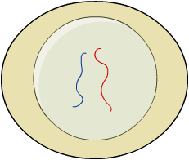
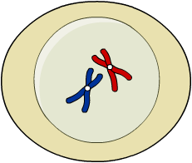
Interphase in meiosis
Before meiosis can begin, there is an interphase stage.
During interphase, all the chromosomes in the cell are duplicated through the process of DNA replication.
original parent cell
At the end of interphase in humans, cells contain 92 chromosomes.
DNA replication
The cell is able to enter meiosis only once interphase is complete.
chromosomes duplicated

Slide 9
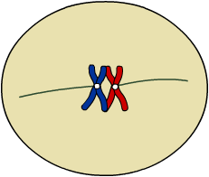
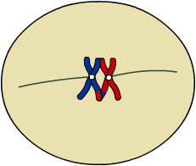
The first stage of meiosis (1)
Meiosis is made of two rounds of cell division. During the first round of cell division, the pairs of chromosomes are separated.
First round of cell division
1.
The nucleus breaks down. The pairs of duplicated chromosomes enter the cytoplasm, and align in the middle of the parent cell.
2.
Genetic information is exchanged between the chromosome pairs.
This helps to increase the amount of genetic variation between the daughter cells produced.

Slide 10
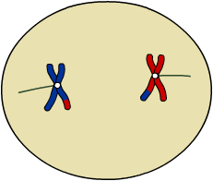
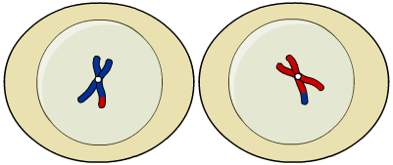
The first stage of meiosis (2)
3.
The chromosome pairs are pulled apart, separating them to opposite ends of the cell.
4.
The parent cell divides to produce two new cells. Each new cell contains one duplicated chromosome from each pair.
This means that the cells are haploid. They contain half the number of chromosomes found in the parent cell.
Notes:
Teacher notes
It is important to make sure students understand that, at the end of the first round of cell division in meiosis, the parent cell has produced two new cells.

Slide 11
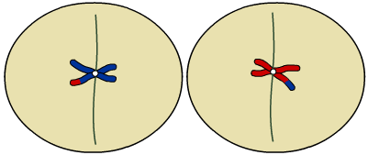
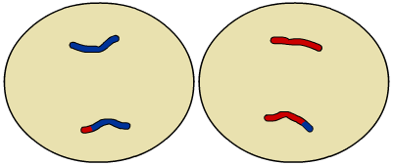
The second stage of meiosis (1)
During the second round of cell division, the duplicated chromosomes are pulled apart.
Second round of cell division
1.
In each of the two cells produced by the first round of cell division, the chromosomes align in the center of the cell.
2.
The duplicated chromosomes are pulled apart to opposite ends of the cell.

Slide 12
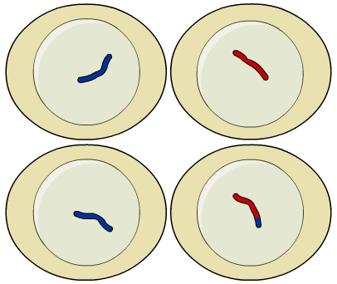
The second stage of meiosis (2)
3.
Both cells divide in two. This produces four daughter cells in total. Each daughter cell is a separate gamete.
both cells divide in two
The daughter cells are all haploid, and contain a genetically different set of chromosomes.
The same sequence of cell divisions is followed whether sperm cells or egg cells are being produced.

Slide 13
What happens during meiosis?
Notes:
Teacher notes
This nine-stage interactive animation shows how a cell divides by meiosis.
Suitable prompts could include:
Start: In which part of the body will meiosis take place?
Stage 1: How many chromosomes would a human cell contain at this stage?
Stage 4: What is the advantage of swapping genetic material between the chromosome pairs?
Stage 6: How many chromosomes would a human cell contain at this stage?
Stage 9: How do the four daughter cells compare with the original parent cell? What differences are there between meiosis and mitosis?
This slide covers the Science and Engineering Practice:
Constructing Explanations and Designing Solutions: Apply scientific ideas, principles, and/or evidence to provide an explanation of phenomena and solve design problems, taking into account possible unanticipated effects.

Slide 14
Order of events in meiosis
Notes:
Teacher notes
This ordering activity could be used as an introductory or summary activity on the stages of meiosis. Mini-whiteboards could be used to make this a whole-class exercise.
This slide covers the Science and Engineering Practice:
Constructing Explanations and Designing Solutions: Apply scientific ideas, principles, and/or evidence to provide an explanation of phenomena and solve design problems, taking into account possible unanticipated effects.

