Slide 1
Mitosis and the Cell Cycle

Slide 2
Information
Developing and Using Models
Constructing Explanations and Designing Solutions
Engaging in Argument from Evidence
Obtaining, Evaluating and Communicating Information
2. Cause and Effect
3. Scale, Proportion, and Quantity
4. Systems and System Models

Slide 3
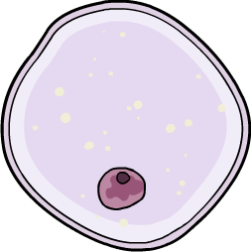
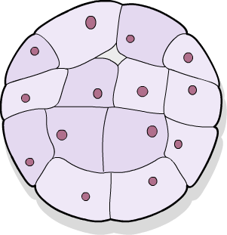
Creating new cells
Most animals and plants begin life as a single cell, but grow to contain billions of cells.
How does one cell become many?
Animals and plants grow by increasing the number of cells they are made of.
To do this, body cells go through a process called the cell cycle.
The cell cycle is made of two stages: interphase and mitosis.
After going through one complete cell cycle, one body cell will have divided to produce two body cells.

Slide 4
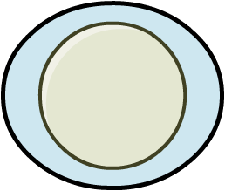
Cell division
The cell cycle enables a cell to divide into two new cells.
parent cell
The cell undergoing cell division is called the parent cell.
The parent cell divides to form two identical daughter cells.
cell cycle
The daughter cells can also go through the cell cycle. This enables even more new cells to be produced.
daughter cells

Slide 5
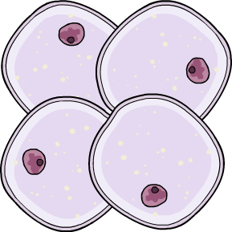
The role of the cell cycle
The cell cycle has a number of roles in living organisms.
Growth and development: the cell cycle produces new body cells. An increase in the number of body cells enables organisms to grow larger in size.
Repair and replacement: new cells produced by the cell cycle can be used to replace old and damaged cells in an organism, so that they can continue to function.
Asexual reproduction: some organisms use the cell cycle to produce offspring. The new cells produced by the cell cycle develop into independent organisms.
Notes:
Teacher notes
Asexual reproduction requires only one parent to produce offspring. The offspring are genetically identical to each other and the parent. Both single-celled and multicellular organisms can reproduce asexually.
For more information about asexual reproduction, please refer to the Sexual and Asexual Reproduction presentation.

Slide 6
The cell cycle in context
Here are just some situations in which cell division, as a result of the cell cycle, is occurring:
An embryo developing into a fully formed organism.
growth and
development
A wound healing following an injury.
repair and replacement
Muscles getting larger as a result of exercise training.
growth and
development
A strawberry plant producing runners, which go on to form new individual plants.
asexual reproduction

Slide 7
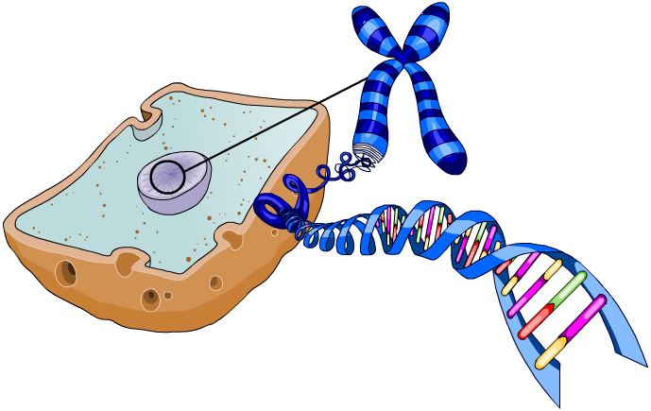
Chromosomes
In eukaryotic cells, genetic information is located inside the nucleus in the form of structures called chromosomes.
Each chromosome is made of a single molecule of DNA. In body cells, chromosomes are normally found in pairs.
chromosome
DNA
Chromosomes contain many genes. A gene is a short section of DNA on a chromosome that contains instructions for a particular characteristic.
gene
cell nucleus
Notes:
Teacher notes
For more information about DNA and genes, please refer to the DNA and the Genome presentation.

Slide 8
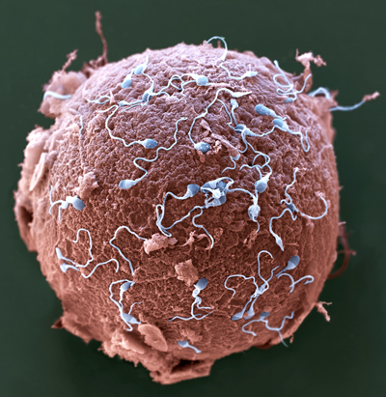
What happens during fertilization?
Fertilization is the stage of sexual reproduction in which the male and female gametes fuse.
In humans, when an egg cell is fertilized by a sperm cell, the haploid nuclei of each gamete combine to form a diploid zygote.
This means the zygote contains the full number of chromosomes.
The zygote then undergoes cell division through mitosis to become an embryo.
Notes:
Photo credit: © Eye of Science / Science Photo Library 2018
Colored scanning electron micrograph (SEM) of sperm (blue) attempting to penetrate a human egg (red). Fertilization occurs when the sperm's genetic material fuses with the egg's. Magnification: ×650 when printed 10 centimeters wide.

Slide 9
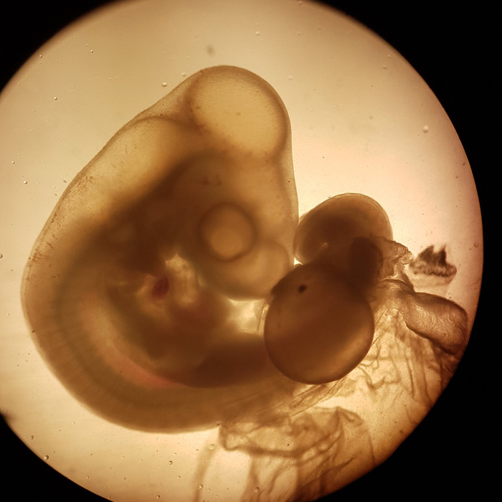
Growth in multicellular organisms
Every multicellular organism begins as a single fertilized cell.
This cell divides by mitosis to produce the many cells that make up a multicellular organism.
Each new cell is genetically identical to its parent cell.
This means that all cells in the developing multicellular organism have the same genetic information, with the exception of gametes.
Notes:
Teacher notes
The image shows a four-day-old chicken embryo.
Photo credit: © morpheus1008, Shutterstock.com 2018

Slide 10
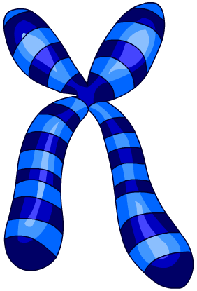
Interphase: DNA replication
When a cell enters the cell cycle, it first goes through a stage called interphase. This stage prepares a cell for mitosis, which happens later in the cell cycle.
During interphase, each chromosome in the cell is duplicated through the process of DNA replication.
original chromosome
duplicated
chromosome
DNA replication
A cell is unable to enter the mitosis stage of the cell cycle until every chromosome has been duplicated.

Slide 11
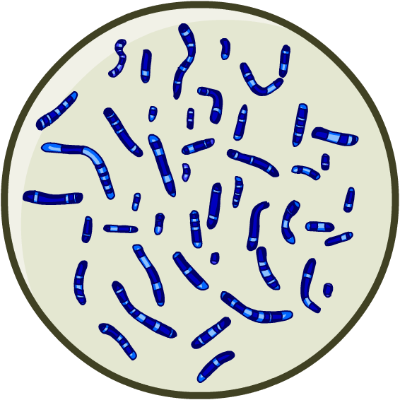
Why is DNA replicated during interphase?
As a result of DNA replication, the cell has double the normal number of chromosomes in its nucleus at the end of interphase.
This means that, when the cell later divides during mitosis, each daughter cell is able to receive one complete set of chromosomes from the parent cell.
As a result, each daughter cell is diploid. This means they contain the normal number of chromosomes in their nucleus.
The daughter cells are also genetically identical to one another, as well as the original parent cell.

Slide 12
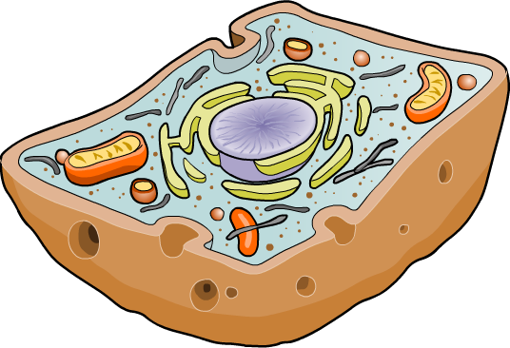
Interphase: cell growth
A cell also undergoes structural changes during interphase.
As a result of cell growth, the cell becomes larger in size. This means that, when the cell later divides during mitosis, each daughter cell will be large enough to function.
The number of sub-cellular structures inside the cell also increases. For example, new ribosomes and mitochondria are produced.
mitochondrion
This means that, when the cell divides, each daughter cell has enough sub-cellular structures to carry out normal cellular functions.
ribosome
Notes:
Teacher notes
Ask students what the role of the ribosomes and mitochondria are.
ribosomes: protein synthesis
mitochondria: cellular respiration.
Any new cell must be able to synthesize its own proteins and release energy through cellular respiration to function independently.
Mitochondrion is the singular of mitochondria.
For more information about sub-cellular structures, please refer to the Cells presentation.

Slide 13
Interphase: true or false?

Slide 14
Mitosis
Mitosis happens after interphase in the cell cycle. Mitosis will only begin once the interphase stage has finished.
Mitosis is the stage of the cell cycle where the cell divides to produce two new daughter cells.
Mitosis consists of several stages, during which the duplicated chromosomes are shared between the daughter cells.
Notes:
Teacher notes
The image shows onion cells undergoing mitosis. One cell can be seen where the duplicated chromosome pairs are being separated from one another. Each set will enter a daughter cell once the cell has fully divided.
Photo credit: mitosis in onion cells © Jose Luis Calvo, Shutterstock.com 2018

Slide 15
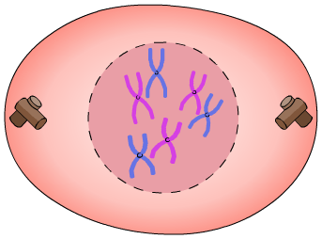
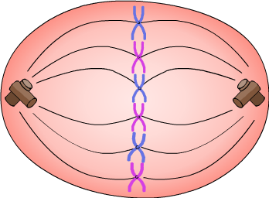
What happens during mitosis? (1)
Mitosis is a complex process, but it can be divided into several key stages:
1. First, the nucleus in the parent cell breaks down. This allows the duplicated chromosomes to enter the cytoplasm.
2. All the chromosomes align across the center of the parent cell.
Notes:
Teacher notes
Ask students to identify the nucleus and chromosomes on the diagrams.
Stage 1 is also known as “prophase.”
Stage 2 is also known as metaphase.”

Slide 16
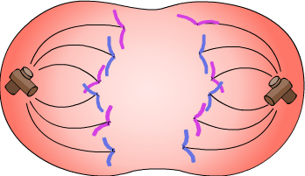
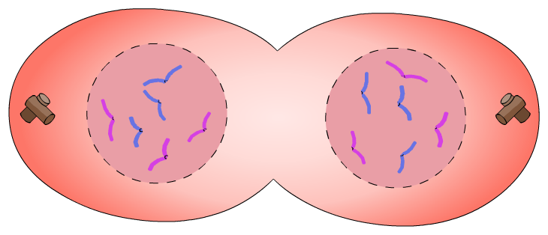
What happens during mitosis? (2)
3. The duplicated chromosomes are pulled apart from one another to opposite ends of the cell.
4. The parent cell divides to produce two daughter cells.
Each daughter cell has its own nucleus, containing a full set of identical chromosomes. They are both diploid.
Both cells also receive sub-cellular structures, such as mitochondria and ribosomes, from the parent cell.
Notes:
Teacher notes
Stage 3 is also known as “anaphase.”
Stage 4 is also known as “telophase” or “cytokinesis.”

Slide 17
Mitosis: a summary
Notes:
Teacher notes
This six-stage interactive animation shows how a cell divides by mitosis. Suitable prompts could include:
Start: What type of cell might this represent?
Stage 1: Where are chromosomes found?
Stage 2: What is the stage of the cell cycle prior to mitosis called?
Stage 5: What must happen after the chromosomes have been separated?
Stage 6: How do the daughter cells compare with each other and the original parent cell?
This slide covers the Science and Engineering Practice:
Constructing Explanations and Designing Solutions: Apply scientific ideas, principles, and/or evidence to provide an explanation of phenomena and solve design problems, taking into account possible unanticipated effects.

Slide 18
The stages of mitosis
Notes:
Teacher notes
This ordering activity could be used as an introductory or summary activity on the stages of mitosis. Mini-whiteboards could be used to make this a whole-class exercise.
This slide covers the Science and Engineering Practice:
Constructing Explanations and Designing Solutions: Apply scientific ideas, principles, and/or evidence to provide an explanation of phenomena and solve design problems, taking into account possible unanticipated effects.

Slide 19
Chromosomes during mitosis
Notes:
Teacher notes
This drag and drop activity provides the opportunity for informal assessment of students’ understanding of what happens to chromosomes during mitosis.
This slide covers the Science and Engineering Practice:
Developing and Using Models: Use a model to provide mechanistic accounts of phenomena.

Slide 20
Under the microscope: mitosis
Which stages of mitosis can you spot in this picture of cells dividing under a microscope?
chromosomes line up along cell center
chromosomes free in the cytoplasm
duplicated chromosomes pulled apart
Notes:
Teacher notes
Before revealing the labels, ask students to identify a cell where the chromosomes are:
free in the cytoplasm (stage 1 of mitosis)
lined up along the center of the cell (stage 2 of mitosis)
being pulled apart to opposite ends of the cell (stage 3 of mitosis).
This slide covers the Science and Engineering Practices:
Constructing Explanations and Designing Solutions: Apply scientific ideas, principles, and/or evidence to provide an explanation of phenomena and solve design problems, taking into account possible unanticipated effects.
Engaging in Argument from Evidence: Construct, use, and/or present an oral and written argument or counter-arguments based on data and evidence.
Photo credit: © Dimarion, Shutterstock.com 2018

