Slide 1
Multicellular Organisms

Slide 2
Information
Developing and Using Models
Constructing Explanations and Designing Solutions
Obtaining, Evaluating and Communicating Information
1. Patterns
3. Scale, Proportion, and Quantity
4. Systems and System Models
6. Structure and Function

Slide 3
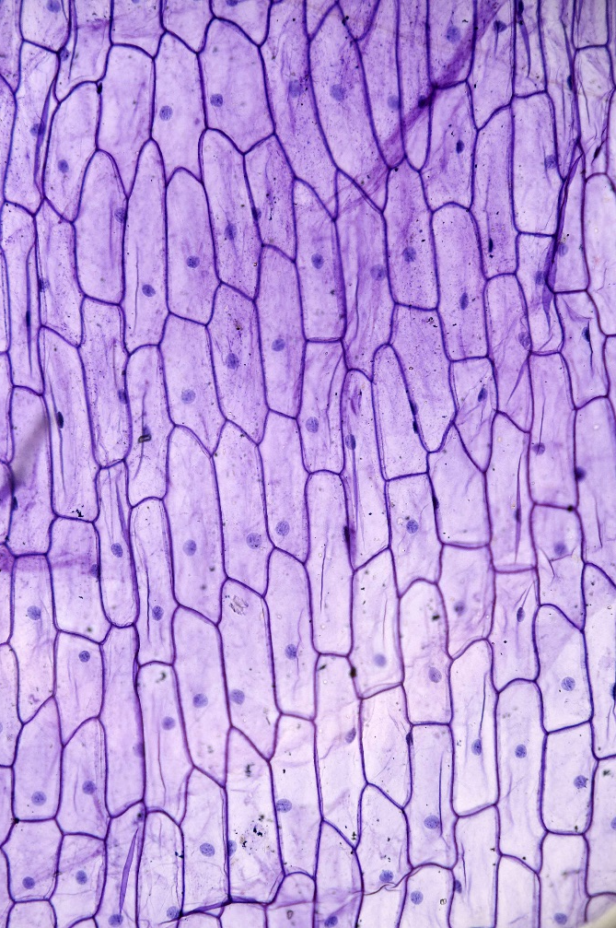
Cells
What is a living organism, such as a human, made up of?
All living organisms are made of cells.
Some living organisms are made up of just one cell. These are unicellular organisms.
Other living organisms are made up of many cells. These are multicellular organisms.
Humans are multicellular organisms.
Notes:
Photo credit: © D. Kucharski K. Kucharska, Shutterstock.com 2018

Slide 4
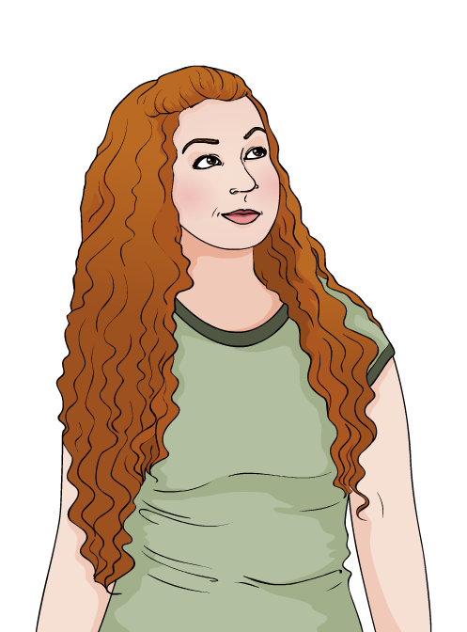
Multicellular hierarchy
Inside a multicellular organism, cells form part of a hierarchy of organization.
Different structures of increasing complexity fit together to create the whole organism:
cells
tissues
organs
organ system
organism.

Slide 5
Organization in multicellular organisms
Notes:
This slide covers the Science and Engineering Practice:
Developing and Using Models: Use a model to provide mechanistic accounts of phenomena.

Slide 6
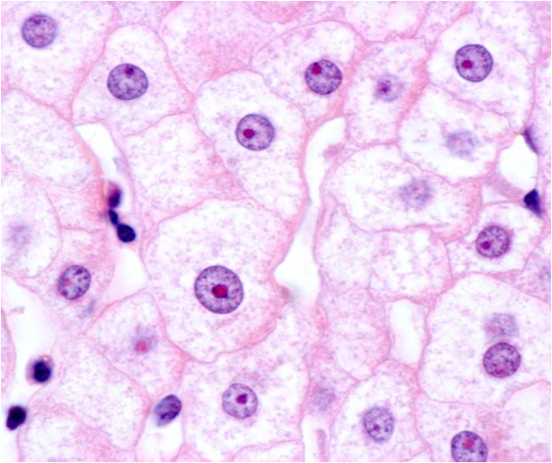
Cell structure
Inside cells are many parts called sub-cellular structures.
Each type of sub-cellular structure has a specific role that contributes to the overall function of the cell.
Can you name any sub-cellular structures?
Can you identify any sub-cellular structures in this image?
Do you think this image shows animal or plant cells?
Notes:
Teacher notes
The image shows liver cells (hepatocytes), which are animal cells. Plant cells often show a more regular shape and arrangement due to their cell walls. Students should be able to identify the nucleus and cell membrane, which are clearly visible in the image. Other structures are not clearly identifiable here. You may want to discuss why this is the case, to help students apply their understanding of magnification. Other sub-cellular structures are discussed in the following slides.
For more information about cells, please refer to the Cells presentation.
This slide covers the Science and Engineering Practices:
Constructing Explanations and Designing Solutions: Apply scientific ideas, principles, and/or evidence to provide an explanation of phenomena and solve design problems, taking into account possible unanticipated effects.
Obtaining, Evaluating, and Communicating Information: Communicate scientific and/or technical information or ideas (e.g. about phenomena and/or the process of development and the design and performance of a proposed process or system) in multiple formats (including orally, graphically, textually, and mathematically).
Photo credit: © Jose Luis Calvo, Shutterstock.com 2018

Slide 7
Exploring animal cells
Notes:
Teacher notes
This click and reveal activity could be used to check students’ understanding of the sub-cellular structures found in animal cells.

Slide 8
Exploring plant cells
Notes:
Teacher notes
This click and reveal activity could be used to check students’ understanding of the sub-cellular structures found in plant cells.

Slide 9
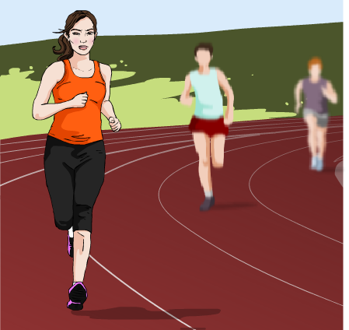
Sub-cellular structure and hierarchy
Sub-cellular structures are an important part of the multicellular hierarchy.
This is because cells in different organ systems can have slightly different sub-cellular structures to help them do their jobs.
For example, muscle cells contain lots of mitochondria.
Mitochondria are the site of cellular respiration, releasing energy that can be used to bring about muscle contraction.

Slide 10
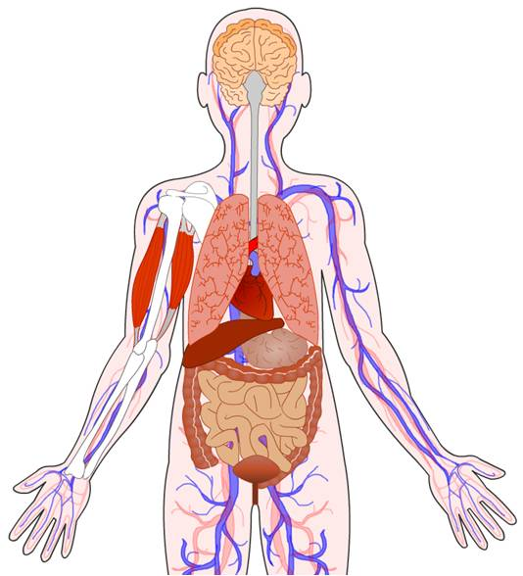
Specialized cells
In multicellular organisms, cells specialize to perform different tasks.
Cells that have adapted to a specific function are known as specialized cells.
Each type of specialized cell has a different structure, which adapts the cell for a specific role.
There are many different types of specialized cell in the human body.
Notes:
Teacher notes
For more information about specialized cells, please refer to the Specialized Cells presentation.

Slide 11
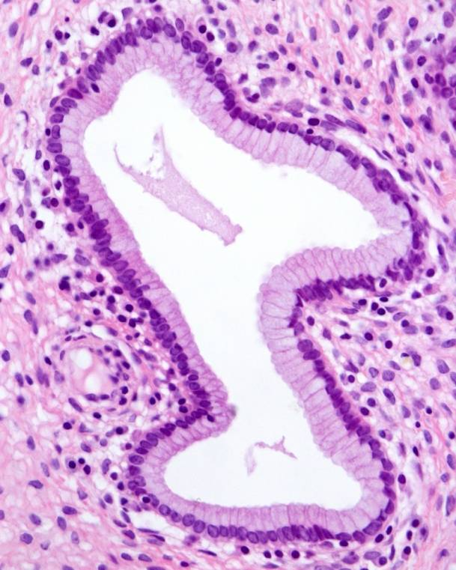
Tissues
Tissues are made when groups of specialized cells work together.
Muscle tissue enables movement. It is made of specialized muscle cells that are able to contract.
Epithelial tissue forms a protective lining in many organs. It is made of specialized epithelial cells. Some of these cells have hair-like structures to move substances along their surface.
Glandular tissue secretes important substances into the body. It is made of specialized cells that are able to produce substances such as hormones and mucus.
Notes:
Teacher notes
The image shows epithelial tissue under a light microscope. Epithelial cells with hair-like structures on their surface are called ciliated epithelial cells. The hair-like structures are called cilia.
For more information on ciliated epithelial cells, please refer to the Specialized Cells presentation.
Photo credit: © Jose Luis Calvo, Shutterstock.com 2018

Slide 12
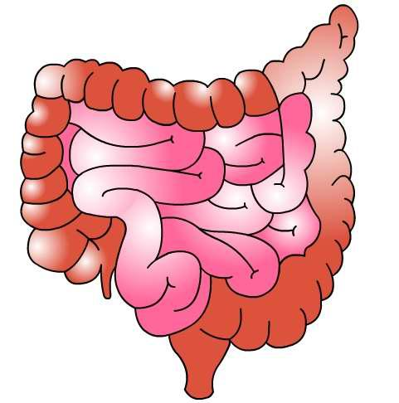
Organs
Two or more tissues can work together to form an organ.
The small intestine is an organ made of several types of tissue. Each tissue contributes to the organ’s overall function.
Epithelial tissue forms the intestinal walls.
Glandular tissue secretes mucus to protect the epithelium from digestive enzymes.
Muscle tissue contracts to move digested food along the intestinal tract.
Notes:
Teacher notes
For more information about digestion and digestive enzymes, please refer to The Digestive System presentation.

Slide 13
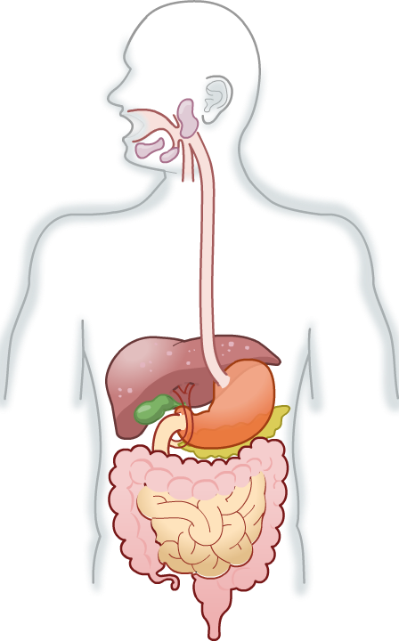
Organ systems
In an organ system, several organs work together to carry out a common function.
The digestive system is made of
organs including the stomach,
small intestine and liver. They work together to break down food and
absorb nutrients.
Organ systems work together to form whole organisms.
Humans are made of organ systems that include the digestive system, circulatory system and nervous system.
Notes:
Teacher notes
For more information about the digestive system, please refer to The Digestive System presentation.

Slide 14
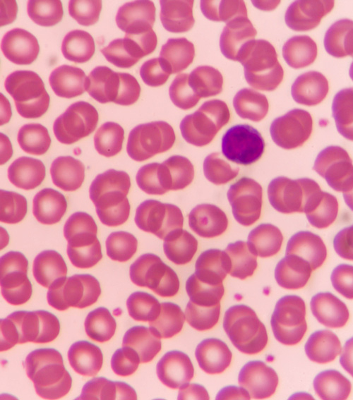
Hierarchy: example
Red blood cells are one example of a specialized cell.
They contain a protein called hemoglobin which can bind to oxygen. This enables the cells to transport oxygen.
Red blood cells work alongside other blood cells to make up blood, which is a tissue.
Blood works with other tissues, such as muscle tissue, to make up the organs of the circulatory system.
Can you name any organs in the circulatory system?
Notes:
Teacher notes
Organs in the circulatory system include the heart and lungs, as well as the circulatory vessels: arteries, veins and capillaries. The image shows a blood smear under a light microscope. The pink circles are red blood cells and the dark circle is a white blood cell.
For more information on red blood cells, please refer to The Circulatory System presentation.
For more information about different types of specialized cells, please refer to the Specialized Cells presentation.
Photo credit: © plenoy m, Shutterstock.com 2018

Slide 15
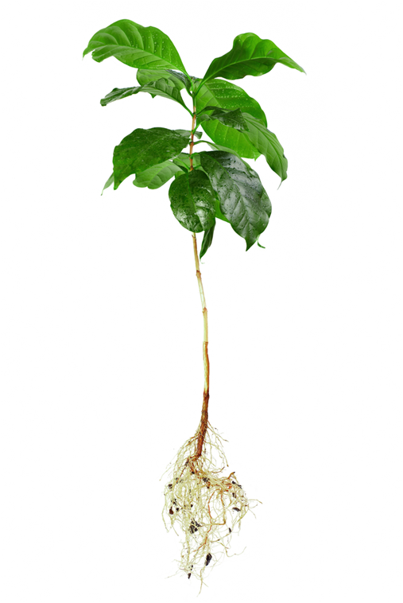
Hierarchy in plants
Plants are multicellular organisms.
This means that, like animals, their internal structure has a hierarchy.
As with animals, the hierarchy includes cells, tissues, organs and organ systems.
Can you identify any parts of the hierarchy in this plant?
Notes:
Teacher notes
Students should be able to identify the leaves, roots and stem. The next slide helps students to place these within the hierarchy. Students should already be able to identify that plant cells form the first stage of the hierarchy.
This slide covers the Science and Engineering Practices:
Constructing Explanations and Designing Solutions: Apply scientific ideas, principles, and/or evidence to provide an explanation of phenomena and solve design problems, taking into account possible unanticipated effects.
Obtaining, Evaluating, and Communicating Information: Communicate scientific and/or technical information or ideas (e.g. about phenomena and/or the process of development and the design and performance of a proposed process or system) in multiple formats (including orally, graphically, textually, and mathematically).
Photo credit: © Olesia Bilkei, Shutterstock.com 2018

Slide 16
Organization in plants
Notes:
Teacher notes
For more information about plant tissues and organs, please refer to the Plant Tissues and Organs presentation.
This slide covers the Science and Engineering Practice:
Developing and Using Models: Use a model to provide mechanistic accounts of phenomena.

Slide 17
Multicellular organisms: key words

