Slide 1
Photosynthesis

Slide 2
Information
Planning and Carrying Out Investigations
Using Mathematics and Computational Thinking
Constructing Explanations and Designing Solutions
Engaging in Argument from Evidence
Obtaining, Evaluating and Communicating Information
2. Cause and Effect
3. Scale, Proportion, and Quantity
5. Energy and Matter
6. Structure and Function

Slide 3
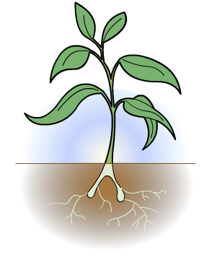
Energy transfers in photosynthesis
Plants and some types of algae make their own food by photosynthesis.
Photosynthesis is a chemical reaction that involves an energy transfer: light energy from the Sun is converted into chemical energy.
The chemical energy is stored inside the organism.
light energy
chemical energy

Slide 4
Uses of photosynthesis
During photosynthesis, light energy is used to build glucose (sugar) molecules.
These important molecules store chemical energy, which photosynthetic organisms can use to power biological processes.
The glucose molecules can also be used to build other molecules that make up the biomass of photosynthetic organisms.
Photosynthetic organisms are the main producers of biomass for life on Earth.
Notes:
Teacher notes
For more information on food chains and biomass transfers, please refer to the Biomass Transfers presentation.
For more information on the uses of glucose, please refer to the Products of Photosynthesis presentation.
Photo credit: © Greg Brave, Shutterstock.com 2018

Slide 5
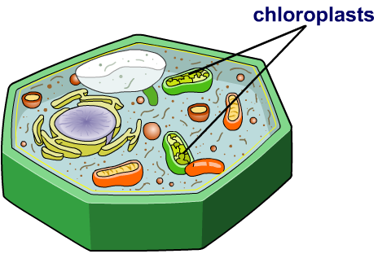
How is light energy absorbed?
Light energy is absorbed by a pigment called chlorophyll. Chlorophyll is found inside chloroplasts.
Chloroplasts are a type of
sub-cellular structure located
in green cells of plants, such as those in the leaves. This is where photosynthesis occurs.
The chloroplasts also contain special enzymes that catalyze the photosynthetic reaction.
Photosynthesis is an endothermic reaction, which means it takes in energy from the environment.

Slide 6
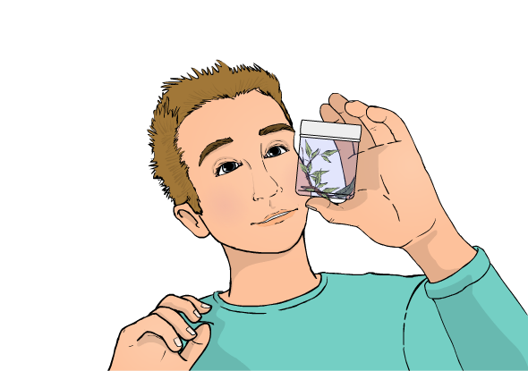
The photosynthetic reaction
Photosynthesis requires a source of carbon dioxide, water and light energy to occur. Carbon dioxide and water are the reactants.
The carbon dioxide and water combine to form glucose and oxygen. Glucose and oxygen are the products of photosynthesis.
The glucose provides a source of food for the plant.
Oxygen is a waste product; it diffuses out of the leaves and into the environment.

Slide 7
A two-stage process
Photosynthesis occurs in two main stages. The first stage requires a source of light energy.
Stage 1
Light energy is absorbed by chlorophyll and used to split water into oxygen and hydrogen ions.
Stage 2
Carbon dioxide combines with the hydrogen ions to produce glucose.
Both of these stages occur inside the chloroplasts.
Notes:
Photo credit: © Volodymyr Krasyuk, Shutterstock.com 2018

Slide 8
Equations for photosynthesis
The reaction of photosynthesis can be represented by the following word equation:
light energy
carbon dioxide
+
water
glucose
+
oxygen
chlorophyll
What is the symbol equation for this reaction?
light energy
6
+
C₆H₁₂O₆
+
6
O₂
CO₂
6
H₂O
chlorophyll
Is this a balanced symbol equation? If not, how would you balance it?
Notes:
This slide covers the Science and Engineering Practice:
Using Mathematics and Computational Thinking: Use mathematical, computational, and/or algorithmic representations of phenomena or design solutions to describe and/or support claims and/or explanations.

Slide 9
Word equation to symbol equation
Notes:
Teacher notes
This drag and drop activity could be used to extend the work on the photosynthesis equation, by providing practice of changing the word equation into a balanced symbol equation. It is important to highlight that chlorophyll and light energy are still represented by words in the symbol equation.

Slide 10
Photosynthesis
Notes:
Teacher notes
This five-stage interactive animation shows how photosynthesis occurs in leaves. At the end of the animation, you can view a summary of this process by clicking on “summary.”
Suitable prompts could include:
Start: What is so special about photosynthesis?
Stage 1: Where in the plant does photosynthesis take place?
Stage 2: Which material comes from the soil and which material comes from the air?
Why does carbon dioxide enter the plant from underneath the leaf?
Stage 3: What is the source of the light energy for photosynthesis?
Stage 4: Where in the plant cell does photosynthesis take place?
What is the name of the pigment that is needed for photosynthesis?
Stage 5: What food is produced during photosynthesis?
What gas is produced during photosynthesis?
This slide covers the Science and Engineering Practice:
Constructing Explanations and Designing Solutions: Apply scientific ideas, principles, and/or evidence to provide an explanation of phenomena and solve design problems, taking into account possible unanticipated effects.

Slide 11
Photosynthesis equation quiz
Notes:
Teacher notes
This multiple-choice quiz of ten questions could be used as a summary activity to check students’ understanding of photosynthesis. To answer the questions, students select the appropriate component of the photosynthesis word equation. Mini-whiteboards could be used to make this a whole-class activity.

Slide 12
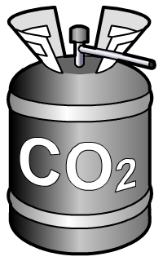
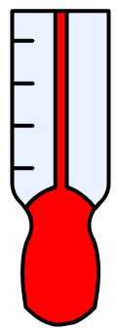
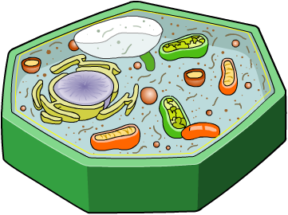
What is the rate of photosynthesis?
Photosynthesis is a chemical reaction and so has a rate.
Like many reactions, photosynthesis is catalyzed by enzymes.
Is the rate of photosynthesis always the same?
Which factors do you think affect the rate of photosynthesis?
light
carbon dioxide
temperature
chlorophyll
Notes:
This slide covers the Science and Engineering Practices:
Constructing Explanations and Designing Solutions: Apply scientific ideas, principles, and/or evidence to provide an explanation of phenomena and solve design problems, taking into account possible unanticipated effects.
Obtaining, Evaluating, and Communicating Information: Communicate scientific and/or technical information or ideas (e.g. about phenomena and/or the process of development and the design and performance of a proposed process or system) in multiple formats (including orally, graphically, textually, and mathematically).

Slide 13
What is a limiting factor?
What is the ideal combination of factors in order to maximize the rate of photosynthesis?
enough light
enough carbon dioxide
optimal temperature
How does restricting one of these factors affect the rate of photosynthesis?
If one of the factors is restricted, the rate of photosynthesis will be below the maximum possible rate.
The restricted factor controls how quickly photosynthesis occurs and so limits the rate. It is called the limiting factor.
Notes:
This slide covers the Science and Engineering Practices:
Constructing Explanations and Designing Solutions: Apply scientific ideas, principles, and/or evidence to provide an explanation of phenomena and solve design problems, taking into account possible unanticipated effects.
Obtaining, Evaluating, and Communicating Information: Communicate scientific and/or technical information or ideas (e.g. about phenomena and/or the process of development and the design and performance of a proposed process or system) in multiple formats (including orally, graphically, textually, and mathematically).

Slide 14
How does light affect photosynthesis?
Light energy is a requirement for photosynthesis.
The brighter the light, the more light energy there is. We say there is an increase in light intensity.
What effect do you think an increase in light intensity will have on the rate of photosynthesis?
Increasing light intensity increases the rate of photosynthesis.
However, if light intensity is very high, chlorophyll can become damaged.
If this happened, how would the rate of photosynthesis be affected?
Notes:
Teacher notes
If chlorophyll becomes damaged then less light energy can be absorbed by the plant. Light energy is needed for photosynthesis. If less is can be absorbed by plant cells then the rate of photosynthesis will decrease.
This slide covers the Science and Engineering Practices:
Constructing Explanations and Designing Solutions: Apply scientific ideas, principles, and/or evidence to provide an explanation of phenomena and solve design problems, taking into account possible unanticipated effects.
Obtaining, Evaluating, and Communicating Information: Communicate scientific and/or technical information or ideas (e.g. about phenomena and/or the process of development and the design and performance of a proposed process or system) in multiple formats (including orally, graphically, textually, and mathematically).

Slide 15
Light intensity and photosynthesis
Notes:
Teacher notes
This animated graph illustrates the effect of light intensity on the rate of photosynthesis. It should be emphasized that after a certain point, other limiting factors will control the rate and further increasing light intensity will have no effect.
This slide covers the Science and Engineering Practices:
Constructing Explanations and Designing Solutions: Apply scientific ideas, principles, and/or evidence to provide an explanation of phenomena and solve design problems, taking into account possible unanticipated effects.
Engaging in Argument from Evidence: Construct, use, and/or present an oral and written argument or counter-arguments based on data and evidence.

Slide 16
Investigating light intensity
Notes:
Teacher notes
This virtual experiment illustrates how light intensity affects the rate of photosynthesis. It could be used as a precursor to running the practical in the lab, or as a summary exercise. When using this activity, it should be emphasized that more oxygen is being produced when the light intensity is increased. This is shown by the rate of production of gas bubbles.
This slide covers the Science and Engineering Practice:
Constructing Explanations and Designing Solutions: Make a quantitative and/or qualitative claim regarding the relationship between dependent and independent variables.

Slide 17
Light intensity and elodea
Notes:
Teacher notes
An alternative method to using a gas syringe is to count the bubbles of oxygen produced. Students could be asked why they think this method is not as good as using a gas syringe. Answers could include the likelihood of miscounting, the fact that bubbles are of different sizes and the difficulty in getting a quantitative result for volume of gas produced from a number of bubbles.
This slide covers the Science and Engineering Practice:
Planning and Carrying Out Investigations: Select appropriate tools to collect, record, analyze, and evaluate data.

Slide 18
Light intensity
Notes:
Teacher notes
The tank of water is used to absorb any heat from the lamp that may interfere with the experiment. Students could be encouraged to see this in terms of controlling other variables or potential limiting factors when carrying out an experiment.
In practice, the amounts of gas collected will be very small. They are shown larger here to differentiate between each run of the experiment clearly without numerical results.
This slide covers the Science and Engineering Practices:
Planning and Carrying Out Investigations: Plan and conduct an investigation individually and collaboratively to produce data to serve as the basis for evidence, and in the design: decide on types, how much, and accuracy of data needed to produce reliable measurements and consider limitations on the precision of the data (e.g., number of trials, cost, risk, time), and refine the design accordingly.
Constructing Explanations and Designing Solutions: Make a quantitative and/or qualitative claim regarding the relationship between dependent and independent variables.

Slide 19
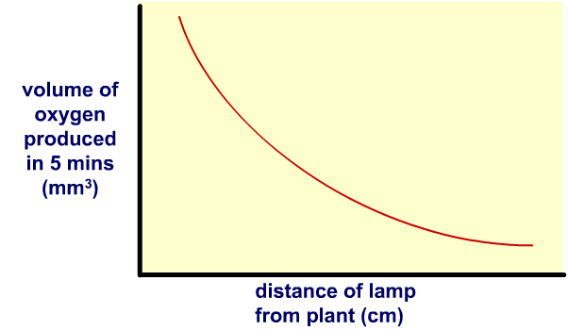
Light intensity results
Inverse square relationship
Here are the results of the light intensity experiment:
How does changing the lamp’s distance affect the rate of photosynthesis?
The results show that the volume of oxygen produced (rate of photosynthesis) decreases as distance of the lamp increases.
However, the decrease isn’t linear; instead it is closer to an inverse square relationship. This is because light intensity follows an inverse square relationship with distance.
Notes:
Teacher notes
An inverse square relationship between light intensity and distance means that doubling the distance of the lamp would quarter the light intensity.
The inverse square relationship explains the relationship between distance of the plant from the lamp and the volume of oxygen produced (rate of photosynthesis shown) in the results above.
This slide covers the Science and Engineering Practices:
Using Mathematics and Computational Thinking: Use mathematical, computational, and/or algorithmic representations of phenomena or design solutions to describe and/or support claims and/or explanations.
Constructing Explanations and Designing Solutions: Make a quantitative and/or qualitative claim regarding the relationship between dependent and independent variables.
Obtaining, Evaluating, and Communicating Information: Communicate scientific and/or technical information or ideas (e.g. about phenomena and/or the process of development and the design and performance of a proposed process or system) in multiple formats (including orally, graphically, textually, and mathematically).
Engaging in Argument from Evidence: Construct, use, and/or present an oral and written argument or counter-arguments based on data and evidence.

Slide 20
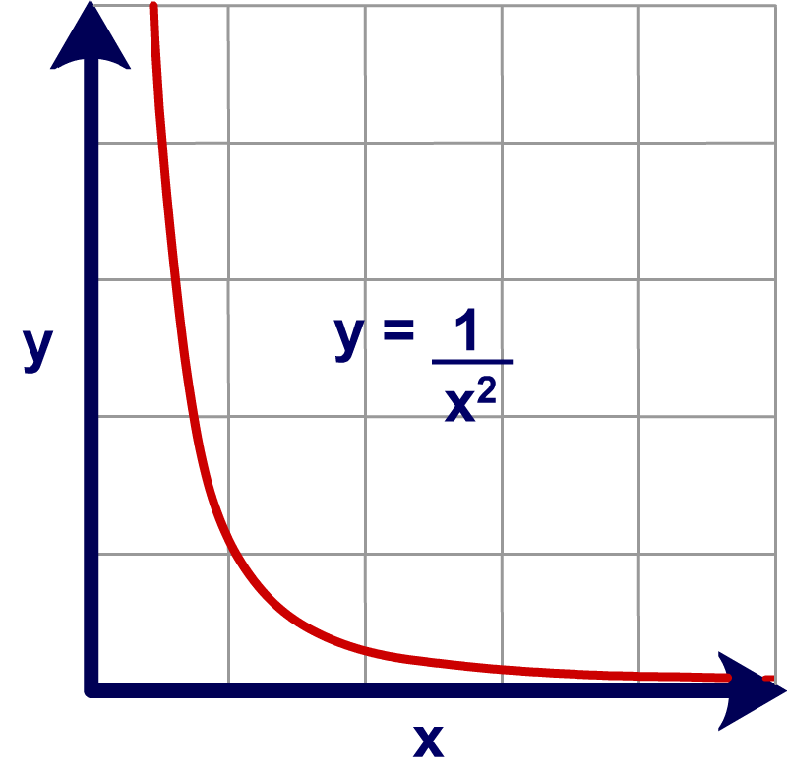
Inverse square law
The inverse square law states that light intensity is inversely proportional to the square of the distance from the light source.
light intensity
1
∝
(distance from light source)²
This graph shows an inverse square relationship.
How does this relationship compare to the results from the light intensity experiment?
Notes:
Teacher notes
Students can derive the inverse square law for light intensity from the y = 1/x² graph by replacing y with “light intensity” and x with “distance from light source.”
This slide covers the Science and Engineering Practices:
Using Mathematics and Computational Thinking: Apply techniques of algebra and functions to represent and solve scientific and engineering problems.
Constructing Explanations and Designing Solutions: Apply scientific ideas, principles, and/or evidence to provide an explanation of phenomena and solve design problems, taking into account possible unanticipated effects.
Obtaining, Evaluating, and Communicating Information: Communicate scientific and/or technical information or ideas (e.g. about phenomena and/or the process of development and the design and performance of a proposed process or system) in multiple formats (including orally, graphically, textually, and mathematically).
Engaging in Argument from Evidence: Construct, use, and/or present an oral and written argument or counter-arguments based on data and evidence.

Slide 21
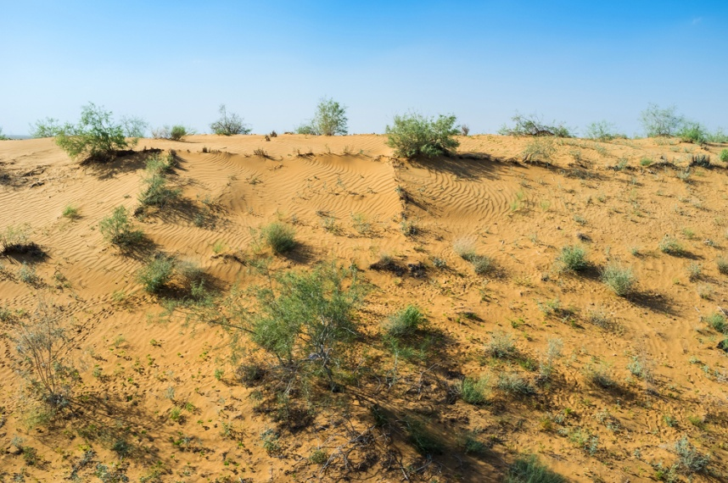
Does temperature affect photosynthesis?
Photosynthesis is catalyzed by enzymes which usually work best in warmer temperatures.
As a result, an increase in temperature normally causes an increase in the rate of photosynthesis.
Does increasing the temperature always increase the rate of photosynthesis?
If it gets too hot (above 40 °C), the enzymes needed for photosynthesis become denatured. The rate of photosynthesis decreases or even stops completely.
Notes:
Teacher notes
Help students to apply their understanding of enzymes to answer the question. For more information about the effect of temperature on enzymes, please refer to the Enzymes presentation.
You may wish to remind students that plants grow faster in the summer than winter. This is because they get more light and a warmer temperature.
This slide covers the Science and Engineering Practices:
Constructing Explanations and Designing Solutions: Apply scientific ideas, principles, and/or evidence to provide an explanation of phenomena and solve design problems, taking into account possible unanticipated effects.
Obtaining, Evaluating, and Communicating Information: Communicate scientific and/or technical information or ideas (e.g. about phenomena and/or the process of development and the design and performance of a proposed process or system) in multiple formats (including orally, graphically, textually, and mathematically).
Photo credit: © eFesenko, Shutterstock.com 2018

Slide 22
Temperature and photosynthesis
Notes:
Teacher notes
This animated graph illustrates the effect of temperature on the rate of photosynthesis. It should highlighted that, unlike carbon dioxide and light intensity, increasing the temperature above 45 °C will cause the rate to decrease or stop completely. Students should be aware that photosynthesis is controlled by temperature-sensitive enzymes. At both stages of the graph, temperature is the limiting factor.
For more information about the effect of temperature on enzymes, please refer to the Enzymes presentation.
This slide covers the Science and Engineering Practices:
Constructing Explanations and Designing Solutions: Apply scientific ideas, principles, and/or evidence to provide an explanation of phenomena and solve design problems, taking into account possible unanticipated effects.
Engaging in Argument from Evidence: Construct, use, and/or present an oral and written argument or counter-arguments based on data and evidence.

Slide 23
Investigating temperature and light
Notes:
Teacher notes
This data handling activity investigates the effects of light and temperature on the rate of photosynthesis. Students are able to plot two graphs using experimental data and a line of best fit is automatically added to each graph. It could be used to complement a practical in the lab, or as a revision exercise. While using the activity, it should be emphasized that two experiments were conducted, changing only one variable at a time.
This slide covers the Science and Engineering Practice:
Using Mathematics and Computational Thinking: Use mathematical, computational, and/or algorithmic representations of phenomena or design solutions to describe and/or support claims and/or explanations.

Slide 24
Carbon dioxide and the rate of photosynthesis
Carbon dioxide is one of the raw materials used by plants to make glucose.
The concentration of carbon dioxide in the air is actually quite low (0.03%).
In commercial greenhouses the concentration of carbon dioxide is often raised to about 0.1%. Why is this?
Increasing carbon dioxide concentration in a plant’s environment increases the rate of photosynthesis.
This enables plants to produce more food which can be used by the plant to grow faster.
Notes:
This slide covers the Science and Engineering Practices:
Constructing Explanations and Designing Solutions: Apply scientific ideas, principles, and/or evidence to provide an explanation of phenomena and solve design problems, taking into account possible unanticipated effects.
Obtaining, Evaluating, and Communicating Information: Communicate scientific and/or technical information or ideas (e.g. about phenomena and/or the process of development and the design and performance of a proposed process or system) in multiple formats (including orally, graphically, textually, and mathematically).

Slide 25
Carbon dioxide and photosynthesis
Notes:
Teacher notes
This animated graph illustrates the effect of carbon dioxide levels on the rate of photosynthesis. It should be emphasized that after a certain point, other limiting factors will control the rate and increasing carbon dioxide levels will have no effect. The similarities of the light intensity and carbon dioxide graphs could also be highlighted.
This slide covers the Science and Engineering Practices:
Constructing Explanations and Designing Solutions: Apply scientific ideas, principles, and/or evidence to provide an explanation of phenomena and solve design problems, taking into account possible unanticipated effects.
Engaging in Argument from Evidence: Construct, use, and/or present an oral and written argument or counter-arguments based on data and evidence.

Slide 26
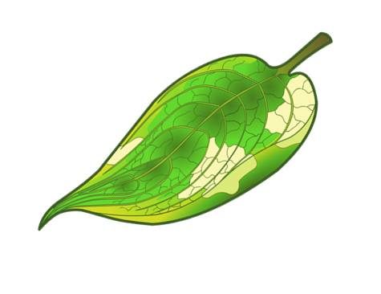
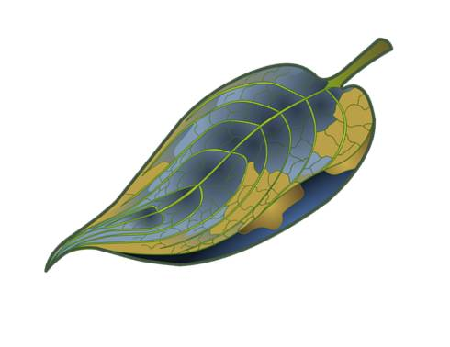
Chlorophyll and the rate of photosynthesis
Variegated leaves have pale parts, which do not contain chlorophyll. Only green parts of the leaf photosynthesize.
Photosynthesis in variegated leaves can be shown using iodine. In the presence of starch iodine turns from yellow to blue-black.
What would you expect to happen if iodine was applied to a variegated leaf?
Only green areas of the leaf would turn blue-black. With no chlorophyll, pale areas cannot photosynthesize to produce the glucose needed to form starch. As a result, the pale areas would not turn blue-black.
Notes:
This slide covers the Science and Engineering Practices:
Planning and Carrying Out Investigations: Make directional hypotheses that specify what happens to a dependent variable when an independent variable is manipulated.
Obtaining, Evaluating, and Communicating Information: Communicate scientific and/or technical information or ideas (e.g. about phenomena and/or the process of development and the design and performance of a proposed process or system) in multiple formats (including orally, graphically, textually, and mathematically).

Slide 27
Limiting factors
Notes:
Teacher notes
This labeling graphs activity could be used to check students’ understanding of factors that limit the rate of photosynthesis and how they interact with one another. It should be emphasized that each of the three factors has the potential to limit photosynthesis.
This slide covers the Science and Engineering Practice:
Constructing Explanations and Designing Solutions: Apply scientific ideas, principles, and/or evidence to provide an explanation of phenomena and solve design problems, taking into account possible unanticipated effects.

Slide 28
Overcoming limiting factors
Notes:
Teacher notes
This simulation activity enables students to experiment with the conditions required for optimum plant growth. It could be used as a summary activity to check students’ understanding of the factors that control photosynthesis.
Ask students why they think it is easier to control factors affecting photosynthesis and plant growth in a greenhouse.
A greenhouse is a closed environment, making conditions easier to manipulate.
Outside you are reliant on atmospheric carbon dioxide which is relatively low (0.03%).
Light intensity and temperature depend on the time of year and weather.
This slide covers the Science and Engineering Practice:
Planning and Carrying Out Investigations: Make directional hypotheses that specify what happens to a dependent variable when an independent variable is manipulated.

Slide 29
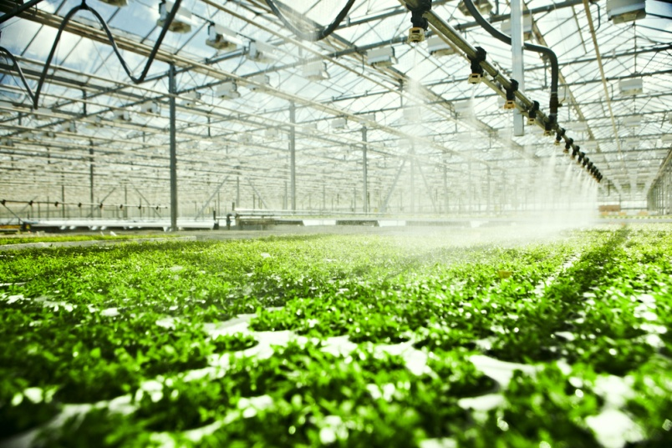
Growing in greenhouses
Conditions inside greenhouses are controlled to overcome
factors that limit the rate of photosynthesis. This enables the plants inside them to grow faster.
However, providing warmth, light, extra carbon dioxide, water and nutrients comes at an economic cost to the grower.
The cost of providing these conditions must be balanced by the benefits gained from enhanced plant growth for the greenhouse to remain profitable.
For a greenhouse to remain profitable, which conditions would you prioritize to enhance plant growth?
Notes:
Teacher notes
Students should consider what they think would enhance the rate of photosynthesis the most.
For example, should a grower invest in extra carbon dioxide over warmth?
This slide covers the Science and Engineering Practices:
Constructing Explanations and Designing Solutions: Apply scientific ideas, principles, and/or evidence to provide an explanation of phenomena and solve design problems, taking into account possible unanticipated effects.
Obtaining, Evaluating, and Communicating Information: Communicate scientific and/or technical information or ideas (e.g. about phenomena and/or the process of development and the design and performance of a proposed process or system) in multiple formats (including orally, graphically, textually, and mathematically).
Photo credit: © gtfour, Shutterstock.com 2018

