Slide 1
Plant Hormones

Slide 2
Information
Developing and Using Models
Planning and Carrying Out Investigations
Constructing Explanations and Designing Solutions
Obtaining, Evaluating and Communicating Information
1. Patterns
2. Cause and Effect
6. Structure and Function
7. Stability and Change

Slide 3
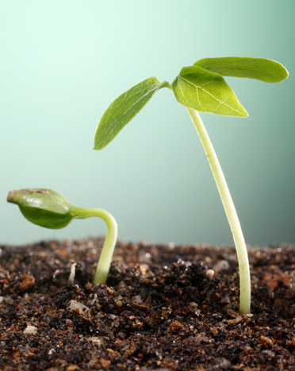
Plant growth
Plants cannot move, but they can control their development and direction of growth. This is achieved through the action of plant hormones.
These hormones enable a plant to coordinate and control changes in growth and development in response to changes in the environment.
If a plant could not alter its growth, it might not be able to get enough water or sunlight from its environment.
Can you name any environmental factors that a plant might respond to, to ensure it grows properly?
Notes:
Teacher notes
Environmental factors that plants might need to respond to by altering their growth include:
gravity
availability of sunlight
temperature
availability of water
availability of mineral ions (e.g. nitrates)
soil quality.
This slide covers the Science and Engineering Practices:
Constructing Explanations and Designing Solutions: Apply scientific ideas, principles, and/or evidence to provide an explanation of phenomena and solve design problems, taking into account possible unanticipated effects.
Obtaining, Evaluating, and Communicating Information: Communicate scientific and/or technical information or ideas (e.g. about phenomena and/or the process of development and the design and performance of a proposed process or system) in multiple formats (including orally, graphically, textually, and mathematically).
Photo credit: © focal point, Shutterstock.com 2018

Slide 4
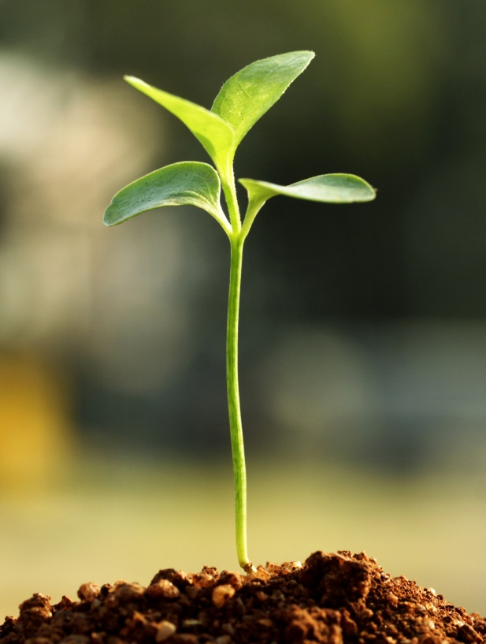
What is a tropism?
A tropism is a growth movement in response to a particular type of stimulus.
A stimulus is any condition that causes a response. For a plant this might be sunlight, water or gravity.
Plants can grow toward or away from stimuli. A growth response toward a stimulus is called a positive tropism.
What is growth away from a stimulus called?
A growth response away from a stimulus is a negative tropism.
Notes:
Teacher notes
Students may need reminding that stimuli is the plural of stimulus.
Photo credit: © infocus, Shutterstock.com 2018

Slide 5
What are the different types of tropisms?
Two of the most important environmental conditions that plants can make growth responses to are light and gravity.
Can you name the tropisms that describe the growth responses to these stimuli?
light
gravity
phototropism
gravitropism
Which parts of a plant respond to these stimuli?
Shoots grow in response to light. Both shoots and roots
need to be able to grow in response to gravity.
Notes:
Teacher notes
Gravitropism is also known as geotropism.

Slide 6
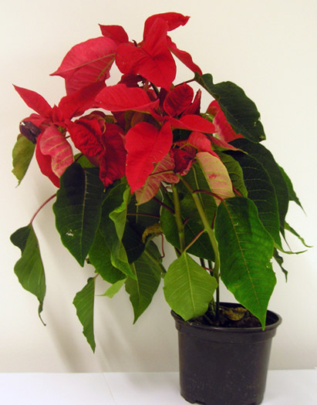
How does light affect growth?
This plant was placed on a windowsill and received light from one direction only.
The shoots of plants grow toward sunlight.
What is the name of this type of plant response?
The growth response to light is called phototropism.
The plant grows toward the light, so it is showing positive phototropism.
Notes:
This slide is accompanied by the worksheet Plant Hormones.
Photo credit: © Boardworks Ltd. 2018

Slide 7
Defining plant growth responses
Notes:
Teacher notes
This matching activity could be used as an introductory or summary activity on plant growth responses.
Photo credit: © Photos.com 2018

Slide 8
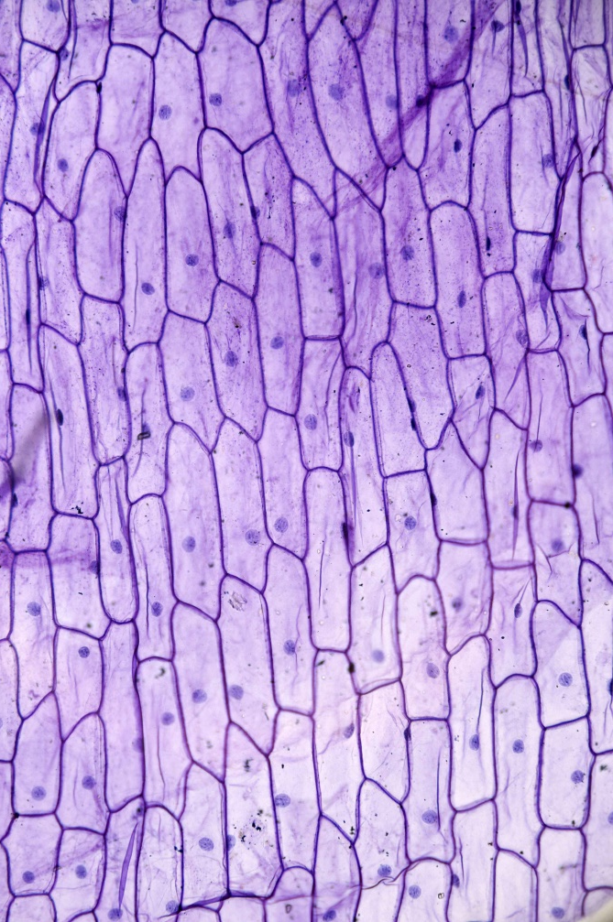
Plant hormones
Hormones are signaling molecules produced by multicellular organisms.
Plant hormones are produced by plant cells.
Unlike animals, plants do not produce hormones in specialized glands. Instead, each plant cell is capable of producing hormones.
Plant hormones initiate changes in the growth or development of the plant.
Notes:
Teacher notes
For more information about hormones produced by humans, please refer to The Endocrine System presentation.
Photo credit: © D. Kucharski K. Kucharska, Shutterstock.com 2018

Slide 9
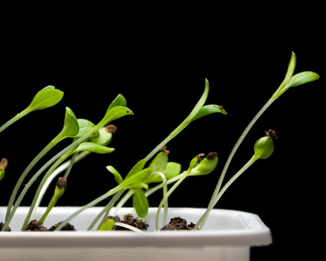
Auxin and phototropism
Plant growth in response to light conditions is coordinated by a plant hormone called auxin.
Auxin controls the growth of shoots and roots. It is produced in the tips of the shoots and roots.
Auxin increases growth rate. An unequal distribution of auxin in a plant stem will cause the stem to bend as it grows.
This enables a plant to grow toward light.
Notes:
Photo credit: © Anest, Shutterstock.com 2018

Slide 10
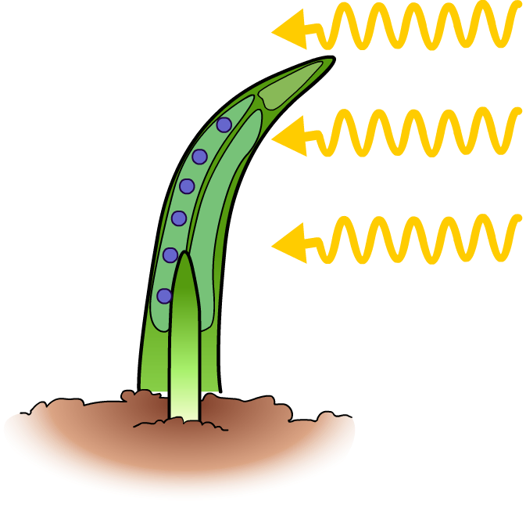
How does auxin cause phototropism?
If a plant only receives light from one side, the auxin in the plant’s stem becomes unequally distributed.
There will be more auxin on the shaded side of the plant stem than the side exposed to light.
This means that the shaded side of the stem will have a higher growth rate than the side facing the light.
more auxin on shaded side of stem
light
As a result, the stem will grow unequally, causing the stem to bend toward the light.
uneven growth rate causes stem to bend

Slide 11
Auxin and the growth response to light
Notes:
Teacher notes
This animated activity illustrates how auxin affects plant growth in response to light. While viewing the animation it should be highlighted that although auxin is produced in the growing tip of the plant, it acts on the cells below the tip to cause growth.
This slide covers the Science and Engineering Practices:
Developing and Using Models: Use a model to provide mechanistic accounts of phenomena.
Constructing Explanations and Designing Solutions: Apply scientific ideas, principles, and/or evidence to provide an explanation of phenomena and solve design problems, taking into account possible unanticipated effects.

Slide 12
Practical: light and plant growth
Notes:
Teacher notes
This virtual experiment investigates how phototropism occurs, using grass seedlings as an experimental subject. It could be used as a precursor to running the practical in the lab or as a summary exercise.
Suitable prompts include:
Stage 1: Why is it important to have a control?
Stage 2: How might removing the tips affect growth?
Stage 3: How might covering the tips affect growth?
Stage 4: How can we make this a fair test?
In this experiment, the distance from the light does not affect growth. However, students can check this by repeating the experiment and altering the order of the seedlings if required.
Stage 5: What do you predict will happen and why?
Stage 6: Why are the seedlings placed in a box?
Stage 7: What do the results suggest about the conditions required for phototropism to occur?
This slide covers the Science and Engineering Practices:
Planning and Carrying Out Investigations: Plan and conduct an investigation individually and collaboratively to produce data to serve as the basis for evidence, and in the design: decide on types, how much, and accuracy of data needed to produce reliable measurements and consider limitations on the precision of the data (e.g., number of trials, cost, risk, time), and refine the design accordingly.
Planning and Carrying Out Investigations: Make directional hypotheses that specify what happens to a dependent variable when an independent variable is manipulated.
Constructing Explanations and Designing Solutions: Apply scientific ideas, principles, and/or evidence to provide an explanation of phenomena and solve design problems, taking into account possible unanticipated effects.
Constructing Explanations and Designing Solutions: Make a quantitative and/or qualitative claim regarding the relationship between dependent and independent variables.

Slide 13
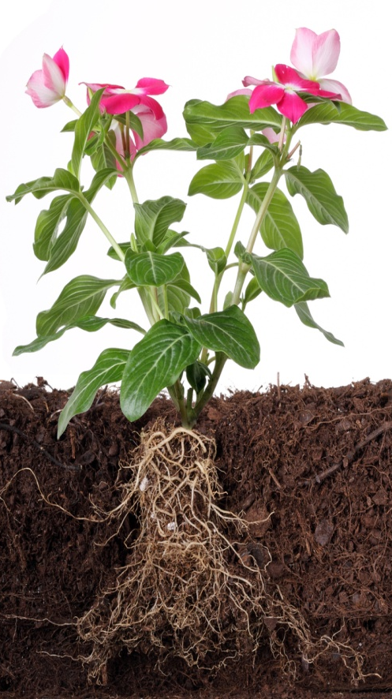
How does gravity affect plant growth?
Plants respond to gravity to grow in the right direction. Roots grow down into the soil, while shoots grow up toward light.
The growth response to gravity is called gravitropism.
Roots grow in the direction of gravity. What type of gravitropism is this?
shoots
Roots grow in the same direction as gravity. They show positive gravitropism.
In contrast, shoots grow in the opposite direction to gravity. They show negative gravitropism.
roots
Notes:
Photo credit: © Filipe B. Varela, Shutterstock.com 2018

Slide 14
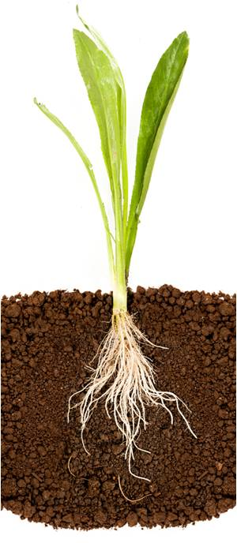
Auxin and gravitropism
Similar to light, a plant’s growth response to gravity is regulated by auxin.
Auxin is produced in both the shoot tips and the root tips of plants.
auxin causes negative gravitropism
Auxin in root tips coordinates positive gravitropism in growing roots.
auxin causes positive gravitropism
Auxin in shoot tips coordinates negative gravitropism in growing shoots.
Why is gravitropism important in plant roots and shoots?
Notes:
Teacher notes
Importance of gravitropism in the roots and shoots of plants:
roots: positive gravitropism enables roots to grow down into the soil to find water supplies that may be deep in the ground.
shoots: negative gravitropism enables shoot to grow up toward sunlight to maximize photosynthesis.
This slide covers the Science and Engineering Practices:
Constructing Explanations and Designing Solutions: Apply scientific ideas, principles, and/or evidence to provide an explanation of phenomena and solve design problems, taking into account possible unanticipated effects.
Obtaining, Evaluating, and Communicating Information: Communicate scientific and/or technical information or ideas (e.g. about phenomena and/or the process of development and the design and performance of a proposed process or system) in multiple formats (including orally, graphically, textually, and mathematically).
Photo credit: © showcake, Shutterstock.com 2018

Slide 15
Plant growth in response to gravity
Notes:
Teacher notes
This five-stage animation shows a simple experiment that could be used to test how shoots and roots respond to gravity. A broad bean has been used in this animation as they make good test subjects because they germinate quickly.
Suitable prompts include:
Stage 1: How can you investigate the seedling’s response to gravity?
Stage 2: Where is auxin produced?
Stage 3: How does the shoot respond to gravity?
Stage 4: Does the root respond to gravity in the same way as the shoot?
It should be highlighted to students that auxin speeds up growth in the shoots but slows down growth in the roots.
Stage 5: What would happen if the plant did not respond to gravity in this way? Would it be able to survive?
Note that gravitropism is sometimes referred to a geotropism.
This slide covers the Science and Engineering Practices:
Developing and Using Models: Use a model to provide mechanistic accounts of phenomena.
Constructing Explanations and Designing Solutions: Apply scientific ideas, principles, and/or evidence to provide an explanation of phenomena and solve design problems, taking into account possible unanticipated effects.

Slide 16
Plant tropisms: true or false?
Notes:
Teacher notes
This true-or-false quiz could be used as an introductory or summary activity on tropisms and auxin, or at the start of a lesson to gauge students’ existing knowledge of the subject matter. Colored traffic light cards (red = false, yellow = don’t know, green = true) could be used to make this a whole-class exercise.
For question six, it should be highlighted to students that auxin speeds up growth in shoots, but slows down growth in roots.

Slide 17
Other plant hormones
There are several other plant hormones that have important roles in the coordination of growth and development.
Gibberellins are a class of hormones that coordinate the initiation of seed germination. They also stimulate flower opening and fruit growth.
Ethene is a hormone that causes fruit ripening and the shedding of leaves. It also controls cell division.
Auxin, gibberellins and ethene interact with one another to ensure optimal plant growth and development in response to changing environmental conditions.
Notes:
Photo credit: © Bogdan Wankowicz, Shutterstock.com 2018

Slide 18
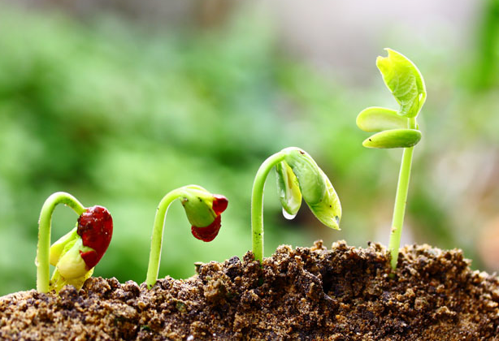
How can plant hormones be used?
Plant hormones are naturally occurring chemicals. However, they can also be produced synthetically for uses in agriculture and horticulture, including:
growing cuttings
ripening fruit
killing weeds
promoting flowering
increasing fruit size.
Can you name some reasons why these uses are beneficial for gardeners and farmers?
Notes:
This slide covers the Science and Engineering Practices:
Constructing Explanations and Designing Solutions: Apply scientific ideas, principles, and/or evidence to provide an explanation of phenomena and solve design problems, taking into account possible unanticipated effects.
Obtaining, Evaluating, and Communicating Information: Communicate scientific and/or technical information or ideas (e.g. about phenomena and/or the process of development and the design and performance of a proposed process or system) in multiple formats (including orally, graphically, textually, and mathematically).
Photo credit: © Paladin12, Shutterstock.com 2018

Slide 19
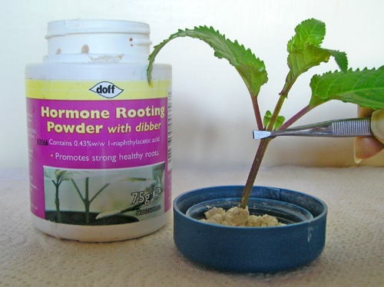
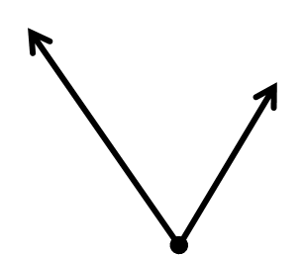
Using plant hormones to grow cuttings
A cutting is a part of a plant that has been removed from the main shoot.
A cutting does not have roots. This means it is unable to absorb water or minerals.
cutting
To stimulate root growth, cuttings are dipped into rooting powder.
Rooting powder contains the plant hormone, auxin.
Cuttings are genetically identical to the parent plant. This allows growers to
copy successful plants.
rooting powder

Slide 20
How are cuttings grown?
Notes:
Teacher notes
This four-stage simulation investigates how rooting powder can be used to encourage growth in cuttings. It could be used as a precursor to running the practical in the lab or as a revision exercise.
Cuttings enable gardeners to grow many plants from a single successful plant that are genetically identical to one another and the original plant. Cuttings can be used to produce clones.
This slide covers the Science and Engineering Practices:
Planning and Carrying Out Investigations: Make directional hypotheses that specify what happens to a dependent variable when an independent variable is manipulated.
Constructing Explanations and Designing Solutions: Apply scientific ideas, principles, and/or evidence to provide an explanation of phenomena and solve design problems, taking into account possible unanticipated effects.
Obtaining, Evaluating, and Communicating Information: Communicate scientific and/or technical information or ideas (e.g. about phenomena and/or the process of development and the design and performance of a proposed process or system) in multiple formats (including orally, graphically, textually, and mathematically).

Slide 21
Using plant hormones in tissue culture
Tissue culture is carried out in a lab and is a method used to grow whole plants from a plant tissue sample. Auxin is commonly used to encourage growth in tissue culture.
The tissue sample usually consists of a cluster of cells, with no roots of shoots.
Auxin is added to the growth medium to induce the cell cluster to develop a shoot and root. This allows the cluster to form a plantlet.
The plantlet can then be planted in soil to continue to develop.
Notes:
Teacher notes
As well as promoting root growth, auxin also promotes shoot growth.
Like cuttings, tissue culture produces plants that are genetically identical to the parent plant from which the tissue sample was originally taken.
Photo credit: © KYTan, Shutterstock.com 2018

Slide 22
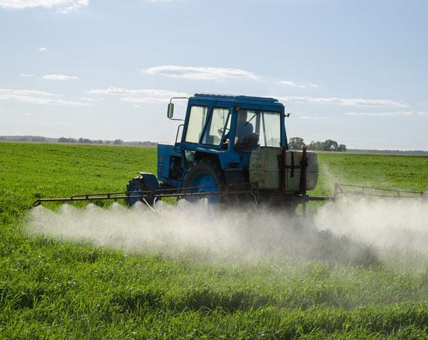
Using plant hormones to kill weeds
Herbicides can be used to kill weeds. They are selective, which means they only affect certain types of plants. Some herbicides contain the plant hormone, auxin.
Most weeds have broad leaves. Cereals crops, such as wheat, have narrow leaves.
Auxin in the herbicide causes the weeds to grow too quickly. They are unable to sustain the high growth rate, causing them to die.
The weeds absorb more herbicide than the crop plant due to their broader leaves. This means the crop plants are unaffected by the auxin in the herbicide and remain healthy.
Notes:
Teacher notes
Weeds are unwanted plants that compete with plants or crops grown by gardeners and farmers.
Weed killers are herbicides. They are used by both gardeners and farmers.
Photo credit: © Sauletas, Shutterstock.com 2018

Slide 23
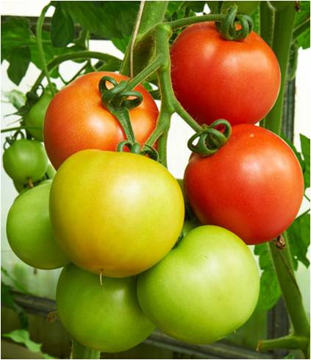
Using plant hormones to ripen fruit
Fruit is commonly picked before it is fully ripe. This is because it often has to travel thousands of miles from where it is picked to where it will be sold.
Early picking is advantageous as unripe fruit is harder and so less likely to bruise than ripe fruit when transported.
When the fruit reaches its destination, it can be sprayed with the plant hormone ethene, which encourages fruit to ripen.
This method is used commercially to ripen tomatoes, bananas and pears.
Notes:
Teacher notes
Using artificial ethene to ripen fruit is not just a modern practice. Ancient Egyptians exposed figs to natural gas, which contains ethene, to encourage ripening.
Photo credit: © Vlad-Siaber, Shutterstock.com 2018

Slide 24
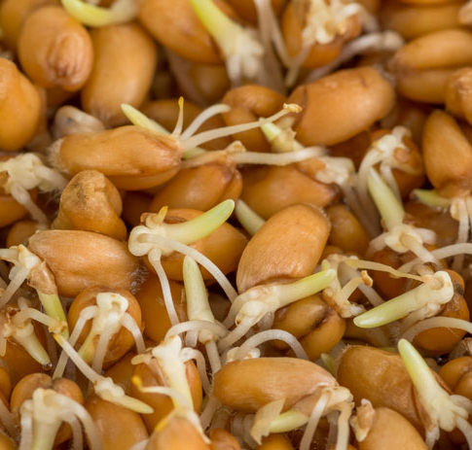
Plant hormones to control dormancy
Seeds can lie dormant for many years. Dormant seeds will not germinate, even in warm and moist conditions.
Gibberellins can be used to end seed dormancy by promoting germination.
This enables farmers to control when crops begin to grow, so that plants all grow at the same time.
Gibberellins can also be used to extend the growing season by making plants start to grow earlier than they would naturally.
Notes:
Teacher notes
Dormancy ensures that seeds do not all germinate at the same time. This means that if there is a period of poor growing conditions, such as a drought, some of the dormant seeds may survive. These seeds have the potential to germinate when conditions improve.
Photo credit: © Viacheslav Rubel, Shutterstock.com 2018

Slide 25
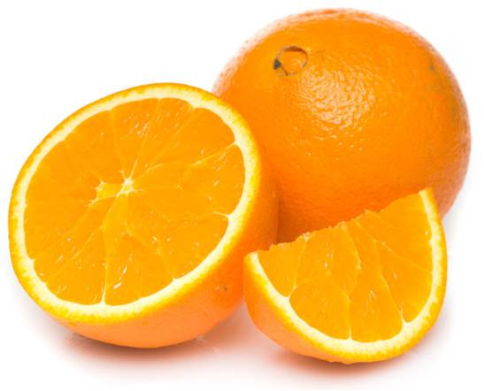
Using plant hormones for seedless fruit
Plants usually reproduce via the seeds found inside fruit. However, many people prefer to eat fruit without seeds.
Most plants only grow fruits if they have been pollinated and have developing seeds. Plant hormones can be used to stimulate fruit growth without the need for pollination. This is known as parthenocarpic fruit development.
Gibberellins can be sprayed on flowers to stimulate fruit growth, even though there are no seeds.
This method is commonly used commercially to produce seedless grapes and oranges.
Notes:
Teacher notes
Parthenocarpic development enables a plant to produce fruit without its ovules having first been fertilized by pollen.
Photo credit: © Sann-von-Mai, Shutterstock.com 2018

Slide 26
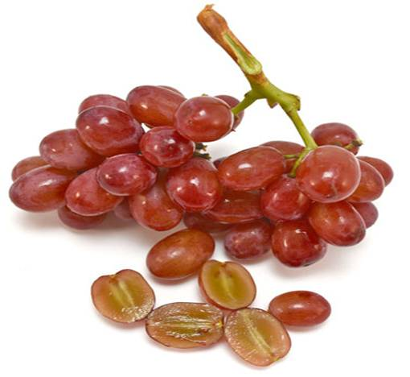
Other uses of gibberellins
Gibberellins can be applied to plants to increase fruit size.
Grape vines are often treated with gibberellins. Not only do they induce the growth of seedless fruit, they also lead to the production of larger grapes.
Gibberellins can also be used commercially to induce flowering.
Naturally, plants use seasonal cues such as day length to control flowering.
Gibberellins can be applied to enable growers to manipulate when plants will bloom.
Notes:
Photo credit: © AlissalaKerr, Shutterstock.com 2018

Slide 27
Missing words: using plant hormones
Notes:
This slide covers the Science and Engineering Practice:
Constructing Explanations and Designing Solutions: Apply scientific ideas, principles, and/or evidence to provide an explanation of phenomena and solve design problems, taking into account possible unanticipated effects.

