Slide 1
Resistant Bacteria

Slide 2
Information
Constructing Explanations and Designing Solutions
1. Patterns
2. Cause and Effect
3. Scale, Proportion, and Quantity
6. Structure and Function
7. Stability and Change

Slide 3
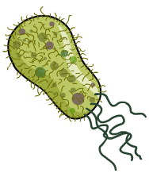
What are resistant bacteria?
Many types of bacteria are pathogens, which means they are capable of causing disease if a person becomes infected.
Bacterial infections are often treated using antibiotics, a type of medicine that kills bacteria or prevents them from growing and reproducing.
Some types of bacteria cannot be killed using antibiotics. If this is the case, they are said to be resistant bacteria.
These bacteria can spread quickly between people because the antibiotic normally used as treatment is no longer effective.
Notes:
Teacher notes
Infections caused by antibiotic-resistant bacteria are very difficult to treat, especially in patients with weakened immune systems. This is because the range of drugs that can kill the bacteria is so limited. Resistant strains may spread quickly through the population if there is no effective treatment.

Slide 4
Mutations in bacteria
Under the right conditions, bacteria reproduce rapidly – doubling in number approximately every 20 minutes.
When bacteria divide, random changes called mutations sometimes occur in their genes to produce a new strain.
Sometimes a mutation offers a competitive advantage, and can spread rapidly in a population of bacteria.
Antibiotic resistance is a relatively common type of mutation amongst bacteria.
Notes:
Photo credit: © Kateryna Kon, Shutterstock.com 2018

Slide 5
Evidence for evolution
Evolution occurs through the process of natural selection. Normally evolution happens over thousands of years – far too slowly for us to see changes as they occur.
However, because bacteria reproduce rapidly we can see changes over many generations in real time.
Antibiotic resistance spreads through a bacterial population by natural selection. This is because resistant bacteria are able to outcompete non-resistant bacteria to produce more offspring.
As a result, the population evolves to become resistant over several generation.
Notes:
Teacher notes
For more information on antibiotic-resistant bacteria as evidence for natural selection, please refer to the Evolution presentation.

Slide 6
Why does antibiotic resistance occur?
Bacteria that become resistant to antibiotics have a competitive advantage over non-resistant bacteria.
This is because their growth and rate of reproduction are not affected by exposure to the antibiotic, nor are they killed.
As a result, they can produce more offspring than the non-resistant bacteria.
When the resistant bacteria divide, they pass on the gene for antibiotic resistance. Over successive generations, more bacteria in the population become resistant.
Notes:
Photo credit: © avarand, Shutterstock.com 2018

Slide 7
The evolution of resistance
Notes:
Teacher notes
This six-stage sequence shows how antibiotic-resistant bacteria can arise. Suitable prompts could include:
What will happen to the non-resistant bacteria?
What will happen to the percentage of resistant bacteria if they are exposed to antibiotics?
Does that mean the resistant bacteria will take over the patient’s body? Could they infect other people too?

Slide 8
How do resistant bacteria develop?
Notes:
This slide covers the Science and Engineering Practice:
Constructing Explanations and Designing Solutions: Apply scientific ideas, principles, and/or evidence to provide an explanation of phenomena and solve design problems, taking into account possible unanticipated effects.

Slide 9
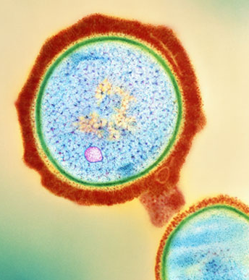
What is MRSA?
MRSA stands for “methicillin-resistant Staphylococcus aureus” and is a strain of bacteria that is resistant to several different types of antibiotic.
About 30% of the population carry MRSA without symptoms.
In patients that do show symptoms, MRSA can cause pneumonia, blood poisoning and even death.
The antibiotic vancomycin can be used to treat MRSA infection. However, resistance to this antibiotic has also evolved, producing a strain of MRSA that is even more difficult to treat effectively.
Notes:
Photo credit: Dr Kari Lounatmaa / Science Photo Library
Colored transmission electron micrograph (TEM) of a section through a methicillin-resistant Staphylococcus aureus (MRSA) bacterium. This bacterium is resistant to most antibiotic drugs. Staphylococcus aureus is a Gram-positive spherical (coccus) bacterium. Here, its capsule (red), cell wall (green) and DNA (deoxyribonucleic acid) genetic material (yellow) are seen. S. aureus can cause boils, abscesses and wound infections. MRSA is of serious concern in hospitals and has caused dangerous outbreaks, particularly in geriatric wards. Its spread may be very hard to control. Magnification: ×41,500 at 6×7cm size.

Slide 10
Preventing antibiotic resistance (1)
Antibiotic resistance is a growing problem in medicine. However, actions can be taken to try and prevent the development of resistant strains.
Doctors should not prescribe antibiotics for treating viral infections, such as influenza.
Antibiotics are not effective against viruses. This is because viruses and bacteria replicate differently.
Unlike bacteria, viruses replicate inside the cells they infect. As a result, the antibiotic is unable to reach the virus to destroy it.
Notes:
Teacher notes
Influenza is more commonly know as “the flu.”
Photo credit: © megaflopp, Shutterstock.com 2018

Slide 11
Preventing antibiotic resistance (2)
When prescribed antibiotics, some people stop taking them as soon as they start to feel better. However, patients should always complete their course of antibiotic treatment.
This is because bacteria can remain, even when symptoms have gone, and can go on to mutate into resistant strains.
Completing the course of antibiotics increases the likelihood that all bacteria are killed.
The strongest antibiotics should be reserved only for the most serious infections. This reduces the risk of bacteria becoming resistant to them.
Notes:
Photo credit: © GoDunk13, Shutterstock.com 2018

Slide 12
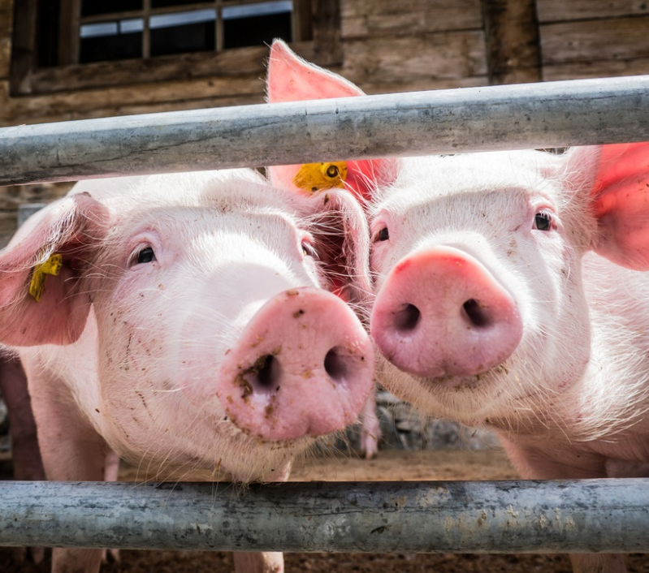
Antibiotics in farming
Antibiotics are often used to treat bacterial infections in farm animals. Bacterial infections can otherwise spread easily between farm animals, as they often live close together.
In some countries, antibiotics are also routinely given to farm animals to make them grow faster.
In the US, more than 70% of the antibiotics given to farm animals are also used in human medicine.
In 2015, a study revealed a strain of MRSA in pigs which could spread to humans, causing skin infections.
Notes:
Photo credit: © FooTToo, Shutterstock.com 2018

Slide 13
The future for antibiotics
The development of new antibiotics is expensive and slow. Over the past few decades, few new antibiotics have become available.
There is currently a risk that we will become unable to treat common infections or perform surgery safely.
Governments and the medical and pharmaceutical industries worldwide are beginning to tackle the problem.
95% of the world’s population now live in countries that have an action plan in place to try to combat antibiotic resistance.
Notes:
Teacher notes
Techniques to prevent antibiotic resistance arising include:
patients taking the full course of antibiotic treatment prescribed
doctors limiting the prescription of antibiotics to only those patients that really need them
doctors reserving the strongest antibiotics for the most serious infections
doctors not prescribing antibiotics for viral infections
limiting the use of antibiotics to treat livestock in farming.
Photo credit: © Alexander Raths, Shutterstock.com 2018

Slide 14
Antibiotics: true or false?
Notes:
Teacher notes
The reasons for each answer are:
This is false, as there are not many drugs that are able to treat antibiotic-resistant bacteria, but researchers are currently looking to develop new medicines.
This is false, as you should always finish the course to reduce the chance of some bacteria surviving.
This is false, as antibiotics are useless at treating viruses, and may increase the chance of resistant bacterial strains developing.
This is true; resistant strains of bacteria have evolved through the process of natural selection. This is because resistant bacteria have a competitive advantage over non-resistant strains.
This is false; the development of new antibiotics is very slow and expensive.

