Slide 1
Selective Breeding

Slide 2
Information
Constructing Explanations and Designing Solutions
Obtaining, Evaluating and Communicating Information
1. Patterns
2. Cause and Effect
6. Structure and Function
7. Stability and Change

Slide 3
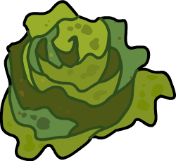
What is selective breeding?
Selective breeding is the process by which humans breed animals or plants to develop particular characteristics. It is also known as artificial selection.
Human have carried out selective breeding for thousands of years. The technique has been used to breed food crops from wild plants and to produce domesticated animals.
The characteristics chosen for selective breeding are coded for by genes. As a result, the characteristics can be inherited by offspring.
Notes:
Teacher notes
For more information about the inheritance of genes, please refer to the Inheritance presentation.

Slide 4
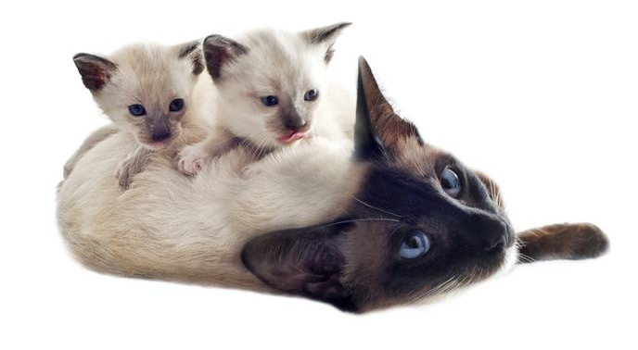
How does selective breeding work?
Selective breeding involves choosing organisms which show the desirable trait and breeding them together.
The trait can be passed on to the next generation via genes. Only offspring that inherit the genes that code for the particular trait will show the desired characteristic.
Offspring that show the trait are then bred together. This continues for many generations until all offspring show the desired characteristic.
Can you think of some desirable traits that might be used in selective breeding?
Notes:
Teacher notes
Remind students that a trait is a characteristic of an organism.
Desirable traits that might be used in selective breeding include:
disease resistance
fur color/length
milk yield (cows)
height/size
flower color
petal shape.
Photo credit: © cynoclub, Shutterstock.com 2018

Slide 5
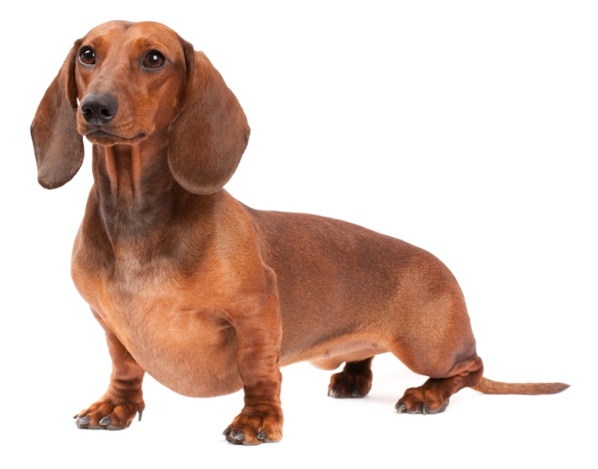
Comparison to natural selection
Selective breeding and natural selection both involve characteristics being inherited by offspring via genes.
In selective breeding, a person decides which characteristics are desirable. In natural selection, the environment determines whether a characteristic is desirable.
Natural selection leads to organisms with traits that make them adapted to their environment. Selective breeding leads to organisms with traits making them useful to humans.
Can you think of a trait in animals that might be useful to humans, but not to the animal if it were to live in the wild?
Notes:
Teacher notes
Help students to think through the impacts of selected characteristics on organisms. Possible answers to question include:
Thick wool in sheep – this might be too heavy in the wild, but useful in the production of wool.
Short legs in dogs – makes it difficult for the dog to run quickly, but seen as a desirable appearance in pets for humans.
High mass in cattle, pigs and chickens – makes it difficult for animals to move in their natural manner, but increases meat yield.
This slide covers the Science and Engineering Practices:
Constructing Explanations and Designing Solutions: Apply scientific ideas, principles, and/or evidence to provide an explanation of phenomena and solve design problems, taking into account possible unanticipated effects.
Obtaining, Evaluating, and Communicating Information: Communicate scientific and/or technical information or ideas (e.g. about phenomena and/or the process of development and the design and performance of a proposed process or system) in multiple formats (including orally, graphically, textually, and mathematically).
Photo credit: © Nikolai Tsvetkov, Shutterstock.com 2018

Slide 6
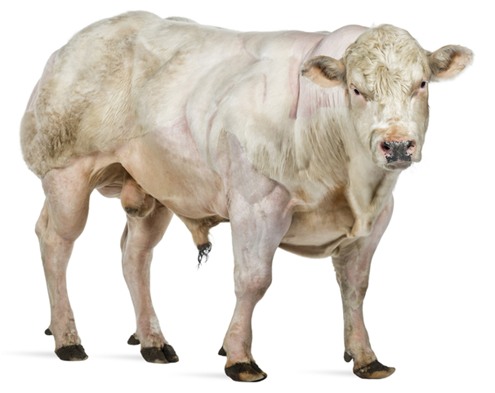
Domestic animals (1)
Domestic animals have been selectively bred from wild animals to be tame enough for humans to use for work, for food or to keep as pets.
Beef cattle have been bred to produce high quantities of meat.
Dairy cattle have been bred to produce high quantities of milk.
Sheep have been bred to produce high quantities of meat and to grow large amounts of wool which humans can use to make fabrics and clothes.
Notes:
Photo credit: Belgian Blue beef cattle © Eric Isselee, Shutterstock.com 2018

Slide 7
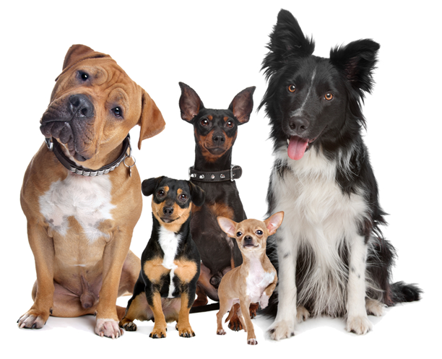
Domestic animals (2)
Domestic animals have also been selectively bred for sport. For example, racehorses have been bred to be tall, gallop quickly and jump well.
Dogs have been bred as pets. There are hundreds of breeds, all originating from wild wolves.
Some dogs have been bred with a focus on behavior, such as farm dogs used for herding sheep.
Most dogs have been bred to be gentle in nature and for their appearance. Fur color, body size and ear shape have been used for selective breeding.
Notes:
Photo credit: © Erik Lam, Shutterstock.com 2018

Slide 8
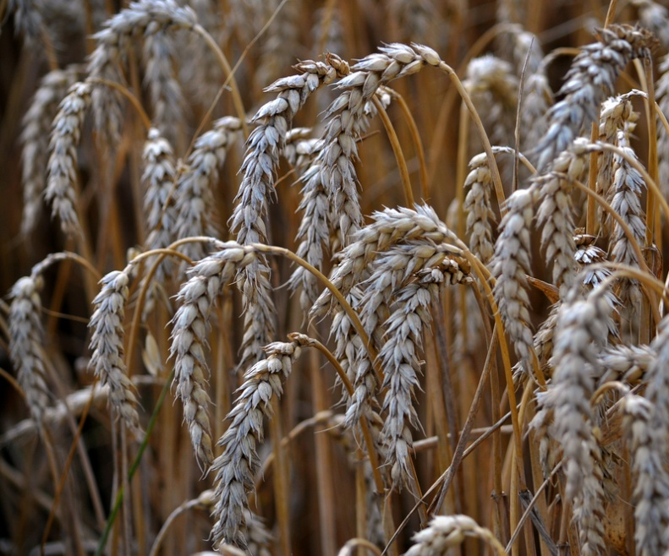
Selective breeding in plants (1)
Selective breeding has been used in agriculture to produce crop plants that give a high yield.
Crops have been bred to show disease resistance. This reduces crop loss and reduces the amount of chemicals that need to be added to fields to protect them from disease.
Crops have also been bred to have larger seed heads, so that they produce a higher quantity of food.
Stem height has been selectively bred to make crops easier to harvest using machinery.
Notes:
Photo credit: © Orest lyzhechka, Shutterstock.com 2018

Slide 9
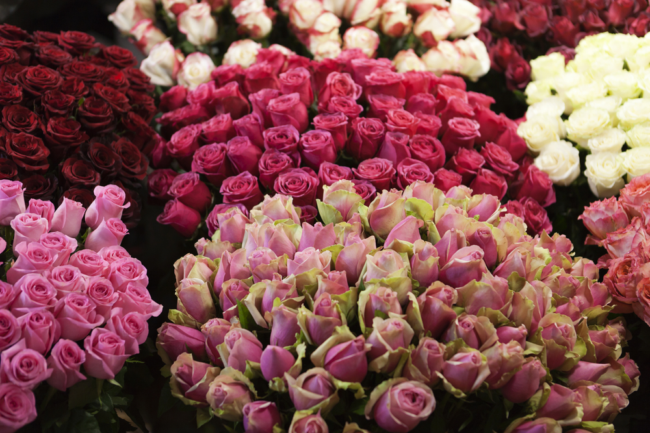
Selective breeding in plants (2)
Selective breeding has also been used in horticulture to create plants that have characteristics desirable to gardeners.
Often plants have been bred to have large or unusually shaped and colored flowers.
For example, there are hundreds of varieties of roses. Each variety has a unique appearance, depending on the traits selected for by the grower.
Notes:
Photo credit: © artcasta, Shutterstock.com 2018

Slide 10
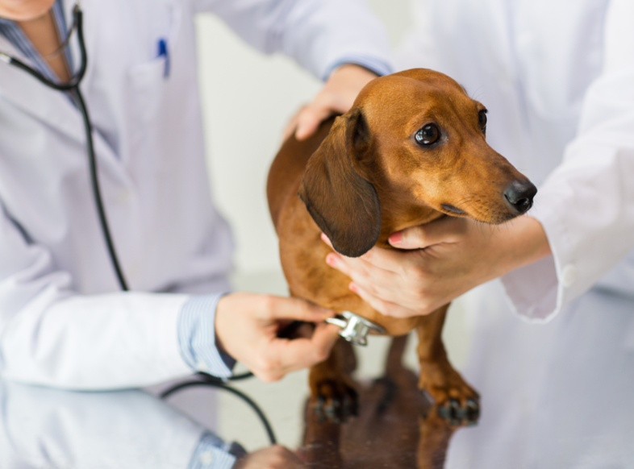
Issues surrounding selective breeding
Selective breeding can involve repeatedly breeding related organisms together over several generations. This leads to inbreeding.
Inbreeding can result in an organism being more susceptible to disease, having a shortened lifespan and having an increased likelihood of inherited defects.
For example, some dog breeds suffer from high rates of disease and have difficulty in walking due to extreme body shapes.
Notes:
Photo credit: © Syda Productions, Shutterstock.com 2018

