Slide 1
Sexual and Asexual Reproduction

Slide 2
Information
Constructing Explanations and Designing Solutions
Obtaining, Evaluating and Communicating Information
1. Patterns
2. Cause and Effect
3. Scale, Proportion, and Quantity
6. Structure and Function

Slide 3
Sexual reproduction
There are two main ways by which organisms can reproduce: sexual reproduction and asexual reproduction.
In sexual reproduction, male and female sex cells fuse together to combine their genetic material and form a new living organism.
Most animals, and many plants, reproduce using sexual reproduction.

Slide 4
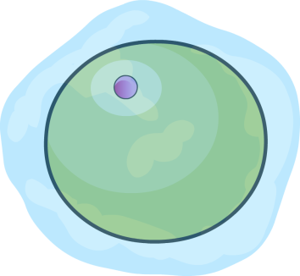
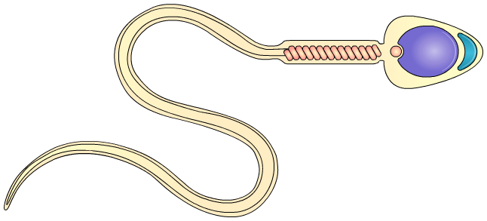
Gametes
In animals and plants, sex cells are called gametes.
In animals, including humans, female gametes are called egg cells and male gametes are called sperm cells.
egg cell
sperm cell
site of pollen cells
In flowering plants, female gametes are called egg cells and male gametes are called pollen cells.
site of egg cells

Slide 5
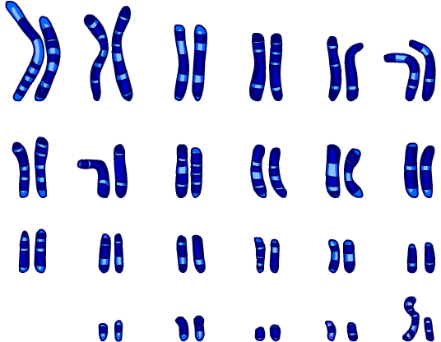
Chromosomes
Gametes are haploid, which means they contain half the number of chromosomes found in normal body cells.
This occurs because only half of
a parent’s chromosomes enter the
gametes during their production.
If gametes were not haploid, zygotes produced by fertilization would contain double the normal number of chromosomes.
In humans, this would mean that a zygote would contain
92 chromosomes rather than 46.
How many chromosomes do human gametes contain?
Notes:
Teacher notes
Human body cells contain 23 pairs of chromosomes. This means there are 46 chromosomes in total.
Human gametes contain 23 chromosomes in total, half that of body cells. The chromosomes in gametes are unpaired.
Normal human body cells are diploid, as they contain a full set of paired chromosomes.
The image on the slide shows a diploid set of human chromosomes – 46 chromosomes, in 23 pairs.

Slide 6
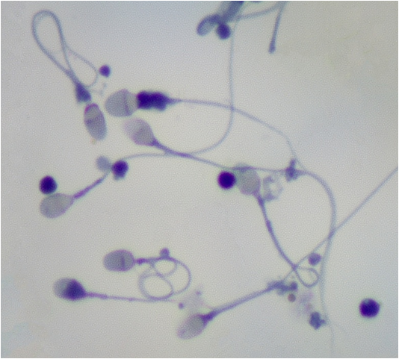
Meiosis
Gametes are produced by a special type of cell division called meiosis.
Unlike mitosis, gametes produced by meiosis contain half the number of chromosomes of normal body cells.
This is because, during meiosis, only one chromosome from each pair of chromosomes in the parent cell is copied to the gamete.
Meiosis produces genetically non-identical, haploid daughter cells.
Why is it important to produce genetically unique gametes?
Notes:
Teacher notes
Meiosis enables the gametes of a single individual to vary in the genes they contain. As a result, offspring produced by the same organism can vary from each other. This explains why siblings can look very different to one another and either of their parents.
Help students to draw on their understanding of natural selection to answer the question. The production of genetically unique offspring contributes to the formation of a genetically varied population.
For more information about meiosis, please refer to the Meiosis presentation.
This slide covers the Science and Engineering Practices:
Constructing Explanations and Designing Solutions: Apply scientific ideas, principles, and/or evidence to provide an explanation of phenomena and solve design problems, taking into account possible unanticipated effects.
Obtaining, Evaluating, and Communicating Information: Communicate scientific and/or technical information or ideas (e.g. about phenomena and/or the process of development and the design and performance of a proposed process or system) in multiple formats (including orally, graphically, textually, and mathematically).
Photo credit: © Carolina K. Smith MD, Shutterstock.com, 2018
Human sperm magnification ×100

Slide 7
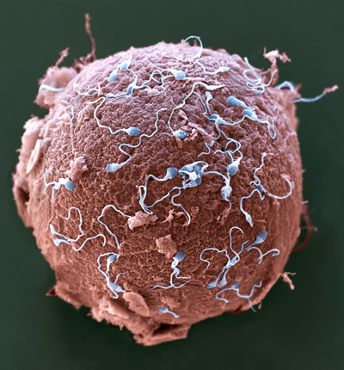
What is fertilization?
Fertilization is the stage of sexual reproduction in which male and female gametes fuse.
During fertilization, the haploid nuclei of the male and female gametes combine to form a diploid zygote.
This means the zygote contains a full set of chromosomes. This is the same number as that found in a normal body cell.
This zygote then divides by mitosis to become an embryo. This goes on to develop into a new organism.
Notes:
Teacher notes
In humans, fertilization occurs when the sperm's genetic material fuses with the egg's genetic material.
Photo credit: © Eye of Science / Science Photo Library, 2018
Colored scanning electron micrograph (SEM) of sperm (blue) attempting to penetrate a human egg (red). Magnification: ×650 when printed 10 centimeters wide.

Slide 8
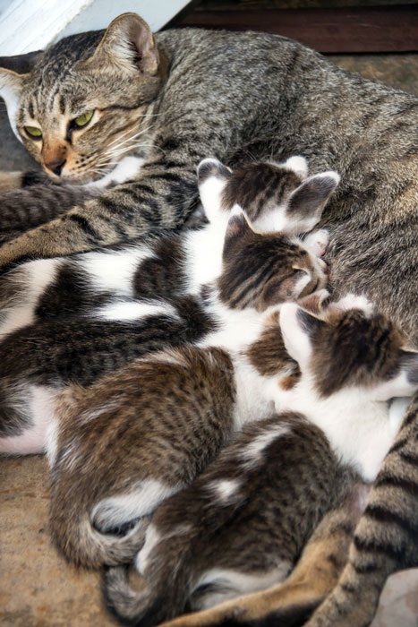
Advantages of sexual reproduction (1)
Sexual reproduction creates variation within a population.
This is because, when male and female gametes fuse during fertilization, they form a unique combination of genes.
As a result, offspring are genetically different from both their parents and one another.
Sexual reproduction results in genetic variation. This means that individuals within a population have differences in the genes they carry.
Notes:
Teacher notes
For more information about genetic variation, please refer to the Variation presentation.
Photo credit: © PJjaruwan, Shutterstock.com 2018

Slide 9
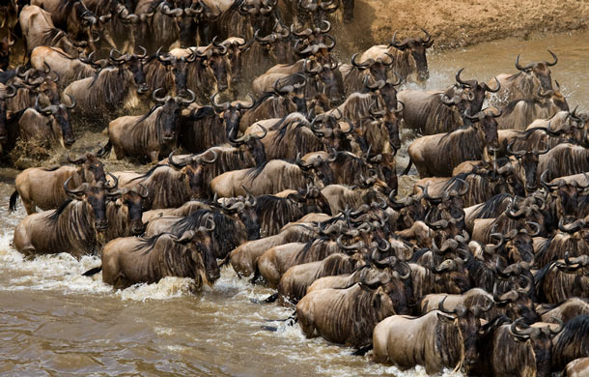
Advantages of sexual reproduction (2)
Genetic variation helps a population to cope with an unstable environment by enabling evolution in response to change.
Variation makes it more likely that at least some individuals in a population will be well adapted to the new conditions.
These individuals will have a
survival advantage. Through
natural selection, they are
more likely to pass on their
genes to the next generation.
As a result, variation reduces the chance of a population crash, which could potentially cause a species to become extinct.
Notes:
Teacher notes
Natural selection requires genetic variation amongst individuals of a species. Natural selection is the process by which evolution and the formation of new species occur.
Natural selection can be sped up by humans through the process of selective breeding. For example, humans can selectively breed crop plants to increase their yield in order to increase food production.
For more information about natural selection, please refer to the Evolution presentation.
For more information about selective breeding, please refer to the Selective Breeding presentation.
Photo credit: wildebeest herd © Gudkov Andrey, Shutterstock.com 2018

Slide 10
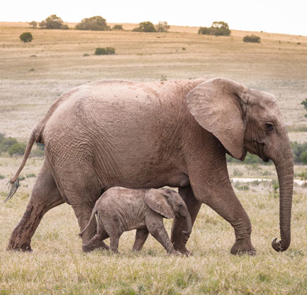
Disadvantages of sexual reproduction
Sexual reproduction can be a relatively slow process.
Organisms that reproduce sexually require a mate to produce offspring. This takes time and energy, and some individuals may never successfully reproduce.
There can be a long period between fertilization and the birth of offspring. As well as this, the number of offspring
produced can be low.
For example, female elephants are pregnant for 21 months before giving birth, and usually to only a single calf.
Notes:
Photo credit: African elephant © Katja Forster, Shutterstock.com 2018

Slide 11
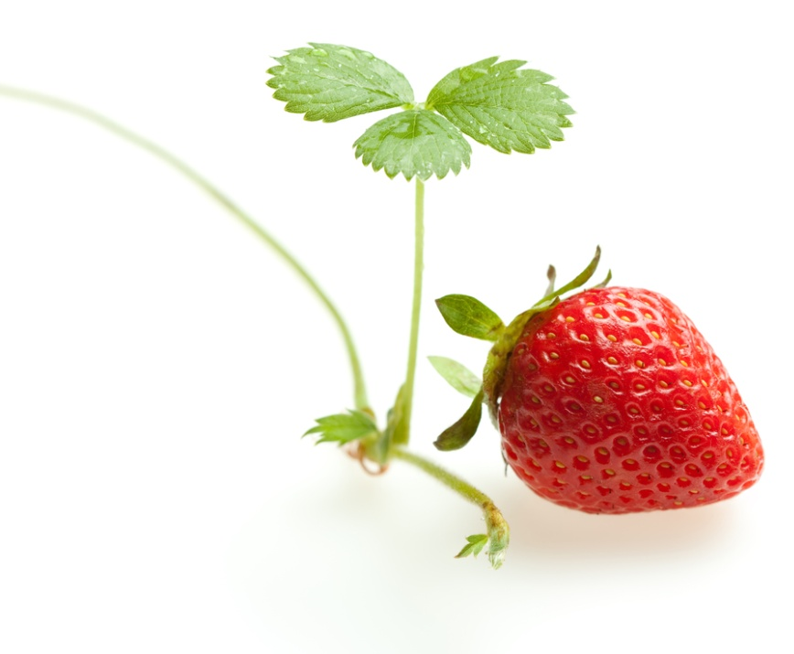
Asexual reproduction
Asexual reproduction involves a single parent producing offspring with exactly the same genes as itself.
Organisms that reproduce asexually include:
many plants, such as spider plants, strawberries and potatoes
microorganisms, such as bacteria and fungi, including yeast
some insects, such as aphids.
new strawberry plant
produced asexually by its parent plant
Notes:
Teacher notes
Strawberry plants can reproduce asexually by producing runners. New plants shoot off the runners. These are genetically identical to the original parent plant.
Photo credit: © Anest, Shutterstock.com, 2018

Slide 12
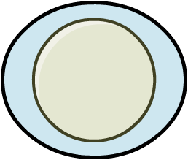
Mitosis
Asexual reproduction can produce offspring through a type of cell division called mitosis.
parent cell
During mitosis, each daughter cell receives a complete copy of the parent cell’s chromosomes.
As a result, mitosis produces daughter cells that are genetically identical to one another and the parent cell.
mitosis
Each daughter cell develops into a new, independent organism.
two identical daughter cells
Notes:
Teacher notes
Bacteria reproduce asexually through a different type of cell division, called binary fission.
For more information about mitosis, please refer to the Mitosis and the Cell Cycle presentation.

Slide 13
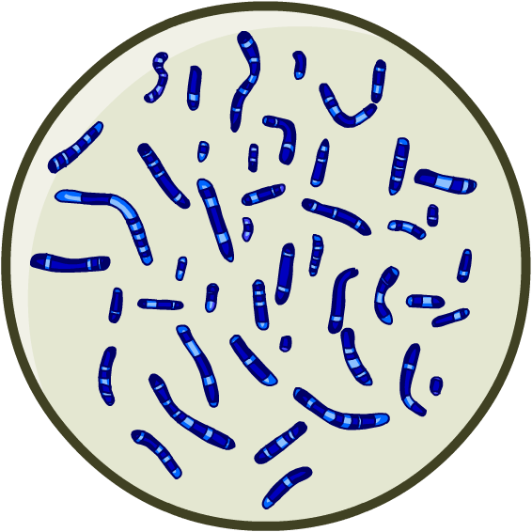
Chromosomes in mitosis
Unlike meiosis, each daughter cell produced by mitosis receives a full set of chromosomes from its parent cell. This means the daughter cells are diploid.
The daughter cells do not act as gametes, as they do not fuse to another cell to produce a zygote.
This prevents the offspring formed from the diploid daughter cells from containing double the normal number of chromosomes.
Instead, each daughter cell continues to divide independently by mitosis to produce a new organism made of diploid cells.

Slide 14
Variation and asexual reproduction
Unlike sexual reproduction, asexual reproduction does not involve the fusion of gametes. This means that there is no mixing of genes.
Consequently, offspring produced by asexual reproduction are genetically identical to each other as well as the parent.
The offspring produced are said to be clones of the parent.
As a result, asexual reproduction does not produce genetic variation.
new spider plants
produced asexually by its parent plant
Notes:
Photo credit: © Judy Drietz, Shutterstock.com, 2018

Slide 15
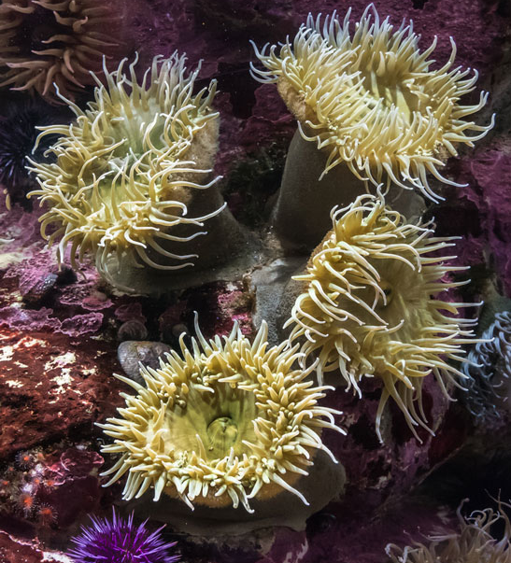
Advantages of asexual reproduction (1)
Asexual organisms do not need to use energy and time to find a mate, as only a single parent is required.
This means that asexual organisms can reproduce even if they are alone.
Asexual reproduction is faster than sexual reproduction, enabling many offspring to be produced quickly.
Both of these advantages could help increase population size following a sudden fall in numbers, preventing extinction.
Notes:
Teacher notes
Some species of sea anemone reproduce asexually by splitting in half along their length to make two fully-formed individuals.
Photo credit: sea anemone, Anthopleura elegantissima © David Litman, Shutterstock.com 2018

Slide 16
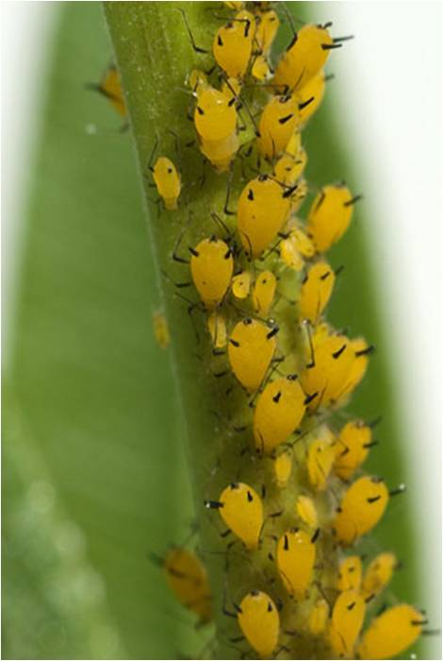
Advantages of asexual reproduction (2)
Asexual reproduction produces offspring that are genetically identical to each other and the parent organism.
If the parent is well adapted to its environment, then its offspring will also be well adapted, as long as conditions remain stable.
Under steady, favorable conditions,
a population of asexual organisms
can rapidly increase in size.
Notes:
Teacher notes
Aphids are a type of insect. They can reproduce sexually or asexually, depending on the time of year. Asexual reproduction occurs in the spring and summer when there is plenty of food available for offspring and weather conditions are more likely to be stable.
Photo credit: aphids © Manfred-Ruckszio, Shutterstock.com 2018

Slide 17
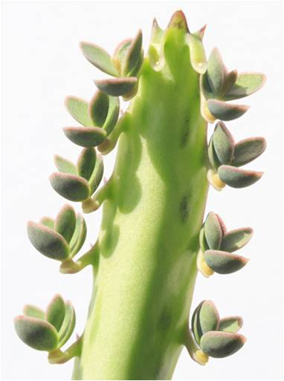
Disadvantages of asexual reproduction
Although asexual reproduction has many short-term advantages, there are some important disadvantages.
Asexual reproduction produces clones, meaning all offspring are genetically identical to the parent and each other. As a result, asexual reproduction is unable to create variation in a population.
This can be a problem if environmental
conditions are unstable. If the parent is
not well adapted to the new conditions,
neither will its offspring be.
This can lead to a population crash if
there are no individuals well suited to
the environment.
Notes:
Teacher notes
A kalanchoe plant can reproduce asexually by producing plantlets on its leaves. Each plantlet has the potential to develop into an individual kalanchoe plant.
Photo credit: kalanchoe plant © matteo-sani, Shutterstock.com 2018

Slide 18
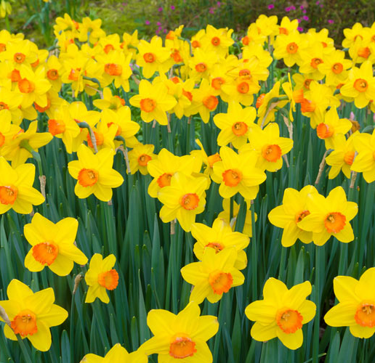
Sexual or asexual reproduction? (1)
Some organisms can reproduce both sexually and asexually. The method of reproduction used often depends on the circumstances of the organism.
Plants reproduce sexually through the production of seeds.
A seed is formed when a male pollen cell and a female egg cell fuse.
Many plants can also reproduce asexually. This can occur through the production of runners, as in strawberries, or bulbs as seen in daffodils.
Notes:
Teacher notes
A bulb is a type of underground storage organ that contains the shoot of a new plant and enables asexual reproduction. Bulbs can divide to produce several individual plants, genetically identical to each other and the original parent plant.
Photo credit: © hans engber, Shutterstock.com 2018

Slide 19
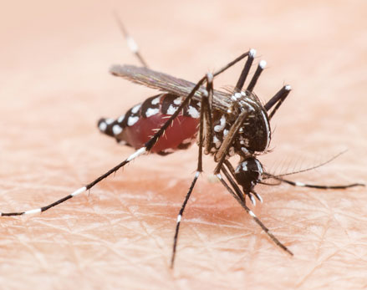
Sexual or asexual reproduction? (2)
Some fungi can produce asexually through the production of spores. These are produced by a single fungus and dispersed. Each spore can develop into an individual fungus.
Fungi can produce a different type of spore to reproduce sexually. A male and female spore fuse to produce a new fungus. This enables the creation of variation.
The parasite that causes the disease malaria reproduces sexually while in mosquitoes.
However, when transferred to
humans, the parasite reproduces asexually inside red blood cells.
Notes:
Photo credit: © chakkrachai-nicharat, Shutterstock.com 2018

