Slide 1
Specialized Cells

Slide 2
Information
Constructing Explanations and Designing Solutions
Obtaining, Evaluating and Communicating Information
1. Patterns
2. Cause and Effect
3. Scale, Proportion, and Quantity
6. Structure and Function

Slide 3
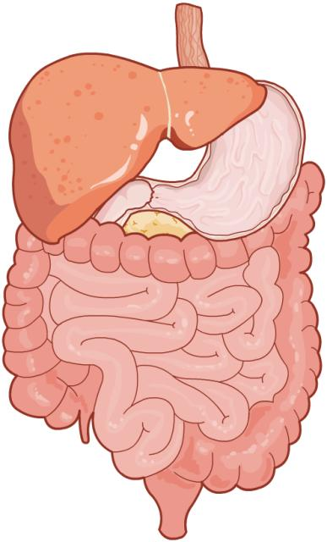
Specialized cells
In single-celled organisms, all the functions necessary for life must be carried out in one cell. In multicellular organisms, different cells perform different tasks that contribute to the overall function of the organism.
Cells that are adapted for a specific role are known as specialized cells.
Specialized cells with a similar role can group together to form tissues.
Two or more tissues can combine to make organs. These can work together to create organ systems, in order to form whole organisms.
Notes:
Teacher notes
This image shows the digestive system. It is an organ system made of several organs including the stomach, liver, small intestine and large intestine. Each of these organs is made of tissues, which are themselves made of specialized cells including muscle cells, epithelial cells and secretory cells.
For more information about multicellular organisms and how they are organized, please refer to the Multicellular Organisms presentation.

Slide 4
Advantages of specialized cells
Single-celled organisms are the smallest living things on Earth, whereas multicellular organisms are the largest.
This is because each type of specialized cell contributes a different function to the survival of the multicellular organism, rather than each cell having to do everything.
Specialized cells enable multicellular organisms to have several levels of organization, from tissues to organ systems.
As a result, multicellular organisms are more complex than single-celled organisms.

Slide 5
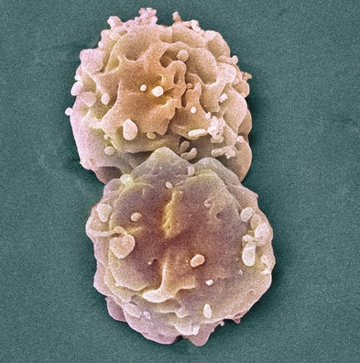
What are stem cells?
Specialized cells in multicellular organisms originate from stem cells. Stem cells are undifferentiated, which means they are not specialized for any specific function.
Embryos contain stem cells. Early embryonic cells are identical to one another.
Stem cells found in animal embryos are called embryonic stem cells.
Stem cells found in embryos have the potential to develop into any one of the specialized cells found in the mature organism.
Notes:
Photo credit: © Steve Gschmeissner, Science Photo Library, 2018
Colored scanning electron micrograph (SEM) of groups of embryonic stem cells (ESCs). ESCs are pluripotent. This means they are able to differentiate into any cell type. The type of cell they mature into depends upon the biochemical signals received by the immature cells. This ability makes ESCs a potential source of cells to repair damaged tissue in diseases such as Parkinson’s and insulin-dependent diabetes. However, research using ESCs is controversial as it requires the destruction of an embryo. Magnification: ×3,000 when printed at 10 centimeters wide.

Slide 6
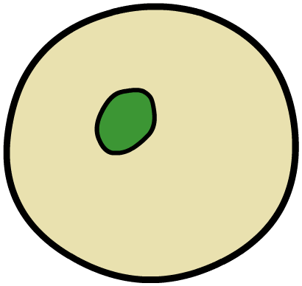
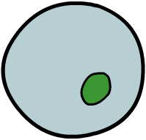
Cell differentiation
As the embryo develops, the cells stop being the same. They start to turn into different types of specialized cells.
Cell differentiation is the process that turns an unspecialized cell into a specialized cell that is adapted to carry out a specific function.
cell differentiation
stem cell
specialized cell
Cell differentiation is irreversible. Once a cell becomes specialized, it cannot de-differentiate back into a stem cell.

Slide 7
Stem cells

Slide 8
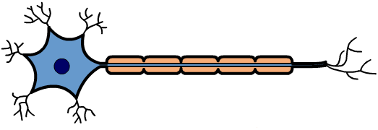
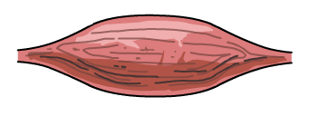
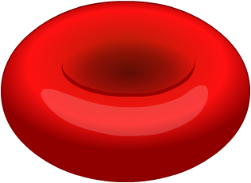
Genes and specialization
Stem cells can differentiate in different ways to produce all of the types of specialized cell found in the organism.
During differentiation, particular genes are turned on or off. The type of specialized cell produced depends on which genes have been affected.
stem cell
cell differentiation
specialized cells
nerve cell
muscle cell
red blood cell

Slide 9
Plant stem cells
Plants also have stem cells. These are called meristem cells.
Like animal stem cells, meristem cells can undergo cell differentiation to produce one of the many types of specialized cell found in plants.
For example, a meristem cell might differentiate into a xylem cell or a leaf cell.
Meristem cells are found in large numbers in plant shoots and roots. This is because these are areas of growth, so there is demand for new specialized cells.
Notes:
Photo credit: © amenic181, Shutterstock.com 2018

Slide 10
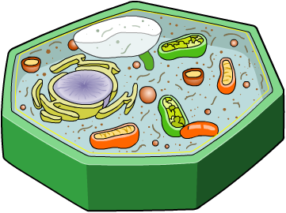
Structure and function
A sub-cellular structure is a specialized structure found inside a cell that is adapted to carry out a particular role. During cell differentiation, the sub-cellular structure of a cell changes.
Specialized cells have a particular arrangement of sub-cellular structures. This enables the cell to carry out a specific role.
chloroplasts
The sub-cellular structure of a specialized cell is therefore adapted to its function.
For example, leaf cells contain lots of chloroplasts to produce sugars through the process of photosynthesis.
Notes:
Teacher notes
Ask students if they can name some sub-cellular structures:
nucleus
mitochondria
chloroplasts
ribosomes
vacuoles.

Slide 11
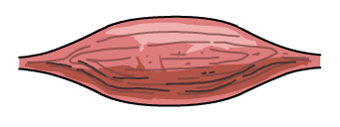
Specialized cells in animals
A single animal contains many types of specialized cell that contribute to survival. Each type of specialized cell has a structure adapted to its particular function.
Muscle cells contain lots of mitochondria to release energy that can be used for contraction.
Nerve cells are long and thin to transmit electrical impulses long distances in the body.
Red blood cells are biconcave in shape to increase the surface area over which oxygen can be absorbed.
Notes:
Teacher notes
Biconcave describes a special disc-like shape that is curved inward on either side.
For more information on the structure of red blood cells, please refer to The Circulatory System presentation.
For more information on the structure of nerve cells, please refer to The Nervous System presentation.

Slide 12
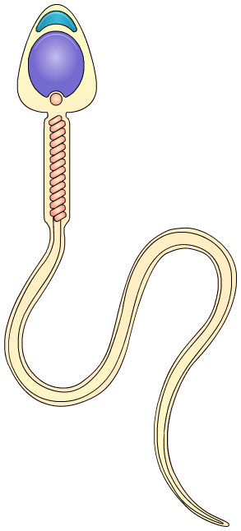
Sperm cells
Sperm cells are a type of specialized cell adapted to carry a male’s genetic information during sexual reproduction.
Long tail: to allow the sperm cell to move towards the egg cell.
acrosome
Mitochondria: to produce the energy needed for the tail to move.
large nucleus
mitochondria
Large nucleus: to carry the genetic material to the egg cell.
The acrosome: a compartment containing digestive enzymes. These are released during fertilization to break down the protective layers around the egg.
long tail
Notes:
Teacher notes
For more information about sexual reproduction, please refer to the Sexual and Asexual Reproduction presentation.

Slide 13
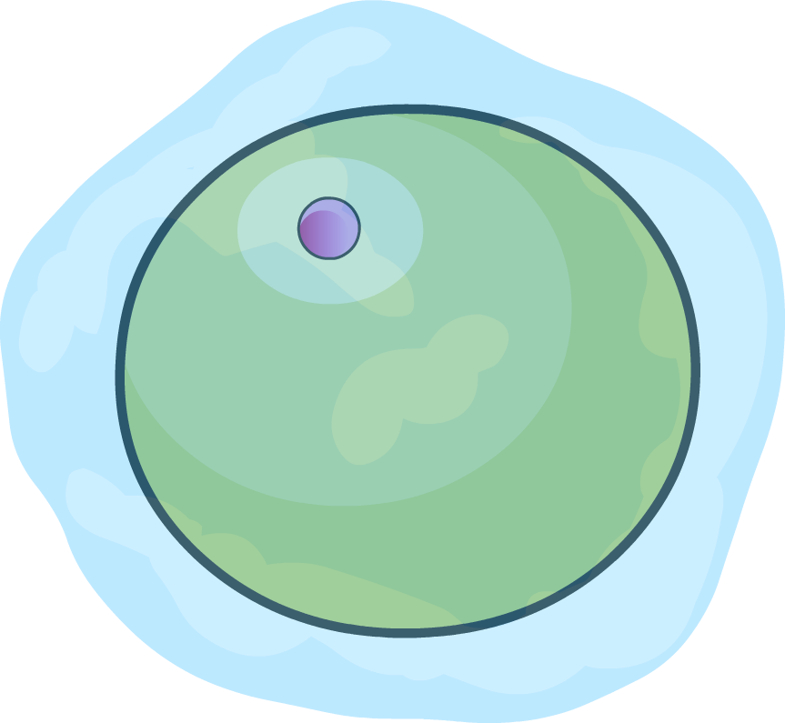
Egg cells
Egg cells are also a type of specialized cell with a role in sexual reproduction.
The structure of an egg cell is adapted to help carry a female’s genetic information and support embryo development.
Cell membrane: provides protection and ensures only a single sperm is able to fertilize the egg.
cell membrane
nucleus
Large cytoplasm volume: contains lots of nutrients that are used to support the development of the embryo if fertilization is successful.
large cytoplasm
Notes:
Teacher notes
For more information about sexual reproduction, please refer to the Sexual and Asexual Reproduction presentation.

Slide 14
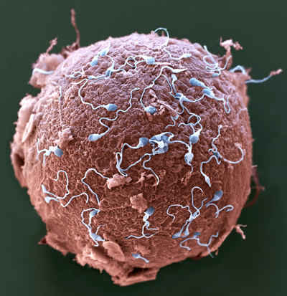
Fertilization (1)
Fertilization involves changes in both the egg cell and sperm cell. If fertilization is successful, a zygote is formed.
Changes in the egg cell membrane
When the sperm fuses with the egg, the enzymes in the acrosome are released and break down the protective layers surrounding the egg cell.
This allows the sperm cell to penetrate the egg cell membrane. Once this happens, no other sperm can fertilize the egg.
Notes:
Photo credit: © Eye of Science / Science Photo Library 2018
Colored scanning electron micrograph (SEM) of sperm (blue) attempting to penetrate a human egg (red). Each sperm (spermatozoa) has a rounded head and a long tail with which it swims. Women usually release one egg (ovum) per month, whereas men release millions of sperm in each ejaculation. Only one of these sperm can penetrate the egg's thick outer layer (zona pellucida) and fertilize it. Fertilization occurs when the sperm's genetic material (deoxyribonucleic acid, DNA) fuses with the egg's DNA. When this occurs the egg forms a barrier to other sperm. Magnification: ×650 when printed 10 centimeters wide.

Slide 15
Fertilization (2)
Fusion of the sperm and egg nuclei
The nuclei of both sperm cells and egg cells contain half the number of chromosomes of normal body cells.
As a result, sperm cells and eggs cells are haploid.
During fertilization, the nuclei of the sperm cell and the egg cell fuse together. This creates a new nucleus with a full set of chromosomes.
As a result, the cells in the zygote are diploid.
Notes:
Teacher notes
Nuclei is the plural of nucleus.
The nucleus of a normal diploid human body cell contains 46 chromosomes. Human egg cells and sperm cells both contain 23 chromosomes. They are haploid.
Photo credit: human zygote © 895Studio, Shutterstock.com 2018

Slide 16
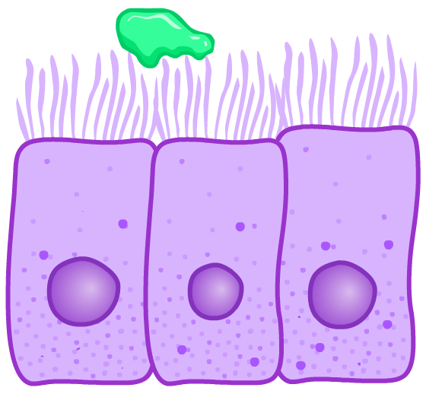
Ciliated epithelial cells
Ciliated epithelial cells are a type of specialized cell found lining many organs in the body. Their structure enables them to move substances along their surface.
mucus
cilia on upper cell membrane
Cilia are hair-like structures located on the top of ciliated epithelial cells that move back and forth.
When cilia move, they can transport substances, including mucus, dust and microorganisms.
Cliated epithelial cells in the trachea help prevent these substances from reaching the lungs.
ciliated epithelial cells

Slide 17
How are animal cells adapted?
Notes:
Teacher notes
This click and reveal activity could be used to check students’ understanding of animal cell structures and function.

Slide 18
Specialized animal cells
Notes:
Teacher notes
This matching activity could be used as an introductory or summary activity on animal cells.

Slide 19
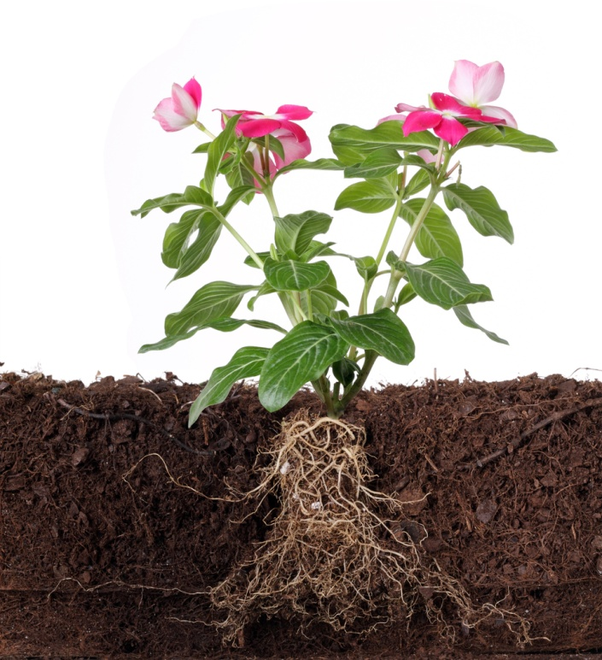
Specialized cells in plants
Like animals, plants are multicellular organisms made of many types of specialized cells. Each type of specialized cell carries out a particular function contributing to the plant’s survival.
Can you think of some of the functions specialized plants cells are adapted to carry out?
photosynthesis
absorbing water
transporting water
transporting sugars
Notes:
Teacher notes
Discuss students’ ideas for the question before revealing the answers. Help them to draw on their understanding of plant processes to identify potential answers.
This slide covers the Science and Engineering Practices:
Constructing Explanations and Designing Solutions: Apply scientific ideas, principles, and/or evidence to provide an explanation of phenomena and solve design problems, taking into account possible unanticipated effects.
Obtaining, Evaluating, and Communicating Information: Communicate scientific and/or technical information or ideas (e.g. about phenomena and/or the process of development and the design and performance of a proposed process or system) in multiple formats (including orally, graphically, textually, and mathematically).
Photo credit: © Filipe B. Varela, Shutterstock.com 2018

Slide 20
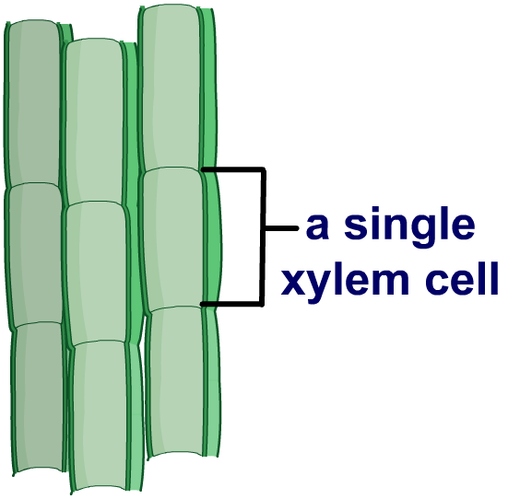
Xylem cells
Xylem cells are structurally adapted to transport water from the roots to the rest of the plant.
The cells are hollow and have a very thin cytoplasm. This makes space for water to move through them.
The cell walls contain a substance called lignin. This waterproofs xylem cells, which prevents water loss.
Many xylem cells join together to form hollow columns to enable water to be moved long distances in the plant.
Notes:
Teacher notes
For more information about xylem cells and the transport of water in plants, please refer to the Plant Tissues and Organs and Transport in Plants presentations.

Slide 21
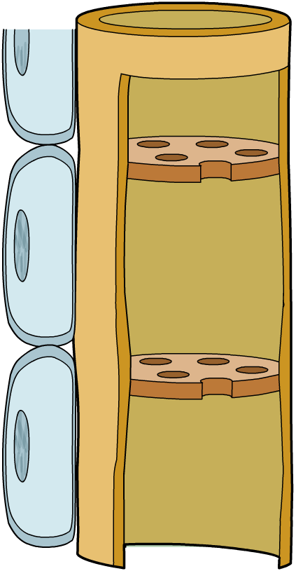
Phloem cells
Phloem cells are structurally adapted to carry the products of photosynthesis from the leaves to the rest of the plant.
Phloem cells can join together to form long columns.
This allows the sugars produced by photosynthesis to be moved long distances in the plant.
a single phloem cell
The walls between neighboring phloem cells contain pores. This allows sugars to pass easily from one cell to the next.
pores in
the end wall
between cells
Notes:
Teacher notes
For more information about phloem cells and the transport of sugars in plants, please refer to the Plant Tissues and Organs and Transport in Plants presentations.

Slide 22
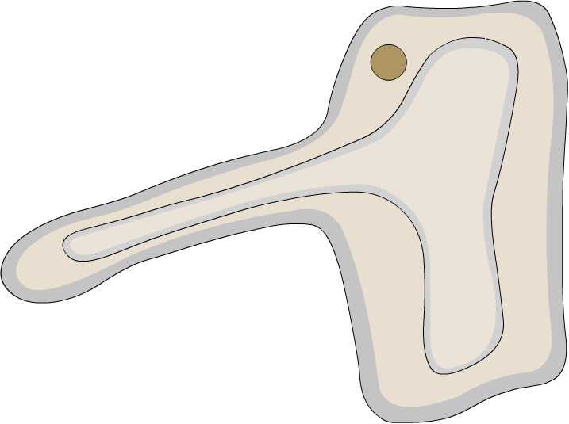
Root hair cells
Root hair cells are a type of specialized plant cell found in the roots. They are structurally adapted to absorb water and nutrients from the soil into the plant.
Cytoplasmic extensions increase the surface area of root hair cells.
cytoplasmic extension
This enables more contact to be made with the surrounding soil, maximizing the rate substances can be absorbed.
A large vacuole helps store water that has been absorbed into the cell.
large vacuole
Notes:
Teacher notes
For more information about the uptake of water and nutrients by the roots, please refer to the Exchange Surfaces and Transport in Plants presentations.

Slide 23
How are plant cells adapted?
Notes:
Teacher notes
This click and reveal activity could be used to check students’ understanding of plant cell structures and function.

Slide 24
Roles of specialized plant cells
Notes:
Teacher notes
This matching activity could be used as an introductory or summary activity on plant cells.

