Slide 1
Studying Cells

Slide 2
Information
Planning and Carrying Out Investigations
Using Mathematics and Computational Thinking
Constructing Explanations and Designing Solutions
Obtaining, Evaluating and Communicating Information
2. Cause and Effect
3. Scale, Proportion, and Quantity
6. Structure and Function

Slide 3
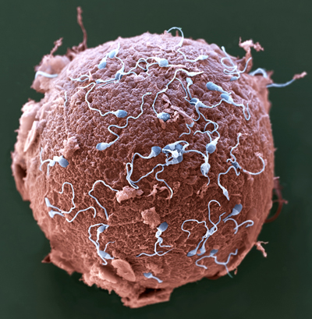
Cells
The cell is the basic unit of life, from which larger structures such as tissues, organs and whole organisms are made.
Most cells are too small to see with the naked eye.
Egg cells are one of the largest cells found in humans. However, even they are only 0.1 mm in diameter, which is about the same as the width of a human hair.
To overcome this, microscopes are used to view cells and the sub-cellular structures inside them.
Notes:
Teacher notes
There is huge variation in the size of cells. This picture illustrates the size difference between human egg cells and sperm cells. Sperm cells are much smaller, the head of a sperm cell is just 5 μm or 0.005 mm across.
For more information about the organisation of tissues, organs and organisms, please refer to the Multicellular Organisms presentation.
Photo credit: © Eye of Science / Science Photo Library
Colored scanning electron micrograph (SEM) of sperm attempting to penetrate a human egg cell. Magnification: ×650 when printed 10 centimeters wide.

Slide 4
Microscopes
There are two main types of microscope: light microscopes and electron microscopes.
Both make objects appear larger than they are in reality.
Microscopes can be used to view a variety of animal and plant cells.
Different types of microscopes are used in research labs, medical labs and schools.
Notes:
Photo credit: © Mtrebbin, Shutterstock.com 2018

Slide 5
Magnification
Magnification is the process of making something appear bigger then it really is.
The magnification power of a microscope determines how large the object being observed appears to the viewer.
Magnification can be calculated using the following equation:
size of image (mm)
magnification =
actual size of object (mm)

Slide 6
Calculating magnification
A human egg cell is 0.1 mm in diameter, but it appears 8 mm in diameter when viewed under a light microscope.
What is the magnification power of the microscope?
size of image (mm)
magnification =
actual size of object (mm)
8 mm
magnification =
= × 80
0.1 mm
The egg cell in the image produced by the light microscope is 80 times larger than it is in reality.
Notes:
This slide covers the Science and Engineering Practice:
Using Mathematics and Computational Thinking: Use mathematical, computational, and/or algorithmic representations of phenomena or design solutions to describe and/or support claims and/or explanations.

Slide 7
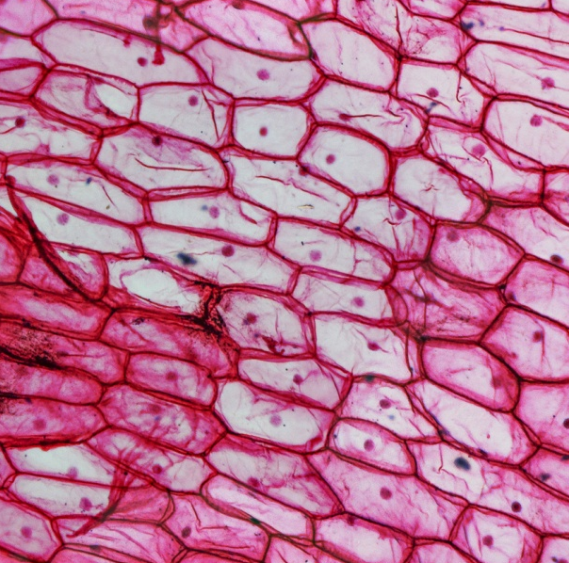
Resolution
Resolution is the ability to tell two objects that are close together apart from one another.
The resolving power of a microscope determines how detailed the image produced by the microscope is.
Sub-cellular structures are both very small and close together. A high resolution is needed to tell these structures apart.
Very small sub-cellular structures, such as ribosomes, cannot always be seen if a microscope has a limited resolving power.
Notes:
Photo credit: onion epidermis cells © Claudio Divizia, Shutterstock.com 2018

Slide 8
Measuring cells
Cells and their sub-cellular structures are usually too small to be measured in m, cm or even mm. Therefore, other units are often used instead.
micrometers (μm): 1 μm = 0.001 mm or 10^{–6} m.
There are 1,000 micrometers in one millimeter.
nanometers (nm): 1 nm = 0.001 μm or 10^{–9} m.
There are 1,000 nanometers in one micrometer and one million nanometers in one millimeter.
picometers (pm): 1 pm = 0.001 nm or 10^{–12} m.
There are 1,000 picometers in one nanometer and one thousand million picometers in one millimeter.
Notes:
Teacher notes
This is an opportunity to check students understanding of standard form.
Can they see how each unit is one thousand times smaller than the one above?
How this is reflected when the units are written in their standard form in meters?
What is one millimeter equal to in meters when written in standard form? (10^{–3} m)

Slide 9
Size and scale
Notes:
Teacher notes
This animation can be used to give students an idea of the comparative size of microorganisms.
1 millimeter = 0.001 meter 1 micrometer = 0.000001 meter 1 nanometer = 0.000000001 meter
9

Slide 10
Virtual microscope
Notes:
This slide covers the Science and Engineering Practice:
Using Mathematics and Computational Thinking: Use mathematical, computational, and/or algorithmic representations of phenomena or design solutions to describe and/or support claims and/or explanations.
Photo credit (first slide): © Med. Mic. Sciences Cardiff University, Wellcome Images 2018 Color-enhanced scanning electron micrograph of rod-shaped Clostridium difficile clinging to the microvilli of the human gut. This bacterium is often responsible for holiday diarrhoea and is of increasing concern as a hospital acquired infection, particularly affecting the elderly.
Photo credit (second slide): © University of Edinburgh, Wellcome Images 2018 Color-enhanced electron micrograph of cells showing the nuclei in green, mitochondria in red, two lysosomes in brown and large amounts of rough endoplasmic reticulum in white.
Photo credit (third slide): © M I Walker, Wellcome Images 2018 A light micrograph of the leaf of a foliaceous liverwort showing cells packed with chloroplasts, Nomarski optics and difference interference microscopy.
Photo credit (fourth slide): © University of Edinburgh, Wellcome Images 2018 Cell from the proximal convoluted tubule in the kidney cortex. The nucleus (purple) has a prominent nucleolus, and many elongated mitochondria (red) fill the cell. The basal lamina and intercellular space are shown in blue.
Photo credit (fifth slide): © M I Walker, Wellcome Images 2018 Epidermal cells in the skin of an onion (Allium).
Photo credit (sixth slide): © M I Walker, Wellcome Images 2018 Light micrograph (dark ground illumination) of ciliates and bacteria from water in a flower vase.

Slide 11
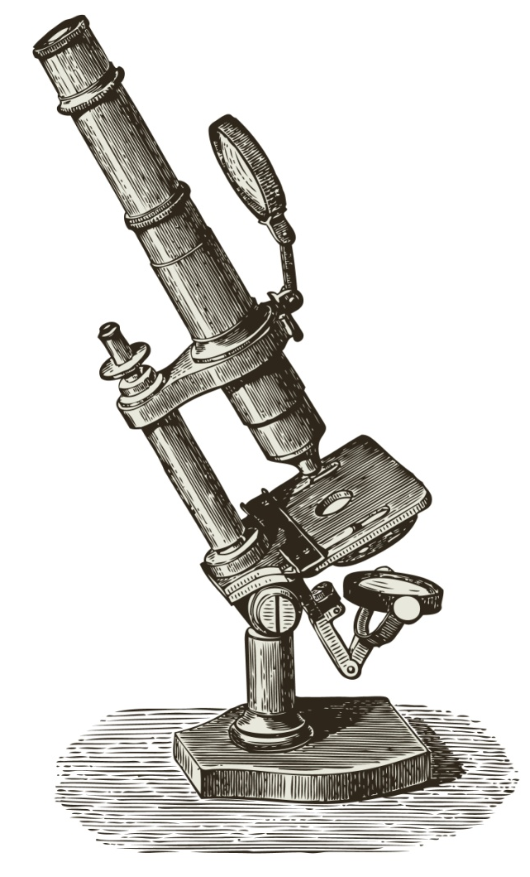
The development of microscopes (1)
In the 1590s, a Dutch father and son who worked as spectacle makers were the first to experiment with glass lenses to make objects appear larger.
The first basic light microscopes appeared in the 1600s; however, they were only able to magnify objects by × 10.
Lens making was improved in the late 1600s, which increased the magnification power to × 200.
Notes:
Photo credit: © lynea, Shutterstock.com 2018

Slide 12
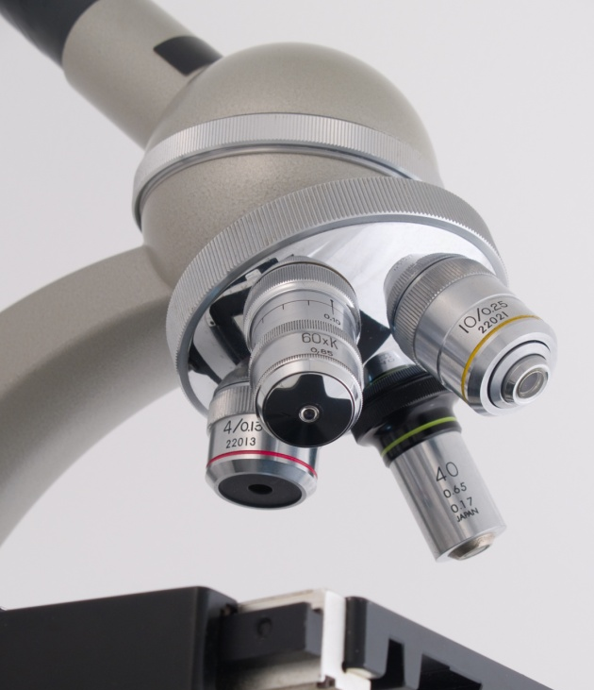
The development of microscopes (2)
In the late 1800s, the glass lenses used in light microscopes began to be made using machines, rather than by hand.
The change in manufacture process significantly improved both the magnification power and resolution of light microscopes.
Today, lenses are made using very precise machinery. As a result, a magnification of up to × 1,500 and resolution of 200 nm is possible.
Light microscopes can be found in schools, and are often used in medical labs to study samples from patients.
Notes:
Photo credit: © Horst Kanzek, Shutterstock.com 2018

Slide 13
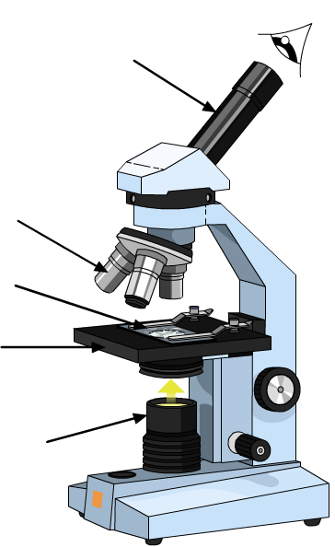
The parts of a light microscope (1)
How many parts of the light microscope labeled below can you name?
eyepiece
lens
specimen
stage
lamp

Slide 14
The parts of a light microscope (2)
What is the function of each of the parts of a light microscope from the previous slide?
Specimen
The sample being viewed.
Eyepiece
The part through which the viewer looks to see the image of the specimen.
Lens
Focuses the light onto the specimen and magnifies it. Lenses are made of glass.
Stage
The part the sample is placed on.
Lamp
Illuminates the sample so that it can be seen.

Slide 15
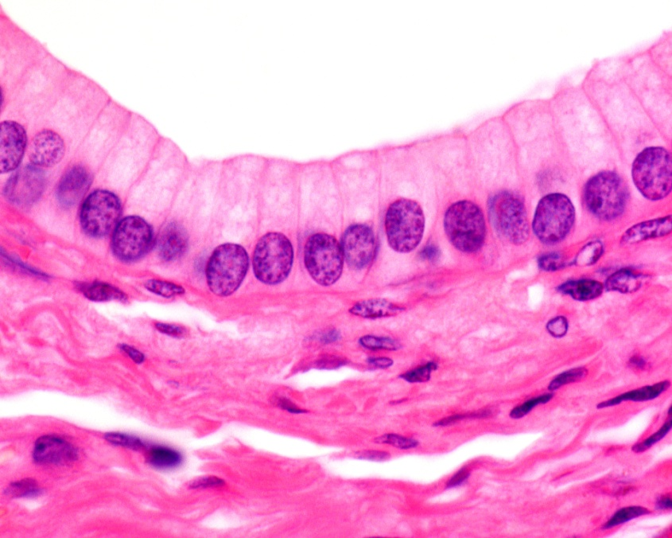
Preparing a specimen (1)
Many cells and the sub-cellular structures inside them are naturally colorless. Staining is a technique used to make these specimens easier to see.
Different types of stain can be used to highlight different structures and tissues in the sample by making them appear different colors.
Some cells and structures do not need staining as they naturally contain colored pigments.
Can you name a sub-cellular structure found in plants that contains a type of green pigment?
Notes:
Teacher notes
Chloroplasts found in plant cells contain the green pigment chlorophyll. This makes chloroplasts easy to see under a light microscope even without staining.
Photo credit: © Jose Luis Calvo, Shutterstock.com 2018
Simple columnar epithelium of an excretory duct of the pancreas

Slide 16
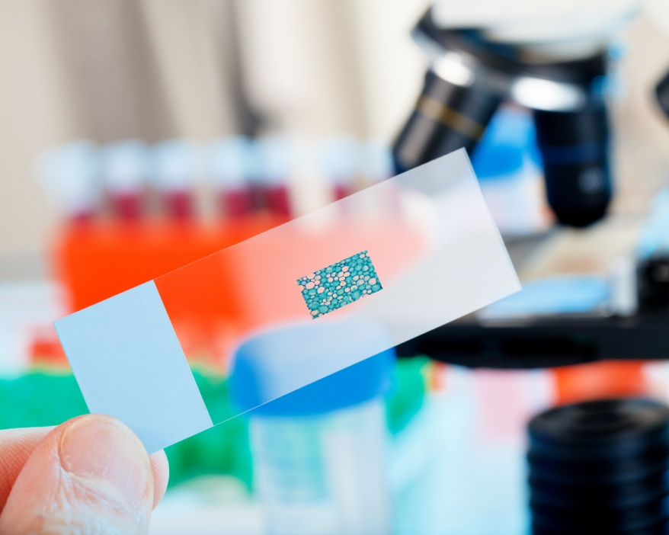
Preparing a specimen (2)
After a specimen has been stained, it is placed onto a microscope slide, usually made of thin glass.
A cover slip is then placed on top of the specimen and gently pressed down. This is also made of thin glass.
The specimen is now ready to be placed on the microscope stage for viewing.
What is the advantage of the microscope slide and cover slip being made of a transparent material?
Notes:
Teacher notes
Help students to apply their understanding of the structure and function of the microscope in order to answer the question. To view the sample, the light must be able to pass from the lamp and through the slide, sample and cover slip to reach the lens and eyepiece. If the slide and cover slip were not transparent the light would be prevented from reaching the lens and eyepiece, and no image would be formed.
This slide covers the Science and Engineering Practices:
Constructing Explanations and Designing Solutions: Apply scientific ideas, principles, and/or evidence to provide an explanation of phenomena and solve design problems, taking into account possible unanticipated effects.
Obtaining, Evaluating, and Communicating Information: Communicate scientific and/or technical information or ideas (e.g. about phenomena and/or the process of development and the design and performance of a proposed process or system) in multiple formats (including orally, graphically, textually, and mathematically).
Photo credit: © science photo, Shutterstock.com 2018

Slide 17
A closer look at animal cells
Notes:
Teacher notes
This five-stage animation shows how to obtain and examine a cheek cell. Suitable prompts could include:
How are animal cells different to plant cells?
Why are cheek cells a good example of a typical animal cell?
Which sub-cellular structures can you identify within the cheek cells?
This slide covers the Science and Engineering Practice:
Planning and Carrying Out Investigations: Plan an investigation or test a design individually and collaboratively to produce data to serve as the basis for evidence as part of building and revising models, supporting explanations for phenomena, or testing solutions to problems. Consider possible variables or effects and evaluate the confounding investigation’s design to ensure variables are controlled.
Photo credit: © Dr. Gopal Murti, Science Photo Library 2018 Light micrograph of squamous epithelial cells from the human mouth. These flat, scale-like cells have oval nuclei (purple) and granular cytoplasm. The epithelia are tissues that cover body surfaces, cavities and tubes. Epithelial cells form a protective layer within the mouth. Magnification: ×1,000 at 35 mm size.

Slide 18
A closer look at plant cells
Notes:
Teacher notes
This five-stage animation shows how to obtain and examine an onion cell. Suitable prompts could include:
How are plant cells different to animal cells?
Why are onion cells a good example of a typical plant cell?
Which sub-cellular structures can you identify within the onion cells?
This slide covers the Science and Engineering Practice:
Planning and Carrying Out Investigations: Plan an investigation or test a design individually and collaboratively to produce data to serve as the basis for evidence as part of building and revising models, supporting explanations for phenomena, or testing solutions to problems. Consider possible variables or effects and evaluate the confounding investigation’s design to ensure variables are controlled.
Photo credit: © Andrew Syred , Science Photo Library 2018 Light micrograph of the epidermis of an onion, showing the bands of large, rectangular cells. The spot in the center of each cell is its nucleus. Magnification: ×200 at 35 mm size.

Slide 19
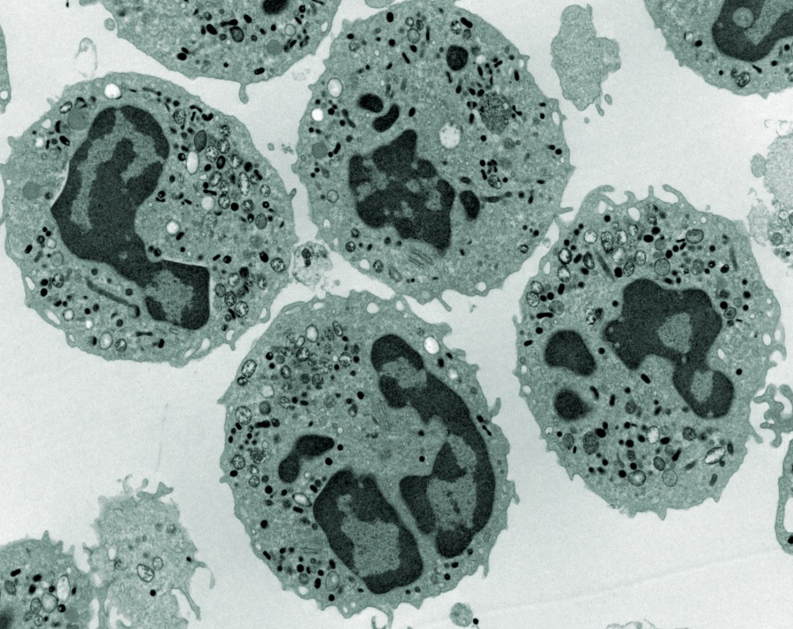
Electron microscopes (1)
Instead of light, electron microscopes use a beam of electrons to view objects. The electron beam is focused onto the object using magnets.
Electron microscopes are much more powerful than optical microscopes, achieving magnifications up to × 10 million.
The resolution of light microscopes is limited by the wavelength of light. As electron microscopes do not use light, their maximum resolution can be as high as 0.1 nm.
Notes:
Photo credit: electron micrograph of white blood cells © Dlumen, Shutterstock.com 2018

Slide 20
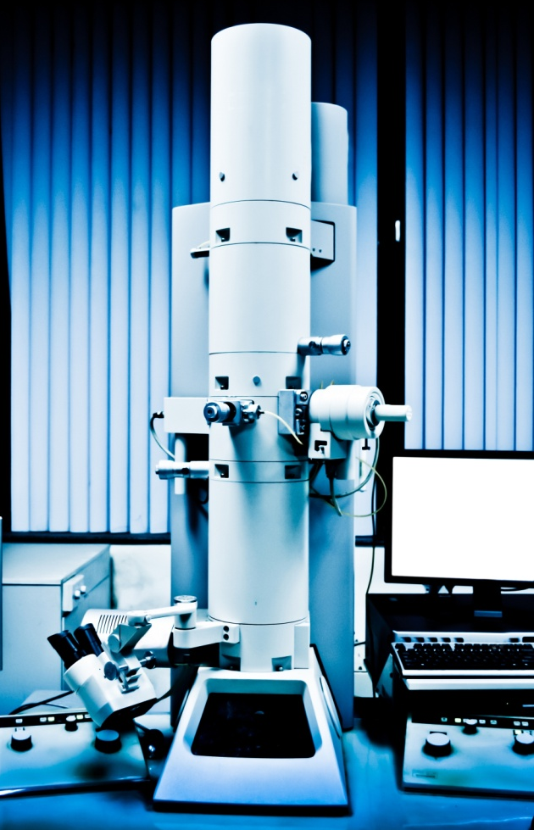
Electron microscopes (2)
Unlike light microscopes, the image produced by electron microscopes cannot be viewed directly through an eyepiece. Instead a computer is needed to generate and view the image.
The images produced are also in black and white. However, color can added artificially using computer software.
Electron microscopes are very large, expensive and require specialist training to use. As a result, they tend to be found only in research laboratories.
Notes:
Photo credit: © Pan Xubin, Shutterstock.com 2018

Slide 21
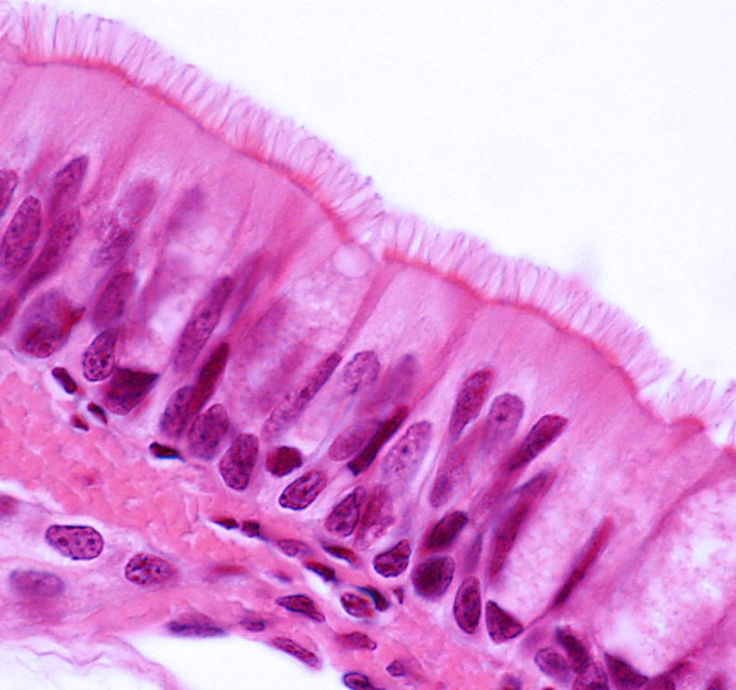
Understanding sub-cellular structures (1)
Electron microscopy has increased our understanding of sub-cellular structures.
Sub-cellular structures are very small and very close together.
This means both a high resolution and high magnification are needed to view sub-cellular structures in detail, which can be achieved using electron microscopy.
Light microscopes’ limited resolution of 200 nm means they cannot be used to see the smallest sub-cellular structures.
Notes:
Photo credit: columnar epithelium of the trachea (light microscope) © Jose Luis Calvo, Shutterstock.com 2018

Slide 22
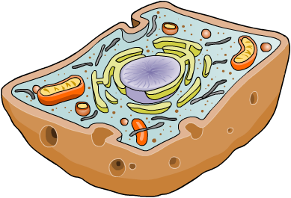
Understanding sub-cellular structures (2)
The largest sub-cellular structure in animal cells is usually the nucleus, which is about 10 μm in diameter. This means it is big enough to be viewed using both light microscopes and electron microscopes.
Mitochondria have a diameter of about 1 μm. Although this is in the range of a light microscope, they can be seen in more detail using an electron microscope.
mitochondrion
Ribosomes are just 30 nm in diameter, which means they can only be seen using electron microscopy.
ribosome
Notes:
Teacher notes
Mitochondrion is the singular of mitochondria.

