Slide 1
The Body's Defence Systems

Slide 2
Information
Using Mathematics and Computational Thinking
Constructing Explanations and Designing Solutions
2. Cause and Effect
3. Scale, Proportion, and Quantity
4. Systems and System Models
6. Structure and Function
Lesson name

Slide 3
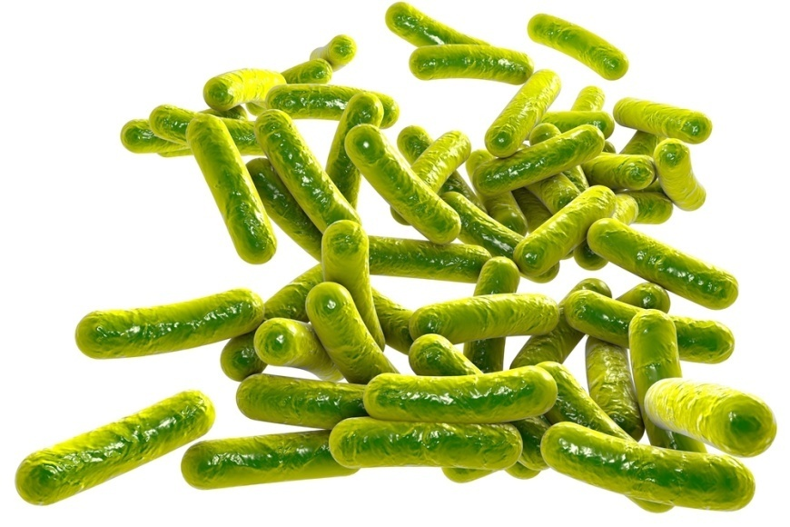
Types of defence
The body has three main lines of defence against pathogens. Pathogens are microorganisms capable of causing disease.
Non-specific physical and chemical defences.
Non-specific defences within the body.
Pathogen-specific defences within the body.
Non-specific defence systems do not target particular types of pathogens, or tell them apart.
In contrast, pathogen-specific defence systems do identify and target particular types of pathogens.
Notes:
3
Photo credit: © Kateryna Kon, Shutterstock.com 2018

Slide 4
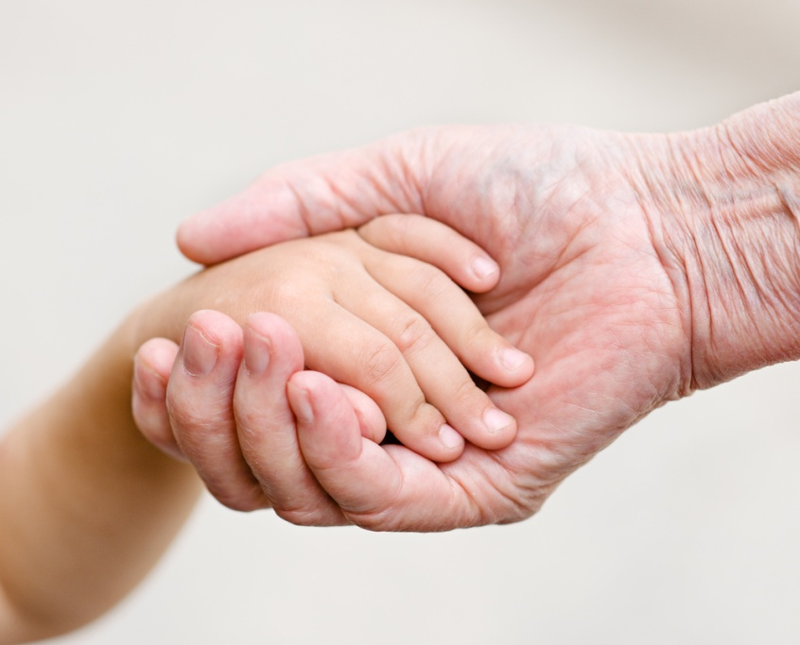
Physical defences (1)
The body has several non-specific physical and chemical barriers that prevent microorganisms from entering the body.
The skin is the body’s main physical defence. It protects the body from physical damage and dehydration. The skin also prevents the entry of microorganisms.
If the skin is cut, platelets in the blood clot at the site of the wound. This stops microorganisms in the air or on the skin’s surface entering through the damaged surface.
Notes:
Teacher notes
For more information about platelets and the blood, please refer to ‘The Circulatory System’ presentation.
Photo credit: © Ermolaev Alexander, Shutterstock.com 2018

Slide 5
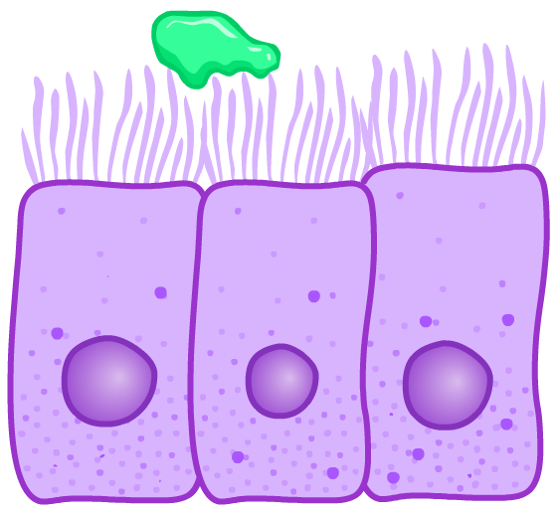
Physical defences (2)
Other organs are lined by mucous membranes, including the trachea and bronchi in the lungs and the nose.
The mucus secreted traps microorganisms in present in these passageways. This prevents them from going further into the body.
mucus transported by movement of cilia
The membranes are also covered in hair-like structures called cilia.
Cilia can move back and forth. This helps transport mucus and trapped microorganisms across the membrane surface and out of the body.
cilia
Notes:
Teacher notes
Cells that line organs and have cilia on their upper surface are called ciliated epithelial cells. Epithelial cells are a type of specialized animal cell and line many organs in the body.

Slide 6
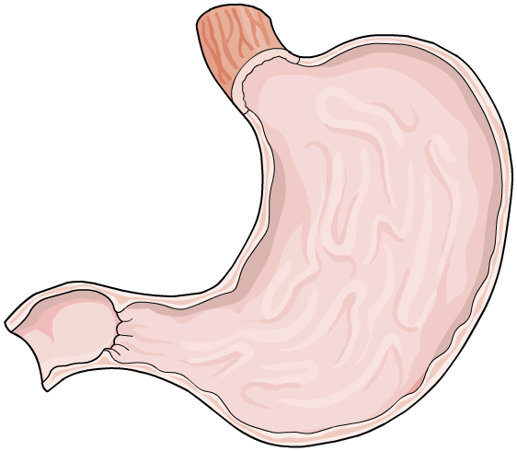
Chemical defences
Some of the body’s organs produce secretions containing anti-microbial chemicals that help destroy microorganisms.
Tears produced by the eyes contain the enzyme lysozyme. It is able to kill bacteria by breaking down their cell wall.
The stomach produces hydrochloric acid (HCl).
HCl has a low pH. This destroys the structure of bacterial enzymes, stopping them from functioning. As a result, any bacteria in the stomach die.
Sweat, produced by the skin, also contains chemicals that can kill microorganisms.
Notes:
Teacher notes
The pH of the human stomach is normally between 1.3 and 3.5.

Slide 7
Physical and chemical defences
Notes:
7

Slide 8
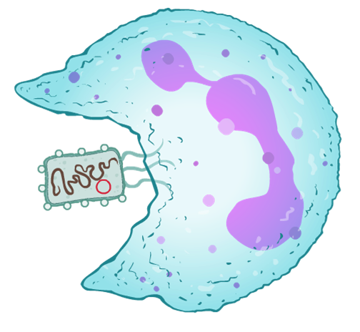
Phagocytosis
Macrophages are a type of white blood cell involved in the body’s non-specific defence system.
They continuously circulate in the blood and are adapted to ingest and destroy microorganisms through a process called phagocytosis.
macrophage
During phagocytosis, the macrophage surrounds and engulfs the invading microorganism before producing enzymes to digest it.
Macrophages destroy many different types of microorganisms, so are considered non-specific.
microorganism
Notes:
Teacher notes
Phagocytosis literally means ‘cell eating’

Slide 9
How does phagocytosis happen?
Notes:
9
Teacher notes
This five-stage animation illustrates the process of phagocytosis of a bacterium by a macrophage.
This slide covers the Science and Engineering Practices:
Constructing Explanations and Designing Solutions: Apply scientific ideas, principles, and/or evidence to provide an explanation of phenomena and solve design problems, taking into account possible unanticipated effects.

Slide 10
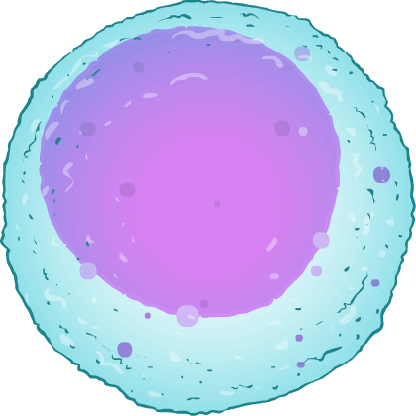
The body’s specific defence system
White blood cells are an important part of the body’s immune system. There are many types of white blood cell, some of which are adapted to function as part of the body’s specific defence system.
Lymphocytes are a type of white blood cell able to recognize and respond to specific pathogens.
When a lymphocyte detects the presence of a particular pathogen in the blood, it triggers an immune response to destroy the pathogen.
Notes:
10
Teacher notes
Lymphocytes are made in the bone marrow.
From the image, students can see that lymphocytes have a very large nucleus.

Slide 11
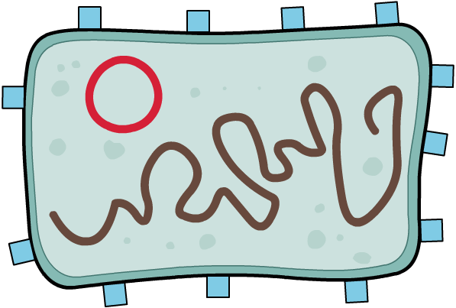
How do lymphocytes recognize pathogens?
The cell membrane of all cells, including pathogens and the body’s own cells, contain special molecules called antigens.
Lymphocytes can distinguish between the antigens of the body’s own cells and those of pathogens.
antigens on cell membrane of bacterium
Different types of pathogen have different antigens on their cell membrane.
Lymphocytes can recognize antigens of specific types of pathogen.
Notes:
11

Slide 12
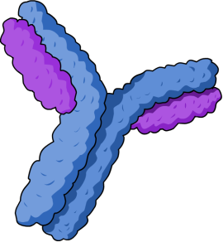
Antibodies (1)
Once a lymphocyte has recognized the presence of antigens belonging to a particular type of pathogen, it coordinates a response specific to that pathogen.
A special type of lymphocyte produces Y-shaped proteins, called antibodies, which help destroy pathogens.
They work by binding to antigens on the cell membrane of pathogens, causing them to clump together.
Macrophages can recognize antibodies bound to antigens. This enables them to target and destroy pathogens efficiently.
Notes:
12
Teacher notes
Antibodies are produced by B-lymphocytes.
Remind students that macrophages are non-specific. They recognize the body’s own antibodies, but do not recognize specific pathogens the antibodies may be bound to during an immune response.

Slide 13
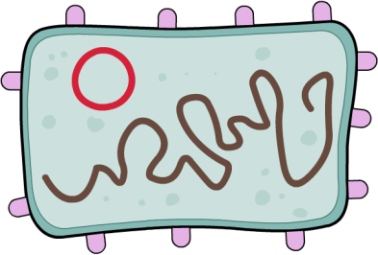
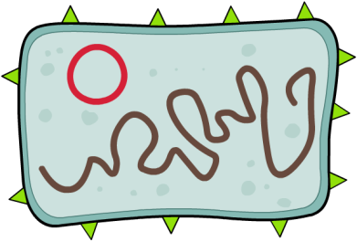
Antibodies (2)
Different pathogens have different antigens on their surfaces.
This means that a different antibody needs to be produced for each type of pathogen.
antibody
The lymphocytes producing the correct antibody for the infecting pathogen divide. This produces more of the correct lymphocytes.
It takes a few days to produce enough antibodies to destroy the pathogen. This means there is usually a delay before the person feels better.
antigen on pathogen
Notes:
13

Slide 14
Antitoxins
Some lymphocytes are also able to produce special proteins called antitoxins.
bacterial toxin
Antitoxins are a type of antibody that can neutralize the toxins some pathogens produce on infecting the body.
Antitoxins work by binding to the toxin. This prevents the toxin from causing damage to the body.
antitoxin
Notes:
14

Slide 15
Key words
Notes:
15

Slide 16
Stages in fighting an infection
Notes:
16
Teacher notes
This ordering activity could be used as a plenary or revision exercise on how the immune system fights infections. Mini-whiteboards could be used to make this a whole-class exercise.
This slide covers the Science and Engineering Practices:
Constructing Explanations and Designing Solutions: Apply scientific ideas, principles, and/or evidence to provide an explanation of phenomena and solve design problems, taking into account possible unanticipated effects.

Slide 17
Memory lymphocytes
As well as antibody-producing lymphocytes, the recognition of pathogen antigens triggers the production of memory lymphocytes.
Memory lymphocytes remain in the body even after the original infection has been dealt with.
Their role is to recognize the pathogen’s antigens if it reinfects the body in the future.
If this happens, memory lymphocytes enable the correct antibodies to be made much quicker. The fast response helps stop a person from feeling ill.
This process is called a secondary response.
Notes:
17

Slide 18
Antibody levels during infection
Notes:
18
Teacher notes
This animation shows how the response to an infection changes when a person is infected for the second time. Students could be asked to draw predicted graphs on mini-whiteboards and then compare them with these graphs, to consolidate their understanding of the previous slide. You need to press the “play” button three times in order for all of the information in this activity to be displayed.
A secondary response will only occur if the person is infected with the same type of pathogen as the first infection. This is because each type of antibody can only bind to the antigens on a specific type of pathogen.
This slide covers the Science and Engineering Practices:
Using Mathematics and Computational Thinking: Use mathematical, computational, and/or algorithmic representations of phenomena or design solutions to describe and/or support claims and/or explanations.

