Slide 1
The Circulatory System

Slide 2
Information
Analyzing and Interpreting Data
Constructing Explanations and Designing Solutions
Using Mathematics and Computational Thinking
1. Patterns
2. Cause and Effect
3. Scale, Proportion, and Quantity
4. Systems and System Models
6. Structure and Function

Slide 3
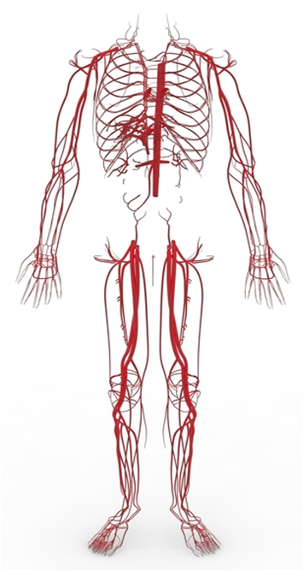
The role of the circulatory system
The circulatory system is a type of specialized transport system made of a group of organs that work together to move substances around the body.
Substances transported by the circulatory system are carried in the blood.
Oxygen and glucose are transported to cells and used to carry out processes such as cellular respiration.
Waste products, such as carbon dioxide and urea, are transported away from cells. This prevents them from building up and causing damage.
Notes:
Teacher notes
For more information on organ systems, please refer to the Multicellular Organisms presentation.
Photo credit: © Malic Sergiu, Shutterstock.com 2018

Slide 4
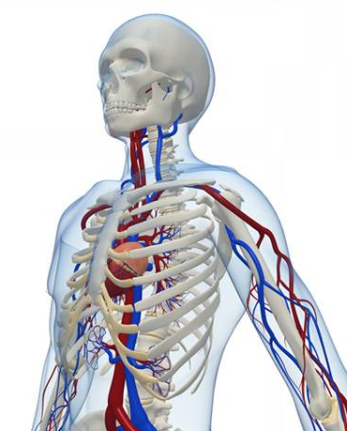
Closed circulatory system
Humans have a closed circulatory system. This means that the blood is contained within vessels.
A closed circulatory system allows the following factors to be controlled:
the speed of blood flow
the pressure of the blood
the distribution of blood in the body.
Notes:
Teacher notes
The distribution of blood affects the supply of nutrients and oxygen to different areas of the body. For example, during exercise the demand for oxygen and glucose by the muscles increases. To meet this demand, an increase in blood supply is needed. To do this, blood is sent toward the muscles in priority to being sent to the digestive system.
Photo credit: © Sebastian Kaulitzki, Shutterstock.com 2018

Slide 5
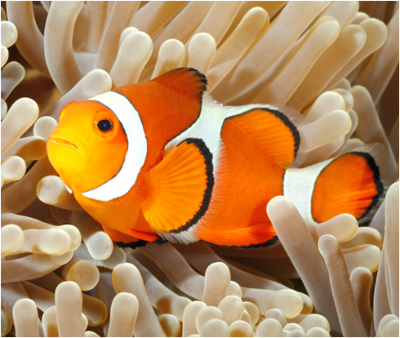
Single and double systems
There are two types of closed circulatory system.
In a single circulatory system, the blood only goes through the heart once during a single complete circuit of the body. Fish have a single circulatory system.
In a double circulatory system, the blood is pumped to the lungs, returned to the heart, and then pumped out again to the rest of the body.
This means that the blood goes through the heart twice during a single complete circuit of the body.
Mammals and birds have a double circulatory system.
Notes:
Teacher notes
Humans have a double circulatory system:
the pulmonary circuit takes blood to the lungs
the systemic circuit takes blood to the body.
Photo credit: © cbpix, Shutterstock.com 2018

Slide 6
Single and double circulatory systems

Slide 7
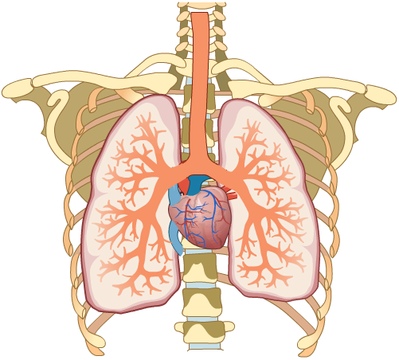
Relationship with the respiratory system
There is a close functional relationship between the circulatory system and the respiratory system.
The lungs and heart work together to supply all the cells of the body with the oxygen required for cellular respiration.
The blood is oxygenated as it passes through the lungs.
Gaseous exchange occurs between air in the alveoli and the blood in nearby vessels.
Notes:
Teacher notes
For more information about gaseous exchange in the alveoli, please refer to the Exchange Surfaces and Cell Transport presentations.

Slide 8
How does gaseous exchange occur?
Notes:
Teacher notes
Alveolus is the singular of alveoli.
This slide covers the Science and Engineering Practice:
Constructing Explanations and Designing Solutions: Apply scientific ideas, principles, and/or evidence to provide an explanation of phenomena and solve design problems, taking into account possible unanticipated effects.

Slide 9
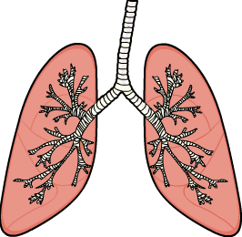
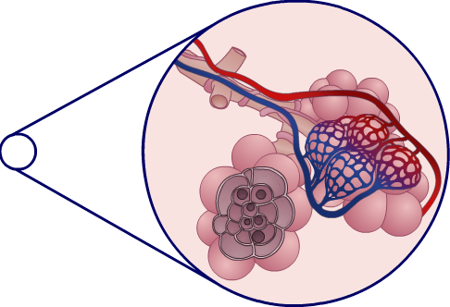
How are alveoli adapted?
Alveoli are structurally adapted for gaseous exchange.
They are covered by a network of blood vessels called the lung capillaries. This means that gases can pass between the blood and the alveoli efficiently.
The alveoli walls are only one cell thick. This minimizes the diffusion pathway to the blood vessels.
lungs
lung capillaries
They have a large combined surface area. This enables large amounts of gases to be exchanged with the blood in each breath.
alveoli
Notes:
Teacher notes
Combined surface area takes into account the total surface area of all alveoli in the lungs. There are approximately 300 million alveoli in the lungs, providing a combined surface area of 50–75 m²!
For more information on diffusion, please refer to the Cell Transport presentation.

Slide 10
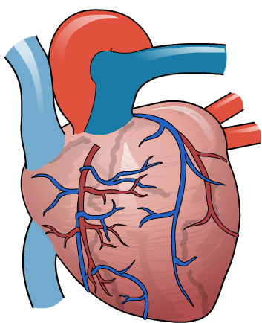
The human heart
The heart is the organ which pumps blood around the circulatory system. It is made of a type of specialized muscle called cardiac muscle.
Cardiac muscle cells are adapted to contract continuously without getting tired.
The heart receives its own blood supply via the coronary artery.
It provides the cardiac muscle cells with the oxygen. This is used by the cells for cellular respiration, which releases the energy needed for contraction.
coronary arteries
Notes:
Teacher notes:
The heart beats constantly to supply our tissues with glucose and oxygen. The speed at which the heart beats can change to react to the increased demand for energy during exercise.

Slide 11
Structures in the human heart
Notes:
Teacher notes
The left and right labels on the diagram are the “wrong” way around because the diagram shows the heart as you would see it if you were looking at it within a person. The labels indicate the right and left side of the person whose heart it is.
The bicuspid valve contains two cusps, or flaps, and the tricuspid valve contains three.

Slide 12
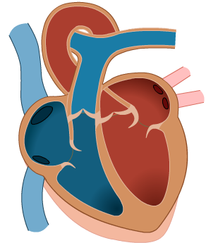
Exploring the heart’s structure
The human heart has four chambers. There are two atria at the top and two ventricles at the bottom.
The left ventricle has the thickest wall. This enables it to pump blood to the body under high pressure.
left atrium
right atrium
The right ventricle wall is thinner. It pumps blood to the lungs, which could be damaged by high blood pressure.
left ventricle
right ventricle
The atria have even thinner walls. This is because they only have to pump blood a short distance, into the ventricles.
Notes:
Teacher notes
The singular of atria is atrium.

Slide 13
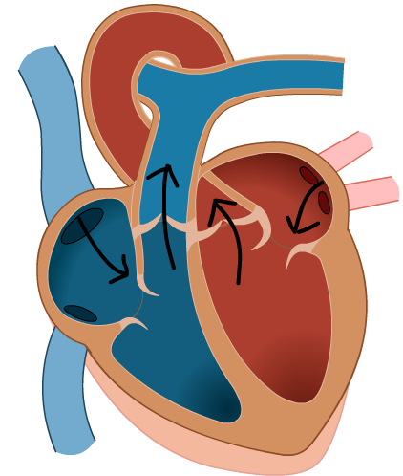
The vessels of the heart
There are four main blood vessels that transport blood to and from the heart.
The pulmonary artery carries deoxygenated blood to the lungs.
vena cava
aorta
pulmonary artery
After the blood has become oxygenated via gaseous exchange, it returns to the heart in the pulmonary vein.
The aorta takes oxygenated blood to the body.
pulmonary vein
After going round the body, deoxygenated blood returns to the heart in the vena cava.
Notes:
Teacher notes
On this diagram, the blue represents vessels and heart chambers containing deoxygenated blood. The red represents vessels and heart chambers containing oxygenated blood.

Slide 14
Pumping in the right direction
The heart contains four valves.
The role of the valves is to prevent the blood from flowing backward within the heart.
This ensures that the blood moves between the four chambers of the heart, and the heart vessels, in the right direction.
two valves between the ventricles and vessels leaving the heart
two valves between the atria and the ventricles

Slide 15
Which structure?

Slide 16
Controlling heart rate
The natural resting heart rate is controlled by a special patch of cells located in the wall of the right atrium.
This patch of cells is known as the pacemaker of the heart.
It contains specialized pacemaker cells that send out electrical signals to the cardiac muscle cells.
location of pacemaker cells
These signals determine how fast the heart contracts.

Slide 17
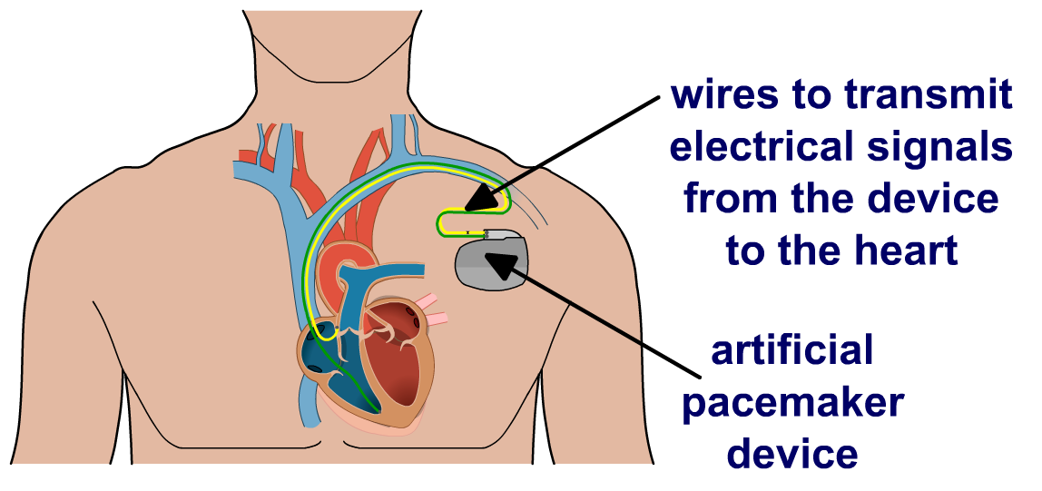
Artificial pacemakers
Some heart problems are caused when an individual’s natural pacemaker cells stop working properly.
One way this can be treated is to have surgery to fit an artificial pacemaker.
This is a battery-powered device that monitors the heart’s activity to ensure it contracts at the correct rate.
The artificial pacemaker senses if the pacemaker cells have stopped working. If this happens, it sends out electrical signals to take over. This helps maintain a regular heart rate.

Slide 18
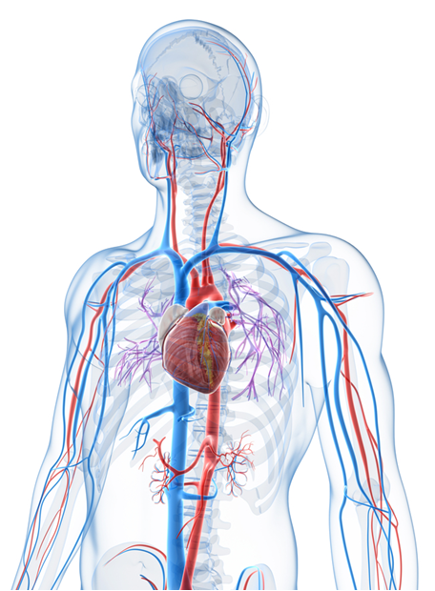
Calculating heart function (1)
The equation below can be used to calculate three important aspects of heart function.
cardiac output = stroke volume × heart rate
Cardiac output: the volume of blood that the heart pumps out over one minute.
Stroke volume: the volume of blood that the heart pumps out in a single heartbeat.
Heart rate: the number of times that the heart beats in one minute.
Notes:
This slide covers the Science and Engineering Practice:
Analyzing and Interpreting Data: Analyze data using tools, technologies, and/or models (e.g., computational, mathematical) in order to make valid and reliable scientific claims or determine an optimal design solution.
Photo credit: © Sebastian Kaulitzki, Shutterstock.com 2018

Slide 19
Calculating heart function (2)
The equation for heart function can be rearranged to work out any one of its three components.
cardiac output = stroke volume × heart rate
Joe has a cardiac output of 6,000 ml/min and a stroke volume of 75 ml. What is his heart rate?
Rearranging the equation, we see that:
cardiac output
heart rate =
stroke volume
Therefore, Joe’s heart rate = 6,000/75
= 80 bpm (beats per minute)
Notes:
This slide covers the Science and Engineering Practices:
Analyzing and Interpreting Data: Analyze data using tools, technologies, and/or models (e.g., computational, mathematical) in order to make valid and reliable scientific claims or determine an optimal design solution.
Using Mathematics and Computational Thinking: Apply ratios, rates, percentages, and unit conversions in the context of complicated measurement problems involving quantities with derived or compound units (such as mg/mL, kg/m3, acre-feet, etc.).

Slide 20
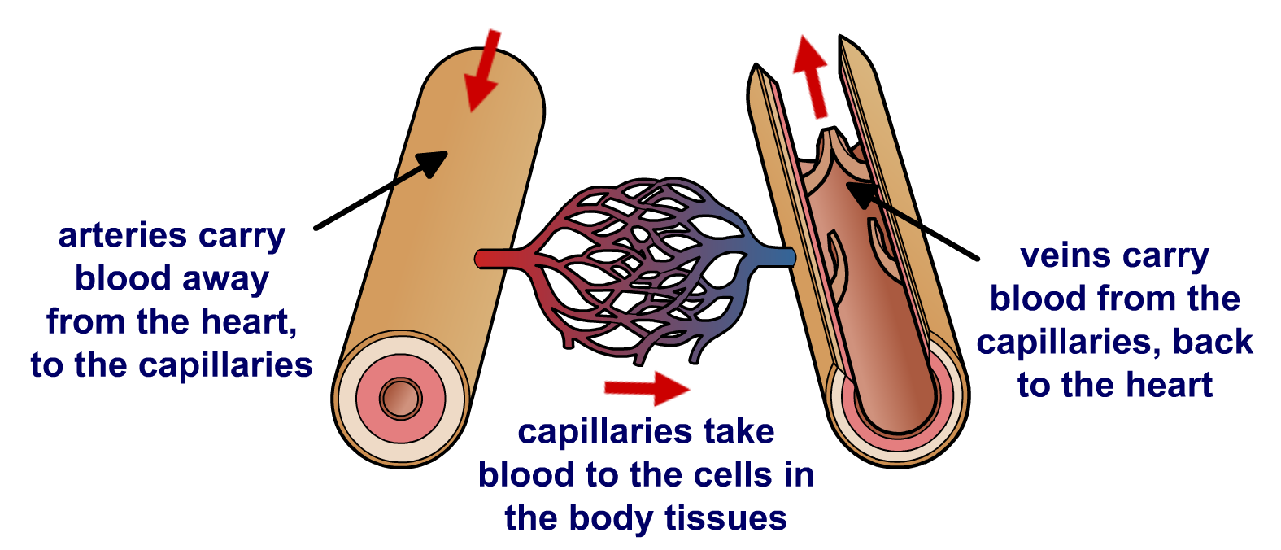
Blood vessels (1)
There are three main types of blood vessel in the body.
Arteries: transport blood away from the heart.
Veins: transport blood toward the heart.
Capillaries: are located within the tissues of the body and transport blood to the body cells. They receive blood from the arteries, and move it toward the veins.

Slide 21
Blood vessels (2)

Slide 22
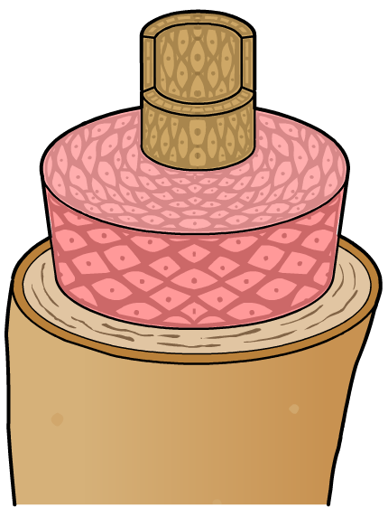
Structural adaptations: arteries
Arteries are structurally adapted to carry blood away from the heart at high pressure.
They have a thick layer of muscular and elastic tissue in their walls. This prevents them from bursting under the high blood pressure.
narrow lumen
thick muscle layer
Arteries have a narrower lumen than veins. This allows them to maintain a high blood pressure.
elastic tissue
Notes:
Teacher notes
Remind students that arteries carrying blood from the heart to the lungs have a lower blood pressure than arteries carrying blood from the heart toward the body. This is because the delicate alveoli in the lungs would be damaged if the blood they received was at very high pressure.
Lumen describes the diameter of a blood vessel’s cavity.

Slide 23
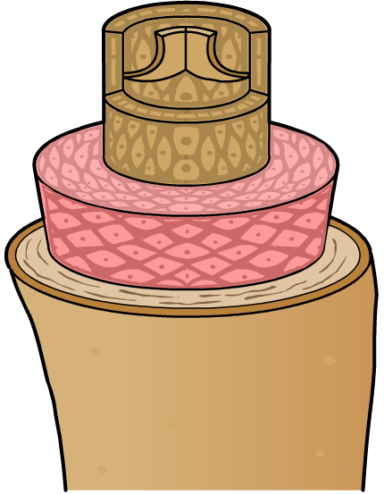
Structural adaptations: veins
Veins are structurally adapted to carry blood toward the heart at low pressure.
wide lumen
They have a wide lumen to keep blood pressure low.
valve
Their walls are thinner and contain less muscular tissue than arteries, as there is a low risk of them bursting.
thin muscle layer
Veins are the only vessel to contain valves.
These stop the blood from flowing backward, which is a risk when blood pressure is low.

Slide 24
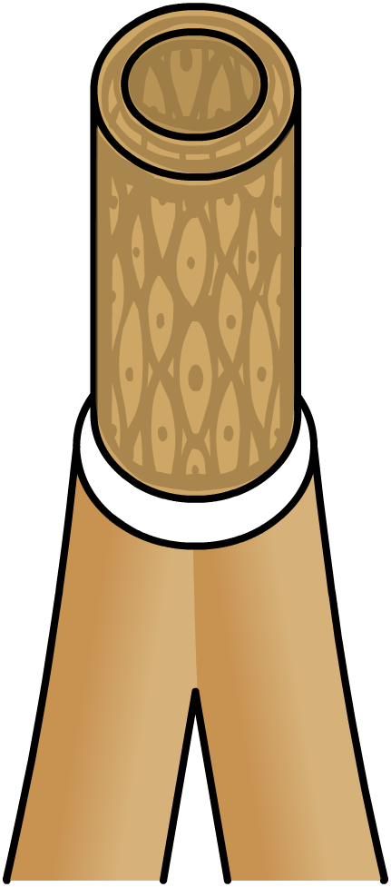
Structural adaptations: capillaries
Capillaries are structurally adapted to carry out exchange with body cells in the tissues.
narrow lumen
They are permeable. This means substances such as gases, nutrients and waste products can cross their walls to reach the body cells.
thin wall
Capillaries have a very narrow lumen. Their walls are just one cell thick and contain no muscular or elastic tissue.
This minimizes the diffusion distance to the body cells, which increases the efficiency of exchange.

Slide 25
Which type of blood vessels?

Slide 26
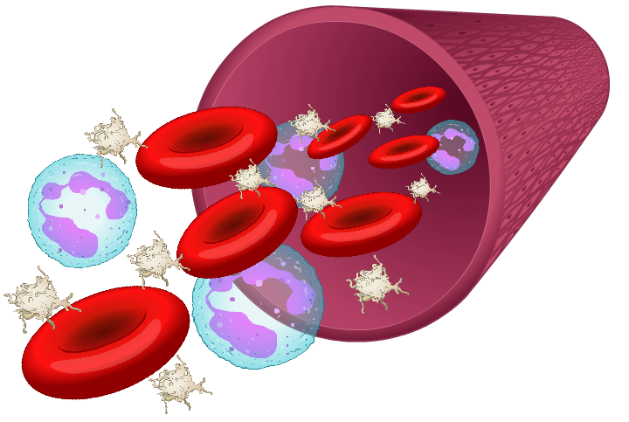
The blood
The blood is a tissue made from many different types of specialized blood cells.
The main constituent of the blood is the blood plasma.
The blood plasma is a clear fluid within which the other blood cells are suspended.
There are three main types of blood cell: red blood cells, white blood cells and platelets.
Each type of blood cell is adapted to carry out a specific role.

Slide 27
What is blood made of?

Slide 28
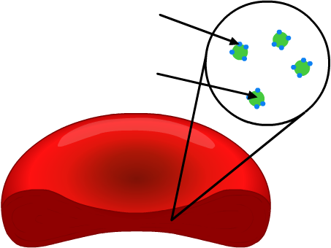
Red blood cells
Red blood cells are specialized to transport oxygen.
They have a biconcave shape. This increases their surface area, enabling efficient gaseous exchange.
They are packed with a protein called hemoglobin that can bind to oxygen.
oxygen bound to hemoglobin
They have no nucleus to increase space for hemoglobin.
hemoglobin protein
Red blood cells take up oxygen in the lungs during gaseous exchange. The oxygen is then released to body cells as the red blood cells pass through the capillaries.
Notes:
Teacher notes
Biconcave describes a disc-like shape that is curved inward on both sides. This provides a larger surface area than if red blood cells were simply disc-shaped.
The scientific name for red blood cells is erythrocytes.

Slide 29
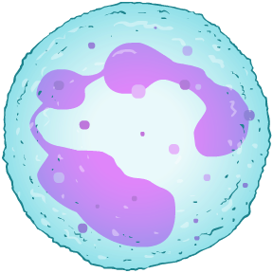
White blood cells
White blood cells are part of the body’s immune system and are the largest type of blood cell.
There are many types of white blood cell, but all play a role in defending the body against harmful microorganisms.
Some white blood cells engulf and break down pathogens using digestive enzymes.
large, lobed nucleus
Other white blood cells can produce proteins called antibodies. These recognize and bind to microorganisms in order to destroy them.
Notes:
Teacher notes
Phagocytes are a type of white blood cell that engulf and break down pathogens using digestive enzymes. This process is called phagocytosis.
Lymphocytes are a type of white blood cell that produce antibodies.
From the diagram, students can see that the nucleus of a white blood cell is typically large and irregularly shaped. This gives white blood cells a distinctive appearance when viewed under a microscope.
For more information on the role of white blood cells in protecting the body from pathogens, please refer to The Body’s Defense Systems presentation.

Slide 30
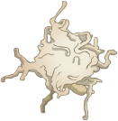
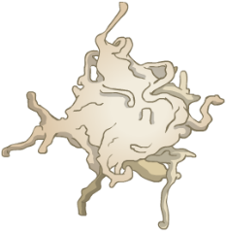
Platelets
Platelets are small cell fragments produced by cells in the bone marrow. They have no nucleus.
Platelets have an important role in blood clotting.
If a blood vessel becomes torn, platelets gather at the site of the injury and stick together to form a clot.
The clot blocks the wound to prevent blood loss.
Some people suffer from disorders that mean they do not have enough platelets in their blood. This puts them at risk of excessive bleeding if they are injured.
Notes:
Teacher notes
A clot is a mass made of thickened blood formed when platelets in the blood stick together. Clots help seal wounds, which helps prevent microorganisms from entering the body.
Von Willebrand Disease is the most common genetic bleeding disorder. The platelets of people with this disease are unable to stick together properly, which means the blood cannot clot properly. If someone with this disease is injured, they are at risk of prolonged bleeding, which can have serious consequences.

