Slide 1
The Digestive System

Slide 2
Information
Developing and Using Models
Planning and Carrying Out Investigations
Using Mathematics and Computational Thinking
1. Patterns
2. Cause and Effect
3. Scale, Proportion, and Quantity
4. Systems and System Models
6. Structure and Function

Slide 3
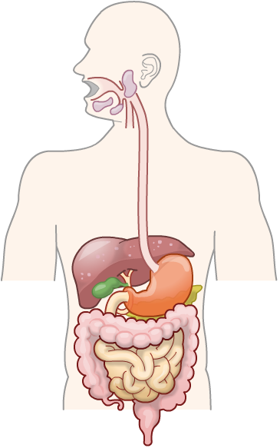
The digestive system in context
The digestive system is a specialized transport system, and one of the many organ systems found in mammals.
The role of the digestive system is to break down food molecules to enable the absorption of nutrients into the blood.
The blood transports nutrients from the digestive system to cells all over the body.
In cells, the products of digestion are used for cellular respiration and to build new molecules.
Notes:
Teacher notes
For more information about organ systems, please refer to the Multicellular Organisms presentation.
For more information about cellular respiration, please refer to the Cellular Respiration presentation.

Slide 4
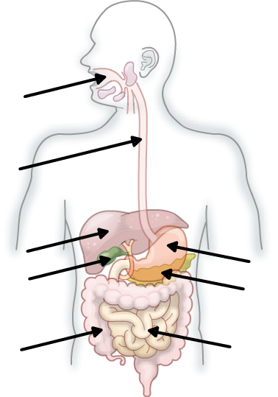
Organs of the digestive system
The digestive system is made of several different organs. These work together to break down and absorb nutrients.
mouth
esophagus
liver
stomach
gall bladder
pancreas
large intestine
small intestine
Notes:
Teacher notes
Ask if students can name any of the organs of the digestive system, and where they are in the body before revealing the labels for the image above.

Slide 5
Organs in the digestive system

Slide 6
Digestive system: quiz

Slide 7
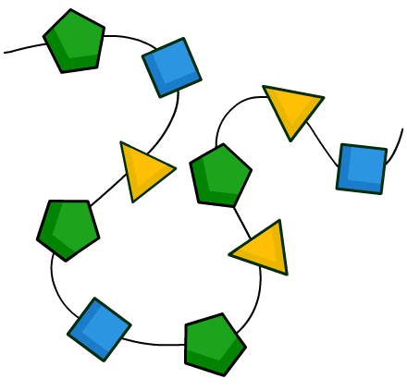
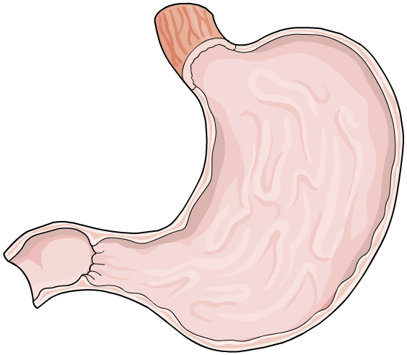
Enzymes in the body
Enzymes are used to catalyze the thousands of reactions that are needed for life.
Can you name any reactions that involve enzymes?
cellular respiration
protein synthesis
digestion
During digestion, digestive enzymes break down large food molecules in a process called chemical digestion.
Notes:
Teacher notes
For more information on how enzymes work, please refer to the Enzymes presentation.

Slide 8
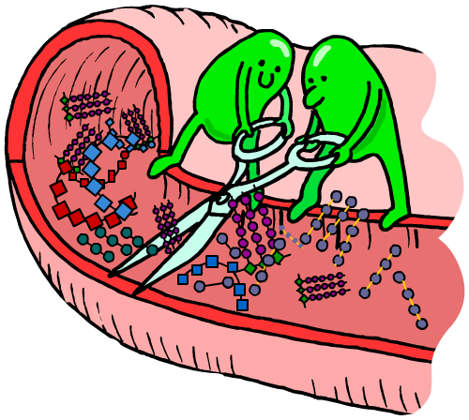
What are digestive enzymes?
Digestive enzymes are produced by specialized cells found in the organs of the digestive system. These enzymes pass out of the cells and into the digestive tract.
Different types of digestive enzyme are produced by different parts of the digestive system.
Digestive enzymes catalyze the breakdown of large food molecules into smaller molecules that can be easily absorbed into the blood.
Notes:
Teacher notes
The small intestine is the site where many digested food molecules enter the bloodstream. The food molecules are transported to other parts of the body, where they leave the bloodstream and enter body tissues.

Slide 9
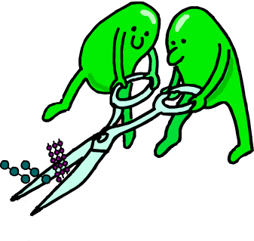
Why is food chemically digested?
Initially, food molecules are in the form of polymers. These include proteins, carbohydrates and fats
Polymer food molecules are insoluble and too large to be absorbed into the blood.
However, polymers can be broken down into their smaller, constituent parts called monomers.
Digestive enzymes catalyze the breakdown of polymer food molecules into their monomers.
These smaller, soluble molecules can be absorbed into the blood.

Slide 10
Food molecules: polymers and monomers
Can you name the monomers found in each of the polymer food molecules below?
polymer | monomer(s)
carbohydrates
simple sugars
proteins
amino acids
fatty acids and glycerol
fats
Different types of digestive enzyme are needed to break down each type of food molecule into its monomers.

Slide 11
Types of digestive enzyme
Carbohydrase breaks down carbohydrates into smaller sugar molecules.
carbohydrase
carbohydrate
simple sugar
Amylase is a type of carbohydrase enzyme. It specifically breaks down the carbohydrate, starch.
amylase
starch
glucose
Amylase is produced by the salivary glands, pancreas and small intestine. It breaks down starch present in the mouth and small intestine.
Notes:
Teacher notes
Carbohydrates are polymers. They are made of many sugar units joined together. Each sugar unit is a monomer.
Starch is a polymer of glucose. Glucose is starch’s monomer.

Slide 12
More digestive enzymes
Protease breaks down proteins into their constituent amino acid molecules.
protease
protein
amino acids
Lipase breaks down lipids, including fats and oils, into glycerol and fatty acids.
lipase
fat
glycerol + fatty acids
Word equations are a useful way of writing down the reactions catalyzed by digestive enzymes.

Slide 13
Breaking down different nutrients
Notes:
Teacher notes
This activity could be used to check students’ understanding of the different types of digestive enzyme.

Slide 14
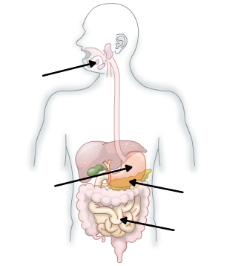
Where are digestive enzymes produced?
Different digestive enzymes are produced in different parts of the digestive system.
carbohydrase: salivary glands, pancreas and small intestine
salivary glands
protease: stomach, pancreas and small intestine
stomach
pancreas
lipase: pancreas and small intestine
small intestine

Slide 15
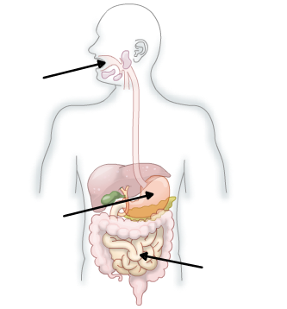
Where do digestive enzymes act?
Each digestive enzyme also catalyzes the breakdown of its specific food molecule in different parts of the digestive system.
carbohydrase: mouth and small intestine
mouth
protease: stomach and small intestine
lipase: small intestine
stomach
Where an enzyme acts depends on the conditions that the enzyme requires to function effectively.
small intestine

Slide 16
Factors affecting enzymes
The rate at which a digestive enzyme is able to break down food molecules depends on its conditions.
Every type of enzyme works best at a particular temperature and pH value. These are an enzyme’s optimal conditions.
food molecule (substrate)
All digestive enzymes work best at a normal body temperature, around 37 °C.
digestive enzyme
However, optimal pH varies between different types of digestive enzyme.
enzyme binds to food molecule to catalyze its breakdown
Notes:
Teacher notes
Digestive enzymes can denature if conditions stray too far from their optimum.
If an enzyme is denatured, the shape of its active site changes which prevents it from binding to its substrate and carrying out catalysis.
This slide covers the Science and Engineering Practice:
Developing and Using Models: Use a model to provide mechanistic accounts of phenomena.

Slide 17
How does pH affect enzymes?
If the pH changes to far above or below an enzyme’s optimum pH, the shape of the enzyme changes irreversibly.
When this happens, the substrate will no longer fit and the enzyme is said to be denatured. As a result, the enzyme is unable to catalyze reactions.
pH
optimum conditions
pH too low or too high
Notes:
This slide covers the Science and Engineering Practice:
Developing and Using Models: Use a model to provide mechanistic accounts of phenomena.

Slide 18
pH and digestive enzymes
Notes:
Teacher notes
This animation highlights that the optimum conditions for one type of enzyme may be different for another type of enzyme. Different parts of the digestive system are maintained at particular pH levels to maximize the enzyme activity.
This slide covers the Science and Engineering Practice:
Using Mathematics and Computational Thinking: Use mathematical, computational, and/or algorithmic representations of phenomena or design solutions to describe and/or support claims and/or explanations.

Slide 19
Digestion in the stomach
The stomach wall secretes hydrochloric acid (HCl). This creates an acidic environment with a pH of 2.
These conditions provide the optimum pH for protease enzymes. As a result, protein digestion is able to occur in the stomach.
However, lipase and carbohydrase work best in less acidic conditions.
Neither of these digestive enzymes are produced in the stomach, as the acidity would cause them to denature.

Slide 20
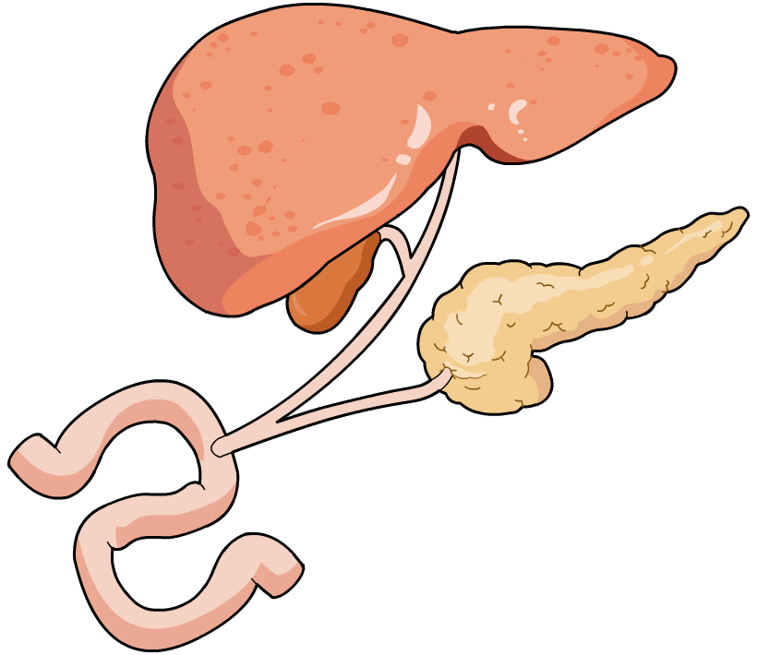
Digesting fats (1)
Food entering the small intestine from the stomach is acidic.
How is lipase able to break down fats in the small intestine?
The liver produces bile which is stored in the gall bladder and released into the small intestine.
liver
Bile is an alkaline liquid. This means that it can neutralize the hydrochloric acid from the stomach.
gall
bladder
As a result, bile creates the optimum pH conditions for lipase to function.
bile duct
small intestine
Notes:
Teacher notes
Ask if students can name any of the organs in the image above before revealing the labels.
The pH in the stomach is maintained at acidic levels (a low pH) to provide optimum conditions for protease enzymes (and to destroy bacteria).
The pH in the small intestine (and the mouth) is maintained at slightly alkaline levels (a higher pH) to provide optimum conditions for intestinal enzymes.

Slide 21
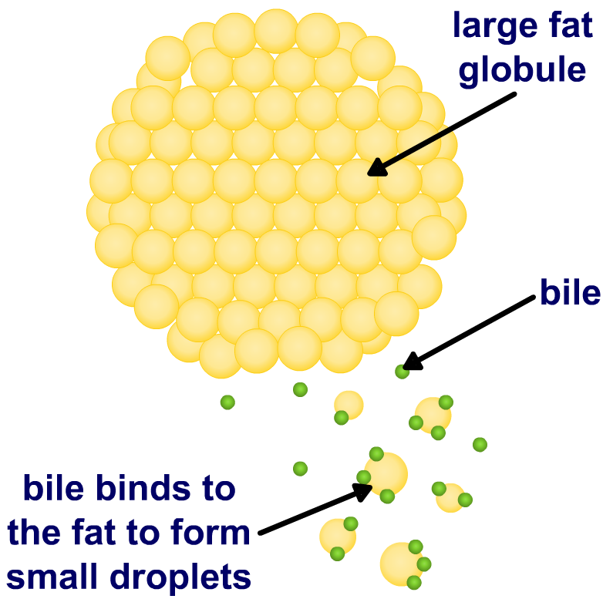
Digesting fats (2)
Bile also emulsifies fats. This means it breaks large fat globules into smaller fat droplets.
Emulsification increases the surface area of the fat.
This provides a larger area for lipase to bind to the fat, enabling chemical digestion to occur more efficiently.
As a result, lipase is able to breakdown the fat into glycerol and fatty acids faster.

Slide 22
How does bile help digest fat?

Slide 23
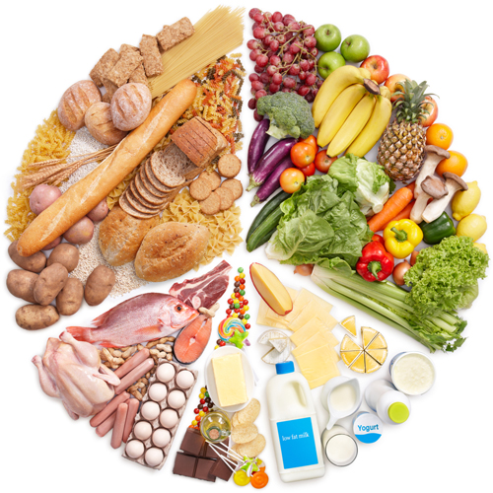
Food tests
Simple food tests can be used to investigate the presence of biological molecules within a food sample, including:
starch
fat
protein
These tests are qualitative, which means they are used to identify the type of molecule present, rather than how much.
Notes:
Teacher notes
Qualitative tests provide descriptive data e.g. the type of food molecule present in a sample.
Quantitative tests provide numerical data e.g. the amount of a food molecule present in a sample.
Photo credit: © ifong, Shutterstock.com 2018

Slide 24
Test for the presence of starch
Notes:
This slide covers the Science and Engineering Practice:
Planning and Carrying Out Investigations: Plan and conduct an investigation individually and collaboratively to produce data to serve as the basis for evidence, and in the design: decide on types, how much, and accuracy of data needed to produce reliable measurements and consider limitations on the precision of the data (e.g., number of trials, cost, risk, time), and refine the design accordingly.

Slide 25
Test for the presence of sugars
Notes:
Teacher notes
A reducing sugar is capable of being oxidized. Only sugars that can be oxidized cause a Benedict’s solution to change color. Glucose and fructose are both types of reducing sugars. Sucrose cannot be detected using the Benedict’s test because it is a non-reducing sugar.
When the Cu²⁺ ions are reduced to Cu⁺ ions they gain an electron from the reducing sugar present in the test solution. Reduction is a gain in electrons. Non-reducing sugars are unable to provide an electron the Cu²⁺ ions, which is why no precipitate is formed in the presence of non-reducing sugars.
This slide covers the Science and Engineering Practice:
Planning and Carrying Out Investigations: Plan and conduct an investigation individually and collaboratively to produce data to serve as the basis for evidence, and in the design: decide on types, how much, and accuracy of data needed to produce reliable measurements and consider limitations on the precision of the data (e.g., number of trials, cost, risk, time), and refine the design accordingly.

Slide 26
Test for the presence of proteins
Notes:
This slide covers the Science and Engineering Practice:
Planning and Carrying Out Investigations: Plan and conduct an investigation individually and collaboratively to produce data to serve as the basis for evidence, and in the design: decide on types, how much, and accuracy of data needed to produce reliable measurements and consider limitations on the precision of the data (e.g., number of trials, cost, risk, time), and refine the design accordingly.

Slide 27
Test for the presence of lipids
Notes:
This slide covers the Science and Engineering Practice:
Planning and Carrying Out Investigations: Plan and conduct an investigation individually and collaboratively to produce data to serve as the basis for evidence, and in the design: decide on types, how much, and accuracy of data needed to produce reliable measurements and consider limitations on the precision of the data (e.g., number of trials, cost, risk, time), and refine the design accordingly.

Slide 28
Summary of the food tests

