Slide 1
The Eye

Slide 2
Information
Constructing Explanations and Designing Solutions
2. Cause and Effect
3. Scale, Proportion, and Quantity
4. Systems and System Models
6. Structure and Function

Slide 3
Sensory receptors
Many things happen around us all the time. We are aware of some of these things because we have special sensory receptors which can detect certain types of stimuli.
There are many different types of sensory receptors.
Each type is specialized to detect a specific stimulus within a certain range.
Can you name any stimuli that can be detected by
sensory receptors?
sound
smell
heat
light
Notes:
Teacher notes
For more information on sensory receptors and responding to stimuli, please refer to The Nervous System presentation.

Slide 4
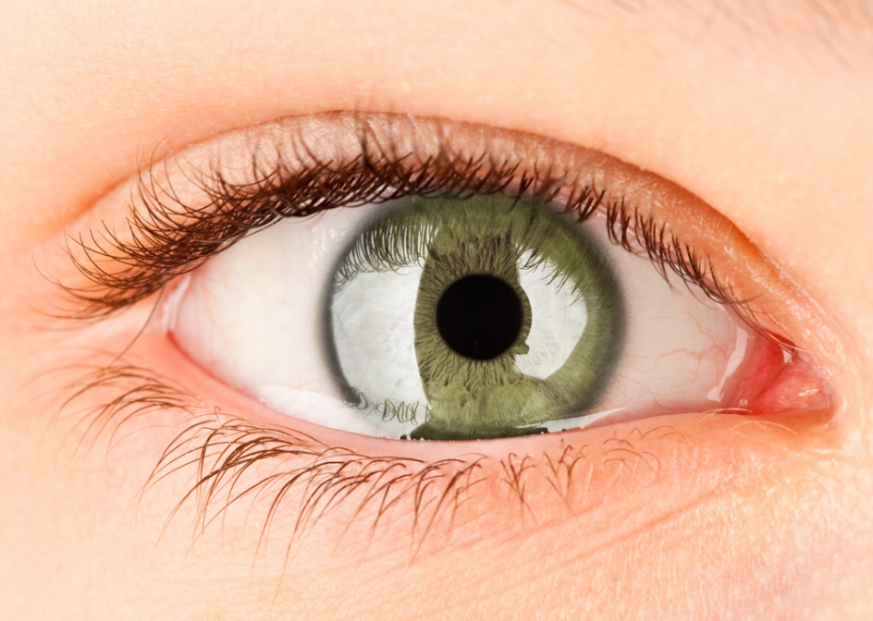
The eye
Sensory receptors are a type of specialized cell usually found in sense organs. The eye is one type of sense organ found in the body.
The eye contains specialized
light receptors.
These are a type of sensory receptor that are sensitive to light intensity and color.
As a result, the eyes enable us to detect changes in the strength and colors of light in our surroundings.
Notes:
Photo credit: © Andrey Armyagov, Shutterstock.com 2018

Slide 5
Light receptor cells
There are two types of light receptor cell located in the retina of human eyes:
path of light
Rod cells are sensitive to light at low intensities. Rod cells are more sensitive to light than cone cells. However, the do not detect color.
Cone cells are sensitive to color and light at high intensities. Humans have three different types of cone cells, each sensitive to a different range of colors.
rod cell
cone cell
Like most animal cells, light receptor cells have a nucleus, cytoplasm and a cell membrane.
Notes:
Teacher notes
The number of different types of cone cells found in the eye varies between animal species. For example, most birds, some insect species, spiders, goldfish and reindeer have four types of cone cell. The fourth cone cell enables them to see UV light. As a result, they are said to be tetrachromatic. Humans on the other hand only have three types of cone cell, so they are said to be trichromatic.
Rod cells contribute to night vision. This is because the high sensitivity allows them to continue to function at low light intensities, when cone cells can no longer detect light.

Slide 6
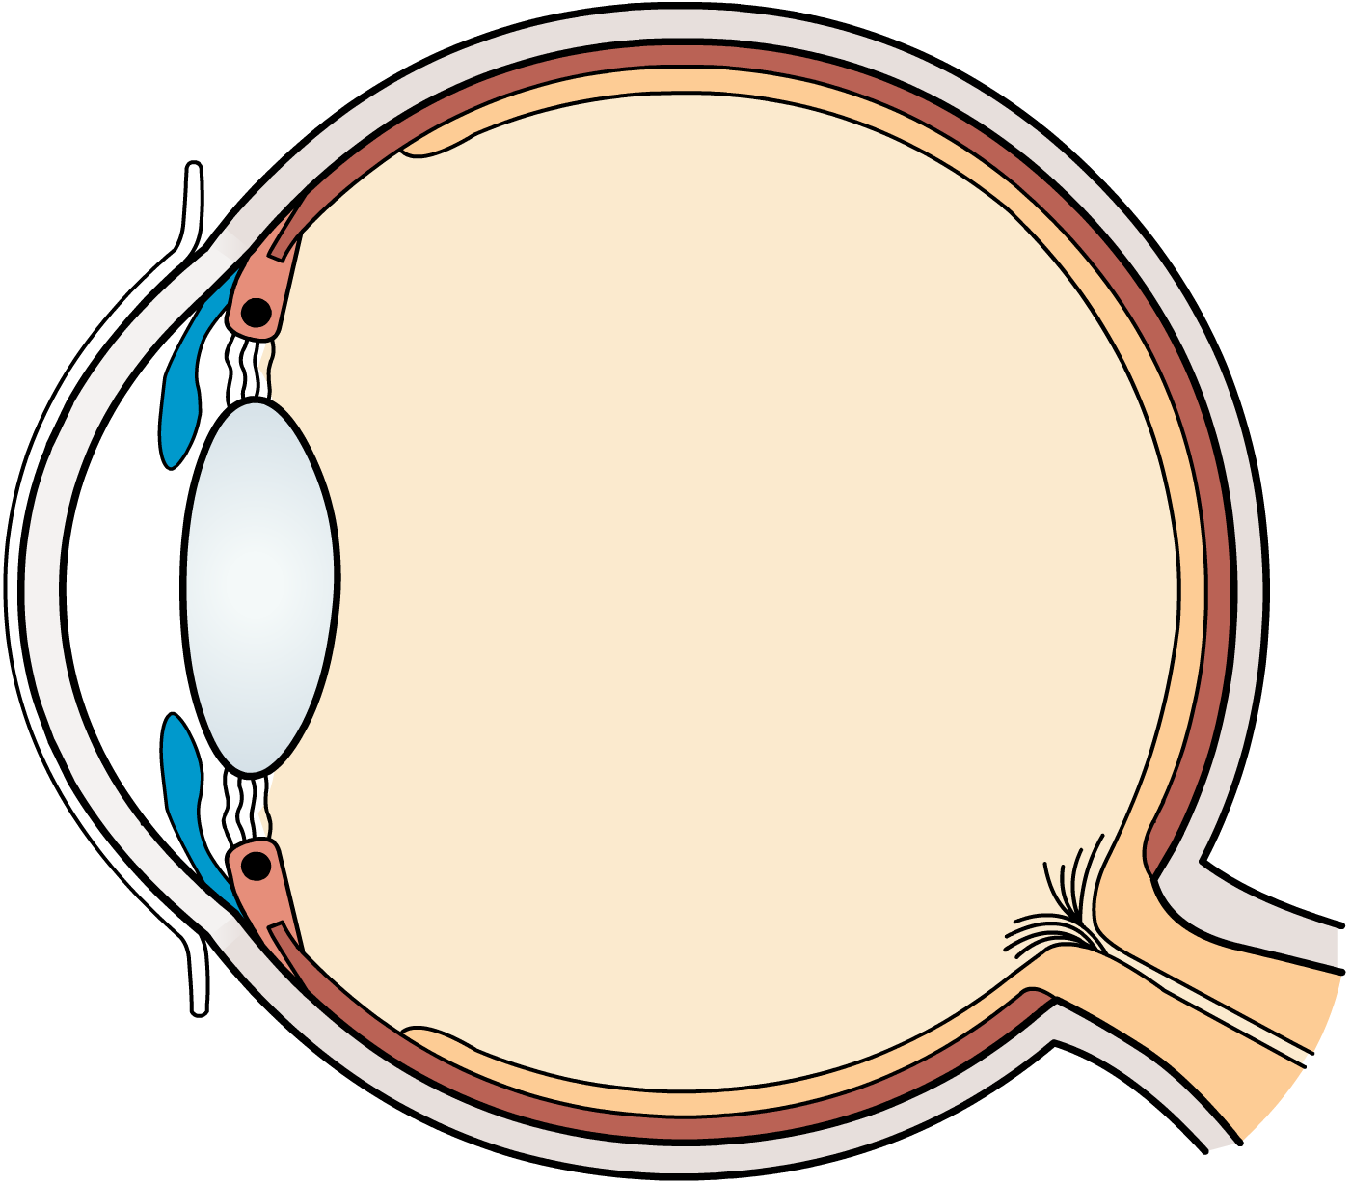
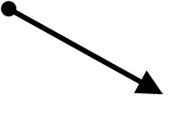
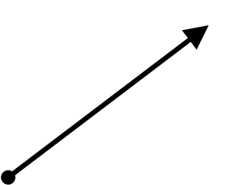
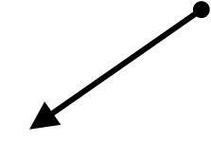
Structure of the eye
The eye is a complex sense organ with many parts:
sclera
ciliary muscle
retina
suspensory ligaments
pupil
optic nerve
cornea
lens
iris
Notes:
Teacher notes
See if students can name the parts of the eye before revealing the labels.
Together, the suspensory ligaments and ciliary muscles form the ciliary body.
The cornea is at the front of the eye and is continuous with the sclera.
The pupil is the space between the iris, in front of the lens.

Slide 7
Naming parts of the eye
Notes:
Teacher notes
This activity could be used as an introduction to the eye. You may wish to ask students to have a go at guessing where the labels go, before pressing solve to see how many they got right. You could then ask them what they think the functions of the cornea, iris, lens, retina and optic nerve are.

Slide 8
Function of eye parts (1)
Each structural part of the eye has a specific role contributing to its overall function.
part of the eye | structure | function
cornea
pupil
iris
lens
transparent layer
at the front of the eye
refracts light as it enters the eye
hole in the center of the iris
enables light to enter the eye
colored part of the eye that contains muscles
controls the diameter of the pupil
transparent disc behind the pupil and iris
focuses light onto the retina as it enters the eye

Slide 9
Function of eye parts (2)
part of the eye | structure | function
retina
optic nerve
suspensory ligaments
ciliary muscles
sclera
the area at the back of the eye, containing cone and rod light receptors
senses light
sends nerve impulses
from the retina to the brain
bundle of nerve fibers
attachment between the lens and the
ciliary muscles
keep the lens in place and allow its shape to be changed by ciliary muscles
small muscles
attached to the suspensory ligaments
alter the shape of the lens
white, opaque outer layer of the eye
protects the eye

Slide 10
Matching parts of the eye to their function

Slide 11
How do our eyes detect light?
Notes:
Teacher notes
The cornea is actually responsible for most of the light refraction, and the lens provides the fine tuning needed to focus.
This slide covers the Science and Engineering Practice:
Constructing Explanations and Designing Solutions: Apply scientific ideas, principles, and/or evidence to provide an explanation of phenomena and solve design problems, taking into account possible unanticipated effects.

Slide 12
The pupil: adapting to changing light
Notes:
This slide covers the Science and Engineering Practice:
Constructing Explanations and Designing Solutions: Apply scientific ideas, principles, and/or evidence to provide an explanation of phenomena and solve design problems, taking into account possible unanticipated effects.

Slide 13
How does the eye focus?
Notes:
Teacher notes
This interactive simulation illustrates how the eye focuses on objects at different distances. Suitable prompts could include:
Start panel: How can you tell that the image this eye can see is in focus?
Distant objects: Why isn't the STOP sign in focus?
Close objects: Why isn’t the paper in focus?
Some students struggle to realize that the ciliary muscle actually forms a ring around the whole of the lens, and is not just attached to one part of it. A 3D model or dissection might help with this. You might also wish to point out that the cornea refracts light, although this is not shown in the activity for simplicity’s sake.
This slide covers the Science and Engineering Practice:
Constructing Explanations and Designing Solutions: Apply scientific ideas, principles, and/or evidence to provide an explanation of phenomena and solve design problems, taking into account possible unanticipated effects.

Slide 14
Eye problems
Notes:
Teacher notes
You could carry out a quick survey to see how many students have these eye problems. Some may not know what the problem with their own eyes is. Take care that this does not lead to teasing of those who wear glasses.

Slide 15
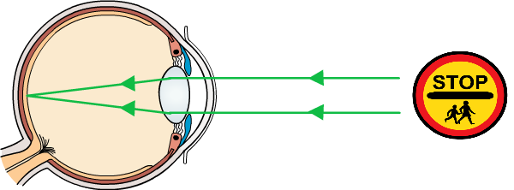
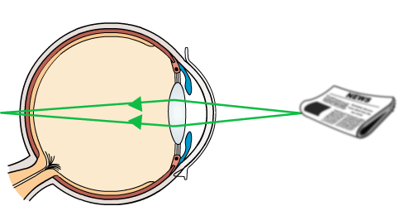
Long-sightedness
People with long-sighted vision can focus clearly on objects in the distance. This is because light from distant objects is focused on their retina.
However, they cannot focus clearly on objects that are close by. This is because the image is focused behind their retina.
the newspaper appears blurry
The scientific name for long-sightedness is hyperopia.

Slide 16
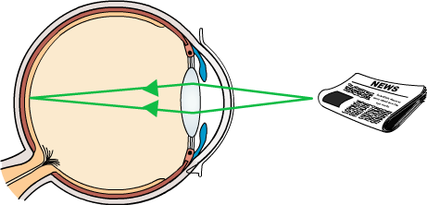
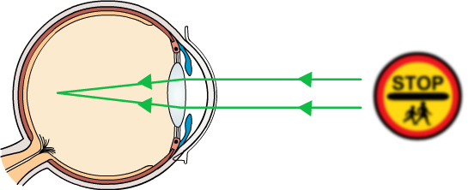
Short-sightedness
People with short-sighted vision can focus clearly on objects that are close to them. This is because the light from close objects is focused on their retina.
However, they cannot focus clearly on objects that are in the distance. This is because the image forms in front of their retina.
the sign appears blurry
The scientific name for short-sightedness is myopia.

Slide 17
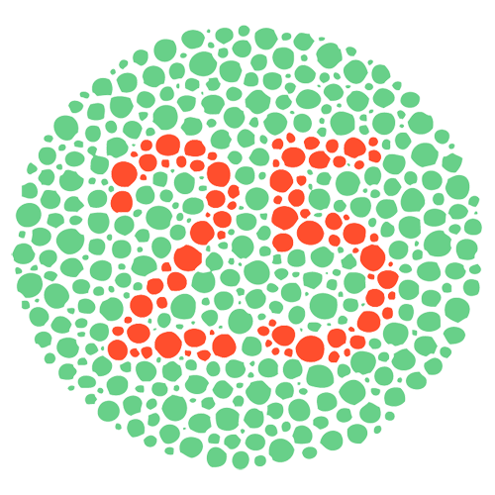
Color blindness
A person with color blindness has difficulty distinguishing between the certain colors, often red and green.
Color blindness is caused by a lack of a certain type of light receptor in the retina. It affects about 7% of men and 1% of women.
What can you see in the circle?
If you are not color blind, then you will see the number 25 in the image. If you have red-green color blindness you will only be able to see either red or green spots.
Notes:
Photo credit: © Vilmos Varga, Shutterstock.com 2018

Slide 18
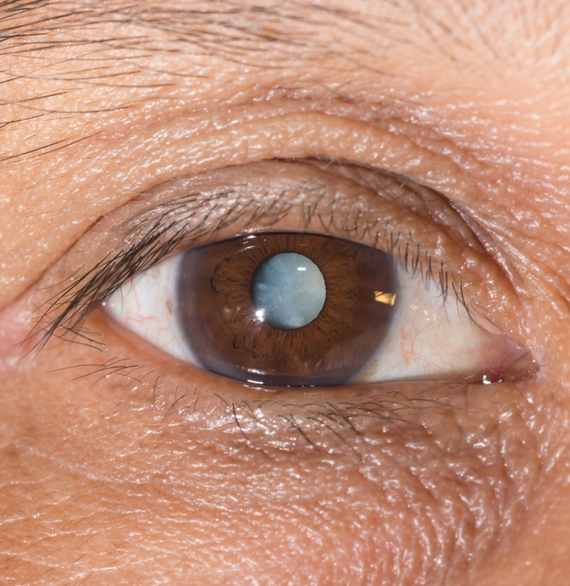
Cataracts
Cataracts occur as a result of changes in the lens. Cataracts can appear in just one lens, or both at the same time.
The lens becomes less transparent, which leads to a decrease in vision. The eyes of a person with cataracts appear cloudy.
Cataracts are more common in older people, as the lenses tend to become more cloudy with age.
To treat cataracts, the affected lens is removed and replaced with a new, artificial lens.
Notes:
Photo credit: man with mature cataracts © ARZTSAMUI, Shutterstock.com 2018

