Slide 1
The Nervous System

Slide 2
Information
Asking Questions and Defining Problems
Developing and Using Models
Planning and Carrying Out Investigations
Constructing Explanations and Designing Solutions
Engaging in Argument from Evidence
Obtaining, Evaluating and Communicating Information
1. Patterns
2. Cause and Effect
3. Scale, Proportion, and Quantity
4. Systems and System Models
6. Structure and Function
7. Stability and Change

Slide 3
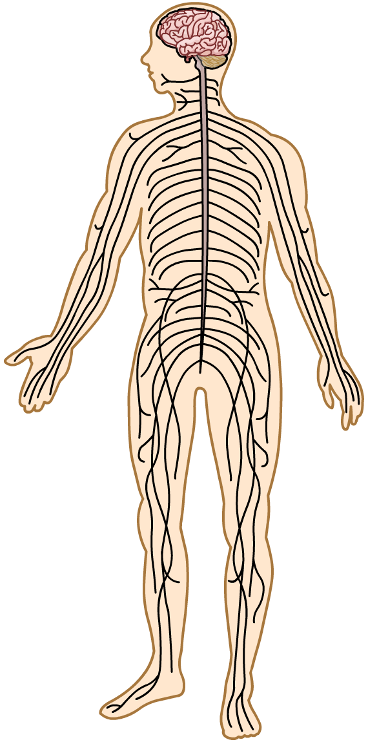
The nervous system
The nervous system is an organ system.
brain
Its job is to allow organisms to react to their surroundings and coordinate their behavior.
Most animals have a nervous system.
In humans and many other animals, the nervous system consists of a brain, spinal cord and nerves.
spinal cord
nerves

Slide 4
Hierarchy in the nervous system
As an organ system, the nervous system is made up of a hierarchy of parts.
Specialized cells in the nervous system work together in tissues to make up organs.
Cells: neurons
Tissues: nerve tissue
Organs: brain, spinal cord
Organ system: nervous system

Slide 5
The two parts of the nervous system
Notes:
Teacher notes
You may wish to have tape measures available for pupils to measure the distance from their spinal cord to the tips of their fingers and toes. You could also highlight the fact that sometimes one cell stretches all that distance.

Slide 6
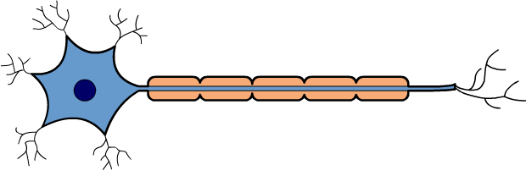
Electrical impulses
The nervous system works by transmitting electrical impulses around the body.
Neurons are specialized cells of the nervous system. They can generate electrical impulses and then carry them long distances around the body.
Electrical impulses travel very fast. This allows organisms to notice and respond to changes in their environment quickly.

Slide 7
What is the structure of a neuron?
Notes:
This slide covers the Science and Engineering Practice:
Developing and Using Models: Use a model to provide mechanistic accounts of phenomena.

Slide 8
Sensory, relay and motor neurons
Notes:
This slide covers the Science and Engineering Practice:
Developing and Using Models: Use a model to provide mechanistic accounts of phenomena.

Slide 9
Sensory receptors
Neurons work with sensory receptor cells, which identify changes in the environment, also known as stimuli.
Sensory receptors are specialized cells.
They are adapted to recognize different types of stimuli, such as light, sound, heat or pressure.
When a sensory receptor cell receives one of these stimuli, it transmits an electrical impulse to a sensory neuron.
rod receptor cell (eye)
cone receptor cell (eye)
Notes:
Teacher notes
Rod and cone receptor cells are both light receptor cells found in the eye.
For more information about the eye, please refer to The Eye presentation.

Slide 10
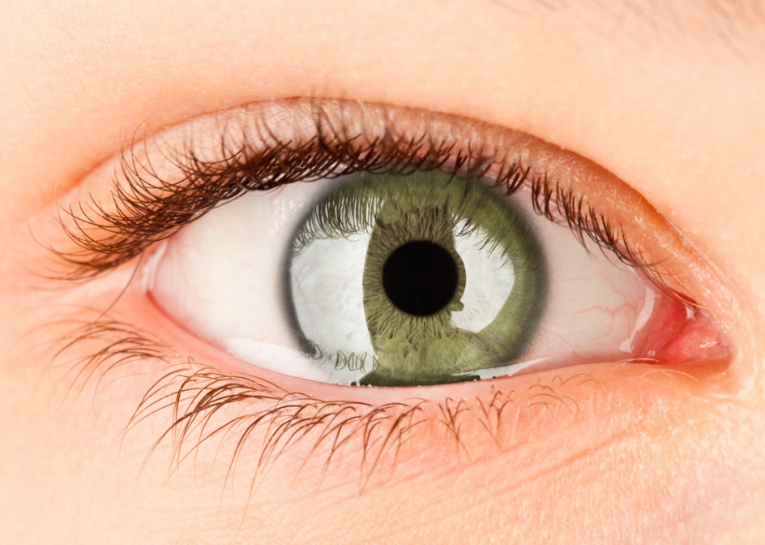
Sense organs
Sensory receptors are located in different areas of the body and concentrated in sense organs.
Receptor cells in the eyes respond to light.
Receptor cells in the ears respond to sound waves.
Receptor cells in the skin respond to heat and pressure.
Receptor cells in the nose and tongue respond to chemicals.
Notes:
Photo credit: © Andrey Armyagov, Shutterstock.com 2018

Slide 11
Coordinating a response (1)
The nervous system coordinates the body’s response to sensory information.
stimulus
After receiving an impulse from a sensory receptor, sensory neurons carry the signal to the central nervous system. This is the brain and spinal cord.
sensory receptor
The central nervous system uses motor neurons to send the signal to an appropriate effector.
coordinator
effector
Effectors carry out a response, such as muscle contraction or hormone secretion.
response

Slide 12
Coordinating a response (2)
Notes:
This slide covers the Science and Engineering Practice:
Constructing Explanations and Designing Solutions: Apply scientific ideas, principles, and/or evidence to provide an explanation of phenomena and solve design problems, taking into account possible unanticipated effects.

Slide 13
Recap: parts of the nervous system

Slide 14
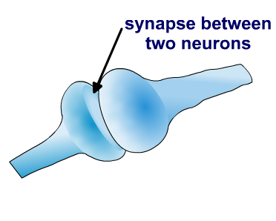
Connecting neurons
Electrical impulses pass between neurons. However, the end of one neuron does not connect directly with the next; instead, there are small gaps between them.
The junction between two neurons is called a synapse.
To cross the gap, when an electrical impulse reaches the end of the first neuron, it triggers the release of a chemical. This chemical is called a neurotransmitter.
The neurotransmitter diffuses across the gap and stimulates a new electrical impulse in the next neuron. This allows the nervous signal to be passed on.

Slide 15
Moving across a synapse
Notes:
Teacher notes
Synapses are found throughout the nervous system, between connecting sensory, relay and motor neurons.
The human brain contains over 100 trillion synapses.
This slide covers the Science and Engineering Practices:
Developing and Using Models: Use a model to provide mechanistic accounts of phenomena.
Constructing Explanations and Designing Solutions: Apply scientific ideas, principles, and/or evidence to provide an explanation of phenomena and solve design problems, taking into account possible unanticipated effects.

Slide 16
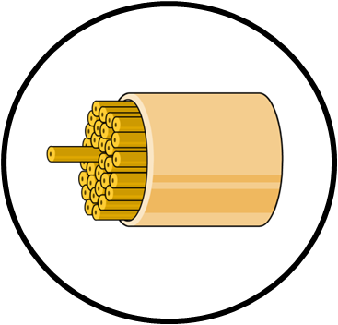
Nerves
A nerve is a bundle containing the axons of many neurons.
Each axon belongs to an individual neuron.
Nerves also contain cells that support and protect the axons.
nerve
Nerves allow electrical impulses to be safely carried long distances in the body.
axon
Notes:
Teacher notes
The longest nerve in the human body is the sciatic nerve, which runs from the base of the spinal cord to the big toe of each foot.

Slide 17
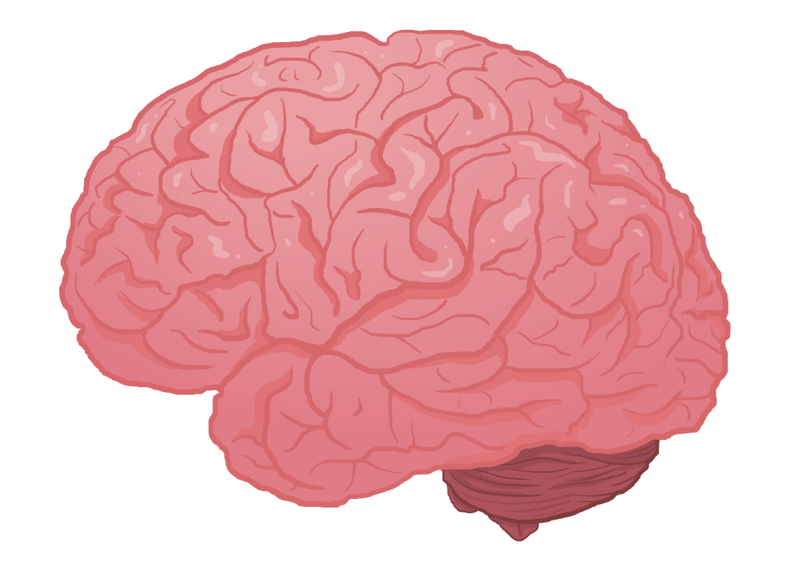
The brain
The brain is the main organ of the nervous system.
The brain is made of nervous tissue. It contains billions of interconnected neurons, as well as other specialized cells that support and protect the neurons.
Different parts of the brain carry out different functions.
These regions work together to process information from sensory neurons and control complex behavior.
Notes:
Teacher notes
The number of neurons in the human brain is estimated to be 86 billion.

Slide 18
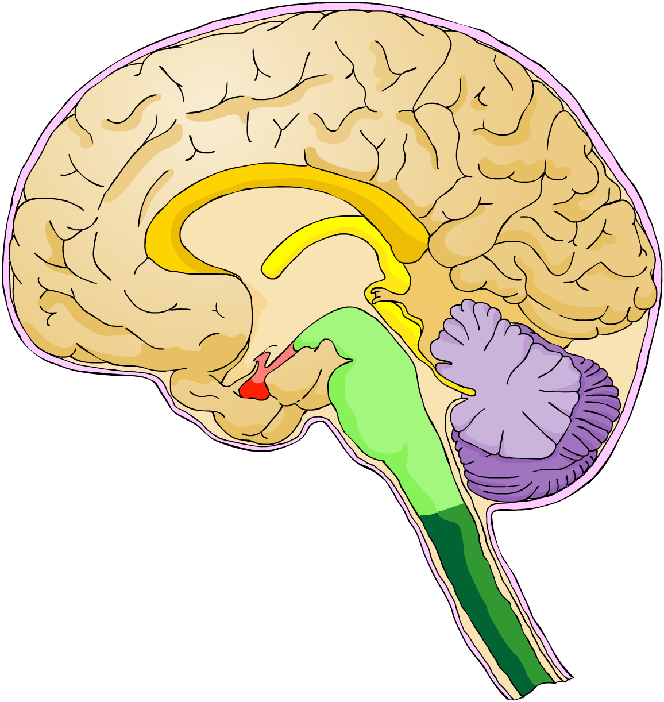
Parts of the brain
Can you name the parts of the brain labeled below?
hypothalamus
cerebral cortex
cerebrum
pituitary gland
cerebellum
medulla
Notes:
Teacher notes
Ask students to try and name the parts of the brain labeled, before revealing the answers.
The cerebral cortex is the outer layer of the cerebrum.

Slide 19
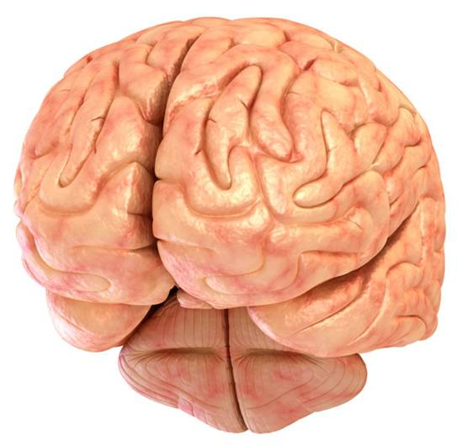
The cerebral cortex
The cerebral cortex is the outer layer of the cerebrum. It is the largest part of the brain.
The cerebrum is split into two cerebral hemispheres: the left hemisphere and the right hemisphere.
cerebral hemispheres
The cerebral cortex is responsible for memory, language, intelligence and consciousness.
Voluntary movement is an example of a conscious action coordinated by the cerebral cortex.
Notes:
Photo credit: © Alex Mit, Shutterstock.com 2018

Slide 20
The cerebellum
The cerebellum is located at the base of brain. It is the second largest part of the brain.
The main role of the cerebellum is to fine- tune voluntary muscle movement initiated by the cerebral cortex.
The cerebellum is also involved in controlling balance and posture.
cerebellum

Slide 21
The medulla
The medulla is located towards the bottom of the brainstem. It is also known as the medulla oblongata.
The brainstem is a
stem-like structure at the base of the brain.
brainstem
It connects the
cerebrum to the top of the spinal cord.
spinal cord
medulla
The medulla controls involuntary actions. These include the regulation of breathing rate and heart rate.

Slide 22
The hypothalamus and pituitary gland
The hypothalamus is a very small region of the brain located directly above the pituitary gland on the underside of the brain.
hypothalamus
The pituitary gland produces several different hormones.
These regulate bodily
functions including water
balance and fertility.
The release of the pituitary hormones into the blood is controlled by the hypothalamus.
pituitary gland
Notes:
Teacher notes
Hormones produced by the pituitary gland are secreted directly into the blood to be transported to the part of the body where they have an effect.
The pituitary hormone that controls water balance is antidiuretic hormone (ADH).
The pituitary hormones that control fertility are luteinizing hormone (LH) and follicle stimulating hormone (FSH).
For more information about hormones, please refer to The Endocrine System presentation.
For more information about the regulation of water balance, please refer to Excretion presentation.

Slide 23
Label the missing parts

Slide 24
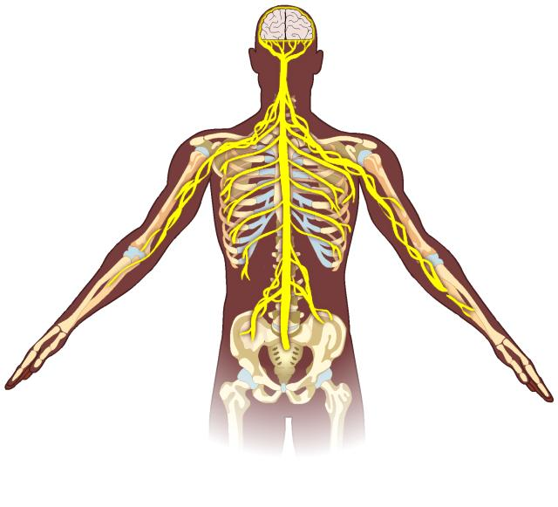
What is a reflex arc?
A reflex is a very fast, automatic response to a stimulus that does not involve direct coordination by the conscious part of the brain.
Instead, they are coordinated by reflex arcs.
A reflex arc consists of an electrical impulse being transmitted directly from a sensory neuron, via a relay neuron, to a motor neuron to stimulate a rapid response.

Slide 25
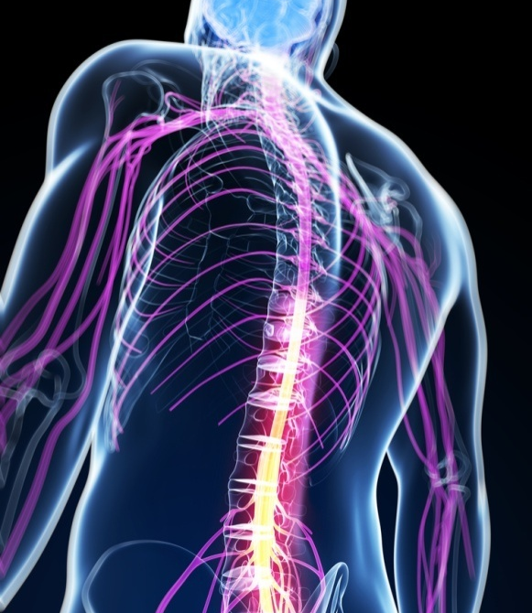
Why do reflexes matter?
Reflexes are very fast in bringing about a response. This is because when the electrical impulse reaches the CNS, it often only passes through the spinal cord, and not the brain.
If the reflex signal does not initially pass through the brain, a separate impulse can be sent from the spinal cord to the conscious part of the brain. This informs the brain that a reflex reaction has occurred.
Reflexes are important in helping protect the body from danger. For example, if you pick up something hot, you immediately drop it without thinking. This is a reflex reaction.
Notes:
Teacher notes
Some reflex arcs do involve the brain, for example the reflex response involved in blinking.
Photo credit: © Sebastian Kaulitzki, Shutterstock.com 2018

Slide 26
Reflexes in action
Notes:
Teacher notes
This five-stage sequence illustrates the electrical pathway of the knee-jerk reflex. Suitable prompts could include:
What are the cells that respond to stimuli called?
Where do sensory neurons take the message to?
What are the nerves in the spinal cord called, and what job do they do?
Which tissues will respond to the message that travels down the motor neuron?
Why isn't the brain consulted before the reflex action starts?
The knee-jerk reflex is actually much faster than most reflexes. The sensory neuron from the thigh muscle connects directly to the motor neuron that signals the thigh muscle to contract. A reflex neuron has been included in this model to help students understand reflex arcs involving relay neurons. During the knee-jerk reflex, a relay neuron signals the muscle on the other side of the leg to relax.
This slide covers the Science and Engineering Practices:
Developing and Using Models: Use a model to provide mechanistic accounts of phenomena.
Constructing Explanations and Designing Solutions: Apply scientific ideas, principles, and/or evidence to provide an explanation of phenomena and solve design problems, taking into account possible unanticipated effects.

Slide 27
The sequence of a reflex arc
Notes:
Teacher notes
This ordering activity could be used as an introductory or summary activity on reflex arcs. Mini-whiteboards could be used to make this a whole-class exercise.
This slide covers the Science and Engineering Practice:
Constructing Explanations and Designing Solutions: Apply scientific ideas, principles, and/or evidence to provide an explanation of phenomena and solve design problems, taking into account possible unanticipated effects.

Slide 28
Reaction times experiment
Notes:
This slide covers the Science and Engineering Practices:
Asking Questions and Defining Problems: Ask questions that can be investigated within the scope of the school laboratory, research facilities, or field (e.g., outdoor environment) with available resources and, when appropriate, frame a hypothesis based on a model or theory.
Planning and Carrying Out Investigations: Plan and conduct an investigation individually and collaboratively to produce data to serve as the basis for evidence, and in the design: decide on types, how much, and accuracy of data needed to produce reliable measurements and consider limitations on the precision of the data (e.g., number of trials, cost, risk, time), and refine the design accordingly.
Constructing Explanations and Designing Solutions: Make a quantitative and/or qualitative claim regarding the relationship between dependent and independent variables.

Slide 29
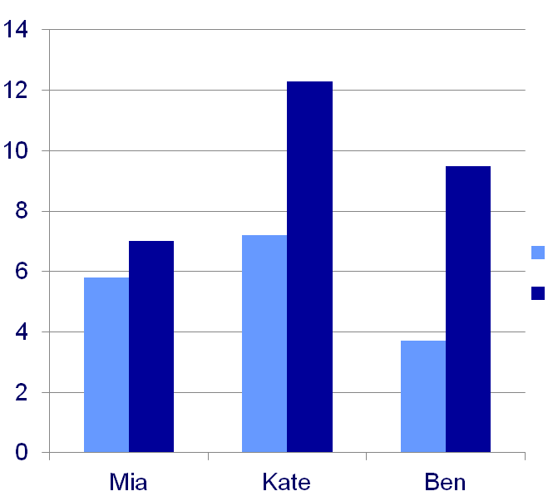
Interpreting reaction times
Reaction time is the time taken for a response to occur in reaction to a stimulus.
Here is a graphical representation of the results from Mia, Kate and Ben’s reaction time experiment.
distance traveled by ruler (cm)
no distraction
distraction
Which student was most affected by distraction?
name of student
Which student had the fastest reaction time?
Notes:
Teacher notes
Answers to questions:
Ben’s reaction time was most affected by distraction. The ruler traveled 5.8 cm further when he had to say the alphabet backwards.
Ben had the fastest reaction time when there was no distraction, as the ruler had traveled the shortest distance before he caught it.
Mia had the fastest reaction time when the students had to say the alphabet backwards at the same time. Distraction also had the least effect on Mia as her reaction time changed the least between the two experiments.
This slide covers the Science and Engineering Practices:
Constructing Explanations and Designing Solutions: Make a quantitative and/or qualitative claim regarding the relationship between dependent and independent variables.
Engaging in Argument from Evidence: Construct, use, and/or present an oral and written argument or counter-arguments based on data and evidence.
Obtaining, Evaluating, and Communicating Information: Communicate scientific and/or technical information or ideas (e.g. about phenomena and/or the process of development and the design and performance of a proposed process or system) in multiple formats (including orally, graphically, textually, and mathematically).

