Slide 1
Thermoregulation

Slide 2
Information
Developing and Using Models
Constructing Explanations and Designing Solutions
2. Cause and Effect
4. Systems and System Models
6. Structure and Function
7. Stability and Change

Slide 3
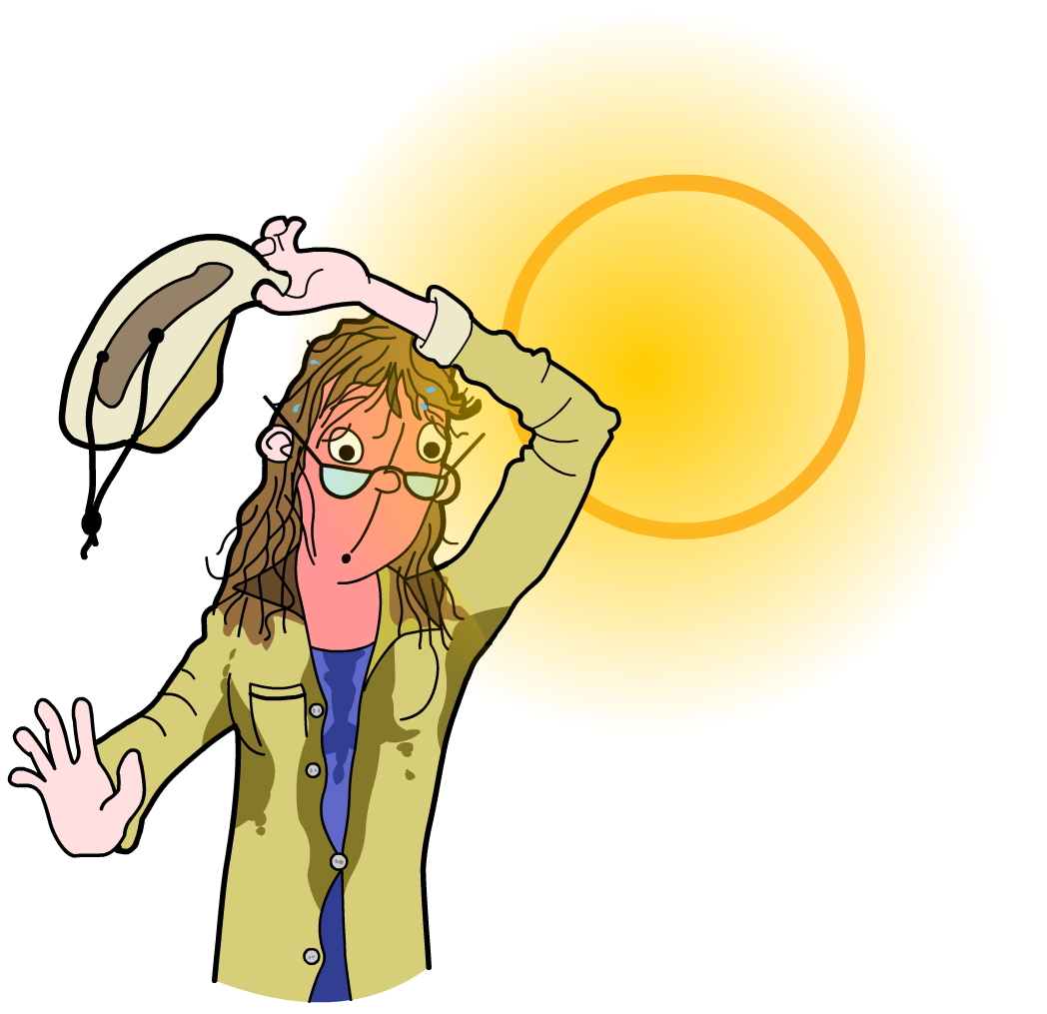
Why control temperature?
Environmental temperature is constantly changing. Despite this, the internal body temperature must be maintained at 37 °C.
Why is it important to keep body temperature constant?
This is the optimum temperature at which the body’s enzymes function.
Thermoregulation is the ability of an organism to regulate its internal body temperature.
It is an example of homeostasis.
Notes:
Teacher notes
Remind students that homeostasis is the process of maintaining a constant internal environment in the body.
For more information about homeostasis, please refer to the Homeostasis presentation.

Slide 4
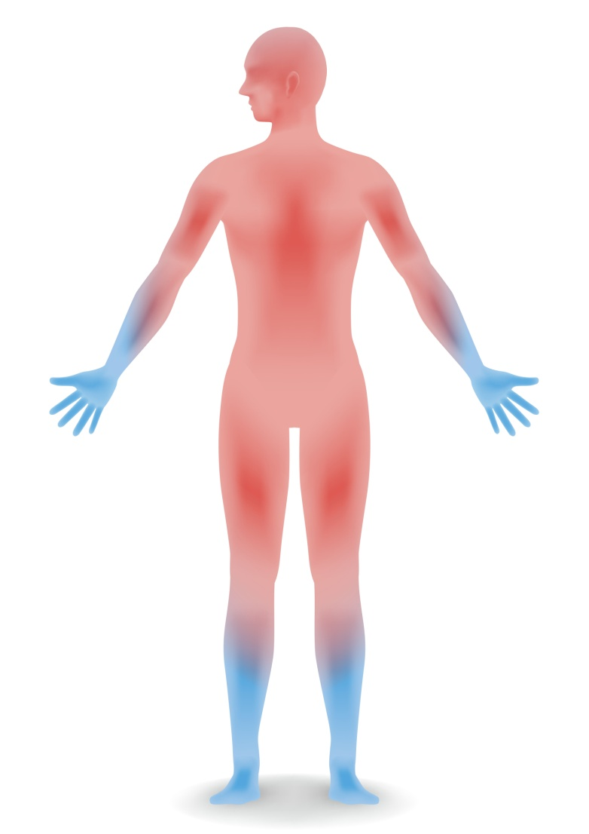
Core body temperature
Internal body temperature is maintained at a constant temperature. This is achieved by balancing heat gain and heat loss, through the process of negative feedback.
The vital organs located deep within the body, such as the heart, liver and kidneys, are maintained at 37 °C.
This is the core body temperature.
The temperature of the skin at the body's extremities, such as the fingers and toes, is usually lower than core body temperature.
Notes:
Teacher notes
Remind students that negative feedback is the process by which a change in the body's internal conditions results in a response that helps reverse the change. This enables conditions in the body to remain stable. Other aspects of the human body regulated by negative feedback include blood glucose levels and water balance.
For more information about negative feedback, please refer to the Homeostasis presentation.
On a warm day, skin temperature at the body’s extremities may be just 1 °C lower than the core body temperature, but on a very cold day it could be up to 9 °C lower.
Skin temperature is usually lower and more variable than core body temperature because the skin’s surface is in close contact with environmental conditions. Changes in air temperature can cause an increase or decrease in skin temperature without a change in core body temperature.
Photo credit: © chombosan, Shutterstock.com 2018

Slide 5
How is body temperature monitored?
Sensory receptors are specialized nerve cells that detect changes in conditions.
Body temperature is monitored by temperature receptors. These are a type of sensory receptor that can respond to changes in body temperature.
Temperature receptors are found in the skin and the brain.
Temperature receptors in the brain are sensitive to changes in blood temperature.
Temperature receptors in the skin respond to changes in skin temperature.

Slide 6
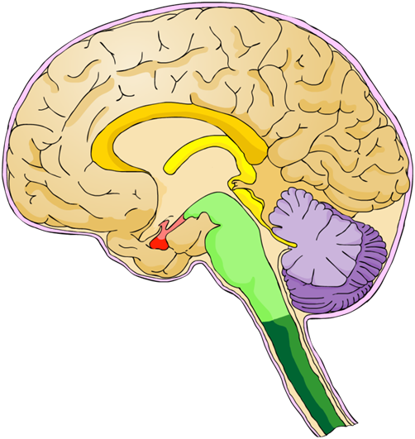
How is body temperature regulated?
Body temperature is regulated by the thermoregulatory center. This is located in an area of the brain called the hypothalamus.
If body temperature moves away from 37 °C, temperature receptors in the skin and the brain send nerve impulses to the thermoregulatory center.
These nervous signals cause
the thermoregulatory center to coordinate a response.
This leads to an increase or decrease in heat loss, which helps return body temperature to normal.
hypothalamus
Notes:
Teacher notes
Ask students if they can identify the location of the hypothalamus in the diagram of the brain before revealing the label.
For more information about the role of the hypothalamus, please the refer to The Nervous System presentation.

Slide 7
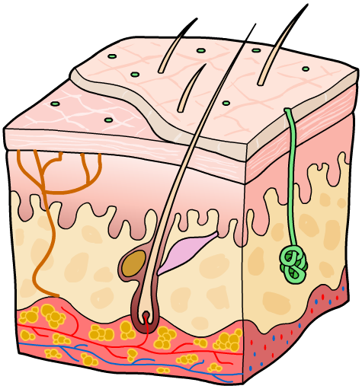
The skin (1)
The skin plays a vital role in thermoregulation, both detecting and carrying out responses to changes in body temperature.
The skin has two layers: the epidermis and the dermis.
The epidermis is a thin layer that forms the surface of the skin. Sweat is emptied onto it from sweat glands.
The dermis is the main skin layer. It is thicker than the epidermis layer.
epidermis
It contains blood vessels, the skin temperature receptors, sweat glands and the base of hairs.
dermis

Slide 8
The skin (2)
Can you identify the different parts of the skin labeled in the diagram below?
skin temperature receptor
epidermis
base of hair
dermis
blood vessel
sweat gland
Notes:
Teacher notes
Ask students to identify each part of the skin when the arrow appears before revealing the correct label.

Slide 9
Getting the balance right
Notes:
Teacher notes
This two-stage animation introduces the physiological and behavioral mechanisms of thermoregulation. You may wish to point out the behavioral responses to temperature change, such as using a fan to cool down or wearing additional clothes to warm up.
This slide covers the Science and Engineering Practice:
Constructing Explanations and Designing Solutions: Apply scientific ideas, principles, and/or evidence to provide an explanation of phenomena and solve design problems, taking into account possible unanticipated effects.

Slide 10
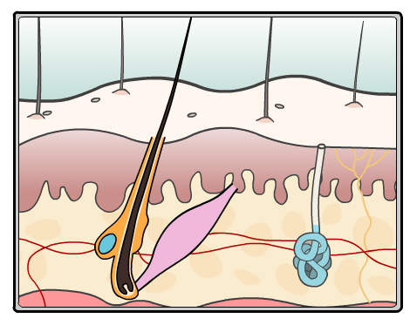
Vasoconstriction and warming up
Why do people go pale when they are cold?
When core body temperature falls, blood vessels in the skin get narrower. This is called vasoconstriction.
Vasoconstriction is caused by contraction of muscle found in the walls of blood vessels.
As a result, the volume of blood flowing near the skin’s surface is decreased. This reduces the amount of heat lost from the body.
blood vessels in the skin narrow due to vasoconstriction
Notes:
This slide covers the Science and Engineering Practice:
Constructing Explanations and Designing Solutions: Apply scientific ideas, principles, and/or evidence to provide an explanation of phenomena and solve design problems, taking into account possible unanticipated effects.

Slide 11
Movement of skin hairs
Hairs on the skin’s surface become upright in response to a decrease in body temperature.
The upright hairs trap an insulating layer of air next to the skin, which helps to reduce heat loss.
Each hair is moved by a muscle found at its base. When the muscle contracts, the hair becomes erect.
When body temperature is normal, the muscle relaxes. The hairs lie flat against the skin so no air can be trapped.
a muscle at the hair base contracts to make it stand up
Notes:
This slide covers the Science and Engineering Practice:
Constructing Explanations and Designing Solutions: Apply scientific ideas, principles, and/or evidence to provide an explanation of phenomena and solve design problems, taking into account possible unanticipated effects.

Slide 12
Shivering in response to cold
Cellular respiration in the muscle cells allows the skeletal muscles to contract.
As well as releasing energy for contraction, cellular respiration also generates heat. This means using your muscles can help keep you warm!
If core body temperature drops, the skeletal muscles begin to contract and relax rapidly, resulting in shivering.
The heat released by the muscles warms the surrounding tissues, leading to an increase in body temperature.
Notes:
Teacher notes
Cellular respiration releases heat as it is an exothermic chemical reaction.

Slide 13
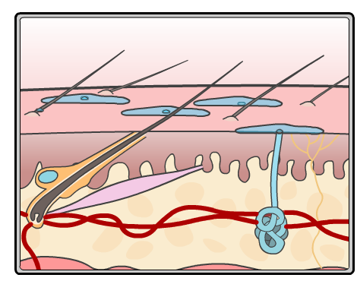
Vasodilation and cooling down
Why do people turn red when they are hot?
When core body temperature rises, blood vessels in the skin get wider. This is called vasodilation.
Vasodilation is caused by the relaxation of muscle found in the walls of blood vessels. This allows a larger volume of blood to flow near the skin’s surface.
This increases the transfer of heat from the body to the environment, cooling the body down.
blood vessels in the skin widen due to vasodilation
Notes:
This slide covers the Science and Engineering Practice:
Constructing Explanations and Designing Solutions: Apply scientific ideas, principles, and/or evidence to provide an explanation of phenomena and solve design problems, taking into account possible unanticipated effects.

Slide 14
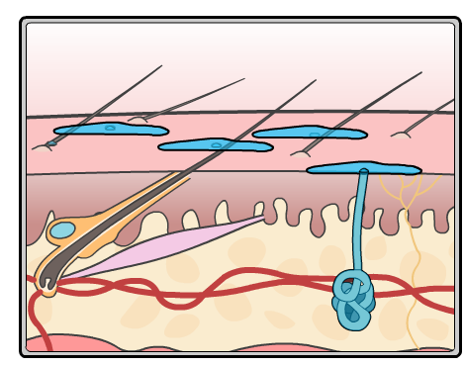
Sweating in response to heat
An increase in body temperature leads to the production of sweat from the sweat glands. A duct transports the sweat from the sweat gland onto the skin’s surface.
As sweat evaporates, it transfers heat from the body to the environment.
This provides a cooling effect, which reduces body temperature.
Sweating is the only way to lose heat if air temperature is higher than body temperature.
sweat glands produce sweat which is emptied out onto the skin’s surface
Notes:
Teacher notes
Other methods of heat loss rely on a temperature gradient between the body and the air. If air temperature is higher than body temperature then the gradient favors heat uptake.
This slide covers the Science and Engineering Practice:
Constructing Explanations and Designing Solutions: Apply scientific ideas, principles, and/or evidence to provide an explanation of phenomena and solve design problems, taking into account possible unanticipated effects.

Slide 15
Maintaining core body temperature

Slide 16
Temperature and negative feedback
Notes:
Teacher notes
This five-stage animation can be used to illustrate how the body uses the principle of negative feedback to control body temperature. Students could be asked if they know of other examples of processes in the body that involve negative feedback. For example, regulating blood glucose levels and water balance.
This slide covers the Science and Engineering Practice:
Developing and Using Models: Develop, revise, and/or use a model based on evidence to illustrate and/or predict the relationships between systems or between components of a system.

Slide 17
The skin and temperature change
Notes:
Teacher notes
This activity could be used to introduce the response of the skin to changes in temperature.
This slide covers the Science and Engineering Practice:
Developing and Using Models: Develop, revise, and/or use a model based on evidence to illustrate and/or predict the relationships between systems or between components of a system.

Slide 18
Thermoregulation: true or false?
Notes:
Teacher notes
This true-or-false activity could be used as a plenary or revision exercise on thermoregulation. Colored traffic light cards (red = false, yellow = don’t know, green = true) could be used to make this a whole-class exercise.

