Slide 1
Transport in Plants

Slide 2
Information
Planning and Carrying Out Investigations
Analyzing and Interpreting Data
Using Mathematics and Computational Thinking
Constructing Explanations and Designing Solutions
Obtaining, Evaluating and Communicating Information
2. Cause and Effect
3. Scale, Proportion, and Quantity
4. Systems and System Models
6. Structure and Function
7. Stability and Change

Slide 3
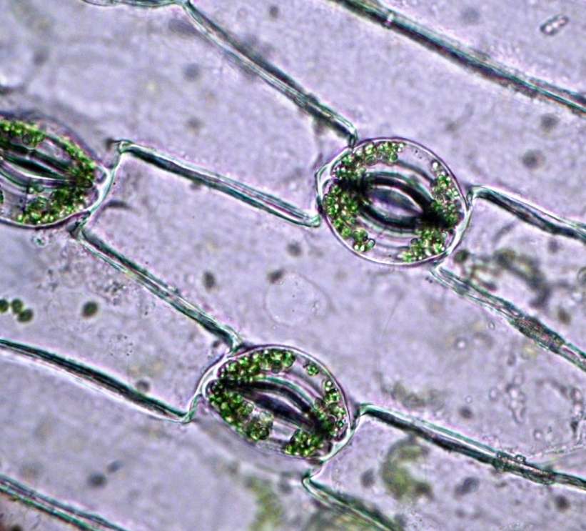
Gas exchange in plants
During photosynthesis, plants use carbon dioxide and produce oxygen.
stoma
These gases move in and out of the leaves of plants by diffusion through small pores on the underside of leaves called stomata.
The singular of stomata is stoma.
The gases for cellular respiration also enter and leave through the stomata.
Notes:
Teacher notes
Remind students that cellular respiration uses oxygen and produces carbon dioxide – the opposite of photosynthesis.
Ask students if they can recall the reactions for photosynthesis and cellular respiration.
The overall movement of oxygen and carbon dioxide depends on the relative rates of these two reactions.
For more information on diffusion, please refer to the Cell Transport presentation.
Photo credit: © Dimarion, Shutterstock,com 2018

Slide 4
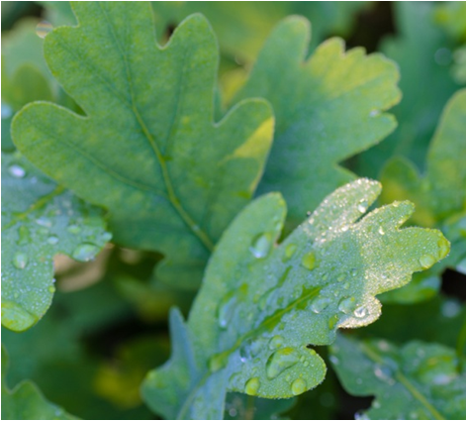
Movement of carbon dioxide and oxygen
Both carbon dioxide and oxygen move in and out of plants via open stomata.
Carbon dioxide diffuses through stomata into leaves. It then diffuses into plant cells, to be used for photosynthesis.
When the rate of photosynthesis is higher than the rate of cellular respiration, oxygen diffuses from plant cells, out of stomata and into the air.
When the rate of cellular respiration is higher than that of photosynthesis, oxygen diffuses into the plant and carbon dioxide diffuses out. This occurs at night, when photosynthesis is unable to occur.
Notes:
Teacher notes
The rate of cellular respiration is higher than the rate of photosynthesis at night because photosynthesis can only occur when a source of light energy (the sun) is available. Photosynthesis occurs during the day, whereas cellular respiration occurs continuously – night and day.
When photosynthesis is occurring during the day, the oxygen produced as a waste product of the photosynthesis reaction can be used by cells to carry out cellular respiration. If the rate of photosynthesis is higher then the rate of cellular respiration, then the excess oxygen produced diffuses out of the stomata, into the air.
Photo credit: © Aga7ta, Shutterstock.com 2018

Slide 5
Water loss via stomata
Water inside the leaves can evaporate to form water vapor. Water vapor is a gas.
The water vapor can leave the plant by diffusing out of stomata into the air.
If more water leaves the plant through the stomata than is being taken up by the roots, the plant will become water deficient and begin to wilt.
How do plants control water loss via their stomata?
Notes:
Teacher notes
Plants can control water loss via their stomata by closing them if there is a shortage of water, for example, during a drought.
Photo credit: © Maria-Zamuriy, Shutterstock.com 2018

Slide 6
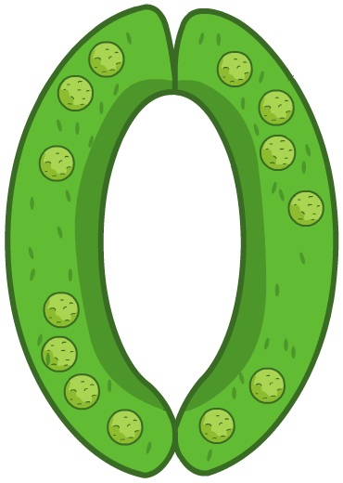
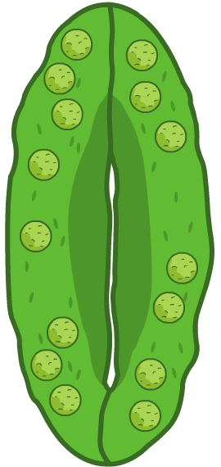
Controlling the stomata
Each stoma is surrounded by two guard cells which control whether the stoma is open or closed. The guard cells control the movement of carbon dioxide, oxygen and water vapor in and out of plants.
When guard cells gain water, they curve outwards. This opens the stoma, allowing gases to diffuse in and out.
If guard cells lose water, they come closer together, closing the stoma. While this stops the movement of carbon dioxide and oxygen, it also prevents water loss.

Slide 7
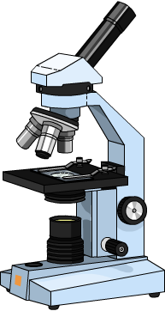
Observing stomata
A light microscope can be used to observe the stomata.
Apply a strip of clear nail polish to the underside of a leaf.
Once dry, peel the nail polish strip off.
Lie the nail polish strip on a microscope slide, and place a cover slip over the top.
Examine the nail polish for impressions of the stomata under a light microscope. Count the number of stomata you can see.
How would you expect the number of stomata on the top and underside of a leaf to compare?
Notes:
Teacher notes
Help students to suggest that stomata are located on the underside of leaves to reduce exposure to sunlight and winds, which increase the rate at which water vapor is lost.
The suggested practical could also be carried out using leaves from different types of plants to see how the distribution of stomata vary.
This slide covers the Science and Engineering Practices:
Constructing Explanations and Designing Solutions: Apply scientific ideas, principles, and/or evidence to provide an explanation of phenomena and solve design problems, taking into account possible unanticipated effects.
Obtaining, Evaluating, and Communicating Information: Communicate scientific and/or technical information or ideas (e.g. about phenomena and/or the process of development and the design and performance of a proposed process or system) in multiple formats (including orally, graphically, textually, and mathematically).

Slide 8
Gas exchange in plants
Notes:
Teacher notes
This completing sentences activity could be used as an introductory or summary activity on gas exchange in plants.
This slide covers the Science and Engineering Practice:
Constructing Explanations and Designing Solutions: Apply scientific ideas, principles, and/or evidence to provide an explanation of phenomena and solve design problems, taking into account possible unanticipated effects.

Slide 9
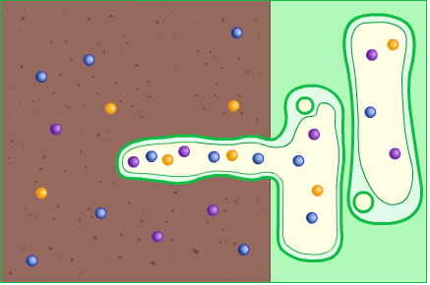
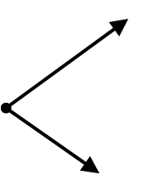
Roots
Roots are adapted to take up water and mineral ions from the soil.
soil
root hair cell
mineral ions and water molecules
Roots are long and thin, and divide into many branches. This forms a root network, covering a large area of soil.
Roots are covered in root hair cells. These have specialized projections that reach out between soil particles, increasing the surface area for absorption.
Notes:
Teacher notes
For more information on root hair cells, please refer to the Plant Tissues and Organs presentation.

Slide 10
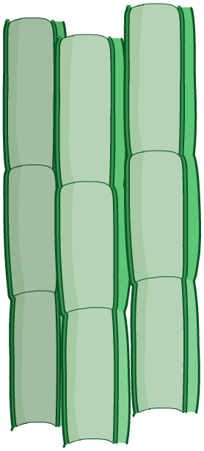
Xylem tissue
Once absorbed into the roots, water and mineral ions enter the xylem tissue to be transported to the stems and leaves.
Xylem tissue is made of dead xylem cells. These are a type of specialized plant cell, structurally adapted to transport water and mineral ions.
Their cell walls contain a substance called lignin. This strengthens and waterproofs the cells.
Xylem cells are long and hollow. Many xylem cells join end to end, forming a continuous tube that can transport water and mineral ions long distances in the plant.
a single xylem cell
Notes:
Teacher notes
For more information of cell specialization, please refer to the Specialized Cells presentation.

Slide 11
Identifying the xylem
Notes:
Teacher notes
This two-stage animation illustrates how celery can be used to demonstrate the movement of water up a plant stem, specifically the xylem. The animation could be viewed before running a similar practical in the lab.
In this demonstration, it should be emphasized that the colored water acts as a reservoir of water and is area of higher water concentration compared to the stem and air. This means water is drawn up the stem by osmosis. It should be highlighted that food coloring is used and not ink. This is because ink contains a mixture of compounds, which may diffuse up the stem at different rates. White flowers, such as carnations, could also be used to demonstrate that water travels up the plant stem.
The vascular bundles in celery can be compared with other stems, such as the stem of broccoli, where the vascular tissue is found in one large ring near the outer edge of the stem.
The flow rate can be calculated by calculating the average rate of water rise using different stems from the same plant species (in cm per minute).
This slide covers the Science and Engineering Practice:
Planning and Carrying Out Investigations: Plan and conduct an investigation individually and collaboratively to produce data to serve as the basis for evidence, and in the design: decide on types, how much, and accuracy of data needed to produce reliable measurements and consider limitations on the precision of the data (e.g., number of trials, cost, risk, time), and refine the design accordingly.

Slide 12
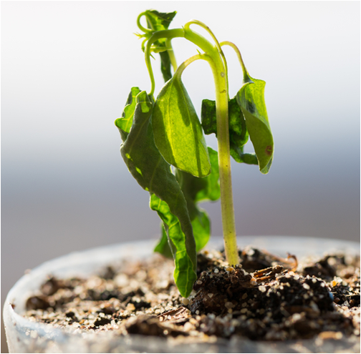
What is the transpiration stream?
The transpiration stream describes the movement of water in the xylem tissues, from the roots to the leaves.
Once water reaches the leaves, it can diffuse through open stomata and into the air as water vapor. As a result, transpiration is a major route of water loss in plants.
The loss of water from the leaves causes more water to be taken up by the roots.
If the roots cannot absorb enough water to meet demand, the guard cells close the stomata to try to prevent wilting.
Notes:
Photo credit: © OhEngine, Shutterstock.com 2018

Slide 13
What affects the rate of transpiration?
The rate of transpiration, and therefore water uptake by plants, varies in response to environmental factors including:
humidity – the amount of water vapor in the air
temperature – the heat in the environment
light intensity – the amount of energy carried by light
air movement – the amount of wind.
In hot, dry and windy conditions, evaporation of water from plant leaves occurs faster. This increases the rate of transpiration, and therefore the rate of water uptake by the plant.

Slide 14
The environment and transpiration
Notes:
Teacher notes
This activity provides illustrated explanations about why certain environmental factors influence the rate of transpiration. It could be used to introduce the topic or for as a summary.

Slide 15
Measuring transpiration
“This [animation/activity] covers a required [biology/chemistry/physics] practical in [AQA, Edexcel, OCR Gateway and OCR 21st Century].”
Notes:
Teacher notes
Transpiration can be measured using a potometer. A cut plant stem is sealed into the potometer using a rubber bung. An air bubble is introduced to the capillary tube. The distance the bubble travels shows how much water the stem has taken up. This gives an indirect measurement of the rate of transpiration.
Students could be asked to explain:
why the shoot should be cut underwater (to prevent air bubbles from entering the stem)
the purpose of placing the water tank between the lamp and the shoot when investigating the effect of light (to absorb the heat from the lamp, which would confound the results).
This slide covers the Science and Engineering Practices:
Planning and Carrying Out Investigations: Plan and conduct an investigation individually and collaboratively to produce data to serve as the basis for evidence, and in the design: decide on types, how much, and accuracy of data needed to produce reliable measurements and consider limitations on the precision of the data (e.g., number of trials, cost, risk, time), and refine the design accordingly.
Planning and Carrying Out Investigations: Select appropriate tools to collect, record, analyze, and evaluate data.
Using Mathematics and Computational Thinking: Use mathematical, computational, and/or algorithmic representations of phenomena or design solutions to describe and/or support claims and/or explanations.
Constructing Explanations and Designing Solutions: Make a quantitative and/or qualitative claim regarding the relationship between dependent and independent variables.

Slide 16
Calculating the rate of transpiration
The rate of transpiration relates to the amount of water lost by a plant over a given period of time.
This can be measured using a potometer. The further the bubble inside the potometer moves, the greater the rate of transpiration. This can be calculated using the equation:
rate of transpiration (mm/min)
distance moved by bubble (mm)
=
time (min)
Plant A’s bubble moved 50 mm in 10 minutes; plant B’s bubble moved 60 mm in 18 minutes. Which had the greater rate of transpiration?
Notes:
Teacher notes
Plant A: 50 mm ÷ 10 min = 5 mm/min
Rate of transpiration in Plant A is 5 mm/min
Plant B: 60 mm ÷ 6 min = 3 mm/min
Rate of transpiration in Plant B is 3 mm/min
Plant A has a higher rate of transpiration than plant B. This means that water vapor is being lost at a greater rate in plant A.
This slide covers the Science and Engineering Practices:
Analyzing and Interpreting Data: Analyze data using tools, technologies, and/or models (e.g., computational, mathematical) in order to make valid and reliable scientific claims or determine an optimal design solution.
Using Mathematics and Computational Thinking: Apply ratios, rates, percentages, and unit conversions in the context of complicated measurement problems involving quantities with derived or compound units (such as mg/mL, kg/m3, acre-feet, etc.).

Slide 17
Transpiration – true or false?
Notes:
Teacher notes
This true-or-false activity about transpiration could be used as an introductory or summary activity on transpiration, or at the start of a lesson to gauge students’ existing knowledge.

Slide 18
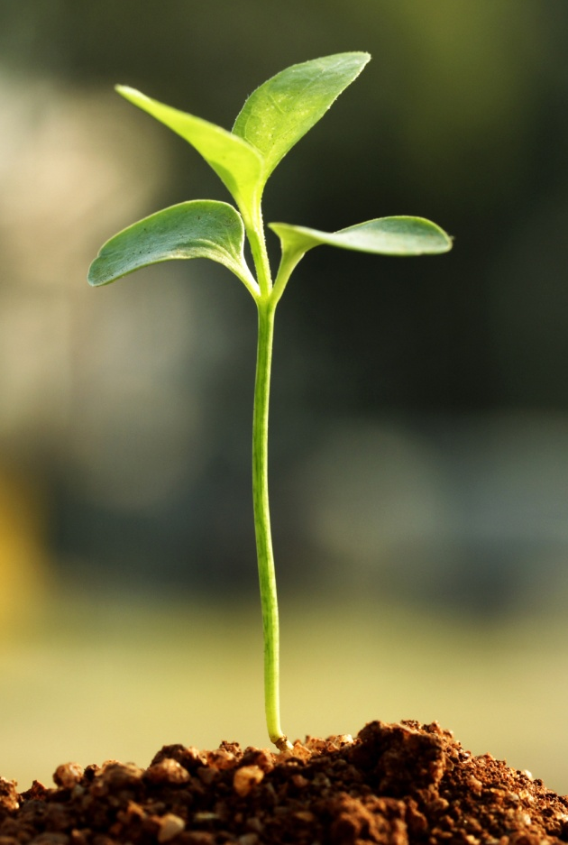
Phloem tissue
Phloem tissue is made of specialized phloem cells. It transports dissolved sugars, produced in the leaves by photosynthesis, up and down the stem to the rest of the plant.
Sucrose is the most common type of sugar transported inside the phloem tissue.
The liquid inside phloem tissue, containing sucrose, is called cell sap.
Sucrose is a source of food for plants. When plant cells receive sucrose, they can use it immediately for cellular respiration and growth. Alternatively, it can be stored for use in the future.
Notes:
Teacher notes
Sugars can be stored in plants as starch, fats or oils.
For more information on cell specialization, please refer to the Specialized Cells presentation.
Photo credit: © infocus, Shutterstock.com 2018

Slide 19
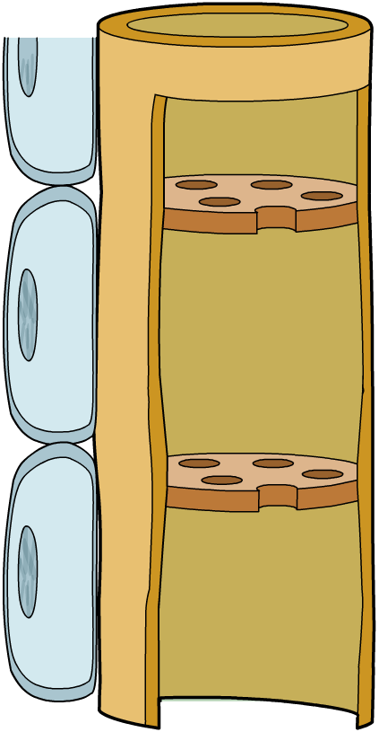
Phloem cells (1)
Phloem tissue is made of two types of specialized cells that are structurally adapted for transport. Unlike xylem cells, both these cells are living.
Sieve tube cells are elongated cells found in phloem tissue.
They are responsible for moving
sucrose around the plant, joining
together to form long vessels.
a single sieve tube cell
Their end walls contain lots of small holes to enable the cell sap to pass continuously from one cell to the next. These are called sieve plates.
sieve plate

Slide 20
Phloem cells (2)
Companion cells are located next to the sieve tube cells.
Their role is to load and unload sucrose to and from the sieve tube cells.
companion cell
Companion cells also provide energy to the sieve tube cells.
a single sieve tube cell
This is necessary because sieve tube cells are unable to carry out cellular respiration themselves.
sieve plate
Without companion cells, sieve tube cells would die.
Notes:
Teacher notes
Companion cells regulate how much sucrose is being transported by the sieve tube cells.
Ask students how the xylem and phloem tissues compare.
Unlike xylem cells, phloem cells are living.
Both tissues are made of many cells joined together to form long continuous vessels.
Xylem tissue only transports substance up the plant, phloem tissue transports substances up and down the plant.

Slide 21
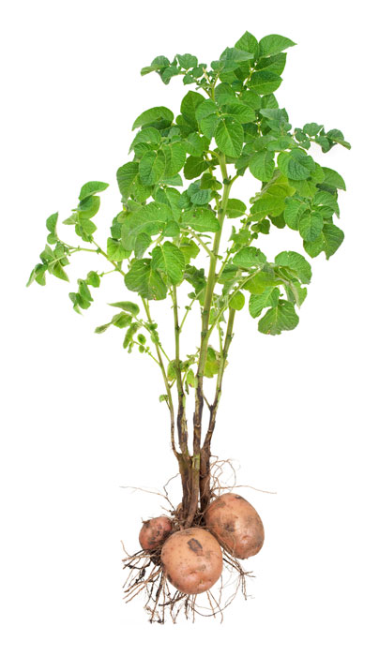
Transporting sugars
The transport of sugars through the phloem tissue is called translocation.
Translocation occurs between regions of the plant where sugars are made (e.g. the leaves) and regions of the plant where sugars are used or stored (e.g. growing tissues or storage organs).
Translocation happens due to pressure created in the phloem tissue.
When the sugars are loaded into the phloem they increase the pressure at that end. As a result, the cell sap in the rest of tube is pushed along, moving it around the plant.
Notes:
Teacher notes
Sucrose is loaded into the phloem tissue by active transport.
Plant storage organs include bulbs and tubers (such as potatoes).
Photo credit: © SeDmi, Shutterstock.com 2018

Slide 22
Transport in the xylem and phloem tissues

