Slide 1
Vaccination and Medication

Slide 2
Information
Constructing Explanations and Designing Solutions
Obtaining, Evaluating and Communicating Information
2. Cause and Effect
3. Scale, Proportion, and Quantity
4. Systems and System Models
6. Structure and Function

Slide 3
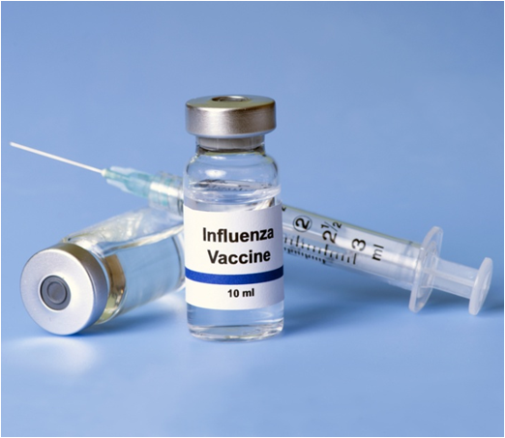
What is vaccination?
Vaccination is a method used to prevent people from getting a particular illness.
Following vaccination, a person is immune from the particular disease that they have been vaccinated against.
As a result, vaccinations prevent the spread of certain diseases throughout a population.
However, for a particular vaccination program to be effective in reducing the spread of a disease, a large
proportion of the population must
be vaccinated.
This is called herd immunity.
Notes:
Photo credit: © Sherry Yates Young, Shutterstock.com 2018

Slide 4
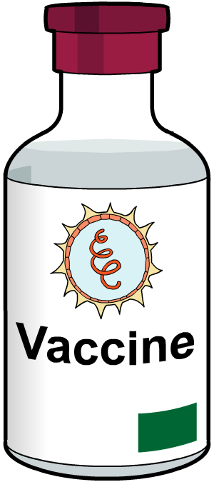
How do vaccines prevent disease?
A vaccine contains a small quantity of a dead or inactive form of a pathogen. In this form, a pathogen is harmless.
When the pathogenic material is introduced to the body, it stimulates white blood cells to produce antibodies.
The antibodies act against the pathogen, without making the person who has been vaccinated feel ill.
Remember, the antibodies produced are only effective against the specific type of pathogen in the vaccine.
Notes:
Teacher notes
An antibody is a special protein produced by some types of white blood cell.
A specific type of antibody is produced in response to a particular pathogen.
Antibodies enable pathogens to be destroyed by the body’s immune system.
For more information about white blood cells and their role in fighting disease, please refer to The Body’s Defense Systems presentation.

Slide 5
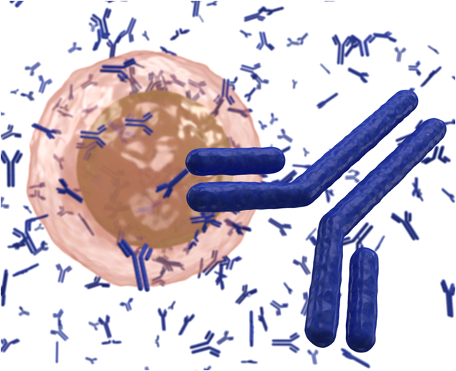
Long-term outcome of vaccination
A vaccination protects a person against being infected by a particular disease in the future.
This is because if a vaccinated person is later infected by the same pathogen, their immune system recognizes the pathogen very quickly.
The white blood cells are able to produce the correct antibodies faster after infection compared to a person that has not had the vaccination.
As a result, the person is less likely to become ill.
Notes:
Teacher notes
For more information on white blood cells and antibodies, please refer to The Body’s Defense Systems presentation.
Photo credit: white blood cell producing antibodies © extender_01, Shutterstock.com 2018

Slide 6
How do vaccines work?
Notes:
This slide covers the Science and Engineering Practice:
Constructing Explanations and Designing Solutions: Apply scientific ideas, principles, and/or evidence to provide an explanation of phenomena and solve design problems, taking into account possible unanticipated effects.

Slide 7
Missing words: immunization
Notes:
Teacher notes
The completed text should read:
When a person is infected by a pathogen, their white blood cells take a few days to learn how to fight it.
To avoid illness, a person can be vaccinated.
This involves injecting the person with dead or inactive pathogens. The white blood cells detect the pathogenic material and learn to produce the right antibodies.
If the person is infected again with the same pathogen, their white blood cells can produce antibodies a lot more quickly and the person does not get ill.
This slide covers the Science and Engineering Practice:
Constructing Explanations and Designing Solutions: Apply scientific ideas, principles, and/or evidence to provide an explanation of phenomena and solve design problems, taking into account possible unanticipated effects.

Slide 8
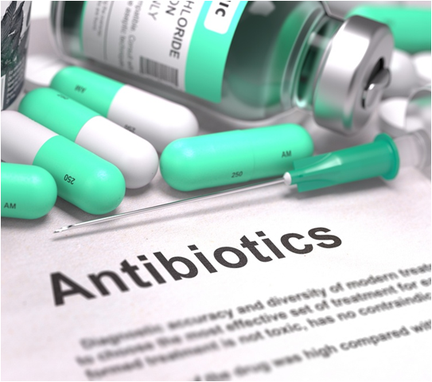
What are antibiotics?
When bacteria infect the body, they multiply and make toxins which make the person feel ill.
Antibiotics, such as penicillin, are powerful medicines that are used to treat diseases caused by bacterial infection. They work by killing bacteria or preventing them from growing and reproducing inside the body.
There are many different types
of antibiotic. Not all antibiotics can
be used to kill the same bacteria.
As a result, bacterial infections
must be treated using an antibiotic
specific to that particular type
of bacteria.
Notes:
Photo credit: © Tashatuvango, Shutterstock.com 2018

Slide 9
When are antibiotics not useful?
Antibiotics cannot be used to destroy viruses, as viruses replicate inside human cells.
Antibiotics work by inhibiting cell processes in the bacteria but not the host organism. Antibiotics are unable to reach the virus inside the cell it has infected in order to kill it.
Alison has had the flu for a few days.
She goes to the doctor and asks for antibiotics to help her get better.
If you were Alison’s doctor, what would you say?
Notes:
Teacher notes
Help students to describe that flu is caused by a virus, so antibiotics would not help cure it. It would be better for Alison to rest and let her immune system deal with the infection. Medicines such as painkillers, decongestants and sore throat treatments might help her to cope with the symptoms, but they will not get rid of the virus.
This slide covers the Science and Engineering Practices:
Constructing Explanations and Designing Solutions: Apply scientific ideas, principles, and/or evidence to provide an explanation of phenomena and solve design problems, taking into account possible unanticipated effects.
Obtaining, Evaluating, and Communicating Information: Communicate scientific and/or technical information or ideas (e.g. about phenomena and/or the process of development and the design and performance of a proposed process or system) in multiple formats (including orally, graphically, textually, and mathematically).
Photo credit: © beerkoff, Shutterstock.com 2018

Slide 10
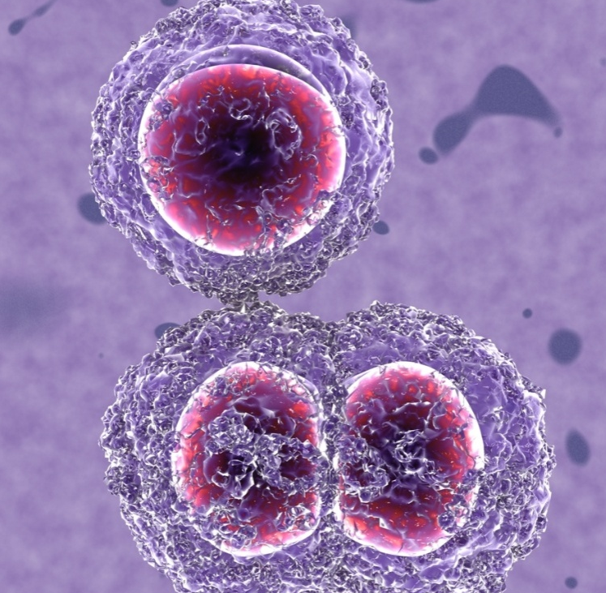
Antibiotic resistance
Some strains of bacteria have mutated to develop resistance to antibiotics that are normally able to kill them.
Antibiotic-resistant bacteria cause problems. If a person becomes infected by the bacteria, the antibiotic normally used will be much less effective and may not work at all.
Bacteria resistant to several antibiotics are called “superbugs” and are the most dangerous.
Antibiotic-resistant bacteria are a huge concern in modern medicine, as new antibiotics are needed to combat resistant strains.
Notes:
Teacher notes
Infections caused by antibiotic-resistant bacteria are very difficult to treat, especially in patients with weakened immune systems. This is because the range of drugs that can kill the bacteria is so limited. Resistant strains may spread quickly through the population if there is no effective treatment.
MRSA is one type of antibiotic-resistant bacteria.
Patients with MRSA are usually put in isolation to stop the resistant bacteria spreading whilst treatment is carried out.
For more information on antibiotic resistance, please refer to the Resistant Bacteria presentation.
Photo credit: MRSA bacteria © MichaelTaylor, Shutterstock.com 2018

Slide 11
How antibiotic-resistant bacteria develop
Notes:
This slide covers the Science and Engineering Practice:
Constructing Explanations and Designing Solutions: Apply scientific ideas, principles, and/or evidence to provide an explanation of phenomena and solve design problems, taking into account possible unanticipated effects.

Slide 12
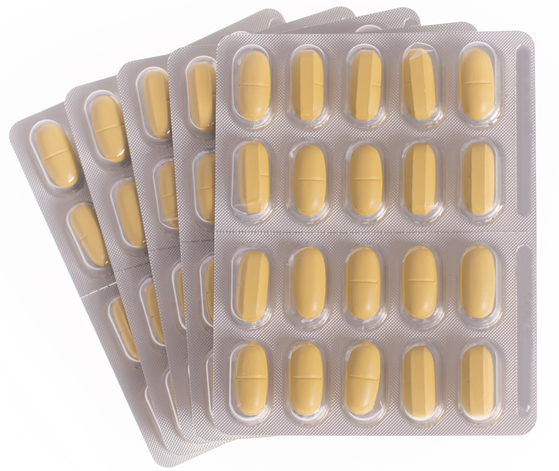
Preventing antibiotic resistance
It is important only to take antibiotics if your body is unable to fight an infection by itself. Often, antibiotics might not be prescribed at all for mild infections.
The strongest antibiotics should be reserved only for the most serious infections, in order to try to prevent resistance to the antibiotic occurring.
If you are prescribed antibiotics, but do not finish the course of treatment, there is a risk that any remaining antibiotic-resistant bacteria will survive and multiply.
Notes:
Photo credit: © Zyuzev, Shutterstock.com 2018

Slide 13
True or false?
Notes:
Teacher notes
The reasons for each answer are as follows:
This is false, as there are not many drugs that are able to treat antibiotic-resistant bacteria, but researchers are currently looking to develop new antibiotics.
This is false, antibiotics cannot reach pathogens inside cells. This is one reason they cannot kill viruses.
This is false, antibiotics are only used to treat bacterial infections.
This is true, different antibiotics are used to treat different types of bacterial infection.
This is false, superbugs are strains of antibiotic-resistant bacteria that are resistant to several types of antibiotic.

Slide 14
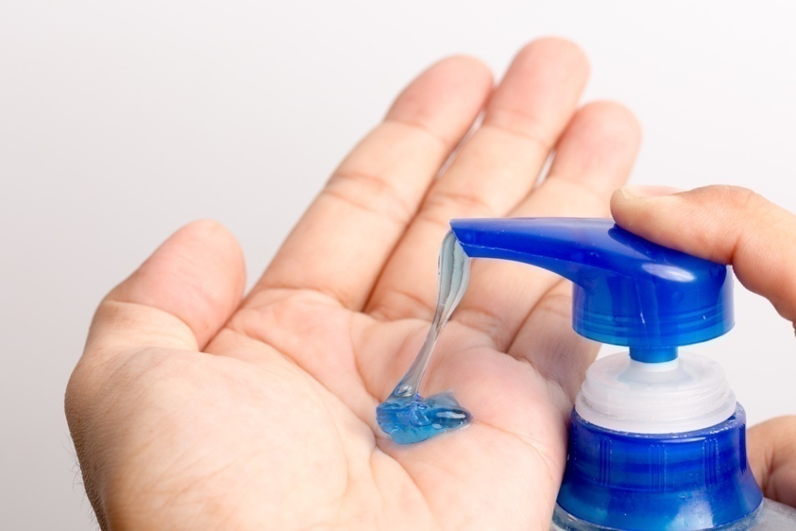
Antiseptics
Antiseptics contain chemicals that are able to kill bacteria outside the body.
Antiseptics are used to kill bacteria on the skin’s surface. They are used to clean wounds, wash hands and, when preparing patients for medical procedures, such as surgery, to prevent bacteria entering the body.
Like antibiotics, antiseptics help to stop the spread of bacterial infection.
However, antiseptics cannot be used to destroy bacteria inside infected individuals.
Notes:
Photo credit: © Mac Nishimura, Shutterstock.com 2018

Slide 15
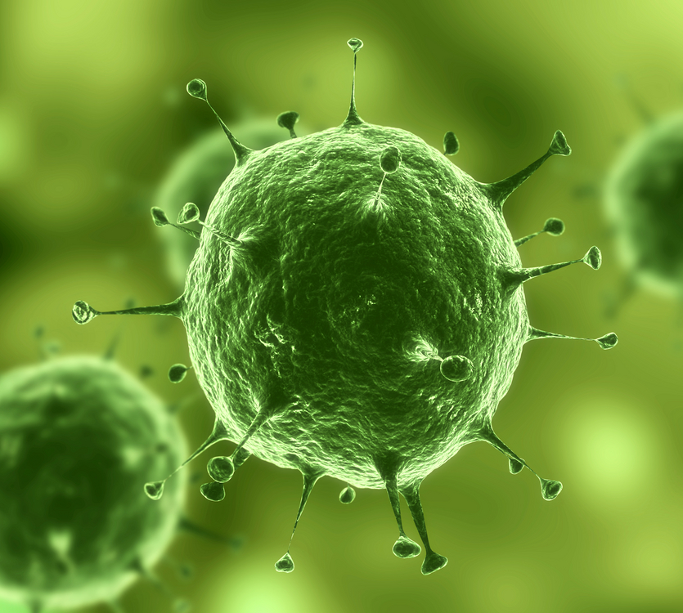
Antivirals
Antiviral drugs are used to treat viral infections.
When a virus infects the body, it enters body cells and replicates inside them. This makes it very difficult to develop drugs that are able to destroy the virus without also causing damage to the body’s tissues.
Like antibiotics, each type of antiviral drug is usually only effective against one specific type of virus.
Rather than destroying the virus, most antiviral drugs work by preventing the virus from being able to replicate.
Notes:
Photo credit: © Sebastian Kaulitzki, Shutterstock.com 2018

Slide 16
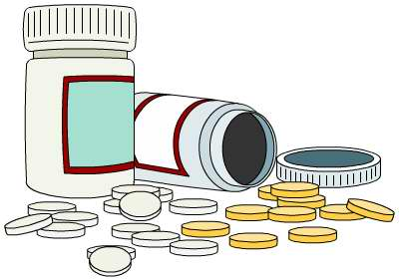
Treating symptoms
Many drugs treat the symptoms of an illness, rather than the cause of the illness itself.
Painkillers are used to treat the discomfort caused by an illness. Types of painkiller include drugs such as paracetamol and ibuprofen.
Although painkillers do not help destroy the pathogen causing the illness, they are useful in helping a person with an illness feel better.
Notes:
Teacher notes
Paracetamol and ibuprofen are also known by the brand names Tylenol and Advil.

