Slide 1
Variation

Slide 2
Information
Constructing Explanations and Designing Solutions
Engaging in Argument from Evidence
Obtaining, Evaluating and Communicating Information
1. Patterns
2. Cause and Effect
6. Structure and Function

Slide 3
Phenotype
Phenotype is the set of observable characteristics of an organism.
The development of phenotype depends on:
the genome of the organism
the organism’s interaction with the environment in which it lives.
phenotype = genome + interaction with environment
Can you name some features that contribute to phenotype?
Notes:
Teacher notes
The genome is the complete set of genetic material in an organism.
Examples of features that contribute to a person’s phenotypes include:
eye color
hair color
height
shoe size
weight
nose shape.
Photo credit: © Monkey Business Images, Shutterstock.com 2018

Slide 4
Variation
Variation is the difference in characteristics between individuals of a population. Variation can occur due to:
genetic causes: differences in the genes an individual has inherited. This is known as genetic variation.
environmental causes: differences in the environmental conditions in which an individual has developed.
The overall variation between individuals is often due to a combination of genes and the environment.
Notes:
Photo credit: © Rawpixel.com, Shutterstock.com 2018

Slide 5
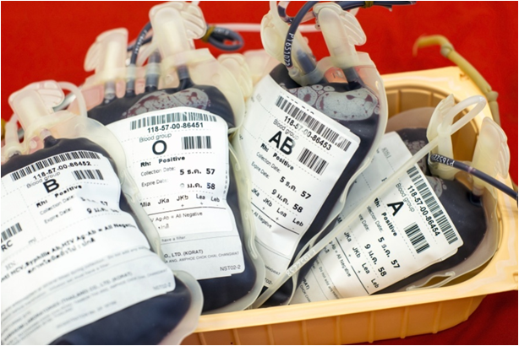
Discontinuous and continuous variation (1)
Features that show variation can be split into two types.
Discontinuous variation is variation that can be described by distinct categories. Each category is a different variant of a particular characteristic.
An individual in a population can only belong to one category.
An example of a trait that shows discontinuous variation is blood type. An individual can only belong to one blood group: A, B, AB or O.
Notes:
Photo credit: © Yuri2010, Shutterstock.com 2018

Slide 6
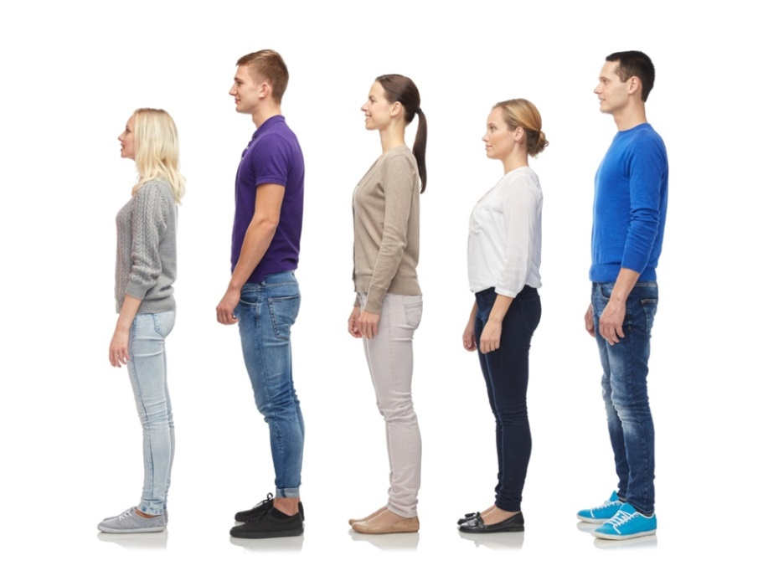
Discontinuous and continuous variation (2)
Continuous variation occurs when a variant can fall anywhere within a range of values between two extremes.
Unlike discontinuous variation, continuous variation can be measured and given a numerical value.
Height shows continuous variation. This is because height can take any value between two numbers (the smallest and tallest possible heights).
Traits that show continuous variation are often controlled by multiple genes and their interaction with the environment.
Notes:
Photo credit: © Syda Productions, Shutterstock.com 2018

Slide 7
Genetic variation and mutation (1)
There is usually extensive genetic variation within a population of a species.
Mutation is a change in the structure of DNA. All genetic variation arises from mutation, which is continuously occurring.
Mutations can be caused by environmental
factors including radiation and some chemicals.
Mutations can also occur spontaneously, often due to errors in DNA replication or the movement of chromosomes during cell division.
Notes:
Teacher notes
Students could be asked about the different effects of a mutation in a body cell and a mutation in a gamete. Mutations in body cells cannot be passed on to future generations, whereas a mutation in a gamete can be passed on.

Slide 8
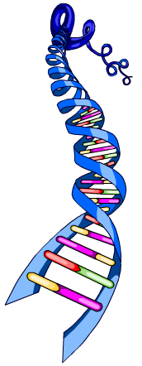
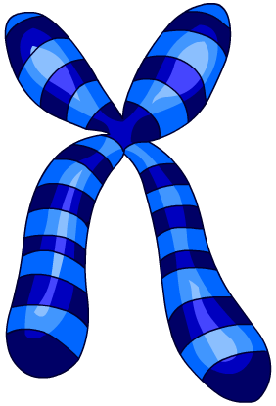
Genetic variation and mutation (2)
Most mutations have no effect on phenotype. However, some mutations do affect an individual’s characteristics, and can do so in either a beneficial or a harmful way.
Rarely does a mutation determine phenotype. This is because most features are the result of multiple genes interacting.
Sometimes a mutation that affects phenotype can make an individual better suited to its environment.
This can lead to a relatively rapid change in a species through natural selection.
Notes:
Teacher notes
Natural selection requires variation in heritable traits (genetic variation) to occur. Individuals with phenotypes that make them well-suited to their environment are more likely to survive and produce offspring. As a result, the genes of these individuals are more likely to be passed on to the next generation.
For more information on natural selection, please refer to the Evolution presentation.

Slide 9
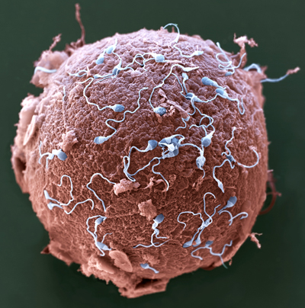
Genetic variation and sexual reproduction
Many features of an individual are influenced by genes inherited via sexual reproduction.
Offspring never inherit the same genes as either parent.
This is because during fertilization the male and female gametes fuse, and the genes they carry combine to form a new combination of genes.
Gametes do not contain all the genes of a parent; they only contain half.
This means that each gamete can contain a different combination of the parent’s genes, which can then be passed on to offspring.
Notes:
Teacher notes
For more information on sexual reproduction, please refer to the Sexual and Asexual Reproduction presentation.
Photo credit: © Eye of Science / Science Photo Library, 2018
Colored scanning electron micrograph (SEM) of sperm (blue) attempting to penetrate a human egg (red). Fertilization occurs when the sperm's genetic material fuses with the egg's. Magnification: ×650 when printed 10 centimeters wide.

Slide 10
Environmental causes of variation
The conditions in which an individual develops can also affect phenotype. This produces variation.
Can you name some environmental factors that can influence an individual’s phenotype?
diet
illness
exercise
injury
education
stress
Which characteristics do these factors affect?
Notes:
Teacher notes
Discuss students’ ideas for the question before continuing. This content could be used as a starting point for a discussion about what makes each student who they are – they may come up with many more examples. You could ask them to start thinking about which environmental factors have had the greatest impact on their development.
This slide covers the Science and Engineering Practices:
Constructing Explanations and Designing Solutions: Apply scientific ideas, principles, and/or evidence to provide an explanation of phenomena and solve design problems, taking into account possible unanticipated effects.
Engaging in Argument from Evidence: Construct, use, and/or present an oral and written argument or counter-arguments based on data and evidence.
Obtaining, Evaluating, and Communicating Information: Communicate scientific and/or technical information or ideas (e.g. about phenomena and/or the process of development and the design and performance of a proposed process or system) in multiple formats (including orally, graphically, textually, and mathematically).
Photo credit: © g-stockstudio, Shutterstock.com 2018

Slide 11
Acquired characteristics
A feature resulting from the interaction between an individual and their environment is called an acquired characteristic.
Acquired characteristics arise during an individual’s lifetime.
They cannot be inherited because they do not have a genetic basis.
Can you think of any acquired characteristics?
tattoos
scars
piercings
Notes:
This slide covers the Science and Engineering Practice:
Constructing Explanations and Designing Solutions: Apply scientific ideas, principles, and/or evidence to provide an explanation of phenomena and solve design problems, taking into account possible unanticipated effects.
Photo credit: © gina smith, Shutterstock.com 2018

Slide 12
Genes, environment or both?
Notes:
Teacher notes
This open-ended activity could be used to focus debate on the relative importance of genes and the environment in developing certain characteristics. Colored traffic light cards could be used with this activity to increase class participation, or students could work individually or in small groups, with mini-whiteboards used to convey the answers.
This activity is not marked.
This slide covers the Science and Engineering Practices:
Constructing Explanations and Designing Solutions: Apply scientific ideas, principles, and/or evidence to provide an explanation of phenomena and solve design problems, taking into account possible unanticipated effects.
Engaging in Argument from Evidence: Respectfully provide and/or receive critiques on scientific arguments by probing reasoning and evidence and challenging ideas and conclusions, responding thoughtfully to diverse perspectives, and determining what additional information is required to resolve contradictions.
Engaging in Argument from Evidence: Make and defend a claim based on evidence about the natural world or the effectiveness of a design solution that reflects scientific knowledge, and student-generated evidence.
Obtaining, Evaluating, and Communicating Information: Communicate scientific and/or technical information or ideas (e.g. about phenomena and/or the process of development and the design and performance of a proposed process or system) in multiple formats (including orally, graphically, textually, and mathematically).

