Slide 1
Alcohols

Slide 2
Information
Asking Questions and Defining Problems
Planning and Carrying Out Investigations
Using Mathematics and Computational Thinking
Constructing Explanations and Designing Solutions
Engaging in Argument from Evidence
Obtaining, Evaluating and Communicating Information
1. Patterns
2. Cause and Effect
3. Scale, Proportion, and Quantity
5. Energy and Matter
6. Structure and Function

Slide 3
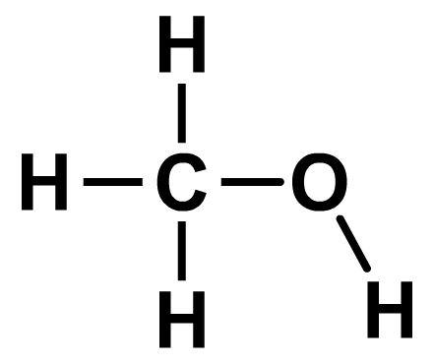
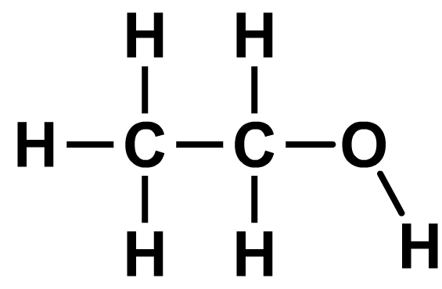
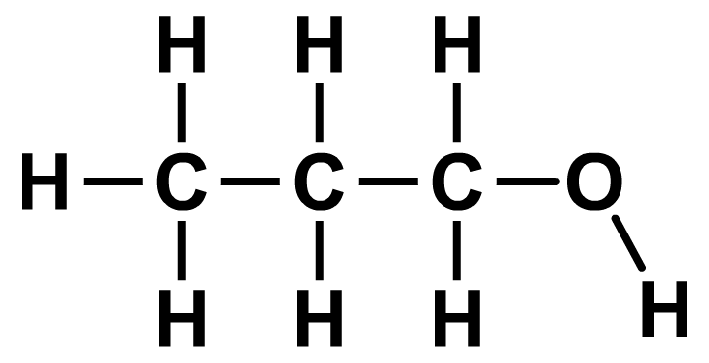
What are alcohols?
Alcohols are a family of organic compounds that contain carbon, hydrogen and oxygen atoms.
They are not hydrocarbons, because they contain oxygen.
The defining feature of alcohols is the functional group –OH, which gives them their chemical properties.
For example:
methanol
CH₃OH
ethanol
C₂H₅OH
propan-1-ol
C₃H₇OH
Notes:
This presentation is accompanied by the worksheet Alcohols.

Slide 4
Naming alcohols
Alcohols are a homologous series.
The name of an alcohol is derived from the number of carbon atoms in the compound and ends with –ol.
number of carbons
name of alcohol
chemical formula
1
methanol
CH₃OH
2
ethanol
C₂H₅OH
3
propanol
C₃H₇OH
4
butanol
C₄H₉OH
Can you work out the general formula for alcohols?
The general formula of alcohols is C_{n}H_{2n+1}OH.
Notes:
This slide covers the Science and Engineering Practice:
Asking Questions and Defining Problems: Ask questions that arise from examining models or a theory, to clarify and/or seek additional information and relationships.

Slide 5
Determining the formulae of alcohols
Notes:
This slide covers the Science and Engineering Practice:
Using Mathematics and Computational Thinking: Apply techniques of algebra and functions to represent and solve scientific and engineering problems.

Slide 6
Identifying alcohols
Notes:
Teacher notes
Draw attention to the carboxylic acid (ethanoic acid, represented by its structural formula), which like alcohols also has an –OH group. Ask students why this compound is not an alcohol. Draw attention to the C=O group, which alcohols do not possess.

Slide 7
Boiling point and structure
Notes:
Teacher notes
For alkanes and alcohols, an increase in the length of the hydrocarbon chain leads to an increase in boiling point. This is due to an increase in intermolecular forces between molecules with a longer hydrocarbon chain.
The boiling point of an alcohol is significantly higher than that of an alkane with the same chain length. This is because there are stronger intermolecular forces acting between alcohol molecules.
The boiling point of pentan-1-ol is greater than 117 °C and is approximately 138 °C.
For more information about alkanes, please refer to the Alkanes presentation.
This slide covers the Science and Engineering Practice:
Constructing Explanations and Designing Solutions: Make a quantitative and/or qualitative claim regarding the relationship between dependent and independent variables.

Slide 8
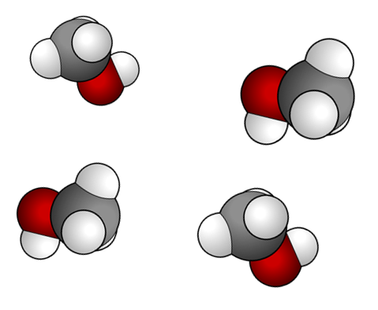
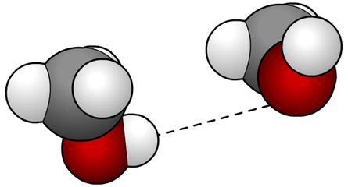
Intermolecular forces
All molecules are held together by intermolecular forces.
These forces must be overcome in order for a substance to turn into a gas (boil).
methanol
The intermolecular forces between alcohol molecules are relatively strong because the –OH groups attract each other.
Greater amounts of energy are needed to separate the molecules. This means that alcohols have relatively high boiling points compared to alkanes of the same length.
Notes:
Teacher notes
The –OH groups in neighboring alcohol molecules form hydrogen bonds that are relatively strong. The intermolecular forces acting between ethanol molecules are a lot stronger than those acting between ethane.

Slide 9
Reactivity of alcohols

Slide 10
Reaction of alcohols with oxygen
Because alcohols contain hydrocarbon chains, they often react in a similar way to alkanes.
For example, ethanol burns in oxygen to form carbon dioxide and water:
ethanol
+
oxygen
carbon dioxide
+
water
C₂H₅OH
+
3O₂
2CO₂
+
3H₂O
What is the equation for the reaction of hexane with oxygen?
hexane
+
oxygen
carbon dioxide
+
water
2C₆H₁₄
+
19O₂
12CO₂
+
14H₂O

Slide 11
Reaction of alcohols with sodium
Because alcohols contain an –OH functional group, they often react in a similar way to water.
For example, ethanol reacts with sodium to form sodium ethoxide and hydrogen:
ethanol
+
sodium
sodium ethoxide
+
hydrogen
2C₂H₅OH
+
2Na
2C₂H₅ONa
+
H₂
What is the equation for the reaction of water with sodium?
water
+
sodium
sodium hydroxide
+
hydrogen
2H₂O
+
2Na
2NaOH
+
H₂

Slide 12
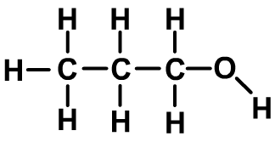
Solubility in water
The solubility of alcohols in water is affected by both the –OH functional group and the hydrocarbon chain.
interacts with water molecules to form new intermolecular bonds
opposes interaction with water molecules
The –OH functional group enables small alcohols to fully dissolve in water to form a neutral solution. Larger alcohols have longer hydrocarbon chains, and are therefore less soluble in water.
Notes:
Teacher notes
Methanol, ethanol and propanol are fully soluble in water. Butanol is moderately soluble, while alcohols containing 5 carbons or more are effectively insoluble.

Slide 13
Combustion of alcohols
Notes:
This slide covers the Science and Engineering Practices:
Planning and Carrying Out Investigations: Plan an investigation or test a design individually and collaboratively to produce data to serve as the basis for evidence as part of building and revising models, supporting explanations for phenomena, or testing solutions to problems. Consider possible variables or effects and evaluate the confounding investigation’s design to ensure variables are controlled.
Using Mathematics and Computational Thinking: Apply ratios, rates, percentages, and unit conversions in the context of complicated measurement problems involving quantities with derived or compound units (such as mg/mL, kg/m3, acre-feet, etc.).

Slide 14
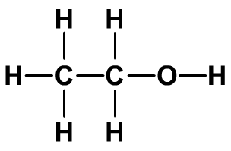
What is ethanol?
Ethanol is an alcohol that can be used as a fuel, a solvent, or as feedstock for processes in the chemical industry. It is also found in alcoholic drinks.
The chemical formula for ethanol is C₂H₅OH.
Ethanol can be made by:
fermentation of plant sugars
reacting ethene (from crude oil) with steam.

Slide 15
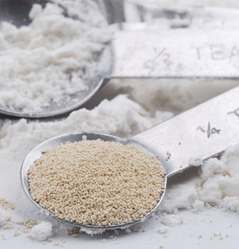
Fermentation
Most ethanol is made from renewable resources using the sugars in plant material. Fermentation converts the sugars (glucose) into carbon dioxide and ethanol.
yeast
glucose
carbon dioxide
+
ethanol
The reaction is performed by the enzymes in yeast when they respire anaerobically (without oxygen). Enzymes are natural catalysts.
The ethanol produced in the reaction is removed from the mixture and purified by distillation.
Notes:
Teacher notes
90% of ethanol is made by fermentation.
Photo credit: © pick, Shutterstock.com 2018

Slide 16
Making ethanol by fermentation

Slide 17
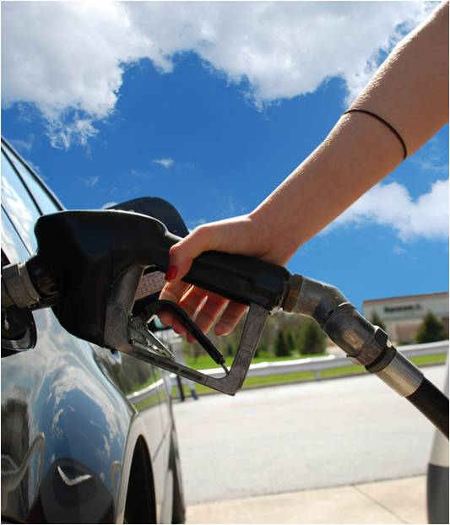
Using ethanol as a fuel
Ethanol can be used as a fuel for cars and other vehicles.
Bioethanol is produced by the natural fermentation of the sugar in sugar beet, sugar cane or wheat crops.
Bioethanol is sold as E85 fuel, which contains 85% bioethanol and 15% gasoline. It can be used by cars that have modified fuel systems, and significantly reduces carbon dioxide emissions.
What are the advantages and disadvantages of using bioethanol as a fuel?
Notes:
Teacher notes
E85 fuel significantly reduces carbon dioxide emissions compared to normal gasoline-engine cars. Brazil has blended all petrol with bioethanol since 1976, with the mandatory minimum level being 18% in 2011.
Advantages of bioethanol include:
a reduction in carbon dioxide emissions from vehicles
bioethanol is a renewable resource
carbon dioxide is absorbed by crop plants as they grow
alcohol produces fewer pollutants during combustion compared to gasoline
by-products of ethanol production can sometimes be used for animal feed.
Disadvantages include:
carbon dioxide is released during fermentation and combustion
growing, transporting and processing the crops requires energy from fossil fuels
VOCs (volatile organic compounds) are given off during the drying process
large amounts of land are needed to grow bioethanol crops, which causes competition with food production.
This slide covers the Science and Engineering Practices:
Engaging in Argument from Evidence: Construct, use, and/or present an oral and written argument or counter-arguments based on data and evidence.
Obtaining, Evaluating, and Communicating Information: Gather, read, and evaluate scientific and/or technical information from multiple authoritative sources, assessing the evidence and usefulness of each source.
Photo credit: © Tony Mathews, Shutterstock.com 2018

Slide 18
Conditions for fermentation
A temperature range of between 25 °C and 50 °C is needed for fermentation to be successful.
If the temperature is too low, the yeast will be less active and the reaction will take place very slowly.
If the temperature is too high, the yeast cells are damaged and eventually killed, bringing the reaction to an end.
If oxygen is present in the mixture, the yeast will create only carbon dioxide and water. The ethanol will be oxidized to form ethanoic acid (which is used to make vinegar).

Slide 19
Fermentation: true or false?
Notes:
Teacher notes
This true-or-false activity could be used as an introductory or summary activity on ethanol, or at the start of the lesson to gauge students’ existing knowledge of the subject matter. Colored traffic light cards (red = false, yellow = don’t know, green = true) could be used to make this a whole-class exercise.

Slide 20
Uses of ethanol
Alcohols have a wide variety of uses, with different alcohols being better suited to some uses than others.
Ethanol is the alcohol that is used to make alcoholic drinks.
Alcoholic drinks vary in the percentage of ethanol that they contain.
Why is ethanol used for alcoholic drinks rather than a different type of alcohol?
Ethanol also has antiseptic properties, so is often used in antibacterial hand wipes.
Notes:
Teacher notes
Ethanol is less toxic to humans than other alcohols. Methanol has a high toxicity in humans; it is broken down to formic acid which inhibits cellular respiration. Ethanol has been consumed by humans in the form of alcoholic beverages for at least 9,000 years, long before alcohols could be chemically distinguished from one another. Ethanol happens to be the product of the fermentation of glucose by naturally occurring yeasts.

Slide 21
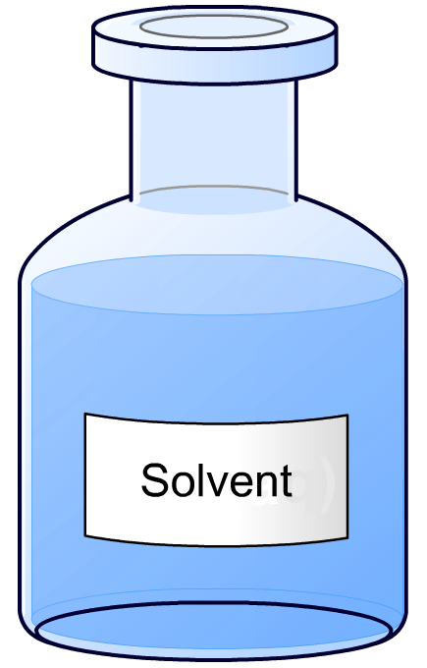
Uses of other alcohols
There are many different uses of ethanol. The other alcohols also have specific uses.
Methanol
Methanol is often used as industrial feedstock to make other chemicals.
It can also be used as a gasoline additive to improve combustion.
Propanols and butanols
These are mainly used as solvents.
Notes:
Teacher notes
A solvent is a substance that is used to dissolve solutes.

