Slide 1
Alkanes

Slide 2
Information
Analyzing and Interpreting Data
Using Mathematics and Computational Thinking
Engaging in Argument from Evidence
3. Scale, Proportion, and Quantity
6. Structure and Function

Slide 3
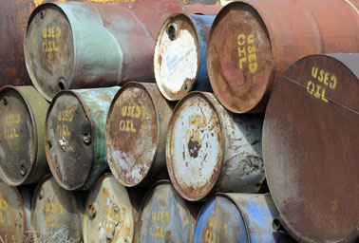
What is crude oil?
Crude oil is a fossil fuel that comes directly from the Earth’s crust and is one of the most important substances in the world. Crude oil is a complex mixture of hundreds of compounds.
The compounds in a mixture are not chemically combined together, meaning they can be separated by methods such as fractional distillation.
Crude oil is used to make fuels for transport, heating and generating electricity. It is also used to make plastics and hundreds of petrochemicals.
Notes:
Teacher notes
Crude oil may also be known as petroleum.
For more information on methods of separating the compounds in crude oil, please refer to the Fractional Distillation presentation.
This presentation is accompanied by the worksheet Alkanes.
Photo credit: © gallimaufry, Shutterstock.com 2018

Slide 4
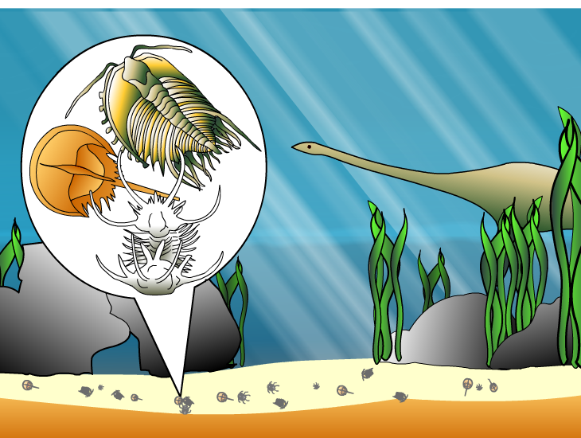
Early stages of oil and gas formation
Crude oil is biological in origin. Millions of years ago, plankton, algae and other very small animals died and collected in the sediment on the sea floor.
As more layers of sediment formed above them, the remains of these animals were compacted.
The heat and pressure turns the sediment into rocks, known as sedimentary rocks.
The heat and pressure from the sediment causes the animal remains to turn into crude oil.

Slide 5
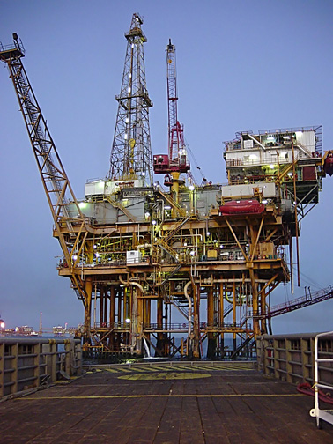
Where is crude oil?
Crude oil is often found trapped in sedimentary rocks under the seabed.
Oil rigs or drilling platforms are used to drill through the seabed to obtain the oil.
Once the oil has been released from the seabed, it is pumped in long pipelines to an oil tanker terminal or an oil refinery on land.
Notes:
Photo credit: © Chad Teer. This image is reproduced under the terms of the Creative Commons License. A copy of the license can be read at this address: http://creativecommons.org/licenses/by/2.5/

Slide 6
Production and consumption
Notes:
Teacher notes
Students could be asked to analyze and interpret the data provided. They may also like to suggest why it is useful to measure oil consumption per capita as well as by country.
The term “production,” when applied to crude oil, refers to the amount of oil that is extracted from reserves, rather than the literal creation of the substance.
Data credit: ENI 17th World Oil, Gas and Renewables Review Volume 1: World Oil Review 2018 , available at https://www.eni.com/docs/en_IT/enicom/company/fuel-cafe/WORLD-OIL-REVIEW-2018-Volume-1.pdf
This weblink was working at the time of publication. Boardworks cannot be held responsible for the content of external weblinks.
This slide covers the Science and Engineering Practices:
Analyzing and Interpreting Data: Analyze data using tools, technologies, and/or models (e.g., computational, mathematical) in order to make valid and reliable scientific claims or determine an optimal design solution.
Using Mathematics and Computational Thinking: Apply ratios, rates, percentages, and unit conversions in the context of complicated measurement problems involving quantities with derived or compound units (such as mg/mL, kg/m3, acre-feet, etc.).

Slide 7
Problems with crude oil
Notes:
This slide covers the Science and Engineering Practice:
Engaging in Argument from Evidence: Construct, use, and/or present an oral and written argument or counter-arguments based on data and evidence.
Photo credits: no gas © David Falconer. This image is in the public domain; oily bird © wim claes, Shutterstock.com 2018; pharmaceutical factory © Light & Magic Photography, Shutterstock.com 2018

Slide 8
Deepwater Horizon
Notes:
Teacher notes
Consider asking students to research a more recent oil spill and have them evaluate the environmental impact. Encourage them to think about how the impact of an oil spill on one species can affect other species by disrupting the food chain.

Slide 9
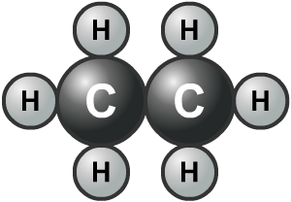
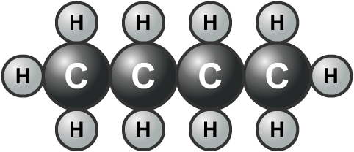
Hydrocarbons
Many of the compounds in crude oil only contain the elements carbon and hydrogen. They are called hydrocarbons.
Most hydrocarbons in crude oil are compounds called alkanes. Alkanes are made up of a single chain of carbon atoms with hydrogen atoms bonded to them.
Methane, ethane, propane and butane are all alkanes.
Notes:
Teacher notes
For more information on hydrocarbons, please refer to the Hydrocarbons presentation.

Slide 10
Hydrocarbons or not hydrocarbons?
Notes:
Teacher notes
Students may need to be reminded that hydrocarbons only contain hydrogen and carbon.

Slide 11
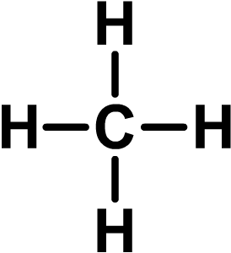
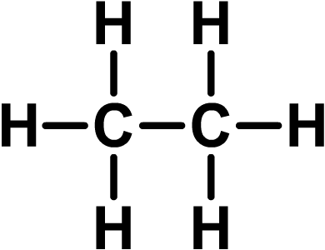
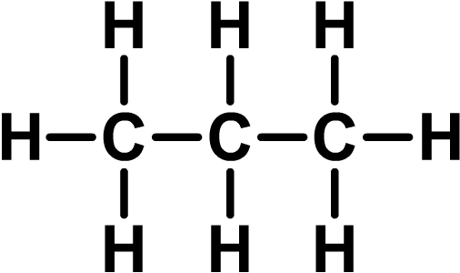
Alkanes
Alkanes are a family of hydrocarbon compounds with the general formula C_{n}H_{2n+2}. This means that an alkane will have two hydrogen atoms for every carbon atom, plus two more.
The simplest alkane is methane. It has the formula CH₄.
The second simplest alkane is ethane. It has the formula C₂H₆.
The third simplest alkane is propane. It has the formula C₃H₈.
Notes:
Teacher notes
The naming of alkanes could be introduced at this stage, making it clear that all alkanes end in “-ane.” The start of the name denotes the number of carbon atoms in each molecule.

Slide 12
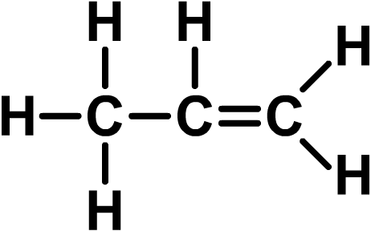
Saturated hydrocarbons
Hydrocarbons like alkanes, which contain chains of carbon atoms joined by single carbon–carbon covalent bonds, are called saturated hydrocarbons.
Some hydrocarbons contain carbon–carbon double or even triple bonds. These are called unsaturated hydrocarbons.
A saturated hydrocarbon
An unsaturated hydrocarbon
Notes:
Teacher notes
In displayed formulae, “–” represents a covalent bond.

Slide 13
Saturated or unsaturated?

