Slide 1
Conservation of Mass

Slide 2
Information
Asking Questions and Defining Problems
Developing and Using Models
Planning and Carrying Out Investigations
Analyzing and Interpreting Data
Using Mathematics and Computational Thinking
Constructing Explanations and Designing Solutions
1. Patterns
3. Scale, Proportion, and Quantity
4. Systems and System Models
5. Energy and Matter
7. Stability and Change

Slide 3
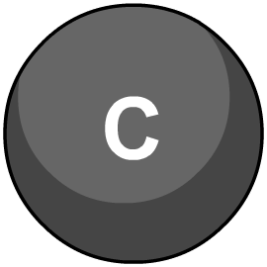
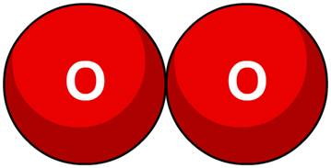
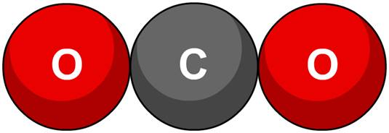
What is a chemical reaction?
A chemical reaction is a change that takes place when one or more substances (called reactants) form one or more new substances (called products).
For example:
+
carbon
+
oxygen
carbon dioxide
It is often difficult to reverse a chemical reaction and change the products back into the reactants.
Notes:
This presentation is accompanied by the worksheet Conservation of Mass.

Slide 4
Does mass change during a reaction?
Notes:
Teacher notes
This three-stage interactive animation shows how mass remains constant during a reaction.
This slide covers the Science and Engineering Practice:
Planning and Carrying Out Investigations: Plan an investigation or test a design individually and collaboratively to produce data to serve as the basis for evidence as part of building and revising models, supporting explanations for phenomena, or testing solutions to problems. Consider possible variables or effects and evaluate the confounding investigation’s design to ensure variables are controlled.

Slide 5
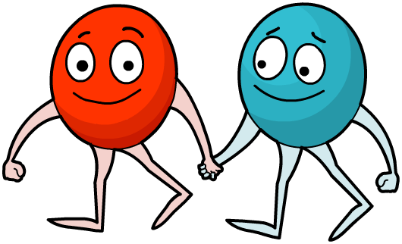
Why doesn’t the mass change?
In a chemical reaction, no atoms are made or destroyed.
The reaction just changes how the atoms are bonded together.
The total mass of reactants at the start of a reaction is equal to the total mass of the products at the end. This is called the principle of conservation of mass.
Notes:
This slide covers the Science and Engineering Practice:
Asking Questions and Defining Problems: Ask questions that arise from careful observation of phenomena, or unexpected results, to clarify and/or seek additional information.

Slide 6
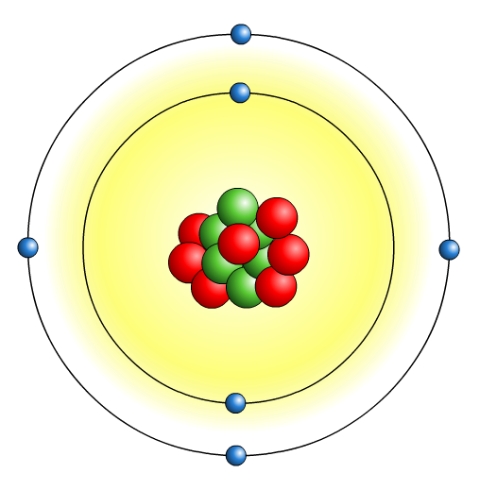
Weighing atoms
What is the mass of an atom?
Would it be sensible to measure its mass in grams?
Scientists use a unit of measurement called relative atomic mass. It can be abbreviated to “r.a.m.” or “A_{r}.”
The relative atomic mass of an atom is its mass relative to the mass of 1/12th of an atom of carbon-12.
Notes:
Teacher notes
The mass of one neutral atom of the isotope carbon-12 has been set at exactly 12 atomic mass units (amu). It follows that 1 atomic mass unit is 1/12 of the mass of a neutral carbon-12 atom. All other atomic masses are measured relative to this value.
This slide covers the Science and Engineering Practice:
Asking Questions and Defining Problems: Ask questions to clarify and refine a model, an explanation, or an engineering problem.

Slide 7
What is relative atomic mass?
Notes:
Teacher notes
This two-stage interactive animation shows what relative atomic mass is.
This slide covers the Science and Engineering Practice:
Using Mathematics and Computational Thinking: Apply ratios, rates, percentages, and unit conversions in the context of complicated measurement problems involving quantities with derived or compound units (such as mg/ml, kg/m³, acre-feet, etc.).

Slide 8
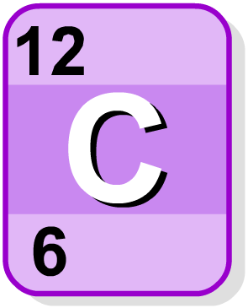
Where are RAM values found?
The values of relative atomic mass (r.a.m.) are usually given in a data book or found in the periodic table. So you don’t have to work them out or remember them all!
relative atomic mass
symbol
atomic number
When looking up relative atomic mass in the periodic table, remember that it is always the larger of the two numbers given.
What is the other number?

Slide 9
How is relative formula mass calculated?
To find the relative formula mass (Mr) of a compound, add up the relative atomic masses of all the atoms in its formula.
Step 1: Write down the formula of the molecule.
Step 2: Find the r.a.m. of each type of atom in the molecule.
Step 3: Multiply each r.a.m. by the number of atoms of that element and add these values together.
What is the relative formula mass of water?
Step 1: the formula of water is H₂O
Step 2: r.a.m. values: hydrogen = 1, oxygen = 16
Step 3: relative formula mass = (2 × 1) + (1 × 16) = 18
Notes:
This slide covers the Science and Engineering Practice:
Using Mathematics and Computational Thinking: Apply techniques of algebra and functions to represent and solve scientific and engineering problems.

Slide 10
Demonstrating conservation of mass
We can use relative formula masses with symbol equations to show that mass is conserved during a reaction.
The M_{r} of a compound is the total of the relative atomic masses (r.a.m.) of all the atoms in its formula.
For example:
+
4Na(s) O₂(g)
2Na₂O(s)
Na r.a.m. = 23
4Na M_{r} = 92
O r.a.m. = 16
O₂ M_{r} = 32
Total M_{r} of products
2Na₂O M_{r} = 124
We can see that the total M_{r} on both sides of the equation are the same, so no mass has been lost.
Total M_{r} of reactants
92 32 = 124
+

Slide 11
What is the relative formula mass?

Slide 12
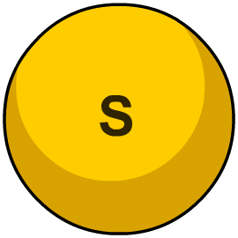
What is a symbol equation?
A symbol equation uses the formulae of the reactants and products to show what happens in a chemical reaction.
A symbol equation must be balanced to give the correct ratio of reactants and products.
S(s)
+
O₂(g)
SO₂(g)
This equation shows that one atom of sulfur (S) reacts with one molecule of oxygen (O₂) to make one molecule of sulfur dioxide (SO₂).
+

Slide 13
Balancing symbol equations

Slide 14
Balanced equations
A symbol equation must be balanced because mass is conserved. The number of atoms of each element in the reactants must be the same as the number of atoms of each element in the products.
Multipliers are used in the equation to balance the reactants and products.
Can you balance this equation?
Cu(s)
+
O₂(g)
CuO(s)
2
Cu(s)
+
O₂(g)
2
CuO(s)
In this equation, the multiplier in front of the copper in the reactants balances the copper atoms. The multiplier in front of the product balances the oxygen atoms.
Notes:
Teacher notes
Multipliers are also referred to as coefficients.
This slide covers the Science and Engineering Practice:
Using Mathematics and Computational Thinking: Apply techniques of algebra and functions to represent and solve scientific and engineering problems.

Slide 15
Balancing ionic equations
Equations involving ions must also be balanced.
For example, magnesium hydroxide (Mg(OH)₂) is formed from magnesium chloride (MgCl₂) and potassium hydroxide (KOH).
The ionic equation for the formation of Mg(OH)₂ is:
Mg²⁺ (aq)
+
OH⁻ (aq)
Mg(OH)₂ (s)
Is this equation balanced?
Mg²⁺ (aq)
+
2OH⁻(aq)
Mg(OH)₂ (s)
There are now an equal number of ions on both sides of the equation.
Notes:
Teacher notes
The potassium and chlorine are not shown in the reaction as they are spectator ions that remain unchanged in the reaction.

Slide 16
Balancing symbol equations
Notes:
Teacher notes
This drop-down activity could be used as a plenary exercise to balancing equations.
Note that where the multiplier is ‘1’, a blank option is given.
This slide covers the Science and Engineering Practice:
Using Mathematics and Computational Thinking: Apply techniques of algebra and functions to represent and solve scientific and engineering problems.

Slide 17
Calculating mass (1)
If you know the mass of a reactant, then you can use a balanced equation to calculate the mass of products produced.
For example, if 6 grams of copper react with oxygen, what is the mass of copper oxide produced?
Step 1. Write out the balanced equation.
2Cu(s) + O₂(g) 2CuO(s)
Step 2. Calculate the moles of reactant.
mass
Remember the equation:
moles =
M_{r}
M_{r} Cu = r.a.m. Cu = 63.5
6
moles =
= 0.094 moles of Cu
63.5
Notes:
Teacher notes
For more information about moles please refer to the Gases and Moles presentation.
This slide covers the Science and Engineering Practice:
Using Mathematics and Computational Thinking: Apply techniques of algebra and functions to represent and solve scientific and engineering problems.

Slide 18
Calculating mass (2)
Step 3. Write out the mole relationship of the reactants and products in the equation.
This is equal to the multipliers in the equation.
2Cu(s) + 1O₂ 2CuO(s)
2 moles of Cu + 1 of mole O₂
2 moles of CuO
Step 4. Calculate the number of moles of CuO produced in the reaction.
2 moles Cu
2 moles CuO
0.094 moles Cu
0.094 moles CuO
Step 5. Calculate the mass of CuO produced in the reaction.
mass = moles × M_{r}
mass CuO = 0.094 × 79.5
= 7.5 g
Notes:
Teacher notes
Students may need reminding how the relative formula mass (M_{r}) of copper oxide is calculated:
r.a.m. Cu = 63.5
r.a.m. O = 16
M_{r} CuO = 63.5 + 16 = 79.5
This slide covers the Science and Engineering Practice:
Using Mathematics and Computational Thinking: Apply techniques of algebra and functions to represent and solve scientific and engineering problems.

Slide 19
What happens to the mass?
Notes:
This slide covers the Science and Engineering Practice:
Asking Questions and Defining Problems: Ask questions that arise from careful observation of phenomena, or unexpected results, to clarify and/or seek additional information.

Slide 20
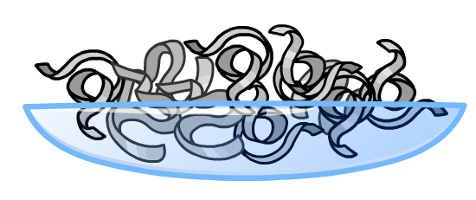
Why did the mass increase?
In the reaction between magnesium and oxygen,
the mass increased.
What is the balanced symbol equation for this reaction?
The balanced symbol equation shows that gaseous oxygen atoms from the air joined up with the magnesium atoms to create solid magnesium oxide.
The mass of oxygen was not taken into account at the start, and so the addition of oxygen has resulted in an increase in mass.

Slide 21
What happens to the mass?
Notes:
This slide covers the Science and Engineering Practice:
Asking Questions and Defining Problems: Ask questions that arise from careful observation of phenomena, or unexpected results, to clarify and/or seek additional information.

Slide 22
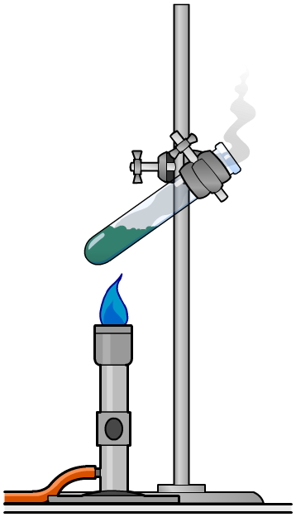
Why did the mass decrease?
After heating 40 g of copper carbonate, the mass decreased to 30 g.
Why did the mass decrease?
The reaction took place in an open system. This means the carbon dioxide gas could escape into the surrounding air.
The mass of carbon dioxide was therefore not taken into account, and so a decrease in mass was observed.
Can you calculate the mass of carbon dioxide that was produced in the reaction?
Notes:
Teacher notes
The mass weighed at the end of the experiment is the mass of copper oxide (30 g). This means that the mass of carbon dioxide produced is: 40 – 30 = 10 g.

Slide 23
Reactions involving open systems
In an open system, changes in mass can be observed during or after a chemical reaction.
This is often because the mass of gases released or used up in the reaction are not taken into account.
When the reaction occurs, the mass of the particles does not change. However, the state of the particles does change.
The change in mass can be explained by the particle model.
Notes:
This slide covers the Science and Engineering Practice:
Constructing Explanations and Designing Solutions: Apply scientific ideas, principles, and/or evidence to provide an explanation of phenomena and solve design problems, taking into account possible unanticipated effects.

Slide 24
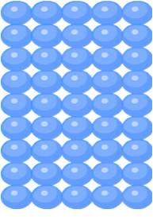
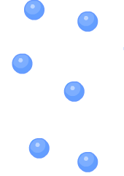
The particle model and changing mass
According to the particle model, all particles are in constant motion, and the amount a particle can move depends on the state the compound is in: solid, liquid, or gas.
Solid particles are strongly bonded to each other, and so cannot move out of their regular arrangement.
Gas particles are not bonded to each other, and so can move far apart in random directions.
In an open system, gas particles can spread through the test tube and exit into the environment.
A decrease in mass is therefore observed.
Notes:
Teacher notes
In the decomposition (break down) of calcium carbonate, gaseous carbon dioxide is released from the open system. This means the weight of carbon dioxide is not taken into account when reweighing the boiling tube, and so a decrease in mass is observed.
This slide covers the Science and Engineering Practices:
Developing and Using Models: Develop, revise, and/or use a model based on evidence to illustrate and/or predict the relationships between systems or between components of a system.
Constructing Explanations and Designing Solutions: Apply scientific ideas, principles, and/or evidence to provide an explanation of phenomena and solve design problems, taking into account possible unanticipated effects.

Slide 25
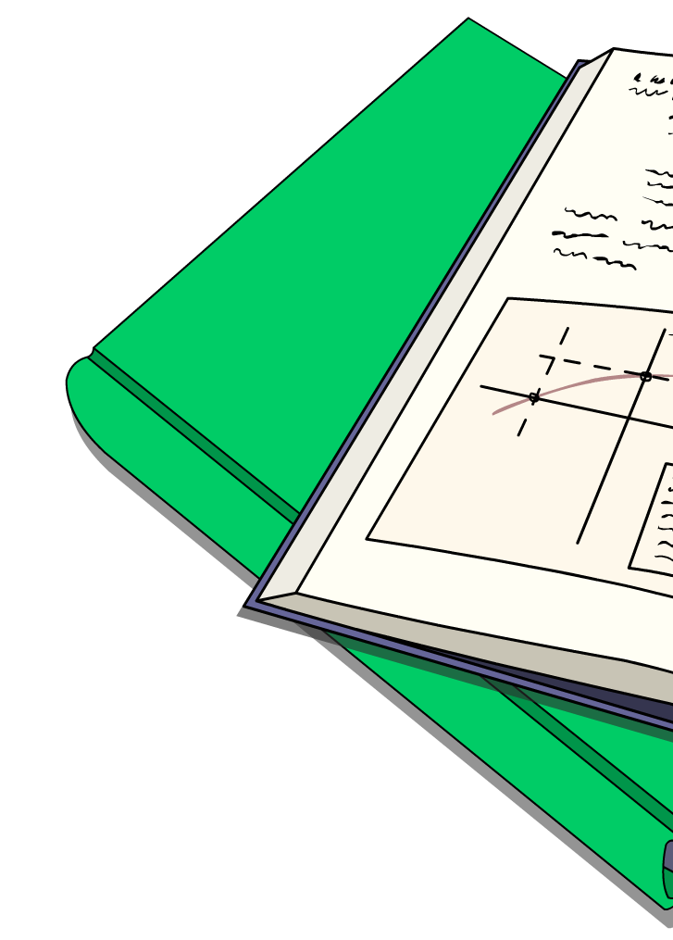
Uncertainty in data
Results obtained from experiments always have some degree of uncertainty.
What is an accurate result?
The accuracy of a measurement is defined by how close it is to the true value.
What is a precise result?
The precision of a measurement is dependent on
the amount of random errors. Precise measurements are very close to the mean value.

Slide 26
How reliable is your data? (1)
The breakdown of 40 grams of copper carbonate to copper oxide and carbon dioxide gas was carried out five times.
The final mass of the reaction for each repeat was recorded in the table below.
mass following decomposition (g)
repeat number
1
30
2
29
3
31
4
30
5
38
How reliable is the data?

Slide 27
How reliable is your data? (2)
Did you spot any outliers in the data?
mass following decomposition (g)
repeat number
1
30
2
29
3
31
4
30
5
38
The mass of repeat 5 varies greatly from repeat 1 to 4. This could be due to equipment malfunction or human error.
Notes:
This slide covers the Science and Engineering Practice:
Analyzing and Interpreting Data: Consider limitations of data analysis (e.g., measurement error, sample selection) when analyzing and interpreting data.

Slide 28
Calculating the mean
The mean is the sum of all the samples divided by the total number of samples.
Ignoring the outlier, can you calculate the mean for the data?
(30 + 29 + 31 + 30) / 4
= 30 grams
What does this tell you?
The mean gives the best estimate for the final mass of the decomposition of 40 g of copper carbonate.
Notes:
This slide covers the Science and Engineering Practice:
Analyzing and Interpreting Data: Apply concepts of statistics and probability (including determining function fits to data, slope, intercept, and correlation coefficient for linear fits) to scientific and engineering questions and problems, using digital tools when feasible.

Slide 29
Calculating the range
The range of a set of data is the highest value minus the lowest value. The smaller the range, the less variation in the data.
Ignoring the outlier, can you calculate the range for the data?
You first need to order the data from lowest to highest:
29, 30, 30, 31
range: 31 – 29 grams = 2
Comparing this with the mean, how accurate do you think the estimate for the final mass of the reaction is?
Notes:
Teacher notes
The smaller the range, the less variation in the data and therefore the more reliable the mean calculated.
This slide covers the Science and Engineering Practice:
Analyzing and Interpreting Data: Consider limitations of data analysis (e.g., measurement error, sample selection) when analyzing and interpreting data.

